Slide 1
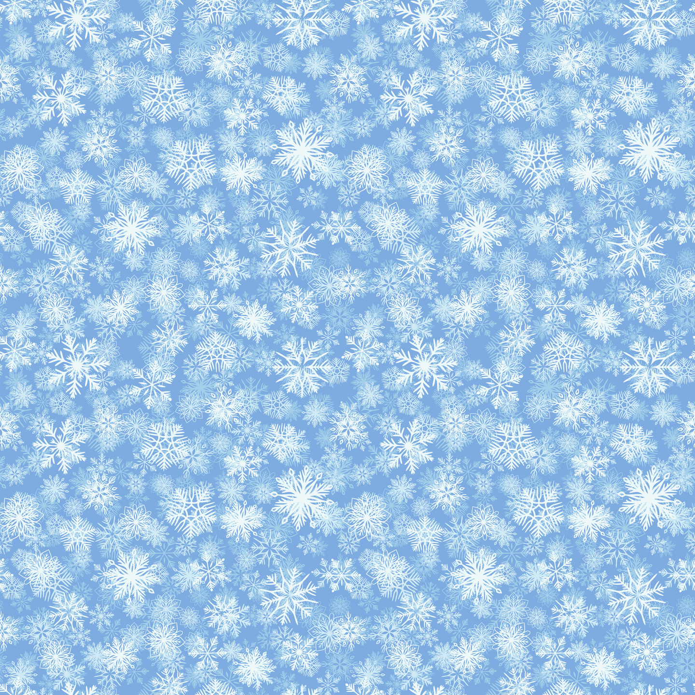






Name
How many snowflakes?
Count the snowflakes in the snow globes and circle the correct amount.
2
3
4
5
6
7
5
6
7
8
9
10

Slide 2



1
2
3
4
5
6
5
6
7
2
3
4
6
7
8
8
9
10

Slide 3

Snowflake
Counting
Count the snowflakes in each row and write how many you see.
6

Slide 4

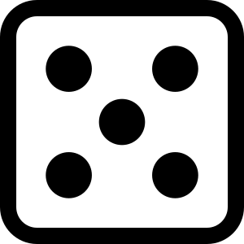

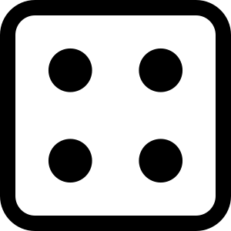
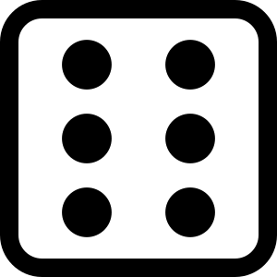
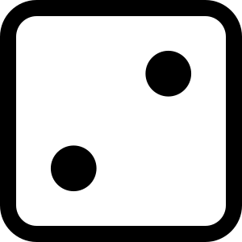
Dice Addition
Count the dice. Fill in the blanks to answer the addition equation.
Name:
Date:
+
+
=
+
+
=
+
+
=
+
+
=
+
+
=
+
+
=
+
+
=

Slide 5

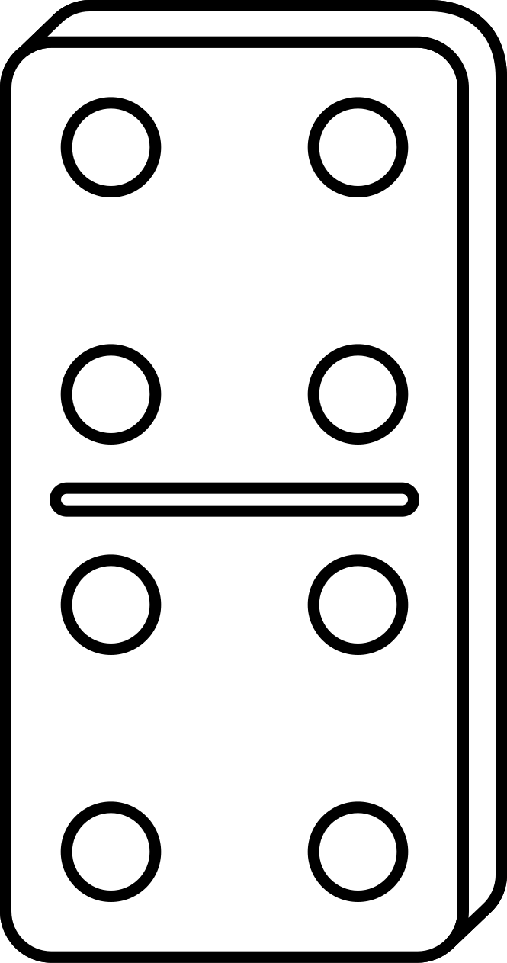


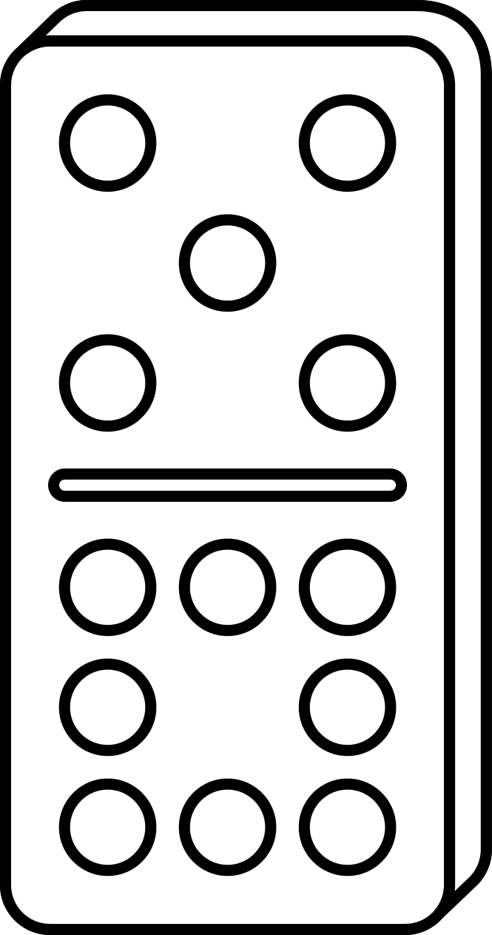

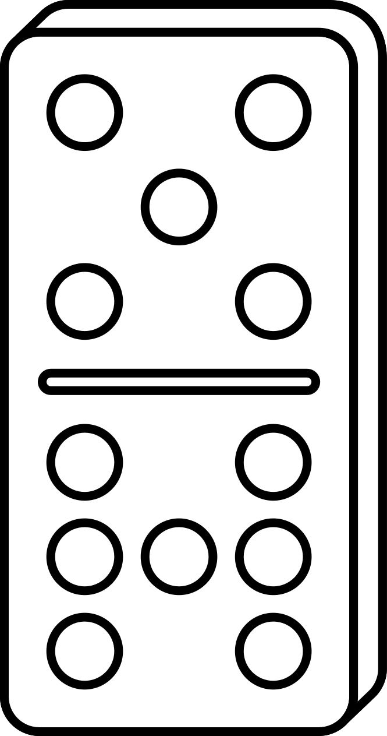
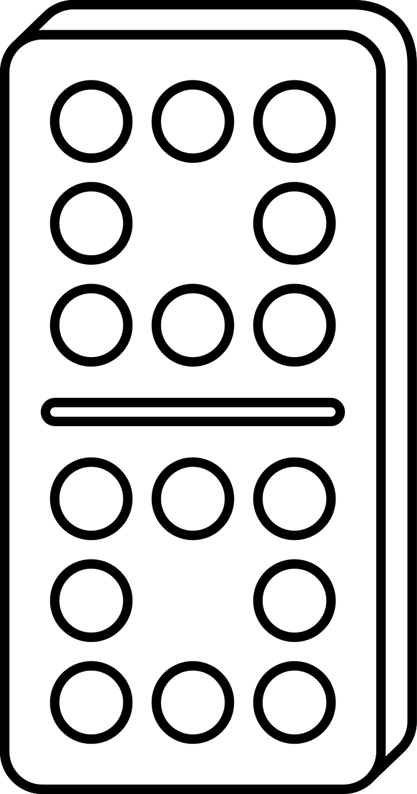
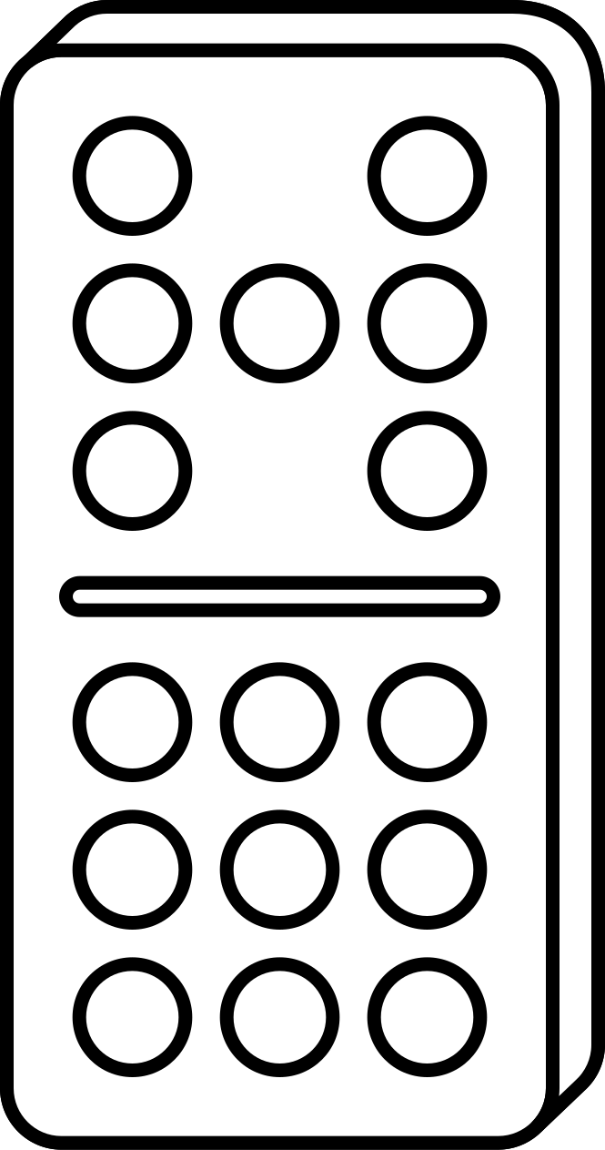


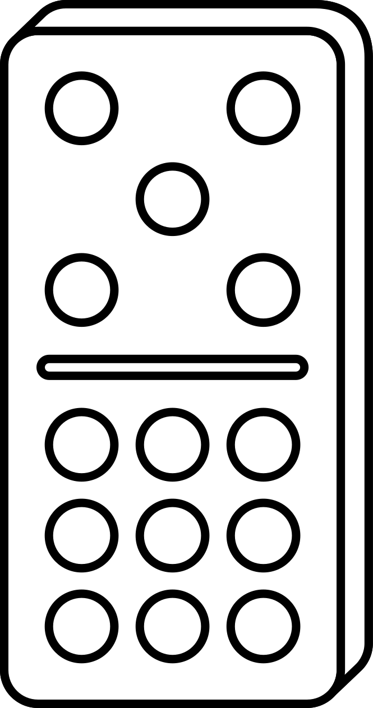
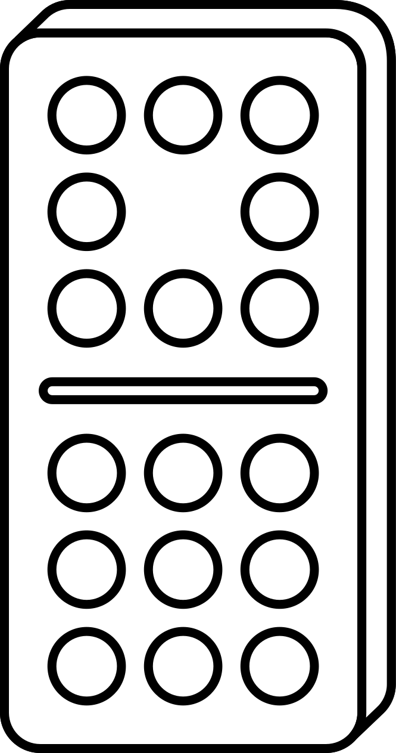



domino counting
Count the dots and write the number:
10

Slide 6
domino counting
Count the dots and write the number:
10

Slide 7
Name:
Numbers to 10
Colour the amount of circles represented by each number:
3
8
2
5
1
10
4
7
9
6

Slide 8
Teacher Olivia's Class
Before and After
Write the numbers before the numbers into the boxes.
8
5
3
7
9
6

Slide 9
Teacher Olivia's Class
Before and After
Write the numbers before the numbers into the boxes.
4
12
14
11
16
18

Slide 10
Teacher Olivia's Class
Before and After
Write the numbers before the numbers into the boxes.
6
15
9
17
19
22

Slide 11






Name:
Directions: Draw a line to the matching the snowflakes, when finished color the snowflakes on the back.

Slide 12

snow

Slide 13

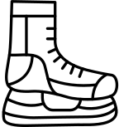

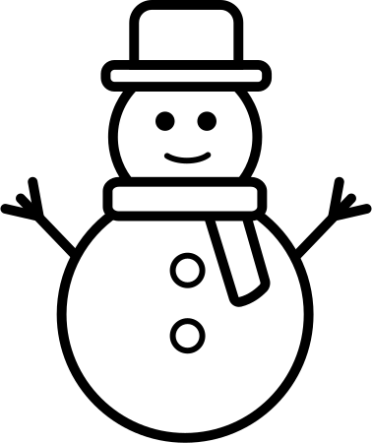
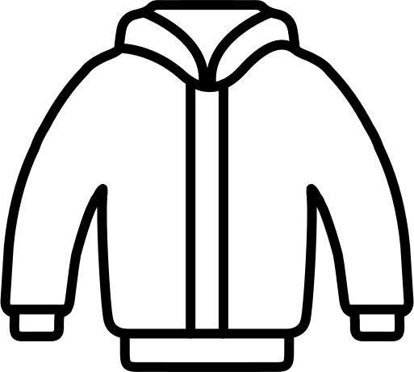




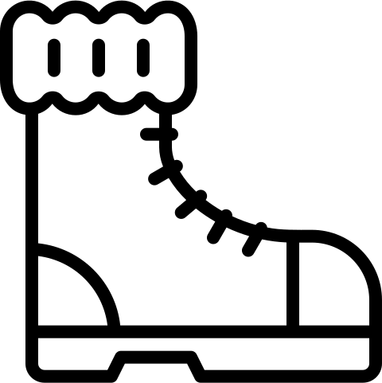

I SPY WINTER
There are ten Winter icons. Count and colour each set of icons as you find them.
Write the number in the box beside the icons you counted.

Slide 14


Name:
Mitten Number Practice
1
Practice writing your numbers on the mittens. When finished turn this sheet over and create your own colorful pair of mittens.
2
3
4
5
6
7
8
9
10

Slide 16


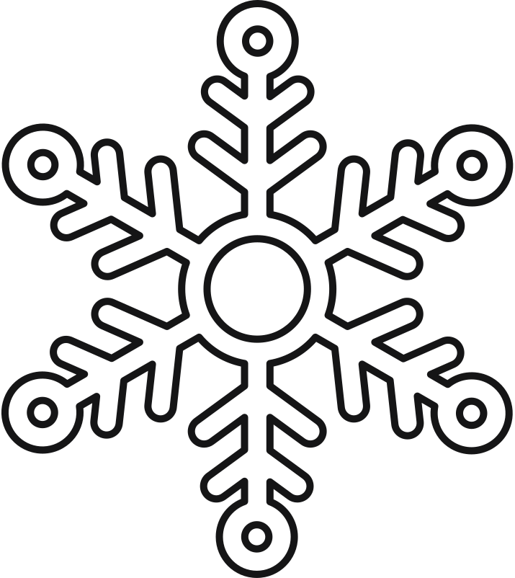

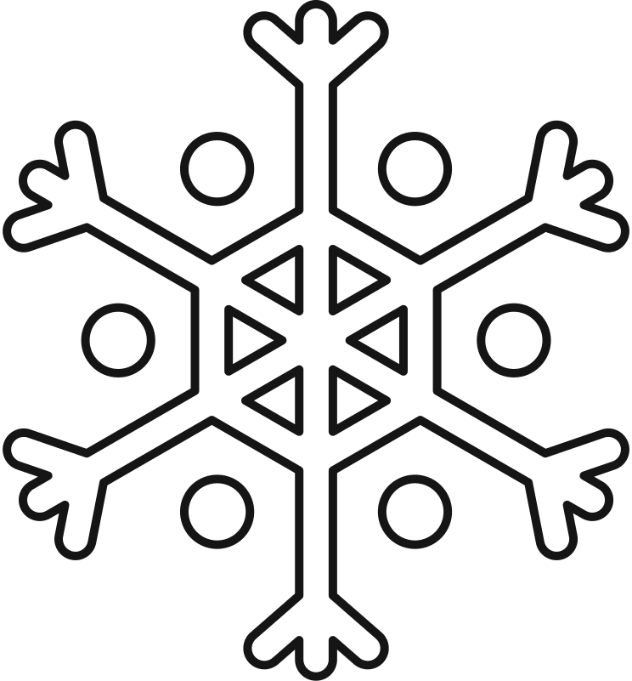
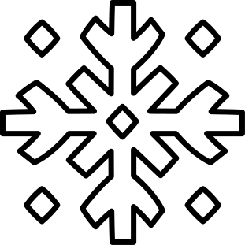

Name:
Snowflake Coloring
Color the snowflakes below using the color indicated. Use your favorite color to color the biggest snowflake.
Blue
Red
Purple
Orange
Yellow
Green
snowflake

Slide 17
Name:
Patterns
Complete the pattern by drawing the next shape

Slide 18




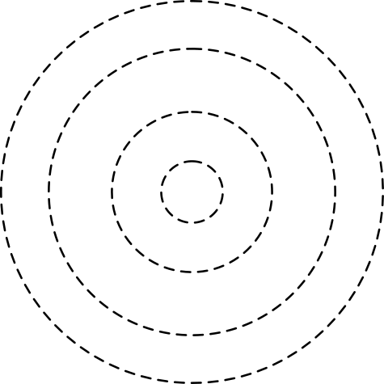
Name:
Tracing Lines
Trace all the lines.

Slide 19


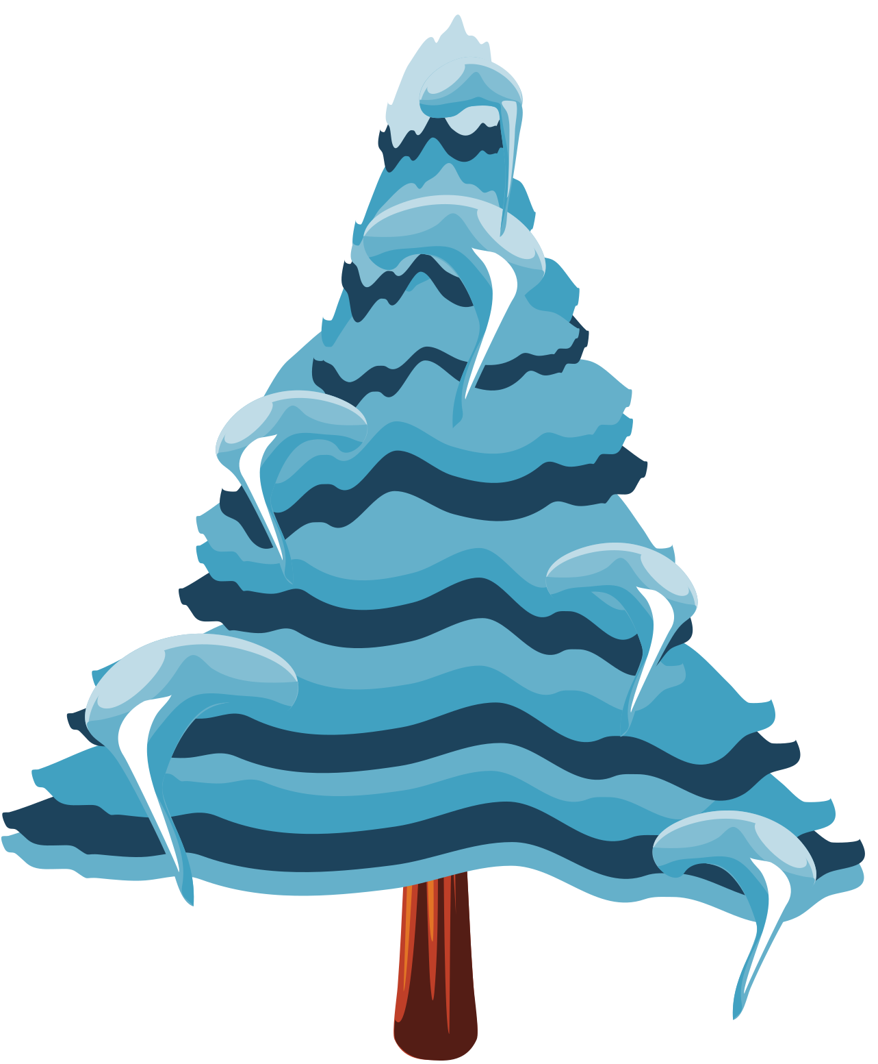



Name:
Tracing Lines
Trace all the lines.

Slide 20








Name:
DATE:
Snowflake Number Skills 1-10
Count how many snowflakes there are in each box, and circle the correct number.
5
6
4
8
6
5
1
6
3
5
2
4
7
1
8
5
9
10
10
2
9
3
7
5

Slide 21

Name:
DATE:
Snowflake Number Skills 1-10
Answer sheet
5
6
4
8
6
5
1
6
3
5
2
4
7
1
8
5
9
10
10
2
9
3
7
5

Slide 22
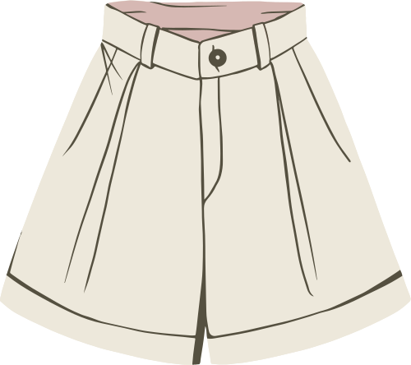
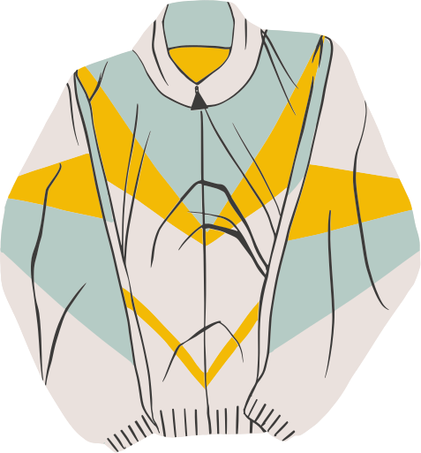
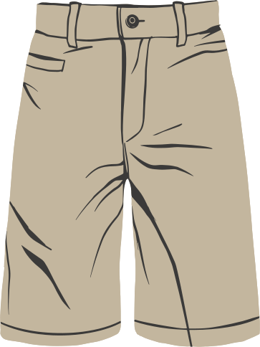
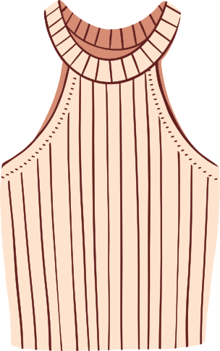
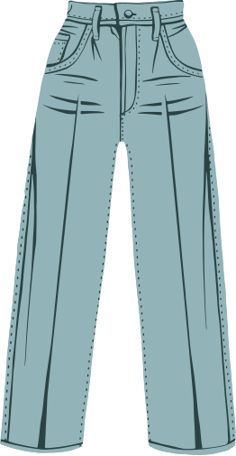
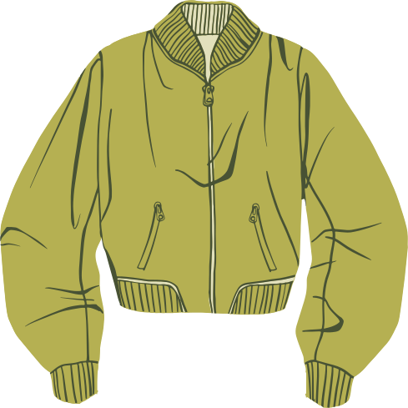
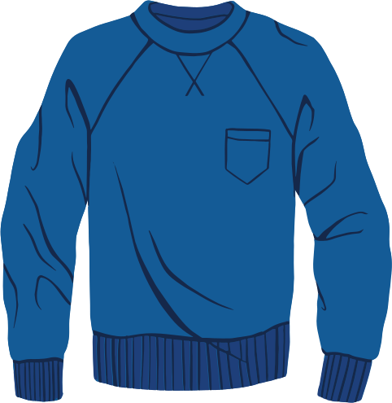
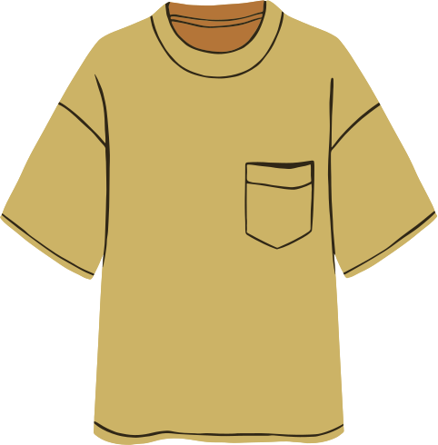
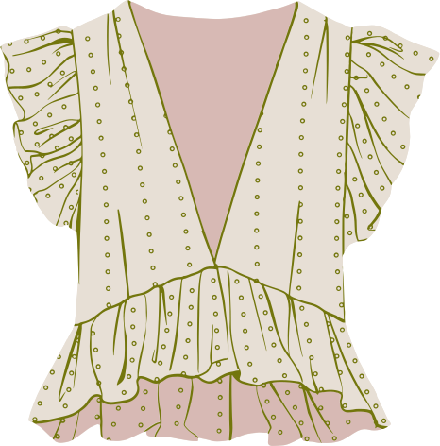
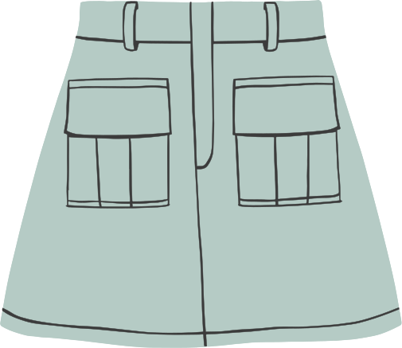
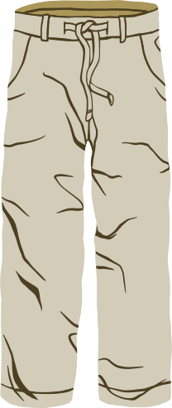
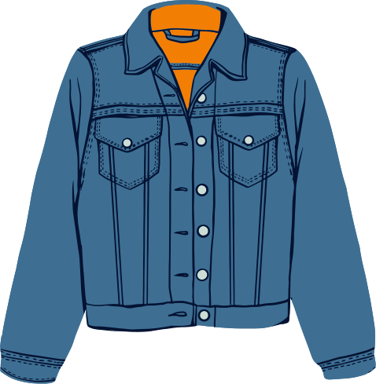
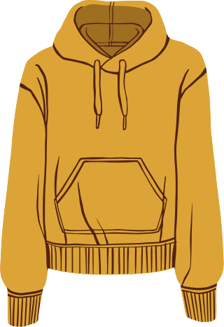
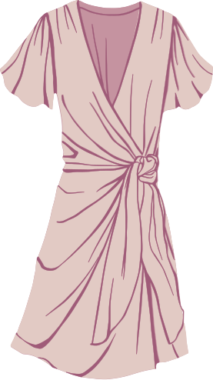
Name:
Class:
Weather and clothes
Classify, cut and paste the types of clothes depending on the weather.
When it's hot
I put on my...
When it's cold
I put on my...

Slide 23



WINTER BINGO
Solve the addition problem and mark the answer on your bingo board.
Five in a row wins!
3
11
13
5
2
1
7
12
19
8
4
16
0
14
18
9
15
6
20
23
22
10
21
17

Slide 24
WINTER BINGO
Solve the addition problem and mark the answer on your bingo board.
Five in a row wins!
7
13
8
4
23
11
3
19
21
6
18
14
9
0
5
12
10
16
22
15
1
17
2
20

Slide 25
WINTER BINGO
Solve the addition problem and mark the answer on your bingo board.
Five in a row wins!
4
5
12
21
16
10
0
19
15
22
2
8
23
11
17
20
9
3
1
14
6
18
13
7

Slide 26
WINTER BINGO
Solve the addition problem and mark the answer on your bingo board.
Five in a row wins!
10
7
11
9
6
0
2
5
12
19
4
17
22
20
1
13
8
15
23
16
21
14
18
3

Slide 27
WINTER BINGO
Solve the addition problem and mark the answer on your bingo board.
Five in a row wins!
20
6
2
18
8
9
21
7
0
15
12
4
23
22
11
10
1
17
14
3
16
5
13
19

Slide 28
1 + 2
2 + 2
2 + 3
2 + 4
2 + 5
2 + 6

Slide 29
2 + 7
2 + 8
1 + 1
3 + 8
3 + 9
0 + 1

Slide 30
0 + 0
4 + 9
8 + 6
7 + 8
8 + 8
9 + 8

Slide 31
9 + 9
10 + 9
10 + 10
11 + 10
11 + 11
12 + 11

Slide 32

SNOWFLAKE NUMBER PRACTICE
Practice writing your numbers 1-25 in the snowflakes below. When finished, color the snowflakes on the back of this page and practice your handwriting.
1
2
3
4
5
6
7
8
9
10
11
12
13
14
15
16
17
18
19
20
21
22
23
24
25

Slide 33
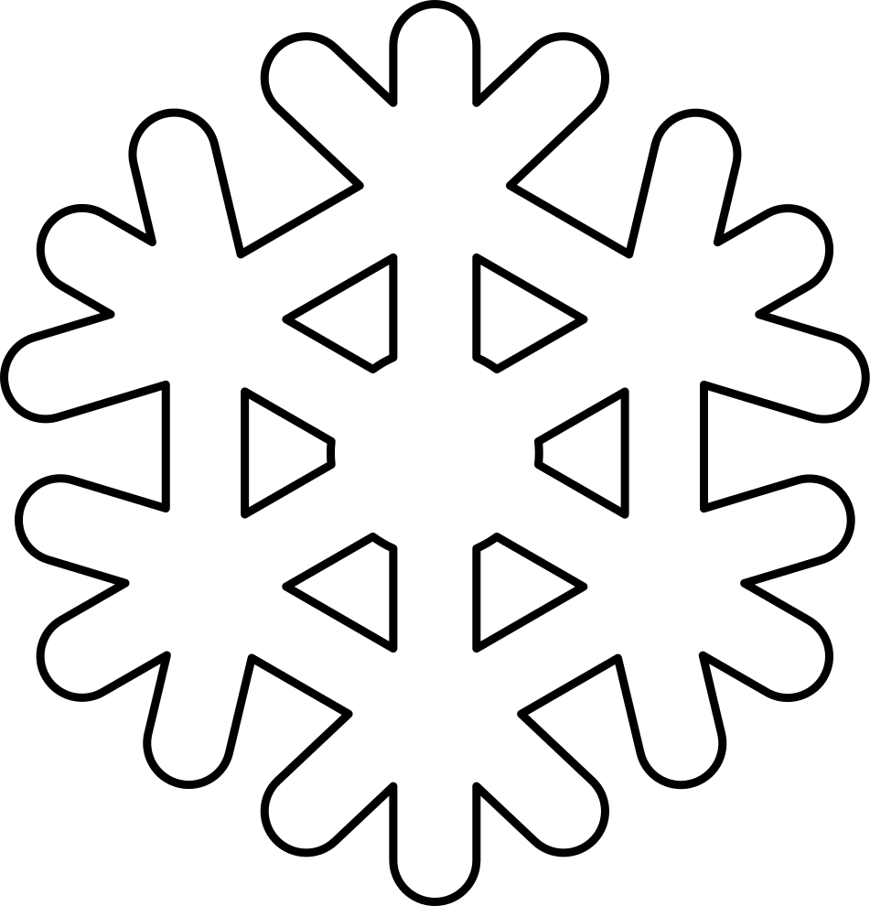
snowflake

Slide 34

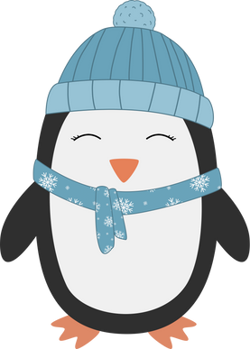
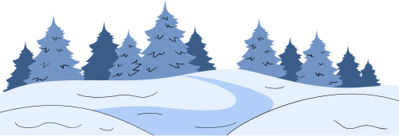
Name:
Date:
Compare and Contrast
Use the Venn diagram below to compare and contrast two winter words. Then, write about the similarities and differences.
An owl and a penguin are similar because
They are different because

Slide 35
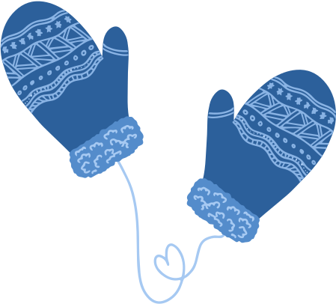

Name:
Date:
Compare and Contrast
Use the Venn diagram below to compare and contrast two winter words. Then, write about the similarities and differences.

Slide 36
Name:
Date:
Compare and Contrast
Use the Venn diagram below to compare and contrast two winter words. Then, write about the similarities and differences.

Slide 37

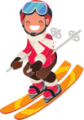
Name:
Date:
Compare and Contrast
Use the Venn diagram below to compare and contrast two winter words. Then, write about the similarities and differences.
Ice skating and skiing are similar because
They are different because

Slide 38
Name:
Date:
Compare and Contrast
Use the Venn diagram below to compare and contrast two winter words. Then, write about the similarities and differences.

Slide 39

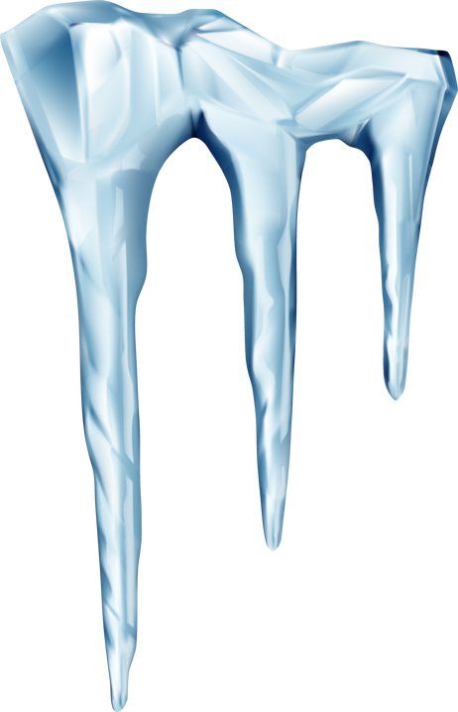
Name:
Date:
Compare and Contrast
Use the Venn diagram below to compare and contrast two winter words. Then, write about the similarities and differences.
A snowflake and icicle are the same because
They are different because

Slide 40
Name:
Date:
Compare and Contrast
Use the Venn diagram below to compare and contrast two winter words. Then, write about the similarities and differences.

Slide 41
Name:
Date:
Compare and Contrast
Use the Venn diagram below to compare and contrast two winter words. Then, write about the similarities and differences.
A snowflake and icicle are the same because
They are different because

Slide 42
Name:
Date:
Compare and Contrast
Use the Venn diagram below to compare and contrast two winter words. Then, write about the similarities and differences.

Slide 43
Answer Sheet
are worn on your hands
keeps your fingers warm
winter accessories
help keep you warm
made of soft fabrics
are worn on your head
keeps your head warm
A mitten and a hat are similar because they are both winter accessories that help keep you warm and are made from soft, insulating materials like wool or fleece. They are different because mittens are worn on the hands to keep fingers warm, while hats are worn on the head.

Slide 44
Answer Sheet
can fly
live in various habitats
nocturnal hunters
eat small mammals
lay eggs
have feathers
both are birds
cannot fly
live in South Africa and Antarctica
can swim
eat fish and squid
An owl and a penguin are similar because they are both birds, have feathers, and lay eggs. They are different because owls can fly while penguins cannot, penguins live in cold climates and owls live in various habitats. Owls eat small mammals and are nocturnal while penguins eat fish and squid.

Slide 45
Answer Sheet
use ice skates
takes place on a frozen pond or lake
winter sports
involve gliding over a surface
require balance
use skis
takes place on a snowy slope or hill
Ice skating and skiing are similar because they are both winter sports, and you have to glide over a surface. Both activities require balance and coordination. They are different because you need ice skates to skate on a frozen pond or lake. You need skis to ski down a snowy slope or hill.

Slide 46
Answer Sheet
is delicate and unique
falls from the sky during a snowfall
made of frozen water
seen during the winter or in cold temperatures
is a solid, frozen drip of water
forms when melted snow refreezes
A snowflake and an icicle are similar because they are made of frozen water and are commonly seen in cold temperatures. They are different because a snowflake is a delicate, unique ice crystal that falls from the sky, and an icicle is a solid, frozen drip of water that forms when melted snow refreezes.

