Slide 1
Teacher Info Slides
What do I need to know before I teach this material?
Notes:
Student slides start at slide #4

Slide 2
Reminders When Answering Questions:
enders When Answering Questions
Set ground rules ahead of time,
set up an anonymous question box and give yourself time to formulate answers for the next session,
use reliable phrases,
always end with a safety message or direction of a reliable resource for more information,
tell students you may rephrase questions to protect confidentiality and safety of all students (no names, no questions that expose anyone)

Slide 3
Useful Phrases When Answering Questions:
some people may,
although not everyone will…
it’s important to understand the safety of…,
experts believe,
doctors suggest,
the safest way…(always end with safety as the message),
ask your family what their rules are or values are about…,
that’s an interesting question: I bet they might have an answer on one of our trusted websites: let’s find out,
sometimes people think of questions that will shock or gross us out but it doesn’t mean they are safe, true, likely or even possible,
not everything you see or hear about it is true (media literacy),
In this question I wonder if there is consent of each person and if anyone would be in harm (redirect difficult questions to safety)…

Slide 4
Health 8
Lesson 7: Sex and Concent

Slide 5
Let’s review
How do we behave in Health Class?
Notes:
Go over the ground rules as a class – Print handout of rules for students included as well if you want to print it and hand it out

Slide 6
Ground Rules:
This is ‘Body Science!’ Learning about the body is fun and it helps us:
Learn how to care for our own bodies
Understand our body belongs to us and our rights
Helps us get along with other people and not cause harm to anyone else
Teaches us how to get out of unsafe situations and who to go to for help
Be private: no using other people’s names, or personal stories. We only talk about our bodies with people we trust, and trusted adults. This information is only appropriate for your age group and older: do not share with younger kids at lunch who may not be ready for it.
Personal Values: Everyone has their own set of beliefs and family values. Even if our values aren’t the same as someone else’s we still show respect and honour the diversity that exists.
Giggly wigglies: sometimes bodies are funny. If you have to laugh…follow the 3 second rule, take a deep breath and look at the ground until you can join the group again.

Slide 7
Ground Rules continued:
Use scientific terms and words: slang is ok, but always use scientific word as well. Using scientific words teaches a universal language of health.
“Interesting”: doctors never say things are gross, or say “ewww”. Instead they say “interesting…” it’s a good word to use when we don’t know what to say!
No personal questions. This rule saves a lot of embarrassing moments. It’s ok for students and teachers to not answer personal questions.
All other questions are ok: there is no such thing as a bad question in health class. There is a time and a place for questions though. Always have a piece of scrap paper out for you to write down questions that may come up so you can ask them at the appropriate time or submit it anonymously to the question box.
Support: sometimes different feelings may come up and you might need to talk with a counselor or teacher after the lesson.

Slide 8
The classroom is a safe spot for you to share your thoughts and feelings.
We have rules, because we want to make sure everyone is able to share their feelings without fear.

Slide 9
The Facts:
Average age of first intercourse?
Average age of first child?
Likelihood you’ll get an STI?
Are miscarriages common?
% of pregnancies that are unplanned?
Effectiveness of condoms and birth control?
Requirement of parental permission for BC?
Notes:
Most people wait until after highschool before having sex. Average age is 16.5 which means some wait until married, 30, some younger, some never. ITs about personal values and family values, and knowing you’re ready
30. How do people have sex but not a baby (vaginal sex): birth control and condoms
5/6
Nearly half of all pregnancies end in miscarriage often in very early stages before even knowing one is pregnant: the vast majority cannot be prevented and are due to chromosomal abnormalities
1 in 2 pregnancies are unplanned: our goal is to reduce # unplanned through education
High 95% if used as directed!
No

Slide 10
Physical Intimacy
Puberty > hormones > sex drive
Notes:
During puberty our brains signal the release of more hormones including sex hormones produced in the ovaries and testicles. These hormones affect our moods, feelings, and sometimes create new feelings of attraction. This is called the sex drive. Humans brains have a part for the sex drive but also a part which helps manage the sex drive. If a person feels attraction they can’t just act on it. They need to get consent first. They also have to follow rules about the age of consent, and also what is appropriate in public/private spaces.

Slide 11
Sexual Orientation
Who you are mostly attracted to
Determined in utero
Discover about self mostly by end of highschool
Can be fluid over lifetime
Notes:
Everyone has a sexual orientation
It is one of the factors which influence one’s identity.

Slide 12
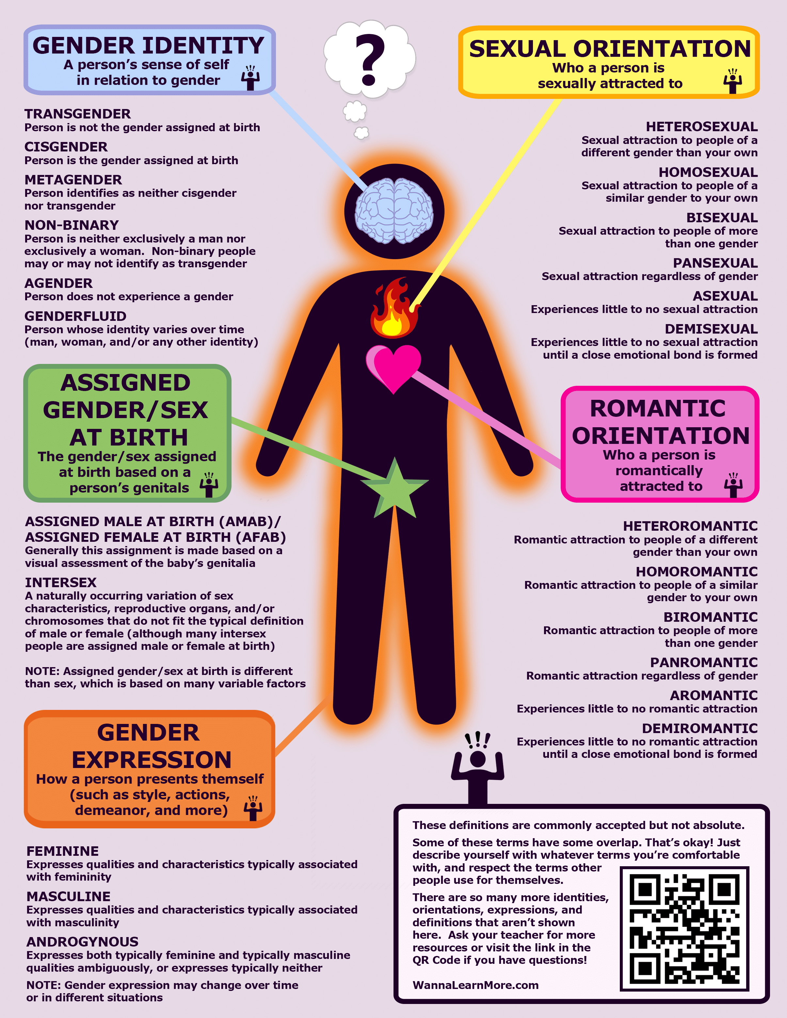
Terms:
Gay, Lesbian, Queer, Bisexual, Pansexual, Asexual, Heterosexual
Notes:
Pansexual - can like anybody
Asexual - Dont really have sexual feelings for anybody

Slide 13
How to manage new sexual feelings
Might feel like:
A crush on another person
Butterflies
Thinking a lot about someone
Wanting to be near someone
Wondering if they like you back
Thinking about touching another person (kissing, hugging,
holding hands)
Touching your own private body parts

Slide 14
Self-Pleasure or Masturbation
Masturbation is making yourself feel good by using your hands or toys on yourself (alone or partnered). Typically, when people talk about masturbating, they mean touching genitals. However, bodies are full of all kinds of sensitive spots, so feel free to explore multiple areas and sensations.
Who engages in self pleasure?
Everybody! People of all ages, genders, abilities, sexualities, ethnicities, cultures, religions, and relationship statuses have a right to experience pleasure and explore it through self pleasure.

Slide 15
Why self-pleasure?
Because it feels good. That can be the whole point.
Some other reasons why you might engage in self pleasure include:
Relieving sexual or physical tension
Relieving stress
Passing the time
Relieving menstrual*/abdominal cramps
Stimulating blood circulation
Learning about your body, and finding out what feels good for you
Getting ready for sex with a partner
Building a connection to your body
Having an orgasm
Avoiding risks of STIs or pregnancy
Having a sexual experience to share with a partner
Notes:
ACTIVITY - Kerri Isham book #2 p. 33-34 worksheet

Slide 16
VIDEO:

Slide 17
Porn Literacy
A key part of porn literacy is remembering that while we can get real pleasure from watching porn, what we see in porn doesn’t always reflect the real-life sex that people have. Porn is acting. It’s fantasy.
When thinking critically about porn, it can help to think about what we see and what we don’t see. Things we may not see include:
Actors negotiating contracts and getting paid for what they do
Actors using lube or doing enemas for anal sex
Actors using medication for birth control or to get or keep erections
Safer sex discussions and strategies, and actors getting STI tests
Conversations about what actors are/aren’t consenting to do
Crew members setting up camera angles, lighting, directing, etc.
Water and/or snack breaks
Mistakes, awkward moments, bloopers, and outtakes
Even amateur porn (or professional porn that looks like amateur porn) still only shows scenes the people making it want you to see.

Slide 18
VIDEO:

Slide 19
Expectations vs. Reality
Porn can be good for inspiration but using porn and thinking we know how to have sex is like watching professional basketball and thinking we can dunk. Sex in porn is entertainment: it’s not always instructive for real life sex. For example:
Sex in porn can give the impression that everything can or should be “smooth”.
It can seem like nobody makes mistakes or has awkward things happen, or like people can or should “just know” what their partners want without talking about it. Sex in real life can be hot and intense, but it can also be awkward and silly, and sometimes people’s bodies do unexpected things.
Orgasms in porn are generally a big deal.
Orgasms in porn often seem easy to achieve, but porn shows actors chosen to portray the types of fantasies porn producers want to create, and porn doesn’t always represent the real variety of bodies and the ways they work.
Things you like in porn are not always things you would want to do in real life.
Much like how you can watch action movies but also be against violence in real life, you can watch porn that shows fantasies about things you’re not interested in actually doing, or ways you wouldn’t want to treat people in real life.

Slide 20
VIDEO:

Slide 21
Knowing what’s ok and what’s not
Public Vs. Private
Private Rooms
Private Activities
Private Rules
Public Places
Public Behaviours
Public Rules
Notes:
In private it’s not ok for someone to watch you do these things. It also makes other people uncomfortable if you were to do private things in a public place.

Slide 22
Private Activities
Bathing
Showering
Going to the bathroom
Sleeping
Changing clothes
Long kisses
Touching own body parts
Touching someone else’s body (with their consent)
Talking about private touch
Talking about private body parts and functions
What could you do or say if someone was breaking a privacy rule?
Notes:
That’s private
Can i have some privacy please
Please knock first
This is just between you and me (not allowed to keep secrets about touch if it’s a child)
That’s not ok with me
Stop
I have to go

Slide 23
How do I know when I am ready for sex?
ACTIVITY: Snowball Target Practice
- Tear a piece of paper in ½
- Keep ½ to write down questions you have (feel free to ask them out loud during the presentation or save them for the end)
On the 2nd ½ write down 3 criteria for having sex
Crumple up the paper
Throw it at the target
Presenter shares student’s criteria for having sex

Slide 24
Sexual Readiness People become ready for sex at different times in their life & for different reasons.
You and your partner are of legal age to provide consent.
Having a sexual relationship at this time in your life does not violate your religious or moral ethics.
You do not feel guilty or frightened about friends/family knowing.
You are confident that you will not be humiliated and that your reputation will not be hurt
Neither partner is pressuring the other for sex.
You are NOT trying to:
a. prove anything (your strength of your love, that you are mature, can attract a sexual partner or your sexual orientation)
b. rebel against your parents/society etc
c. improve a poor relationship.

Slide 25
Sexual Readiness continued
You can have fun together without any sexual activity and feel safe being “yourself”.
You can discuss the potential of contracting or transmitting sexually transmitted diseases and are both prepared to get regular medical checks.
You have discussed and agreed on what BOTH of you will do if pregnancy occurs, because no contraception is 100% effective.
You can afford condoms and prescription medicines and are not embarrassed to have them filled.
Reflect on this statement: “If you are already sexually active and could change anything about your first time, is there anything you would change?”
Notes:
Resources that review the top reasons why young people do or do not have sex.
www.goodchoicesgoodlife.org/choices-for-young-people/articles-158918/
www.plannedparenthood.org/learn/teens/sex/all-about-sex/am-i-ready-sex

Slide 26
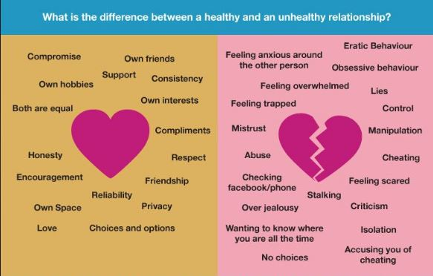
Healthy relationships take skill and practice!
Notes:
Talk about how you would demonstrate these healthy qualities at each level
Talk about who teaches people healthy relationship skills
Besides our family, how else can we learn the skills to have healthy relationships

Slide 27
VIDEO:
Notes:
Watch short cartoon https://youtu.be/UB9anEZx9LU and brainstorm

Slide 28
Respecting other people
Doing no harm
Body language
Words they use or don’t use
What is consent (asking permission)
Must be enthusiastic YES!
Know what a No sounds and looks like
Any time you want to touch someone else, or someone wants to touch you they must get consent

Slide 29
Consent
Consent means… “permission for something to happen”
Sexual Consent refers to…
“clear and verbal consent that is happily, readily, voluntarily, enthusiastically and freely given to agree to take part in the sexual activity”
Sexual consent can be withdrawn at any time during the sexual contact. That is, someone initially says YES to sexual activity but then changes their mind during the sexual act. If consent is withdrawn, the sexual touching must stop.

Slide 30
VIDEO:

Slide 31
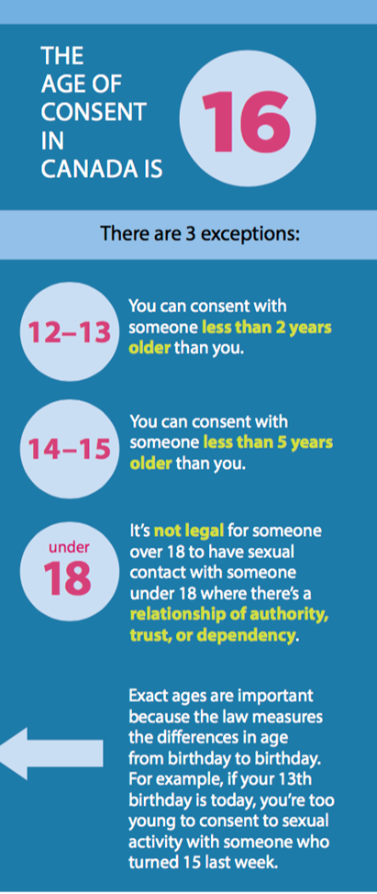
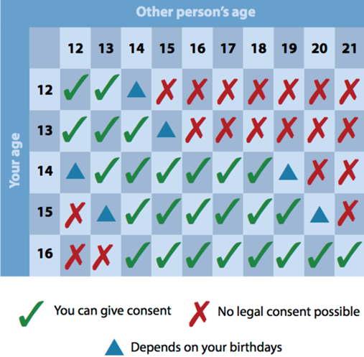
Age of Consent Law
The law says how old a person must be for sexual consent.
The intent of this law is NOT to grant permission for 12-year-olds to have sex.
Instead, it legally protects a younger person from being tricked or manipulated into sex by an older (unethical) person.

Slide 32
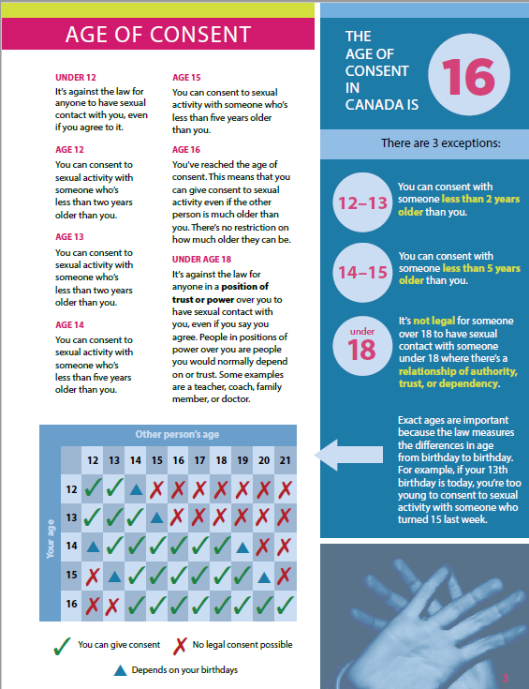
You cannot consent if...
They are your boss, coach, teacher
They are way older than you
Someone is drunk or high
Someone is feeling pressured
Notes:
Look at Is That Legal?! Page 3

Slide 33
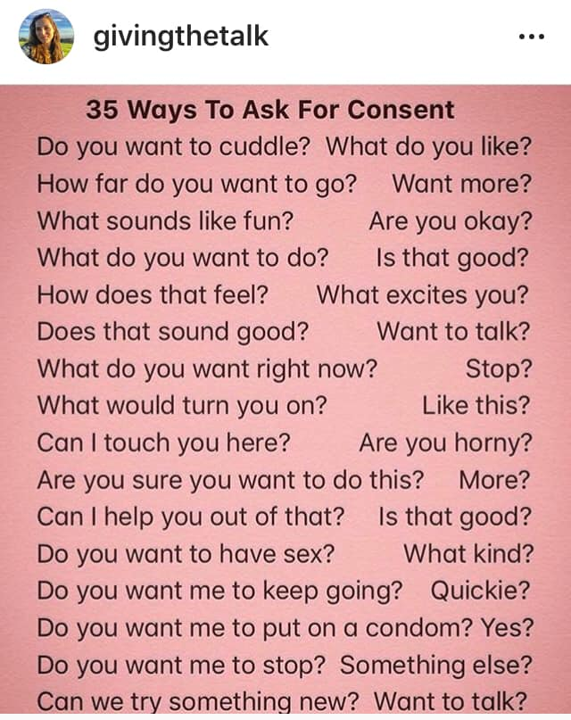
Ways to Ask For Consent:

Slide 34
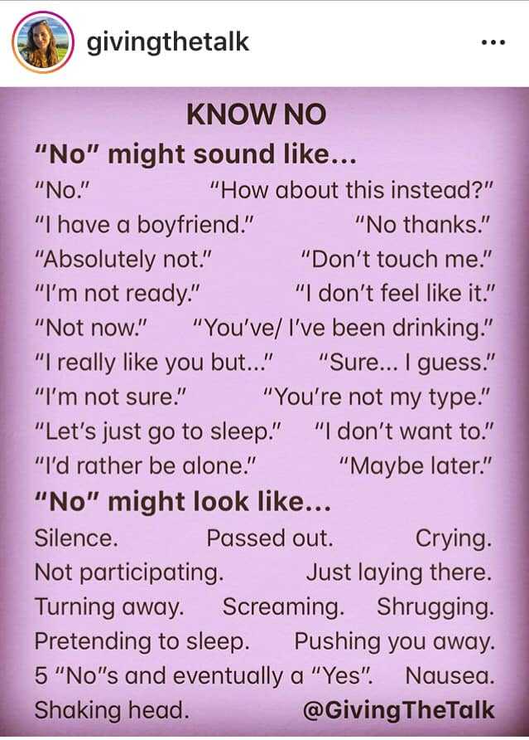

Slide 35
Sexual Assault
...includes ALL forms of unwanted sexual activity: intercourse, oral sex, anal sex, groping, kissing, sexual touching, etc.
Any Sexual touching without consent is a sexual assault.
ANY GENDER can commit a sexual assault.
Sadly, sexual assaults are COMMON, and few are reported to the police. Only 5% of sexual assaults are being reported (2014).
Sexual assault is NEVER the fault of the victim.
Reach out for help. You need to hear that message face-to-face & get the support needed to heal and recover.

Slide 36
Notes:
Go over types of harassment and assault and discuss how to respond if you witness or receive this type of treatment

Slide 38
VIDEO:

Slide 39
Questions ?
Notes:
Question Box time: Have students fill out questions and address them next class.

