Slide 1

Name
RAINY DAYS
Directions: Finish the picture and then complete the sentence based on your drawing.
On rainy days
I like to

Slide 2


Slide 4


MY FAVORITE THING TO DO OUTSIDE
Directions: Finish the picture and then complete the sentence based on your drawing.
My favorite thing to do outside is

Slide 6





Name
Teacher
Rain Drops
ADDITIONS
Directions: Count and add the raindrops. Then, solve the problem.
5 + 2 =
3 + 2 =
4 + 1 =
3 + 3 =
2 + 3 =
1 + 4 =

Slide 7







WEATHER
dice

Slide 8
DESIGN
your own dice

Slide 9
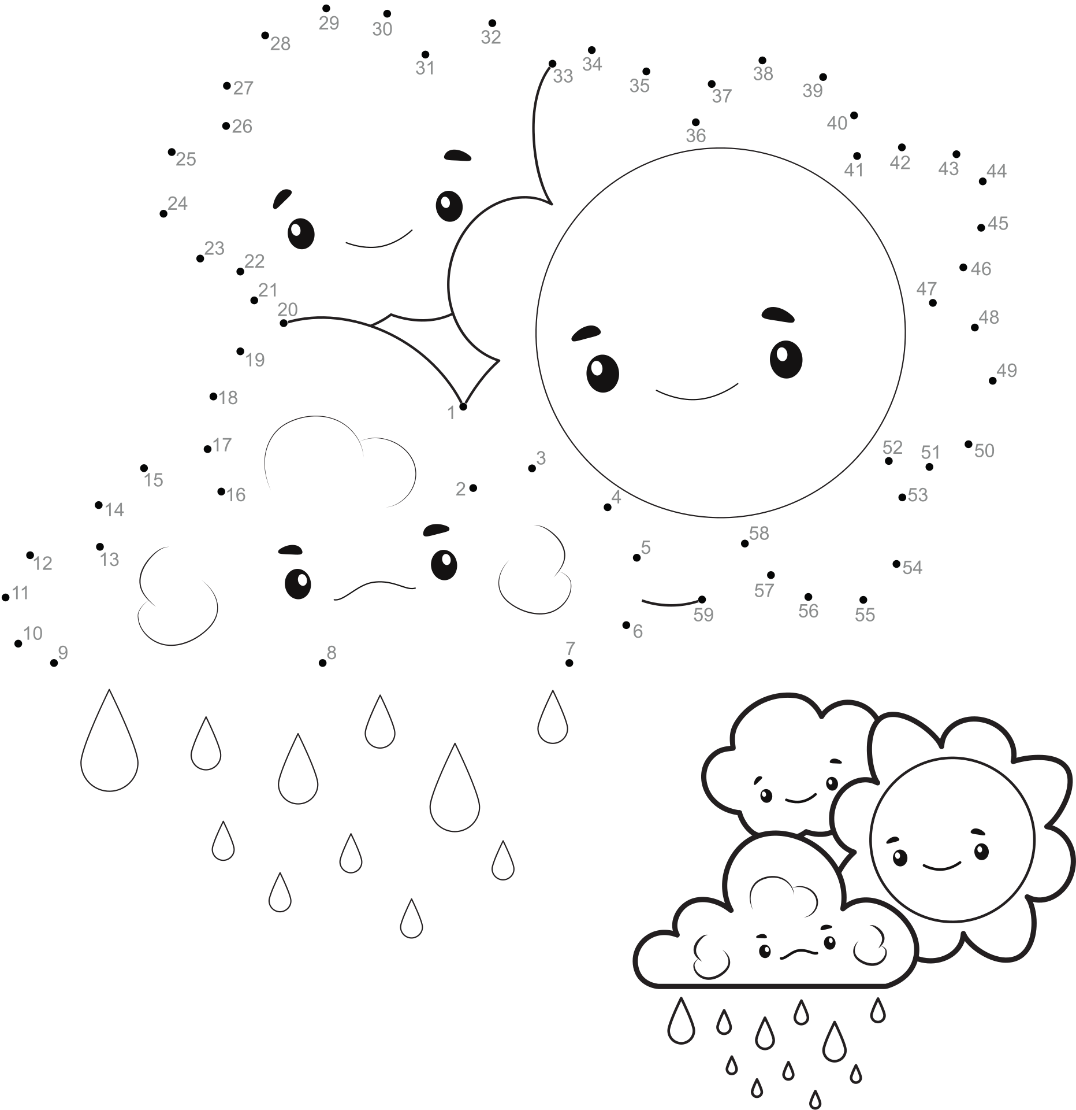
WEATHER
Complete the dot to dot to reveal the different types of weather. Colour once completed.

Slide 10
WEATHER
Complete the dot to dot to reveal the different types of weather. Colour once completed.

Slide 11








WEATHER
Attach the arrow using a pin.
Spin it and then say what the weather is like.

Slide 12











Name:
Date:
What's the weather like?
Look at the pictures and circle the correct words
Snowy
Partly cloudy
Sunny
Cloudy
Rainy
Cloudy
Sleeting
Windy
Snowy
Rainy
Hailing
Sleeting
Windy
Windy
Stormy
Foggy
Tornado
Rainy
Hailstone
Rainbow

Slide 13


Name:
Date:
Weather words
Look at the pictures and write the words in the correct place
Stormy
Sleeting
Partly cloudy
Rainy
Windy
Snowy
Thunder
Tornado
Sunny
Cloudy
Snowflake
Rainbow

Slide 14
Name:
Date:
Weather words
Look at the pictures and complete with the correct words

Slide 15
Name:
Date:
What's the weather like?
Look at the pictures and describe the weather as in the example
It's snowy

Slide 16

Name:
Date:
Weather Forecast
Look at the weather forecast chart and answer the questions
MONDAY
TUESDAY
WEDNESDAY
THURSDAY
FRIDAY
What will the weather be like on Monday?
What will the weather be like on Tuesday?
What will the weather be like on Wednesday?
What will the weather be like on Thursday?
What will the weather be like on Friday?

Slide 17

Name:
Date:
Weather Predictions
Make weather predictions for the week and draw them in the weather chart.
MONDAY
TUESDAY
WEDNESDAY
THURSDAY
FRIDAY
Using the previous chart, write sentences describing the weather of this week.
Look at the sky every day and draw the real weather of each day.
MONDAY
TUESDAY
WEDNESDAY
THURSDAY
FRIDAY
Using the previous chart, describe the real weather of this week.

Slide 18









Name:
Date:
Drag and Drop: Match the Weather!
Drag the correct weather name and drop it onto the matching picture.
Cloudy
Sunny
Rainny
Windy
Stormy
Snowy

Slide 19

Name:
SEASONS OF THE YEAR
Direction: Color the trees for each season.
Spring
Summer
Autumn
Winter

Slide 20

Name
Date
place value
I can represent a two-digit number as tens and ones.
Base Ten Blocks
Place Value
Number
4
6
46
tens
ones
2
5
tens
ones
tens
ones
19
tens
ones
8
0
tens
ones
tens
ones
63
tens
ones

Slide 21
Name
Date
place value
I can represent a two-digit number as tens and ones.
Base Ten Blocks
Place Value
Number
tens
ones
44
tens
ones
1
8
tens
ones
tens
ones
24
tens
ones
3
2
tens
ones
tens
ones

Slide 22


Name:
Date:
Rain Clouds
Trace the lines and color the pictures.

Slide 23


Counting Raindrops
Using the word clue written in the cloud, color the correct number of raindrops.
seven
three
nine
two

Slide 24
eight
four
five
ten
one
six

Slide 25


Name:
Finding Numbers
Count the raindrops andwrite them
in the cloud.
2

Slide 26

Tracing Skills
Carefully trace then color the raindrops.

Slide 27

Tracing Skills
Carefully trace then color the hearts.

Slide 28

Tracing Skills
Carefully trace then color the circles.

Slide 29




Name:
NUMBERS OR LETTERS?
Directions: Trace the numbers and letters. Color the raindrops with letters blue. Color the raindrops with numbers green.
2
D
4
A
k
3
8
G
f
7
R
9
T

Slide 30

Counting Practice
Connect the Dots
1
27
2
26
3
25
4
24
5
23
6
22
7
21
8
20
9
19
10
18
11
17
12
16
13
15
14
Count by 1s

Slide 31
Name__________________
Date________________
EVEN NUMBERS
Color the even numbers.
2
16
11
12
4
9
17
21
18
13
5
1
14
20
19
8

Slide 32








Fall I Spy
Count each object and write how many you see.

