Slide 1
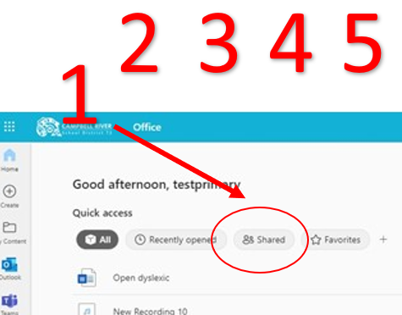
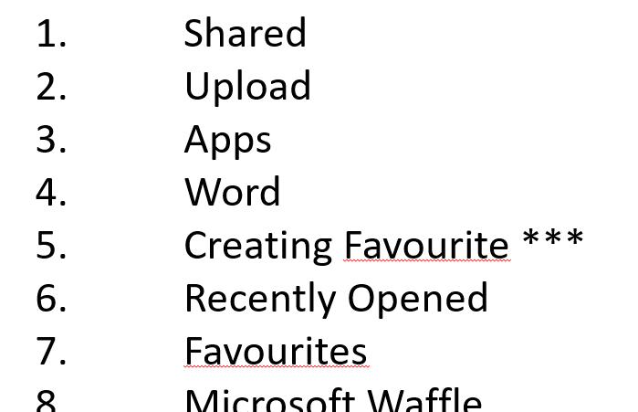
Navigating Your Office.com and OneDrive
Scavenger Hunt
Locate the items on your screen from the list.
Drag and drop the numbers to the correct location.

Slide 2
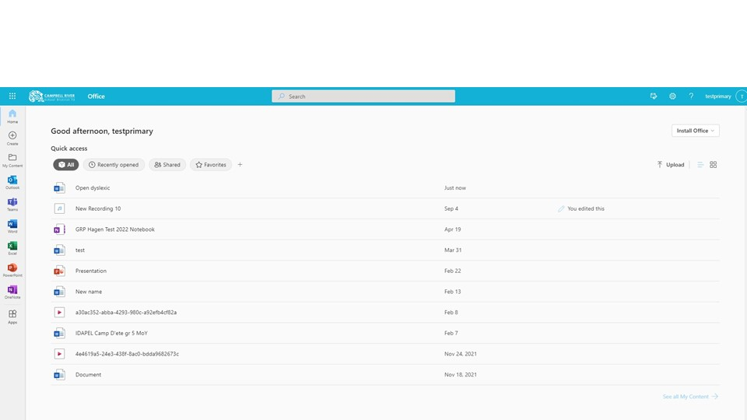
1
2
3
4
5
6
7
8
9
10
11
12
office.com

Slide 3
Shared
Upload
Apps
Word
Creating Favourite ***
Recently Opened
Favourites
Microsoft Waffle
List vs Tile View
Share Icon (to share with others) ***
Recently Opened
OneDrive Icon ***
Locate each of these on your screen.
Drag the numbers on the previous slide to where these are located.

Slide 4
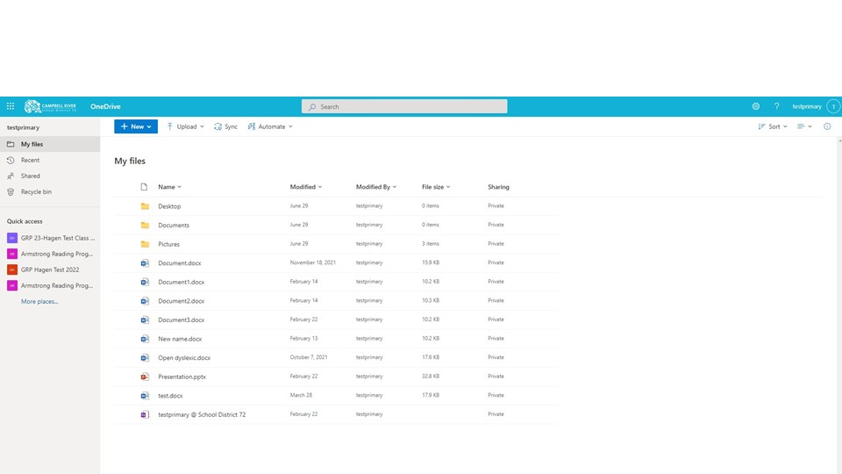
1
2
3
4
5
6
7
8
9
10
11
onedrive

Slide 5
Recycle Bin
Shared
Upload
Create New Word Document
List/ Grid View ***
Class Team
Recent
Microsoft Waffle
My Files
Share Icon (to share with others)
Search
Locate each of these on your screen.
Drag the numbers on the previous slide to where these are located.

