Slide 1



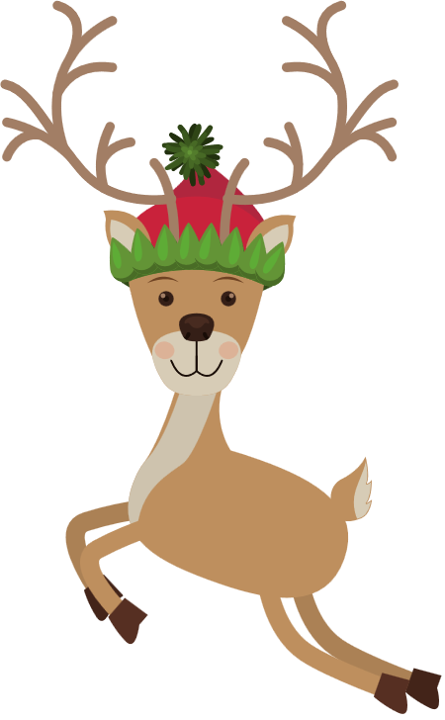






Name:
Total: /6
Christmas Addition
Grade 1
= 2
= 3
= 5
+
=
+
+
=
+
+
=
+
+
=
+
+
+
=
+
+
+
=

Slide 2
Name:
Total: /6
Christmas Subtraction
Grade 1
= 10
= 5
= 1
-
=
-
=
-
=
-
-
=
-
-
=
-
-
-
=

Slide 3
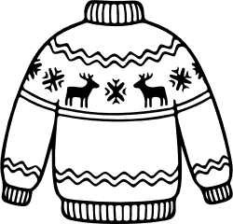
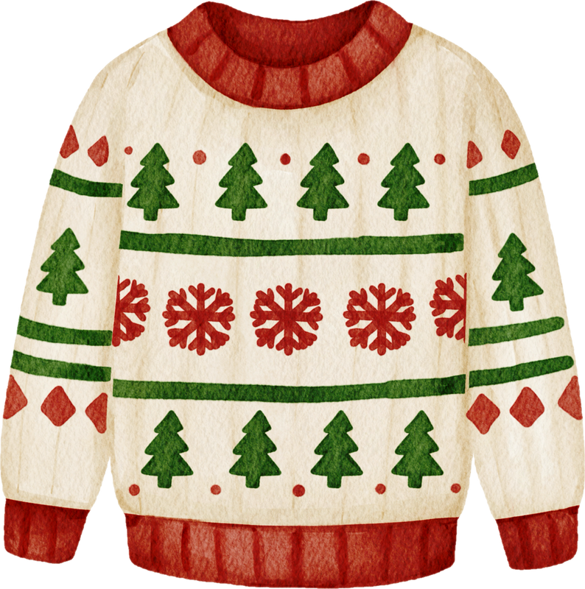
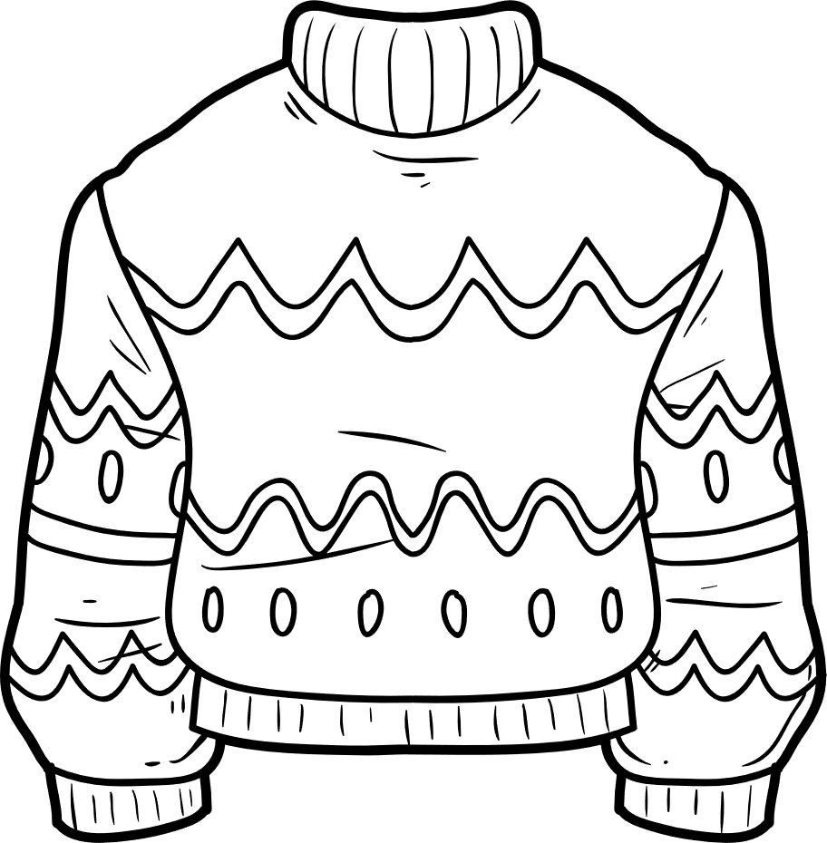


My Sweater Design

