Slide 1



COSY
Counting in K-1

Slide 2
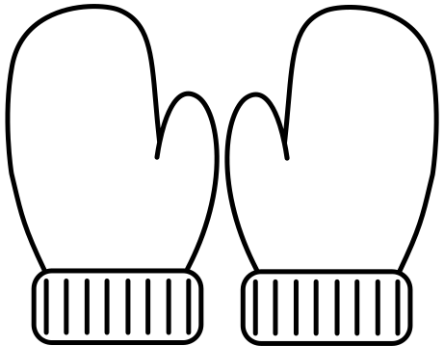






6
Six
8
Eight

Slide 3




7
Seven
9
Nine

Slide 4
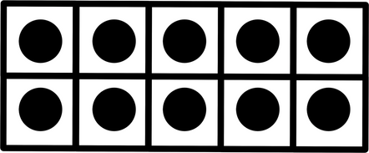



10
Ten
5
Five

Slide 5




4
Four
1
One

Slide 6



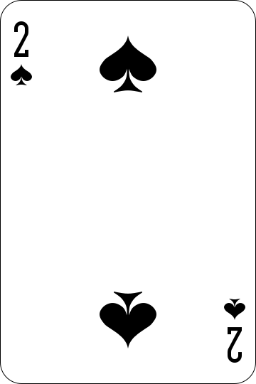
3
Three
2
Two

Slide 7




11
Eleven
12
Twelve

Slide 8

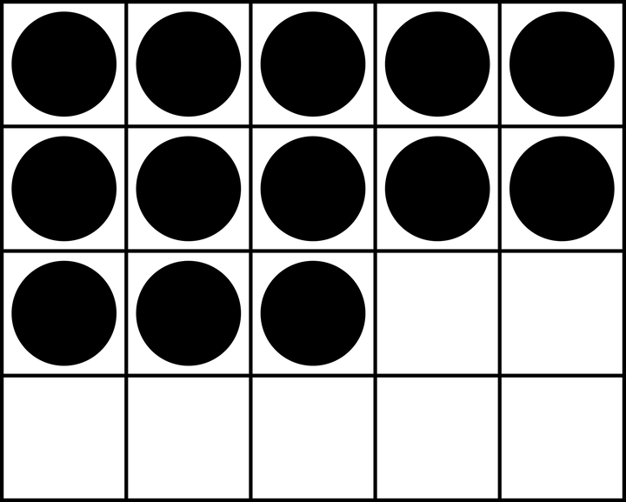
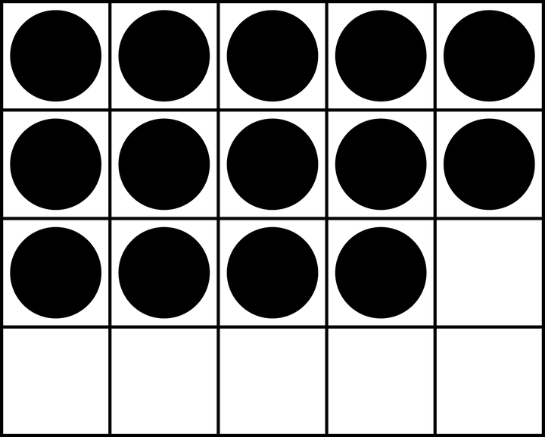

13
Thirteen
14
Fourteen

Slide 9
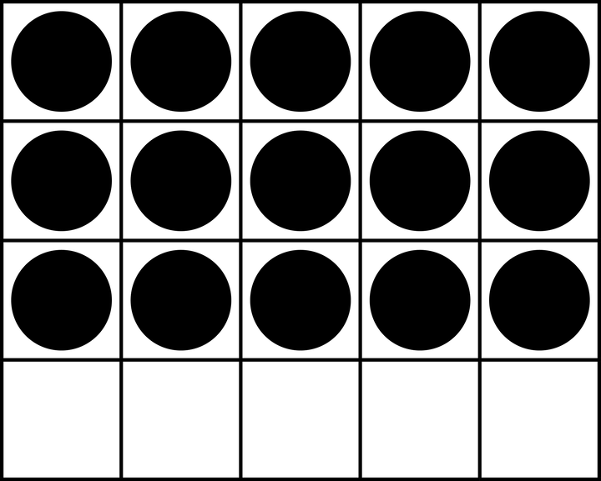
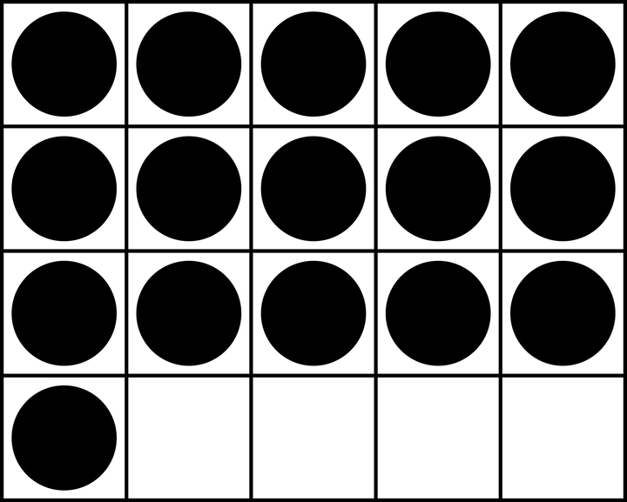

15
Fifteen
16
Sixteen

Slide 10
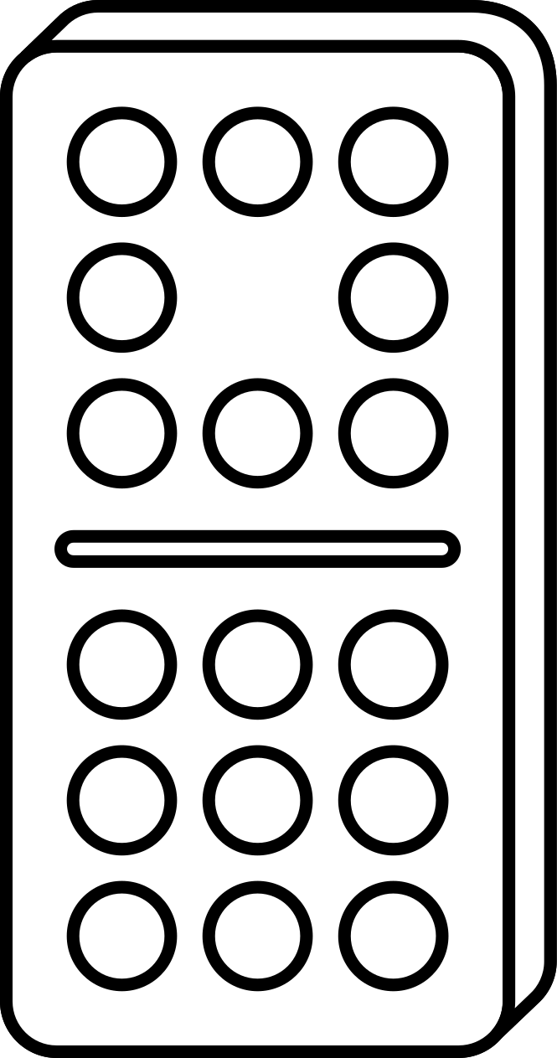
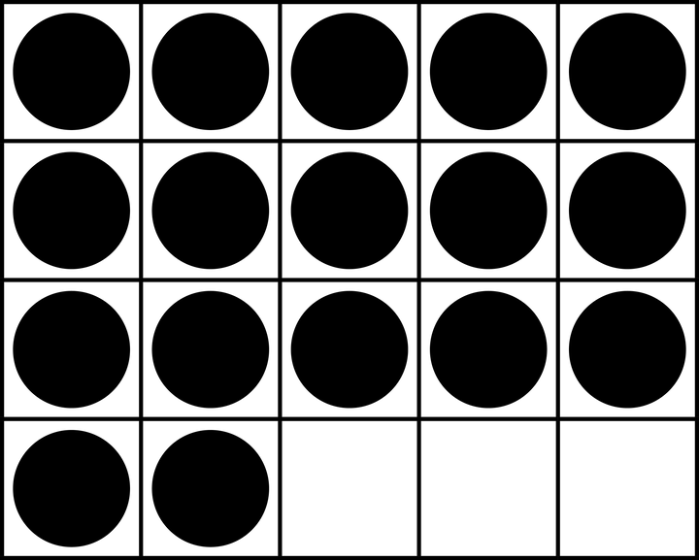
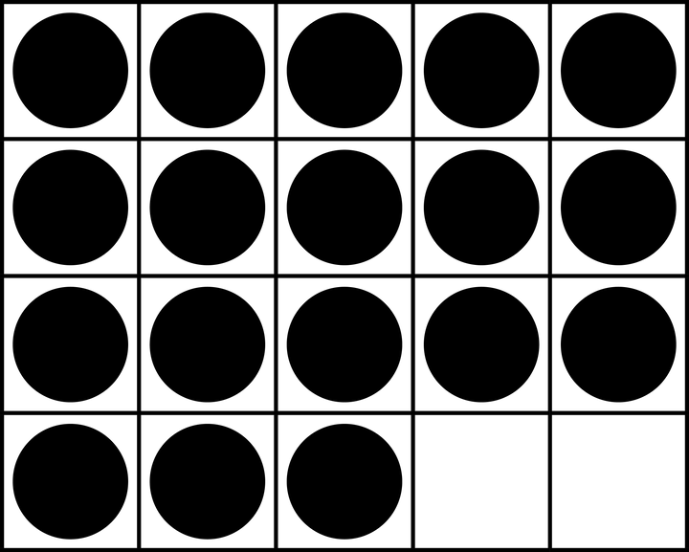
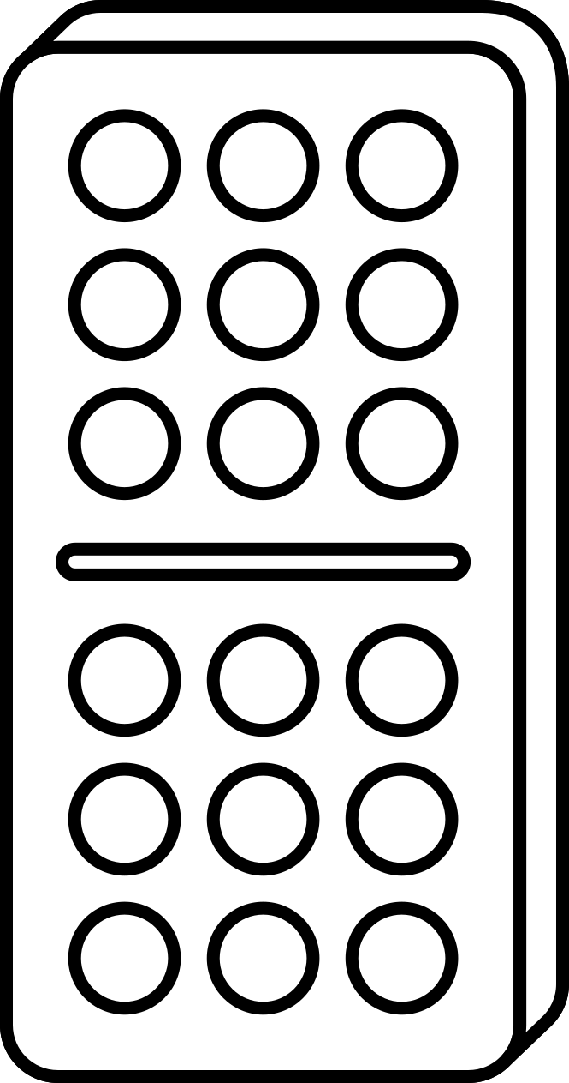
17
Seventeen
18
Eighteen

Slide 11


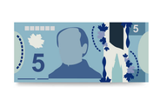
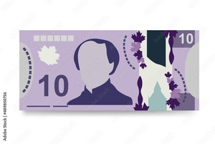

19
Nineteen
20
Twenty

