Slide 1





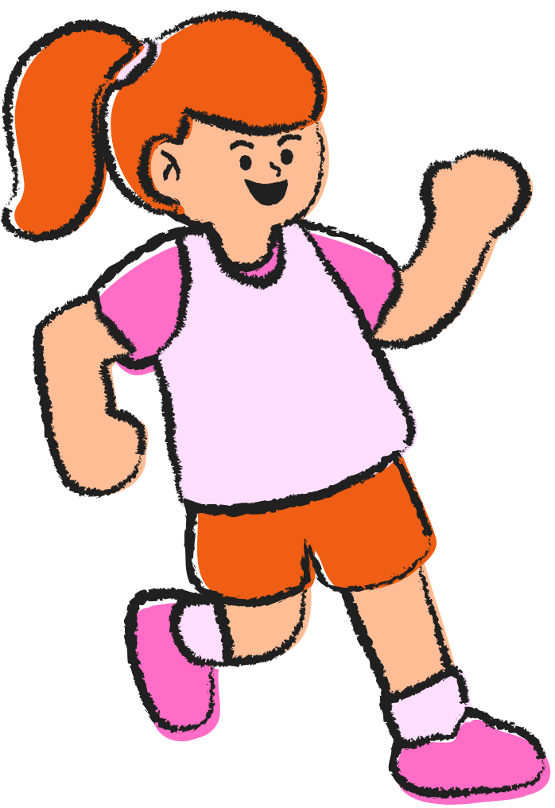



MATH GAMES
AND PUZZLES
from around the world

Slide 2
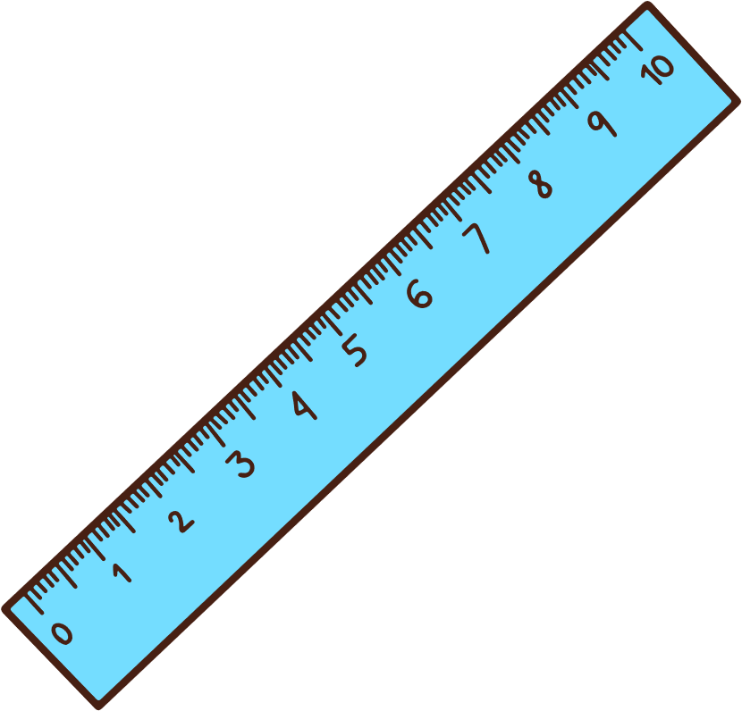


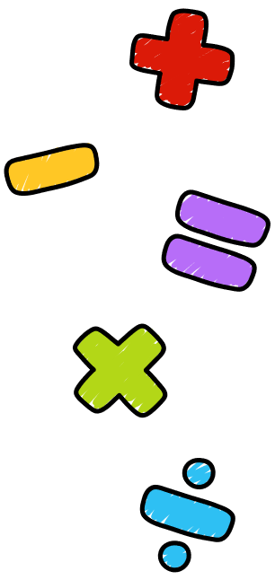
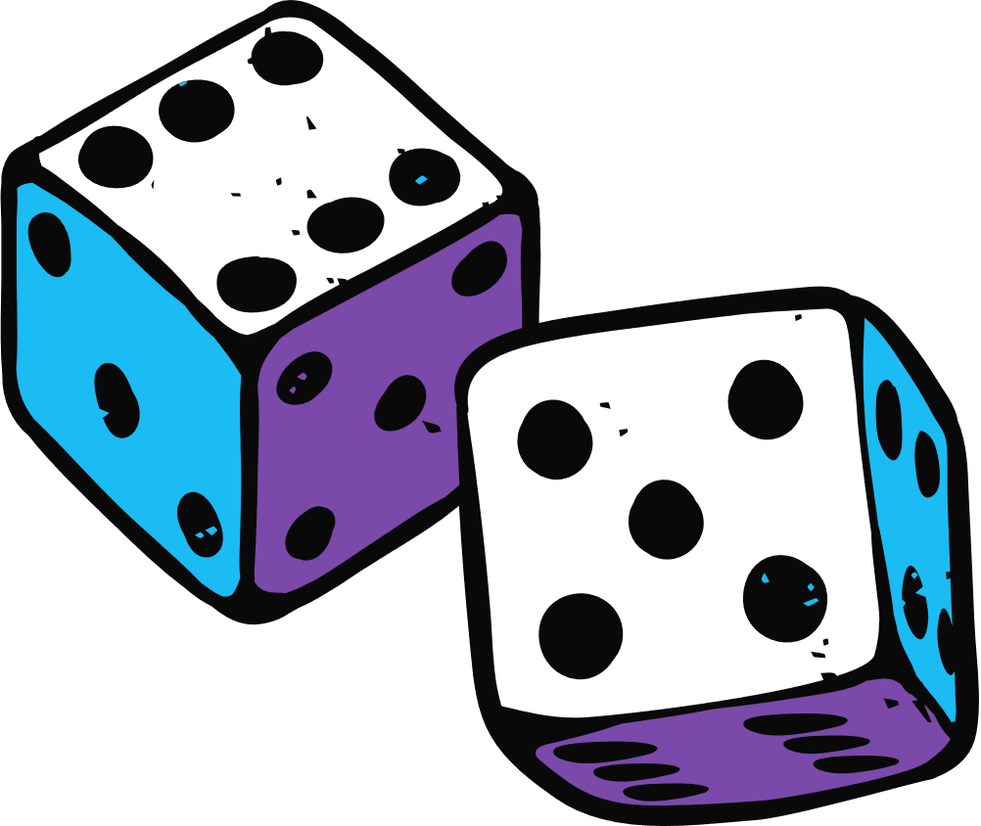
THE GAMES
These games include elements of number sense, logic, and patterning. The games can be played on a whiteboard, on a printed gameboard, or drawn by hand. Click on any blue title to learn more about each game.

Slide 3
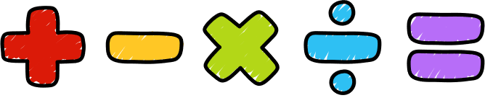
Patterning / Geometry Games
Counting Games
GAME TYPES
There are four main types of games in this resource
Logic / Strategy Games
Operations / Calculation Games

Slide 4

NUMBER
PATTERNS
KOLOWIS AWITHLAKNANNAI - THE FIGHTING SERPENTS GAME
STRATEGY
CALCULATIONS

Slide 5



Fighting Serpents Game
Click Title to Watch a Demo

Slide 6
Instructions for the Fighting Serpents Game
Set up the game board
Decide who goes first. 4 tokens per player are placed on outside row of points nearest each player. The remaining 2 tokens are placed on the middle row of points, starting with the point to the far right of each player. The middle point will be empty.
Make the first move!
The first player moves one token to an empty point. At the start of the game, only the middle point is empty.
Rules
Alternating turns, players move one token to an adjacent empty point according to the following conditions:
Tokens may move in any direction but may only move along the lines.
Players must jump any available token that can be jumped. This means the second player's first move must be a jump.
Jumped tokens are removed from play.
Multiple jumps with the same token are allowed in a single turn. You may also change direction after making the first jump in order to make the second jump.
If a player fails to make an available jump, their opponent gets to remove that token from play before their next move. If two different jumps were available, but not possible to complete with a single token, no forfeit is made.
Winning
The first player to remove all of their opponent's tokens from play is declared the winner.
Alternatively, if a player is able to prevent their opponent from making a legal move, they win.
Notes on playing:
If players reach an impasse in play, with no end in sight, they can decide to either 1) call it a draw; or 2) decide that the player with the most tokens remaining is the winner.

Slide 7
NUMBER
PATTERNS
ROMAN
TIC-TAC-TOE
STRATEGY
CALCULATIONS

Slide 8


Roman Tic-Tac-Toe
6 tokens, 3 of each colour

Slide 9
Roman Tic-Tac-Toe
Roman tic tac toe is a 2 player game but differs from the modern day game, because it uses a circular shaped playing board and movable tokens instead of being a pen and paper game. But the goal is the same: be the first player to get three in a row!
How to Play Rota
Learning how to play Roman tic tac toe is easy!
Objective: be the first player to get all three of your tokens in a row.
To draw a game board make a large circle. Draw an X through the center of the circle, then draw a cross (+) through the center. It should look like a wheel with eight spokes. At each point where a line intersects with the circle, draw a large dot, plus one dot in the very center. There should be nine dots in total.
Instructions
Decide who goes first. Flip a coin, thumb wrestle, play rock-paper-scissors. However you decide, just figure it out. Note that in a perfectly played game, the lead player has the advantage.
Drop phase:
Player A places his token on any point on the Rota wheel.
Player B places her token on any empty point.
Alternating turns, players continue place their tokens on the board until all tokens have been placed.
Move phase:
Players take turns moving one token into an adjacent empty spot. You may move along the curved edge, or along a straight line.
You may not jump your token or your opponent's token, or knock it off its spot. You may not skip a turn.
Play continues until one player has achieved three-in-a-row.
Unlike tic tac toe, Rota never ends in a tie.

Slide 10
NUMBER
PATTERNS
LAU KATA KATI
(FROM INDIA)
STRATEGY
CALCULATIONS

Slide 11
Lau Kata Kati
9 tokens x 2 colours

Slide 12
Lau kata kati
Lau kata kati is a two-player abstract strategy game from India, specifically from Lower Bengal, and also from United Provinces, Karwi Subdivision where it is called Kowwu Dunki. It was described by H.J.R. Murray in A History of Board-Games Other Than Chess (1952). The game is related to draughts and even more so to Alquerque.
Pieces are captured by leaping over them. The board is a pattern of two triangles joined together at a common vertex with further lines subdividing them. It is the same game as Butterfly (game) from Mozambique, which suggests a historical connection between the two games. Lau kata kati belongs to a specific category of games called Indian War-games, and the other games in this category are Dash-guti, Egara-guti, Pretwa, Gol-skuish.
All Indian War-games have one important thing in common, and that is that all the pieces are laid out on the patterned board, with only one vacant point in the center. This forces the first move to be played on the central point, and captured by the other player’s piece.
The winner is the person who captures the most pieces or who blocks their opponent from making a legal move.

Slide 13
NUMBER
PATTERNS
SHISIMA
(3 IN A ROW GAME)
FROM KENYA
STRATEGY
CALCULATIONS

Slide 14


Shisima 3 in a Row Game
3 x 2 colours counters

Slide 15
Shisima
Shisima is a two-player abstract strategy game from Kenya. It is related to tic-tac-toe, and even more so to three men's morris, Nine Holes, Achi, Tant Fant, and Dara, because pieces are moved on the board to create the 3-in-a-row. Unlike those other games, Shisima uses an octagonal board.
Shisima means "body of water" in a language spoken in Kenya. The pieces are called imbalavali which translates to "water bugs" as the pieces move quickly on the board as water bugs do on the surface of a lake.
Game Setup
The board consist of an octagon, and four diametrical lines connecting each corner of the octagon to its opposite corner. The four diametrical lines intersect at the middle of the octagon forming the central intersection point of the board. Each of the eight corners of the octagon is also an intersection point, therefore there is a total of 9 intersection points (here-in-forth called "points").
Each player has 3 pieces. One plays the black pieces, and the other plays the white pieces. Alternatively, any two colors or small objects differentiated in another way will suffice.
Each player places their 3 pieces on three successive vacant points along the octagon's perimeter. There must be a vacant point on both ends of each player's set of pieces. This leaves three vacant points at the beginning of the game including the central point of the board.
Rules
Players alternate their turns
A player may move one of their pieces to an adjacent vacant point on the board along a marked line in a turn.
The first player to make a "three-in-a-row" with one's pieces along a diametrical line wins the game.
Repeating a position three times is a draw (a tie game).

Slide 16
NUMBER
PATTERNS
KAOOA
STRATEGY GAME
FROM INDIA
STRATEGY
CALCULATIONS

Slide 17

Kaooa Strategy Game (AKA Vulture and Crows)
7 tokens of one colour (crows)
1 of another colour (vulture)

Slide 18
Kaooa (Vultures and Crows)
Kaooa is a two-player abstract strategy game first recorded in the central provinces of India. It is a hunt game like rimau, the fox games, and aadu puli attam. However, what makes kaooa unique is that the board is a five-pointed star or a pentagram. Kaooa is also known as vultures and crows. One vulture goes up against seven crows.
Goal
The goal of the crows is to block the movements of the vultures.
The goal of the vulture is to capture four crows which is enough to prevent the crows from ever blocking its movements.
Equipment
A five-pointed star or pentagram is used which makes for ten points or spaces on the board that pieces can be dropped and moved upon. There is one vulture piece, and seven crow pieces. The vulture and crows must be of different color or distinguishable objects.
Rules and game play
1. Players decide who will play the vulture, and who will play the crows.
2. The board is empty in the beginning. All pieces are set beside the board.
3. Players alternate their turns throughout the game.
4. Drop phase: Crows start first, and one crow is dropped anywhere on the board. Crows continue to drop one piece per turn on any vacant point until all seven crows have been dropped which requires seven turns. Afterwards, the crows can begin to move.
After the first crow is dropped, the vulture is dropped by the other player on any vacant point on the board. On the vulture's next turn, it can move and capture crows.
5. Move phase: After all seven crows have been dropped, the crows can move one space onto a vacant point per turn following the pattern on the board. Crows cannot capture.
Vultures can either move one space onto a vacant point per turn following the pattern on the board, or capture one crow per turn. A vulture can jump over an adjacent crow piece and land on a vacant point on the other side. The jump must follow the pattern of the board, and be in a straight line. Multiple captures are not allowed.

Slide 19
NUMBER
PATTERNS
QUEAH STRATEGY GAME FROM LIBERIA
STRATEGY
CALCULATIONS

Slide 20

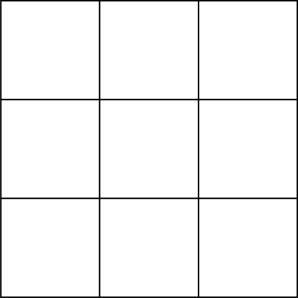
Queah Strategy Game
10 x 2 colours of tokens

Slide 21
To play Queah, a traditional board game from Liberia, follow these rules:
Objective: Capture all of your opponent's tokens.
Setup: Each player has 10 tokens, and the game is played on a slanted or diagonal square board with 13 spaces. (The squares are the spaces)
Movement: Tokens move orthogonally along the slanted board and can jump over an opponent's token to capture it.
Capturing Tokens: Only one token can be jumped per turn, and if a token is captured, it must be placed on the board for the next turn.
Resupply: Captured tokens can be resupplied from a reserve if the player has no more tokens to use.

Slide 22
NUMBER
PATTERNS
TSORO YEMATATU FROM ZIMBABWE
STRATEGY
CALCULATIONS

Slide 23
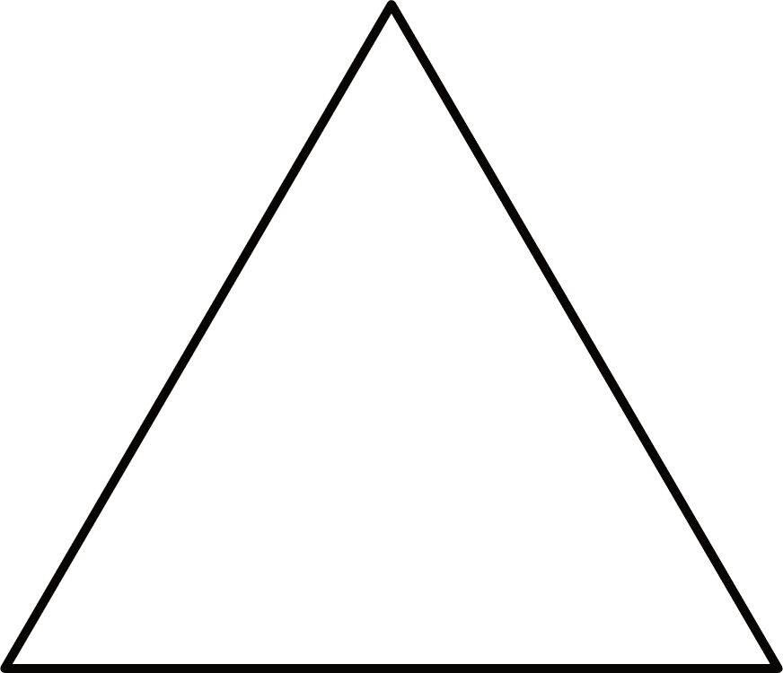
Tsoro Yematatu
3 x 2 colours of tokens

Slide 24
Tsoro Yematatu is a two-player abstract strategy game from Zimbabwe.
Here are the basic rules:
Objective: Be the first to form a row of three pieces in a straight line.
Setup: Each player has three pieces, and the board is an isosceles triangle with seven intersection points.
Gameplay:
Players take turns dropping their pieces on vacant points on the board.
After all pieces are dropped, players can move their pieces to adjacent points or jump over other pieces to reach vacant points.
There are no captures; pieces can only move or jump over each other.
Winning: The game can last a long time, and if no one can form a three-in-a-row, players can agree to a draw.

Slide 25
NUMBER
PATTERNS
Len Choa FROM Thailand
STRATEGY
CALCULATIONS

Slide 26
Len Choa (Tiger and Leopards)
Game Play:
Decide who will be the tiger and who will be the leopards.
The first player positions the tiger at the top of the triangle.
The second player places his first leopard at one of the dots the board, "the jungle“
The tiger then moves along the lines, one dot at a time.
Play alternates as the second player continues to place his leopards on the game board one at a time. He cannot move any of the leopards on the board until all six have been placed.
Once all leopards are on the board, play continues to alternate between players.
The tiger can jump over a leopard provided the dot on the opposite side of the leopard on the same line is free (as in checkers). The jumped leopard is removed from the board.
Play continues until either the tiger is trapped and can no longer move or jump, or there are too few leopards to trap the tiger.
7 tokens

Slide 27
NUMBER
PATTERNS
KNOCK-OUT DICE GAME
STRATEGY
CALCULATIONS

Slide 28
Knock Out is a fun and simple dice game where players aim to avoid rolling a specific "knock out" number to stay in the game.
Objective
The goal of the game is to be the last player remaining by avoiding the designated "knock out" number during your turn.
Setup
Players: The game can be played with 2 or more players.
Knock Out Number: Before starting, players agree on a "knock out" number, typically between 6 and 9. Each player can choose the same or different numbers.
Rounds: Decide how many rounds to play, usually between 5 and 10 rounds keeps the game engaging.
Gameplay
Taking Turns: Players take turns rolling two dice once per turn.
Scoring: After rolling, players add the numbers on both dice. If a player rolls their "knock out" number, they are knocked out of the game for that round.
Continuing the Game: The game continues until only one player remains, who is declared the winner of that round. Players can then start a new round if desired.
Winning
The last player remaining after all others have been knocked out wins the game.
Players can choose to play multiple rounds and keep track of wins to determine an overall champion if desired.
This game is not only easy to learn but also provides a fun way to engage with friends and family, making it a great choice for gatherings or casual game nights.
Enjoy rolling the dice!

Slide 29
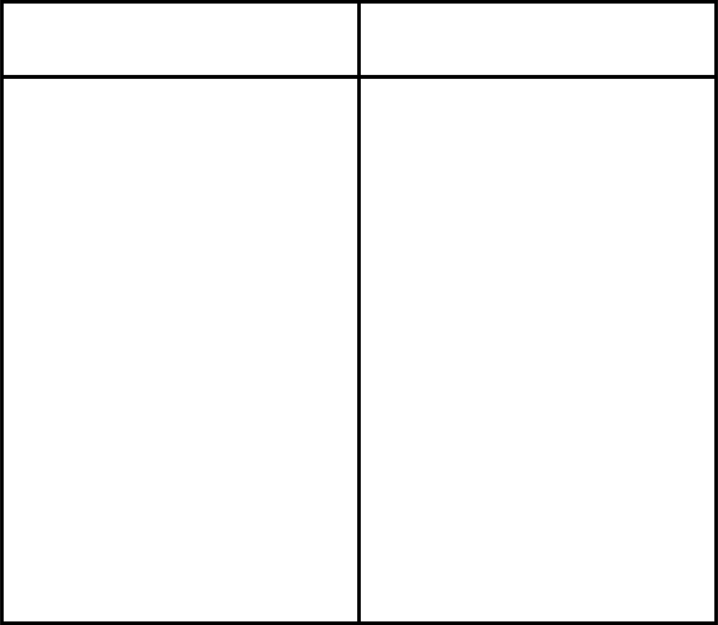
Player 1
Player 2

Slide 30
NUMBER
PATTERNS
FOX AND GEESE GAME
FROM SCANDINAVIA
STRATEGY
CALCULATIONS

Slide 31


Fox and Geese Game
One fox (token) and 13 geese (tokens)

Slide 32
To play Fox and Geese, follow these steps:
Setup: The game is played on a cross-shaped board. One player controls the Fox (1 piece), while the other player controls the Geese (13 pieces).
Place the Geese on the along the black points of the board.
Objective:
The Fox aims to capture all the Geese.
The Geese try to block the Fox so it cannot move.
Gameplay:
Players take turns moving their pieces. The Fox can move to any adjacent space, while the Geese can only move forward or sideways.
The Geese cannot capture the Fox but must work together to trap it.
Winning: The game ends when the Fox captures all the Geese or when the Geese successfully trap the Fox so it cannot move.
Enjoy your game!

Slide 33
NUMBER
PATTERNS
50 DICE GAME (DOUBLES)
STRATEGY
CALCULATIONS
Need: 2 dice per player

Slide 34
NUMBER
PATTERNS
MAGIC TRIANGLE PUZZLE
STRATEGY
CALCULATIONS

Slide 35
Magic Triangle (Addition)
1
2
3
4
5
6

Slide 36
NUMBER
PATTERNS
MAGIC SQUARE PUZZLE FROM CHINA
STRATEGY
CALCULATIONS

Slide 37
Magic Square
(Addition to 15)
1
2
7
3
8
4
9
5
6
Solution on next page

Slide 38
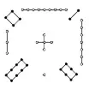
Luoshu (Magic Square)

Slide 39
MORE TO COME...
Stay tuned!

