Slide 1
K-2 Estimation Tasks
Inspired by Andrew Stadel
Constructed by…
@4ryandent
@kristianquiocho
@JSchwartz10a
@jamiedunc3

Slide 2
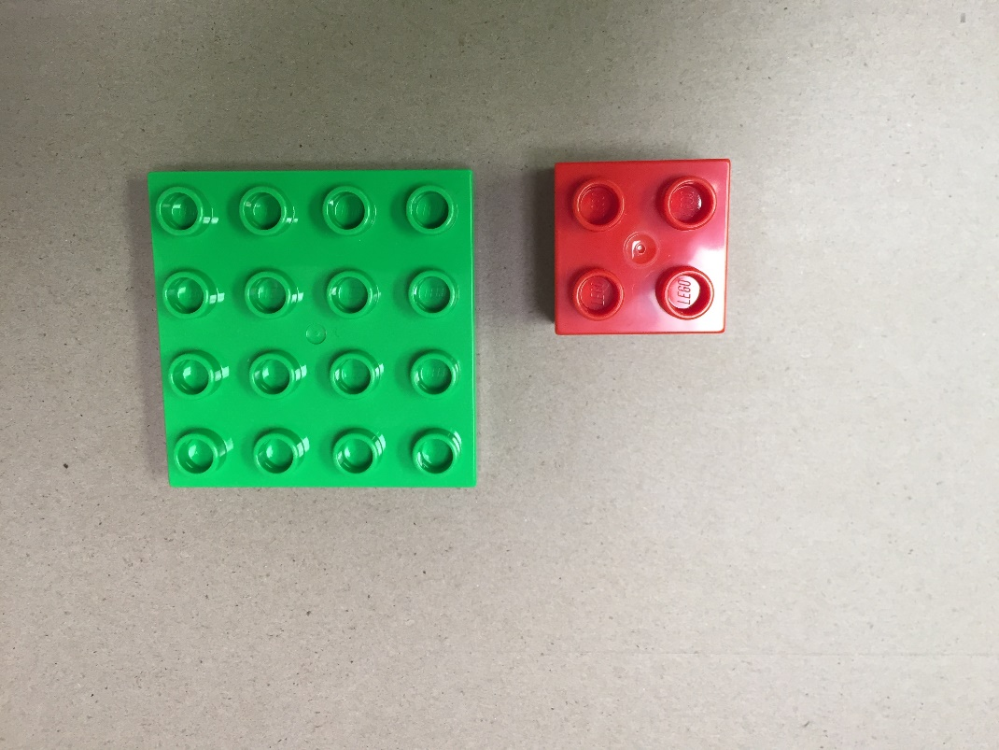
How many red blocks will it take to cover the green block?
Video Answer

Slide 3
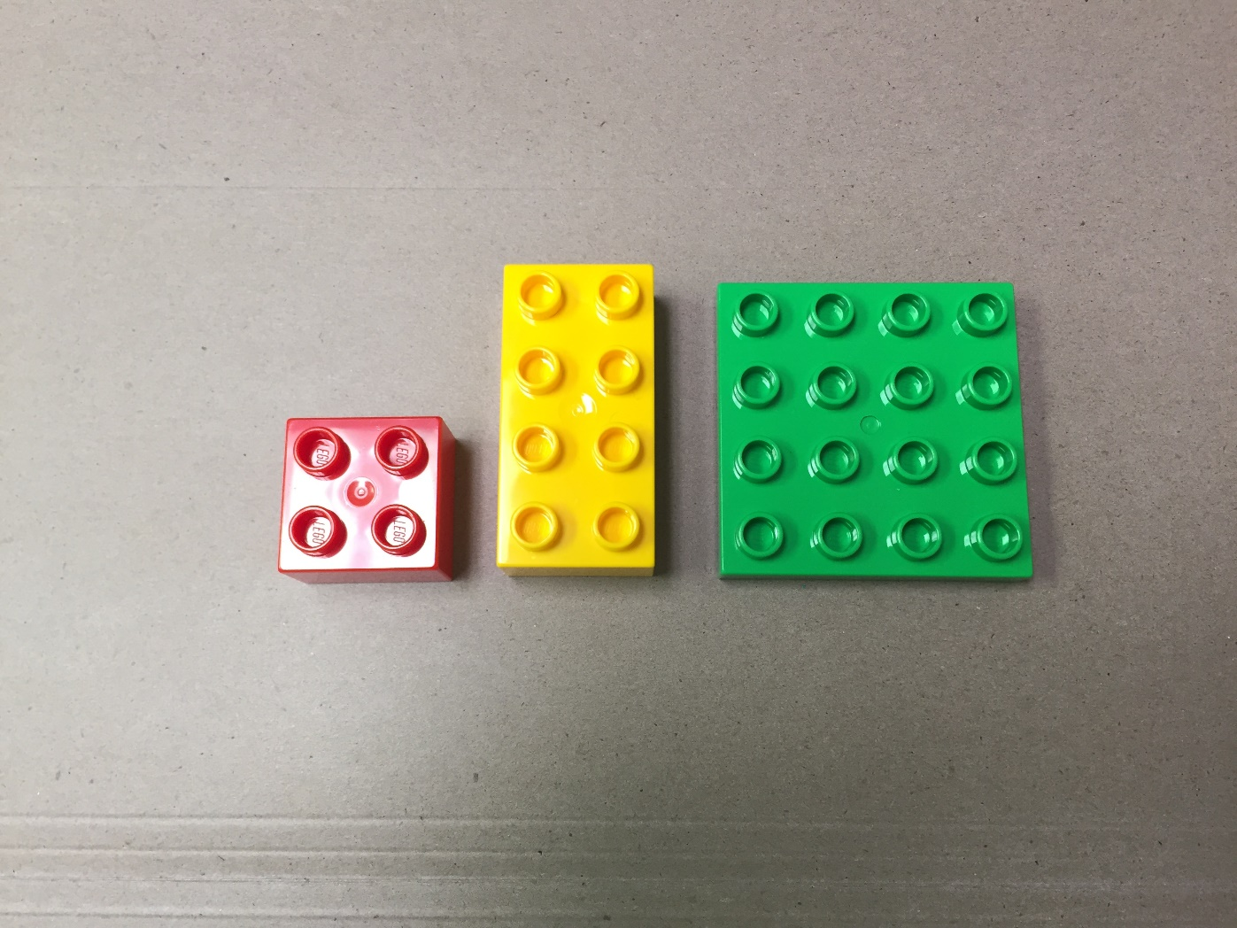
How many yellow blocks will it take to cover the green block?
Video Answer

Slide 4
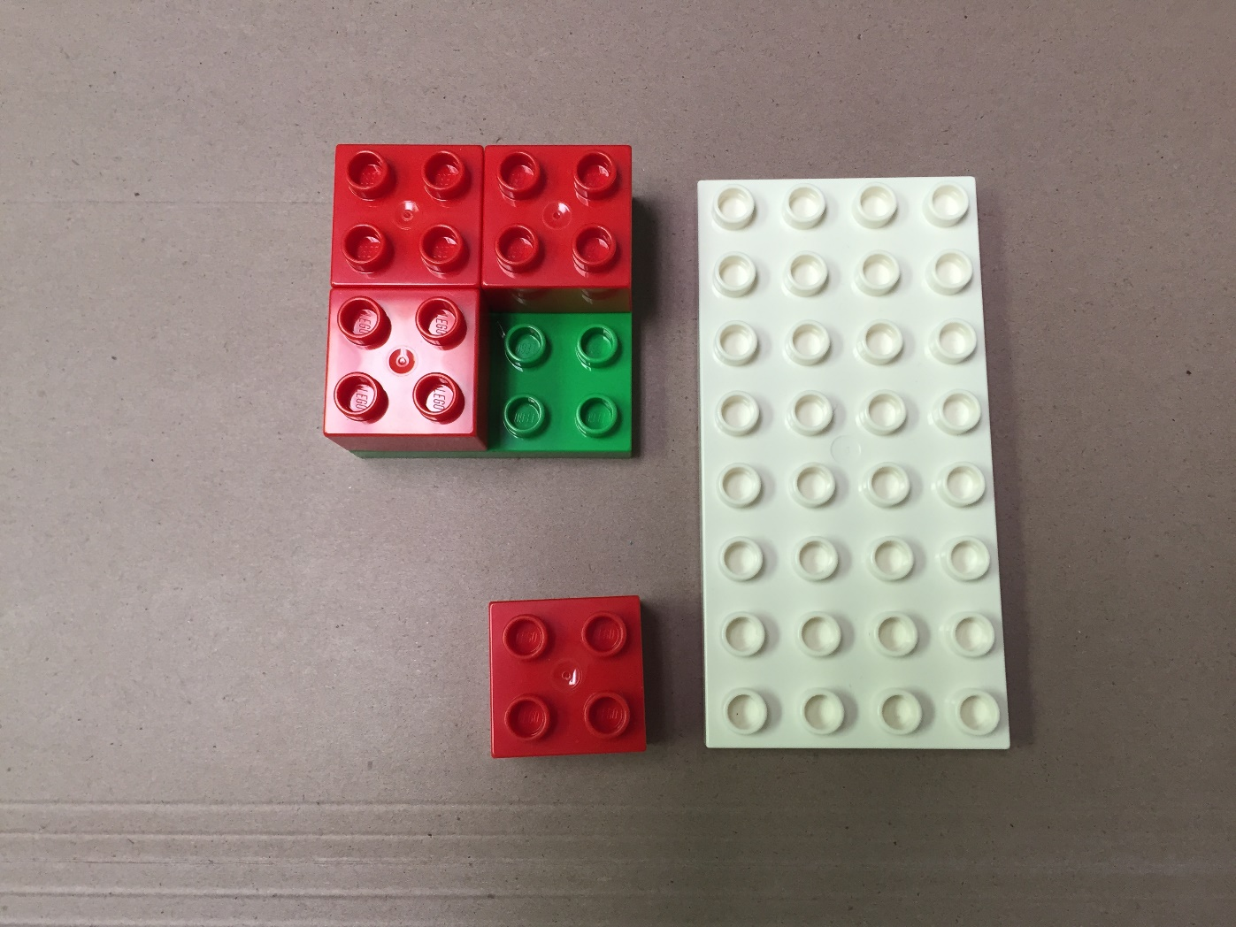
How many red blocks will it take to cover the white block?
Video Answer

Slide 5
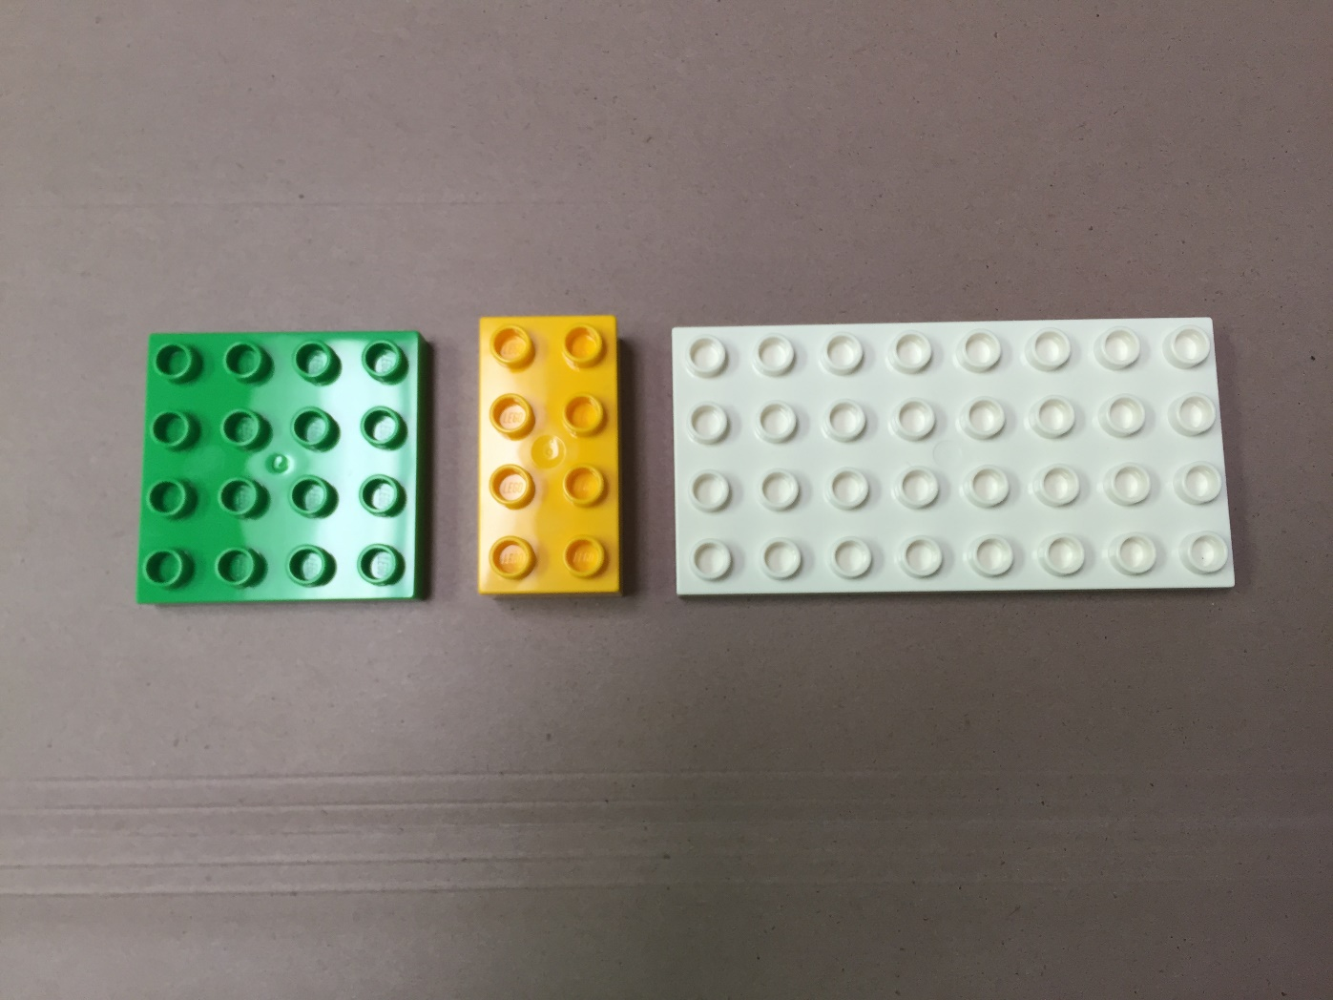
How many of the yellow blocks will it take to cover the white block?
Video Answer

Slide 6
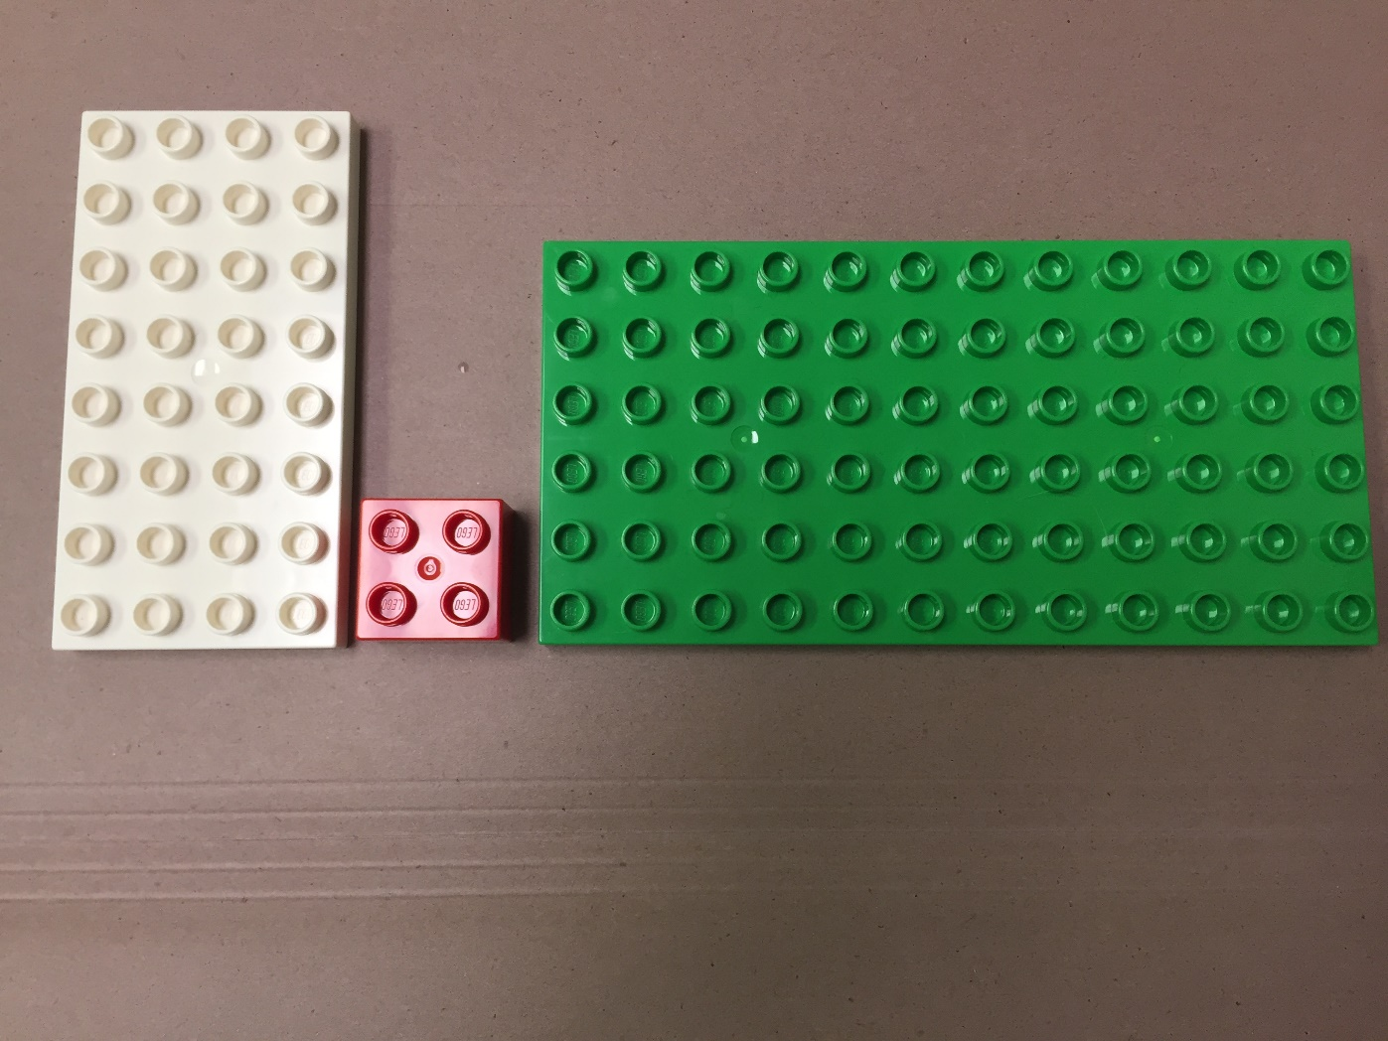
How many red blocks will it take to cover the green block?
Video Answer

Slide 7
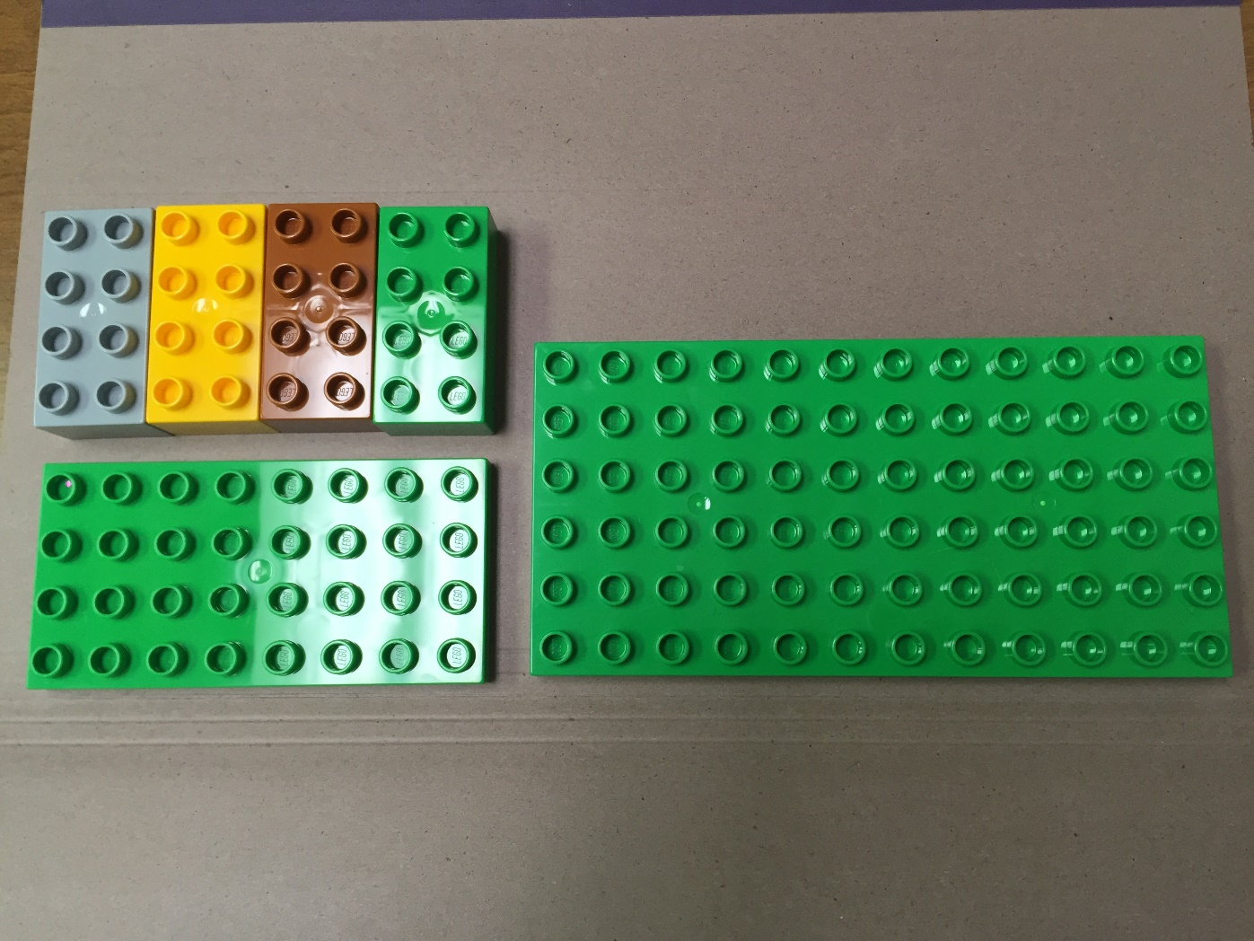
How many of the smallest blocks will it take to cover the biggest block?
Video Answer

Slide 8
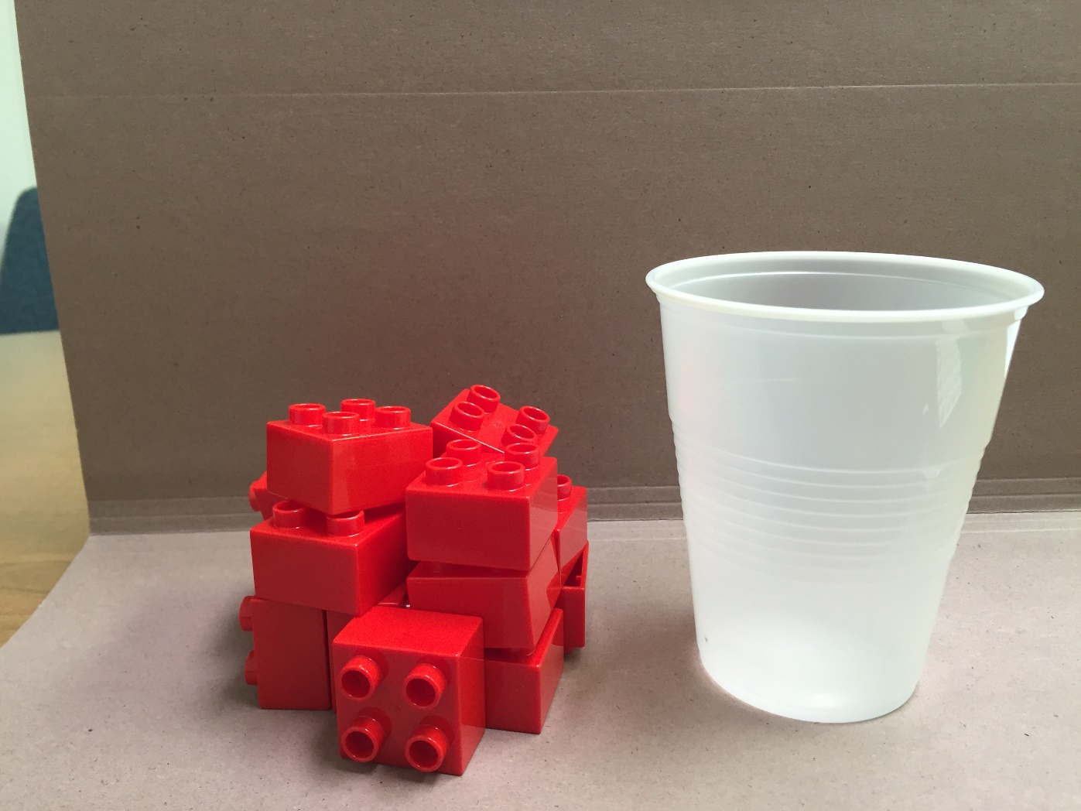
How many red blocks will it take to fill the cup?
Video Answer

Slide 9
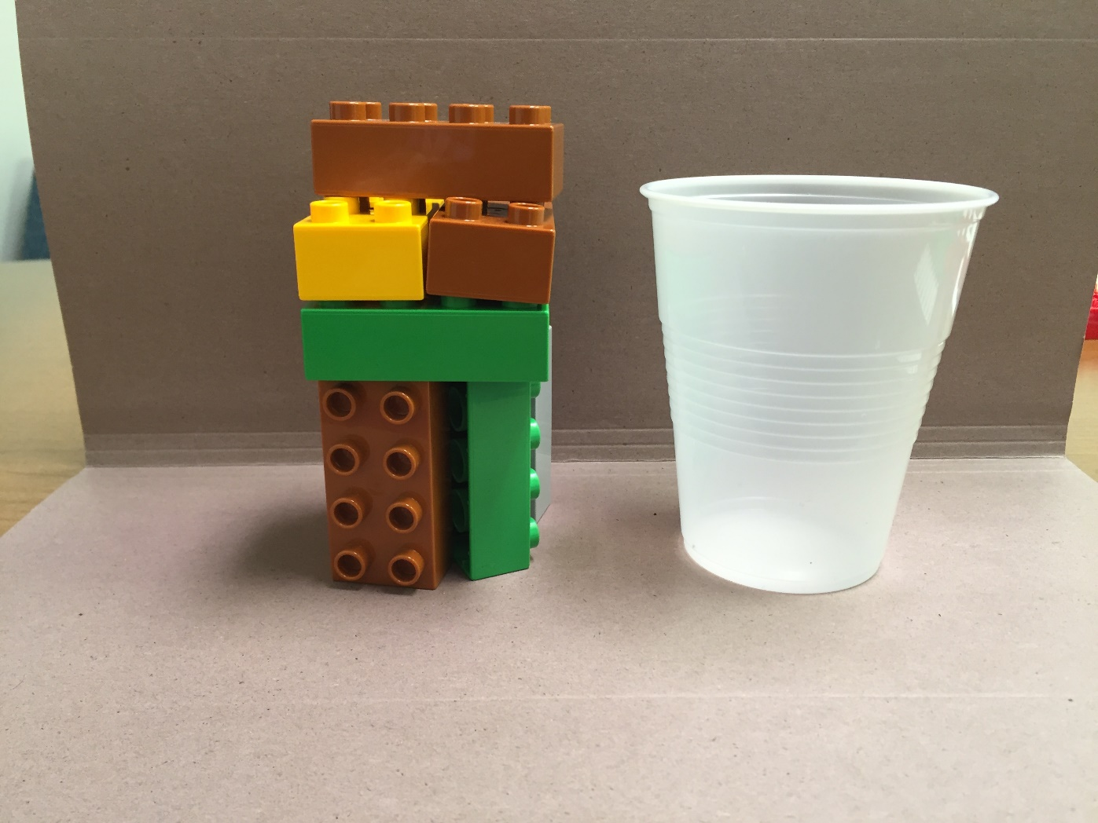
How many blocks will it take to fill the cup?
Video Answer

Slide 10
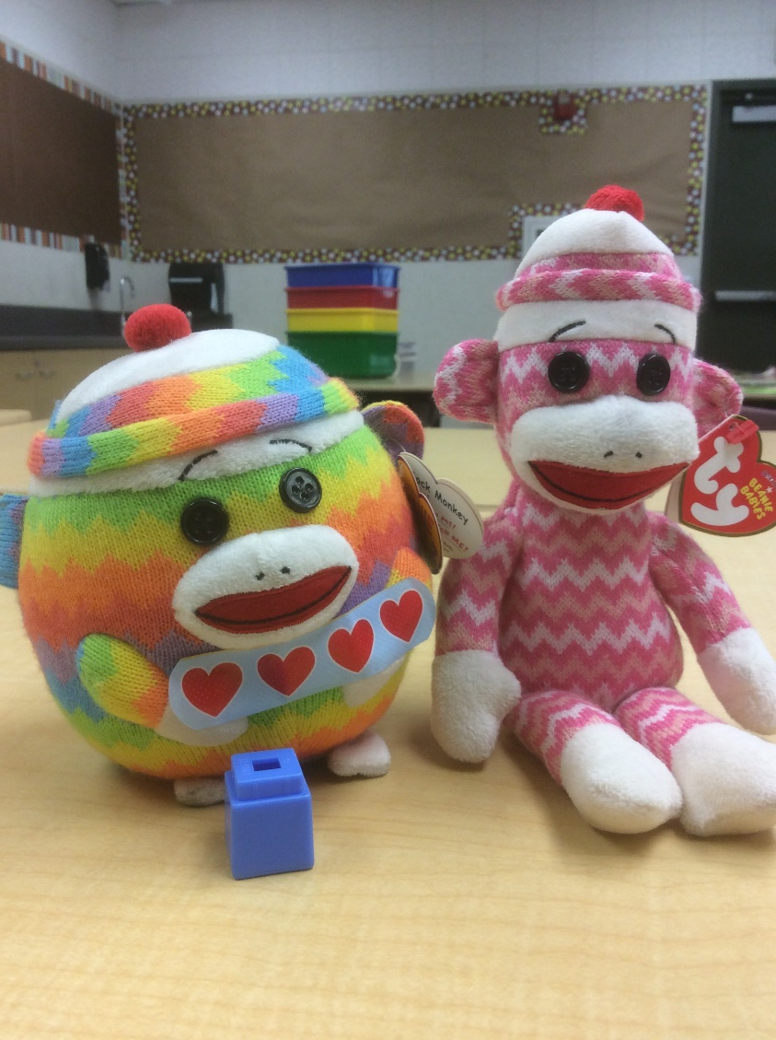
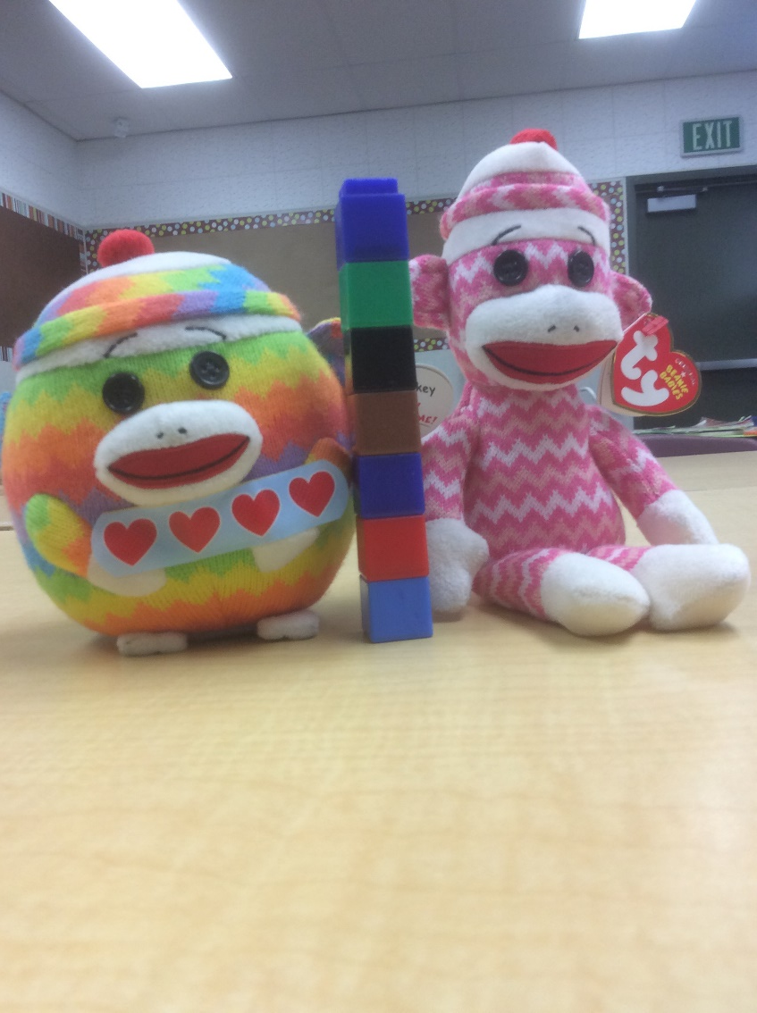
How many cubes high is the pink monkey?

Slide 11
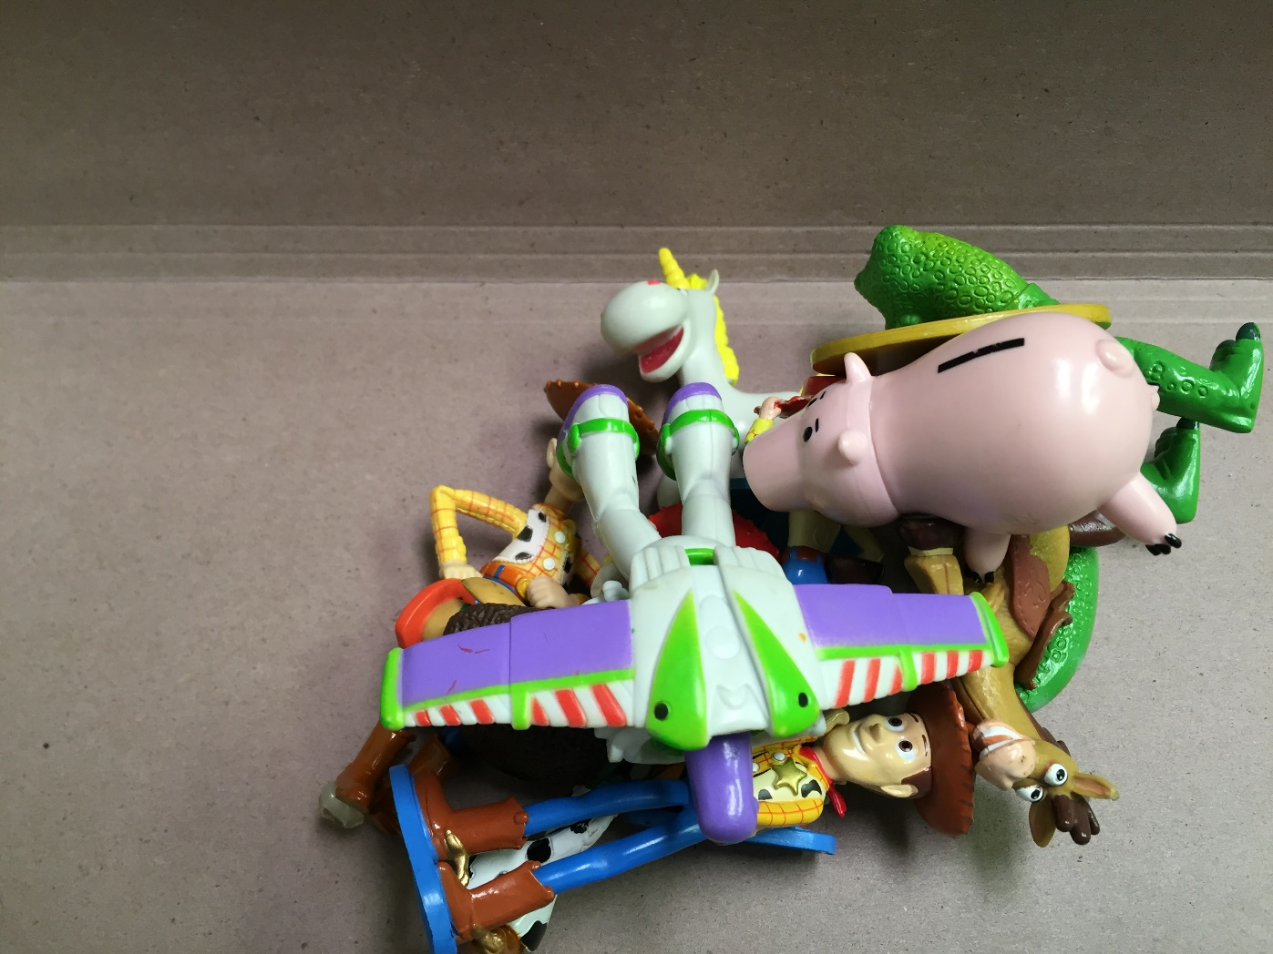
How many Toy Story figures are there?
Video Answer

Slide 12
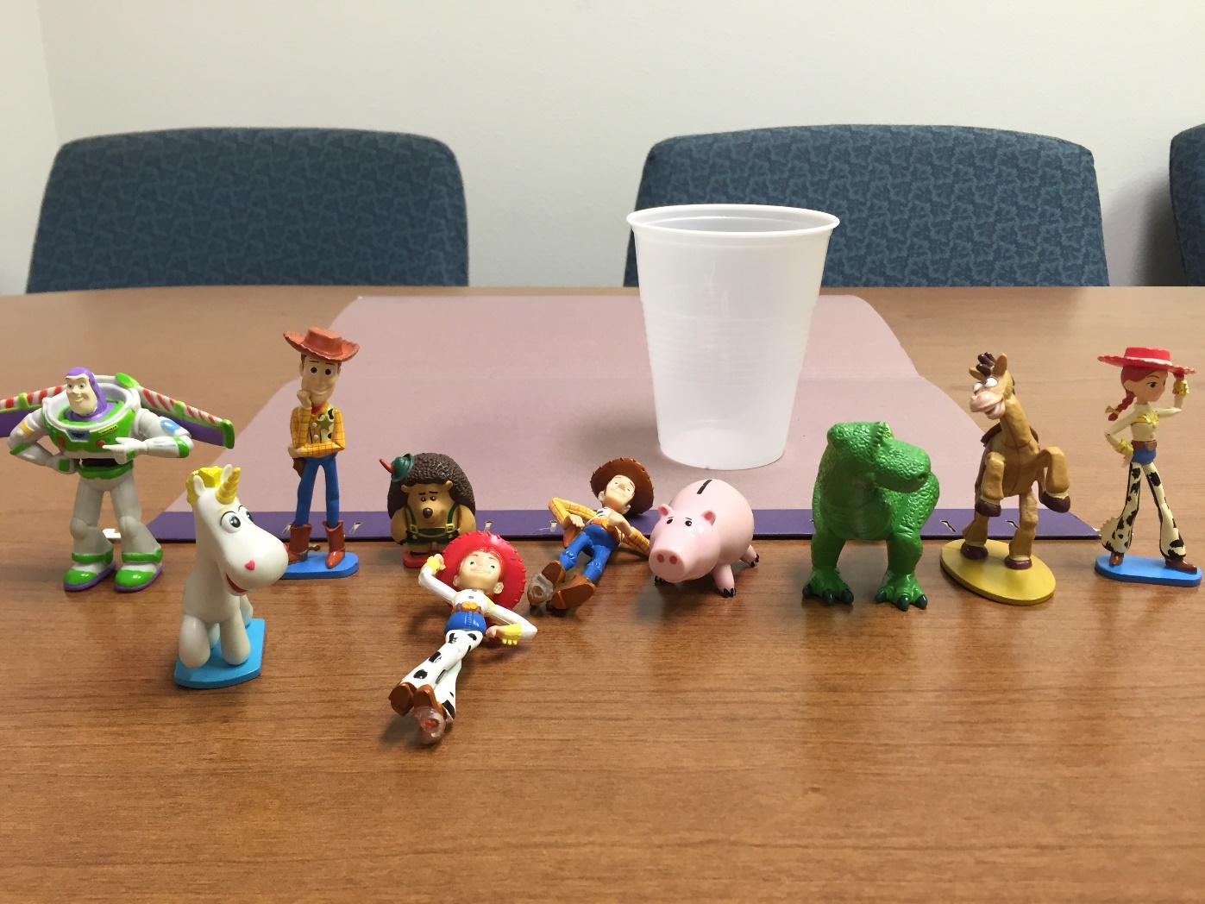
How many Toy Story figures can fit in the cup?
Video Answer

Slide 13
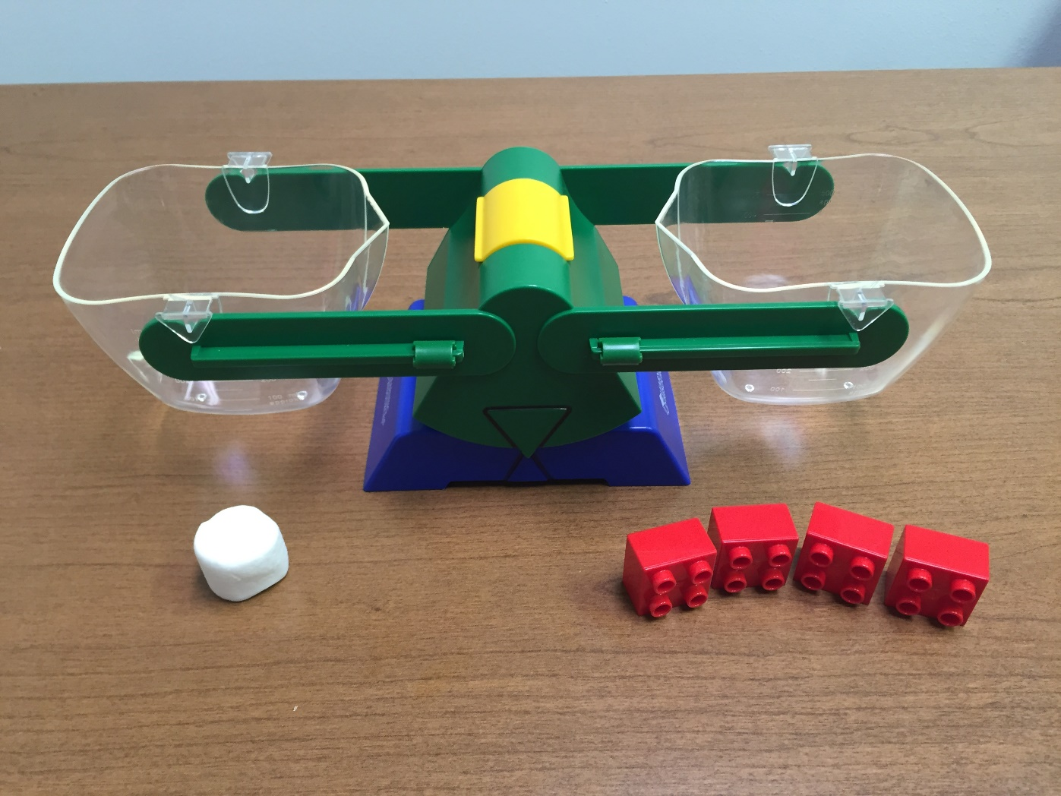
How many marshmallows will balance with 4 red blocks?
Video Answer

Slide 14
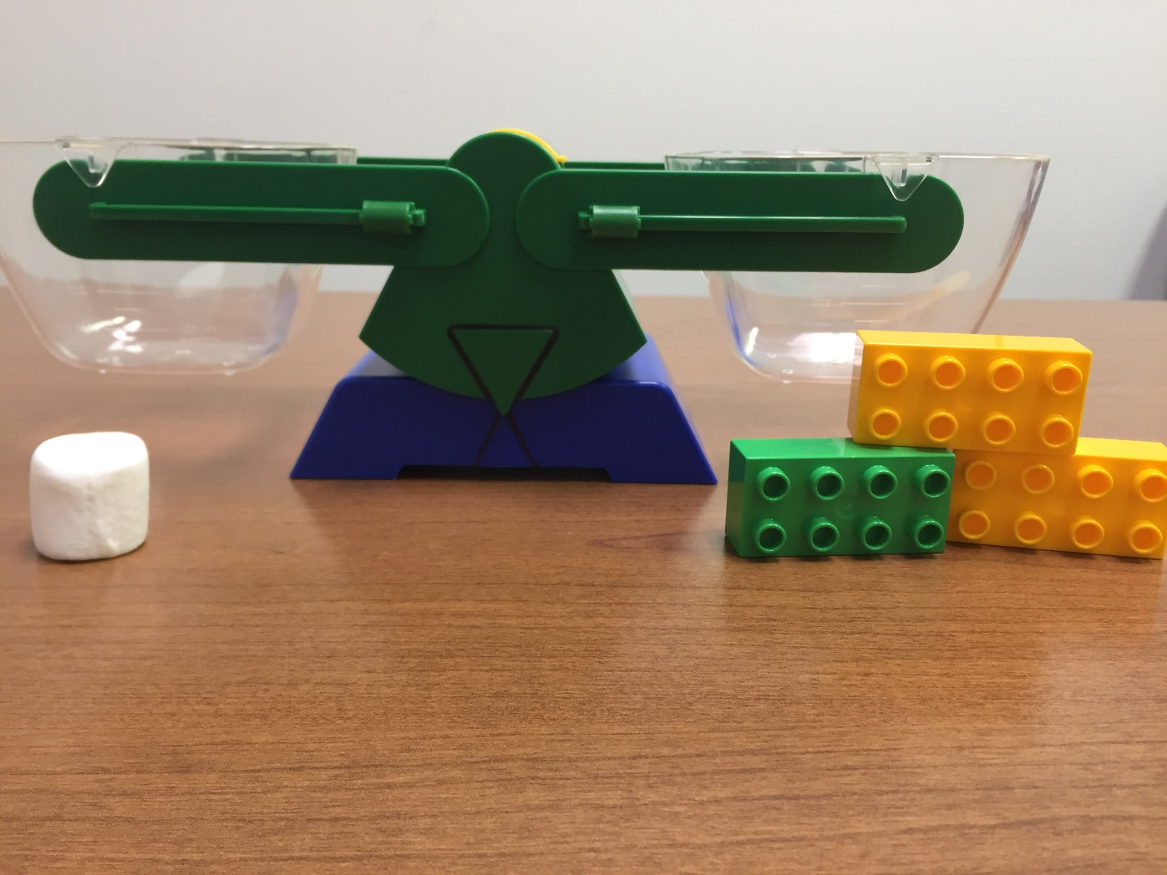
How many marshmallows will balance with these 3 blocks?
Video Answer

Slide 15
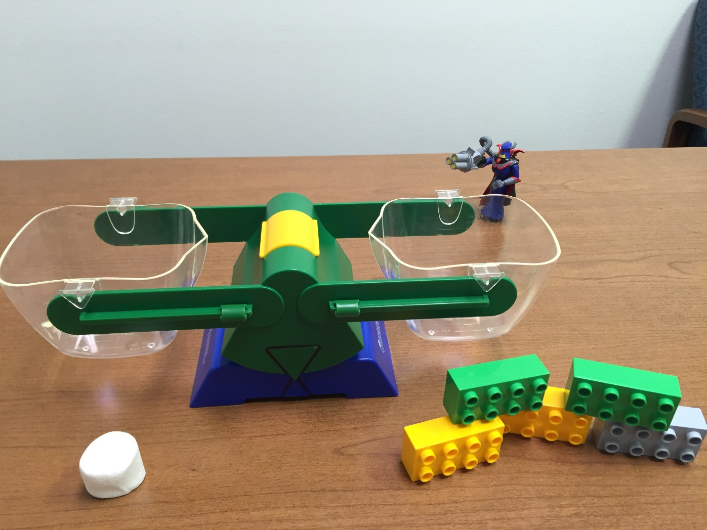
How many marshmallows will balance with these 5 blocks?
Video Answer

Slide 16
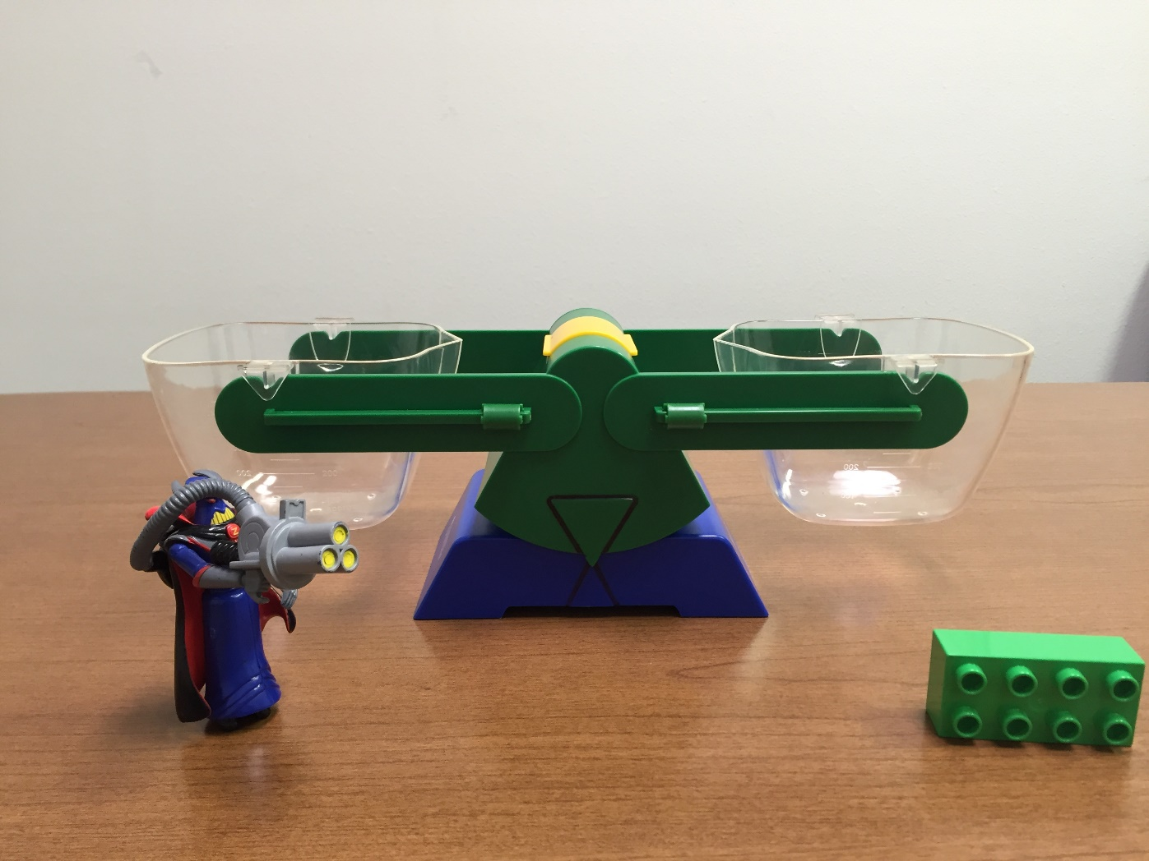
How many blocks will balance with Zurg?
Video Answer

Slide 17
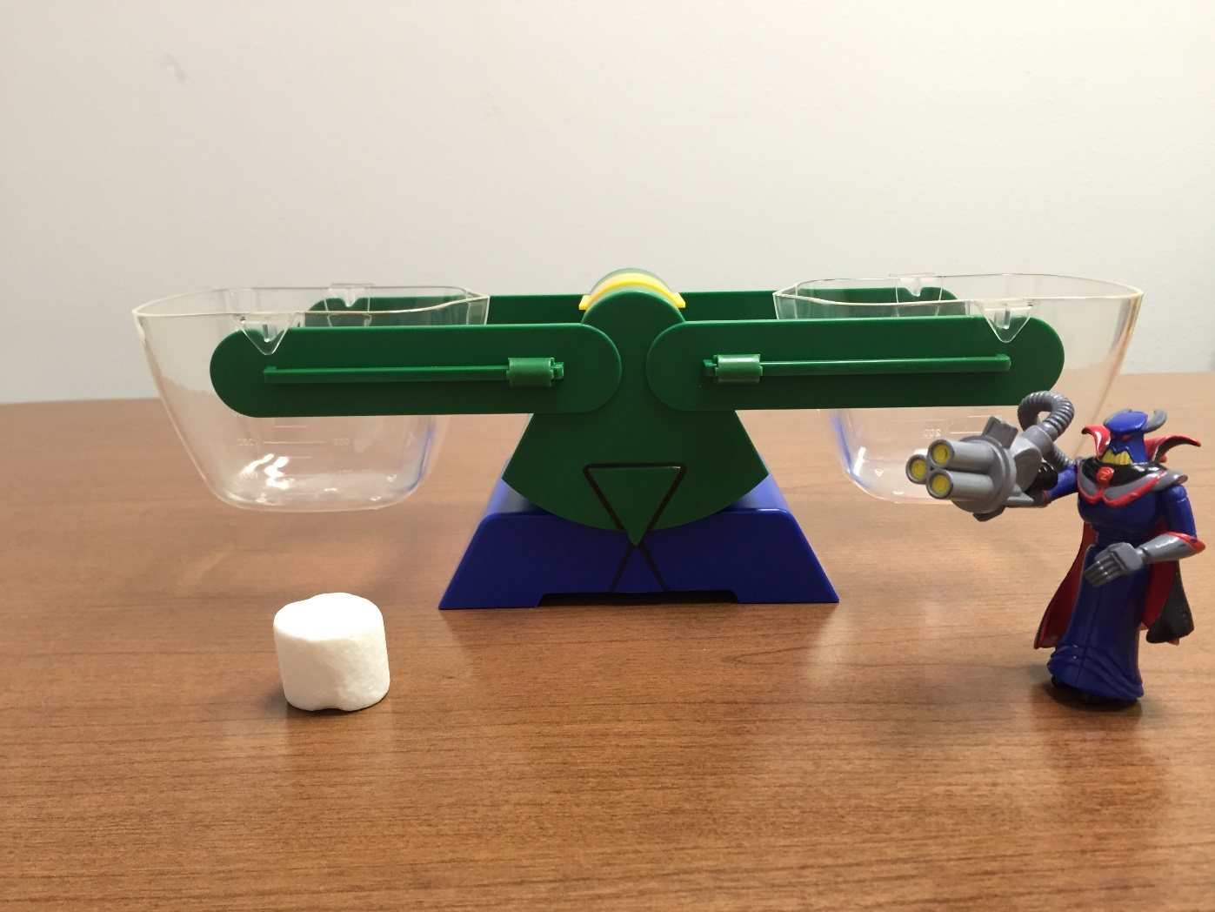
How many marshmallows will balance with Zurg?
Video Answer

Slide 18
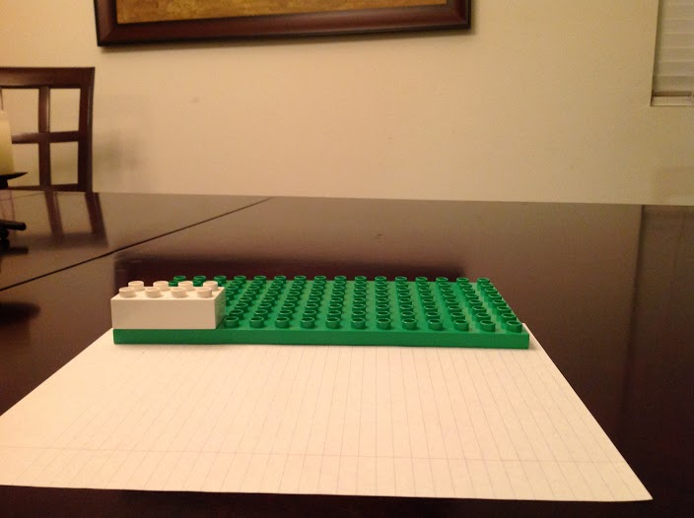
How blocks long is the green flat piece?
Video Answer

Slide 19
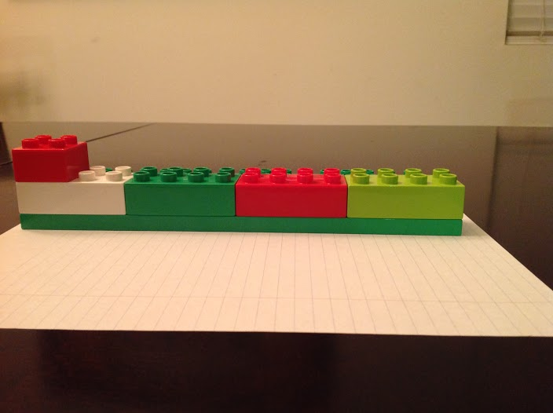
How square blocks long is the green flat piece?
Video Answer

Slide 20
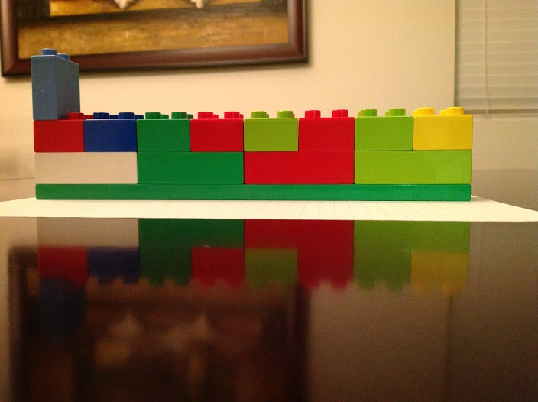
How of these blocks long is the green flat piece?
Video Answer

Slide 21
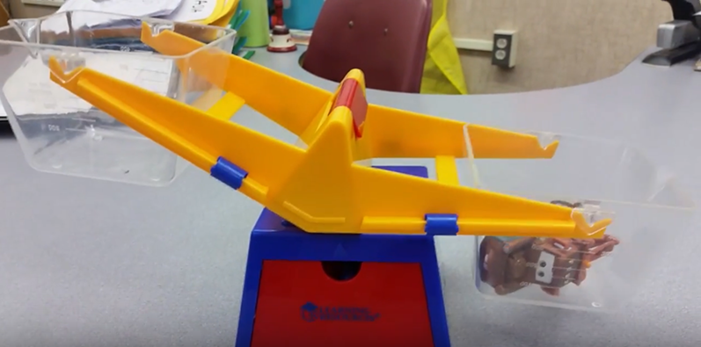
Mater and the Bears
Click here to launch the task
Video Answer

Slide 22
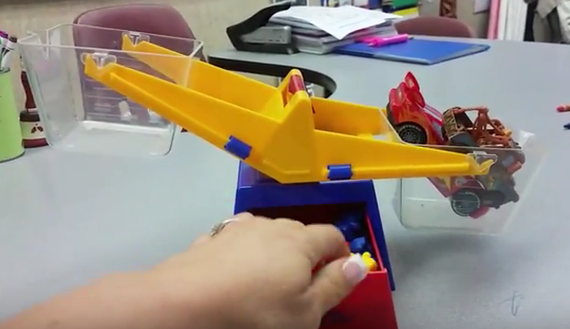
Mater, McQueen and the Bears
Click here to launch the task
Video Answer

Slide 23
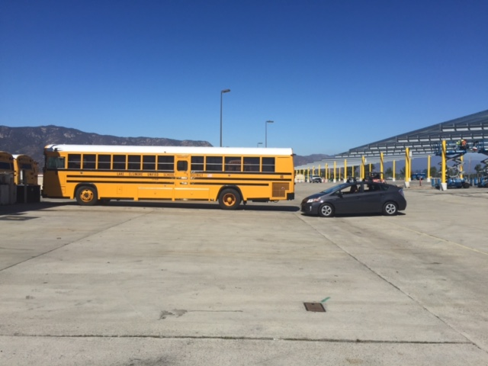
How many of these cars will fit in the length of the bus?
Video Answer

Slide 24
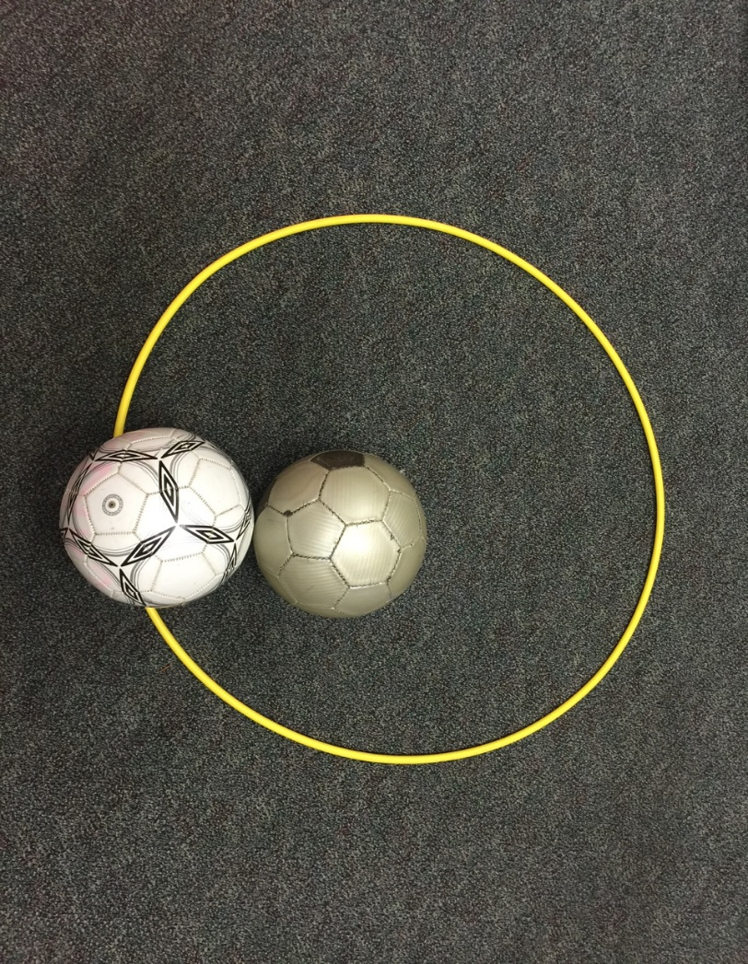
How many soccer balls fit inside the hula hoop?
Video Answer

Slide 25
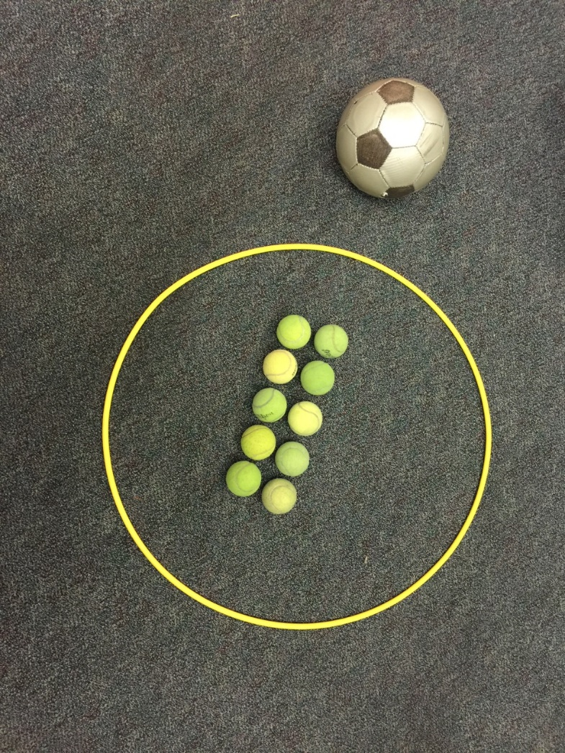
How many tennis balls will fit inside the hula hoop?
Video Answer

Slide 26
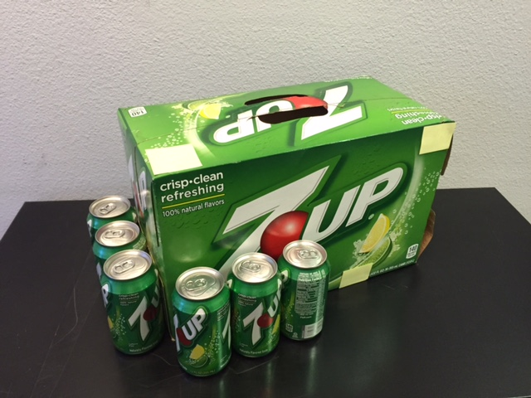
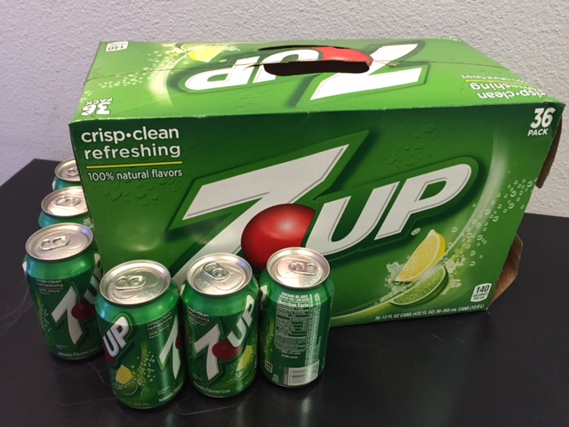
How many 7-Up cans can fit in the box?

Slide 27
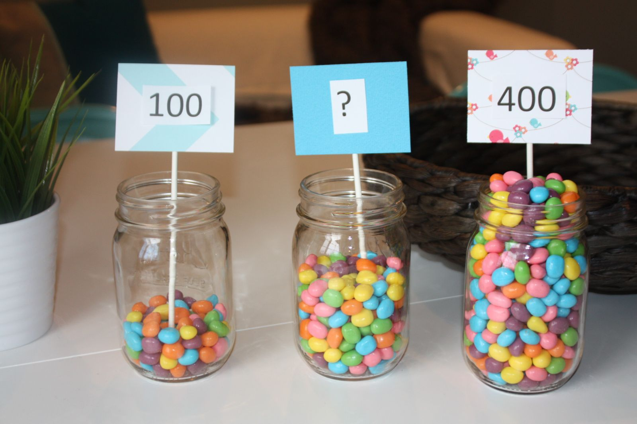
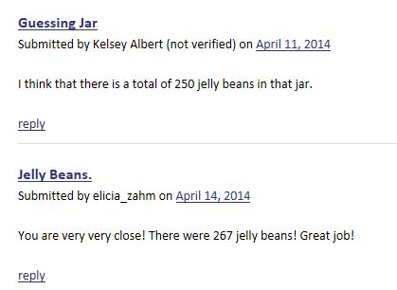
How many jelly beans in the middle jar?

Slide 28
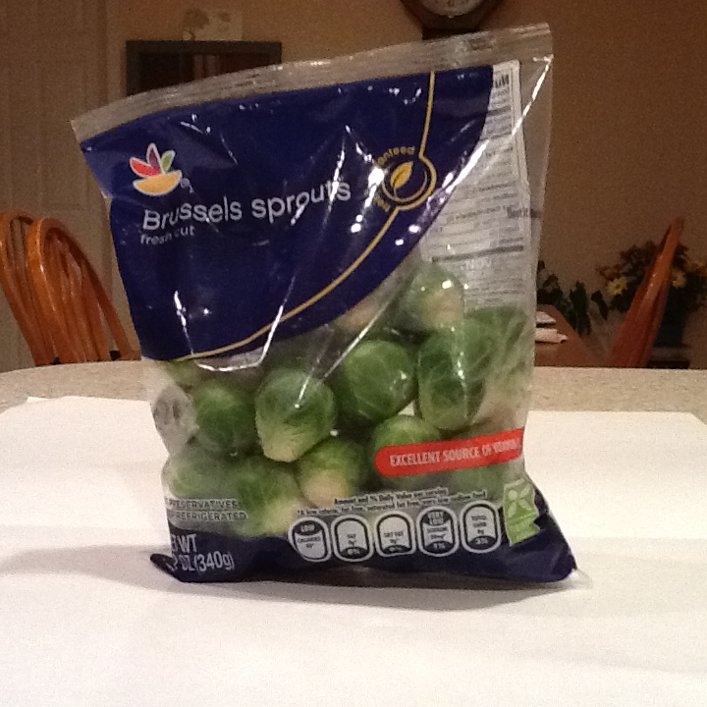
How many Brussels sprouts are in the bag?
Video Answer

Slide 29
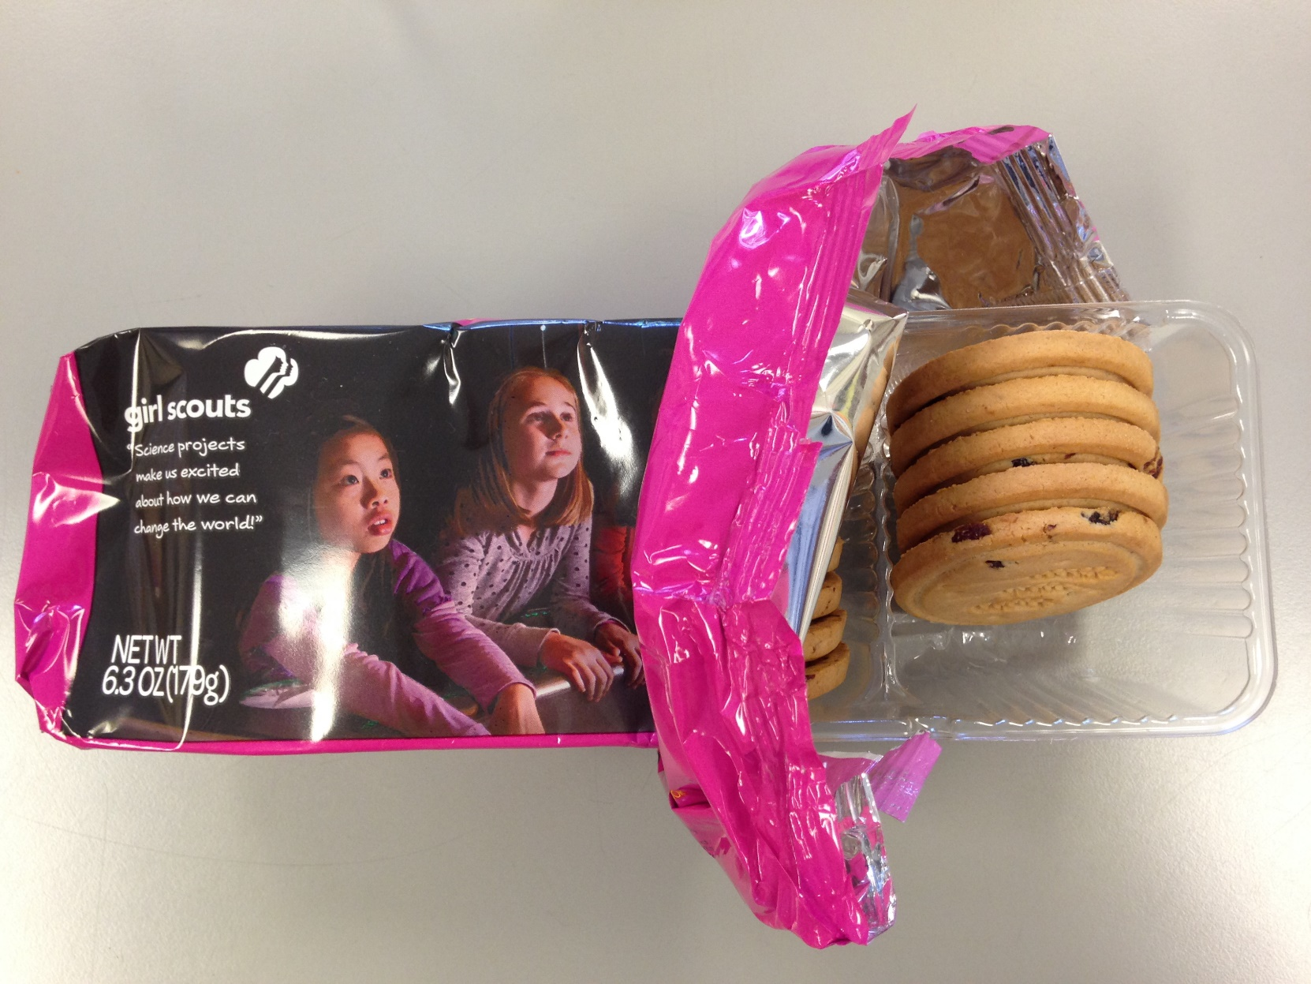
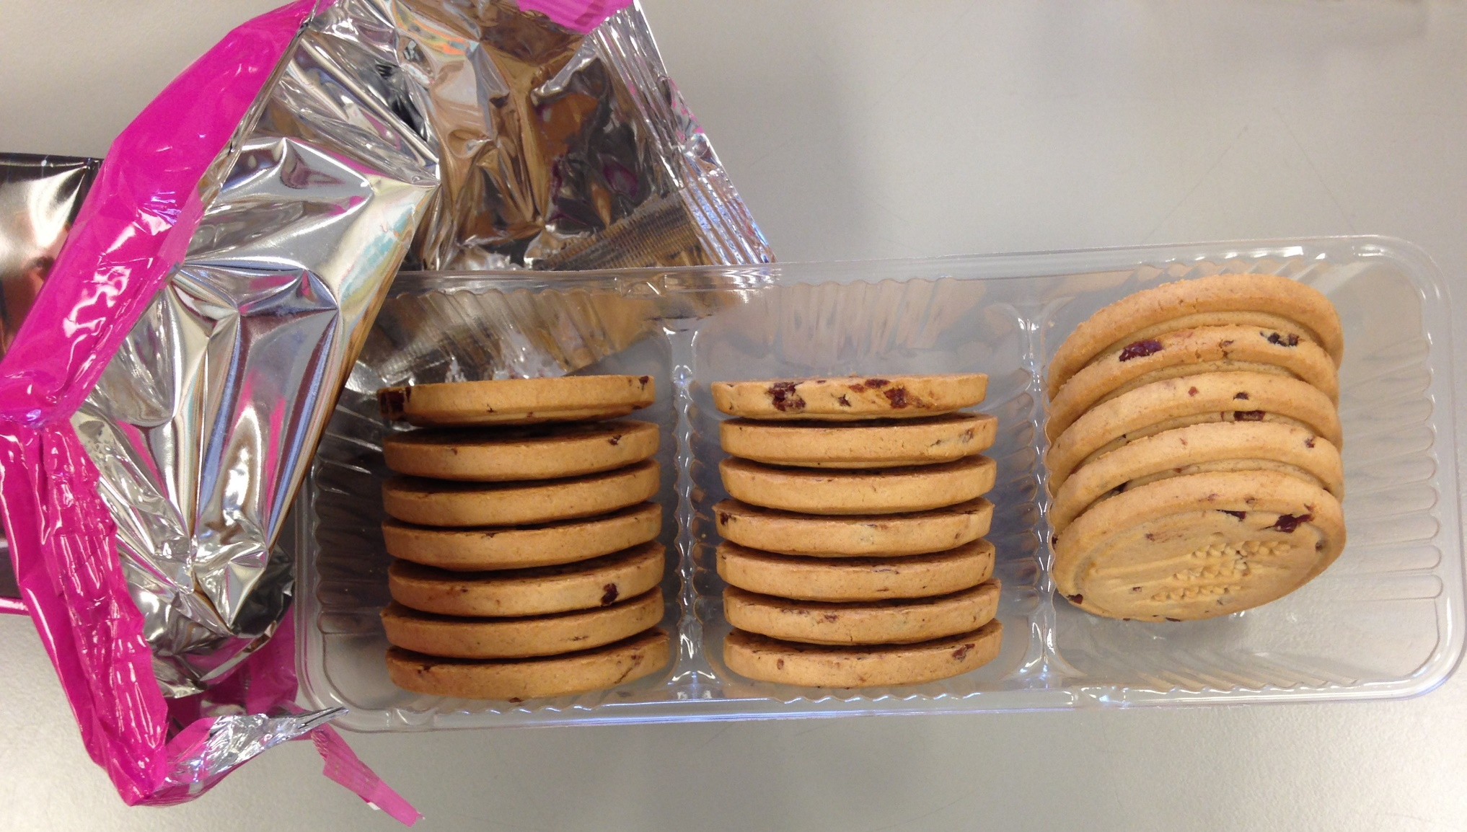
How many cookies are in the package?

Slide 30
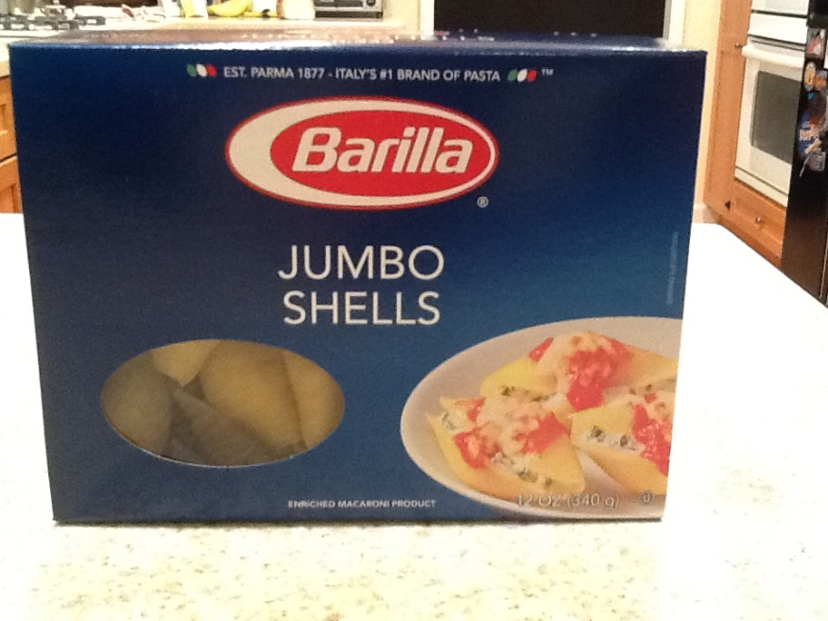
How many jumbo shells are in the box?
Video Answer

Slide 31
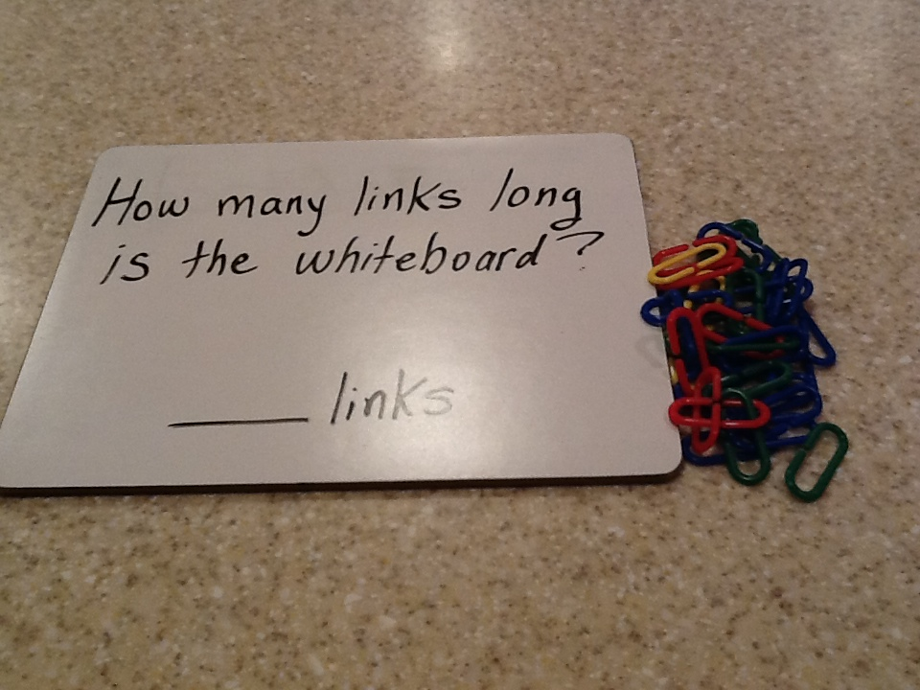
How many links long is the whiteboard?
Video Answer

Slide 32
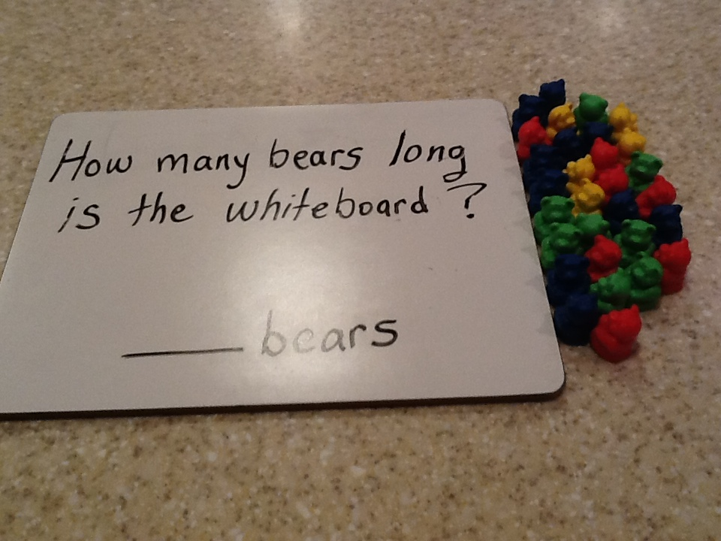
How many bears long is the whiteboard?
Video Answer

Slide 33
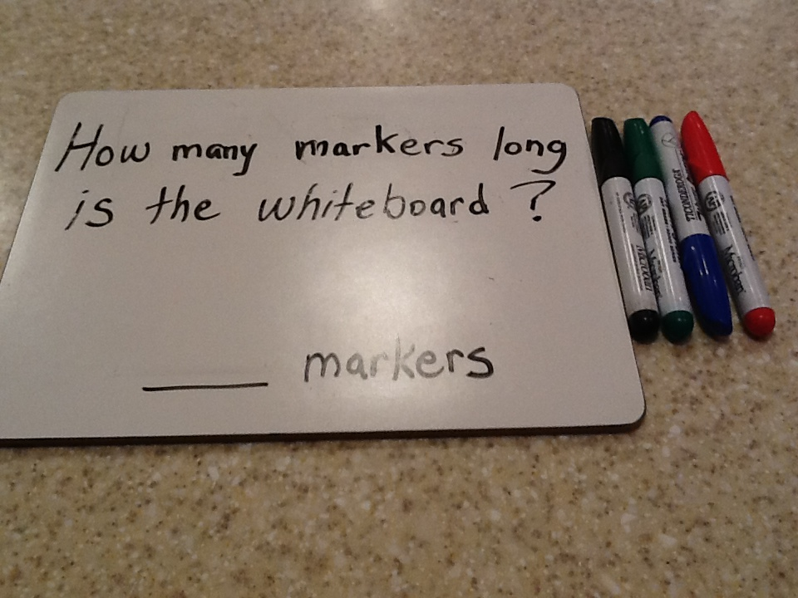
How many markers long is the whiteboard?
Video Answer

Slide 34
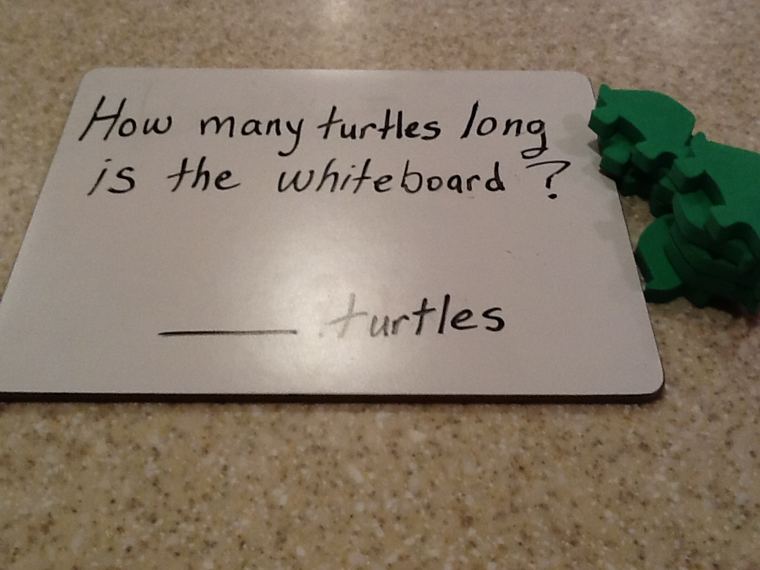
How many markers long is the whiteboard?
Video Answer

Slide 35
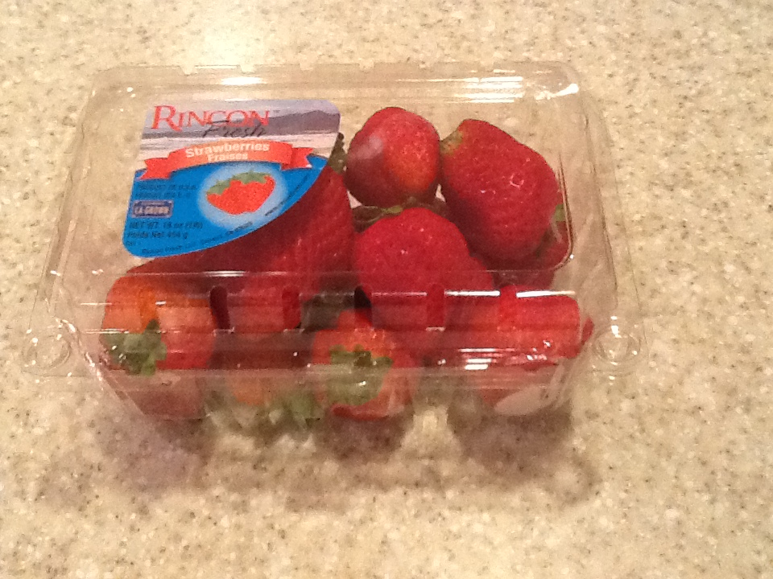
How many strawberries are in the package?
Video Answer

Slide 36
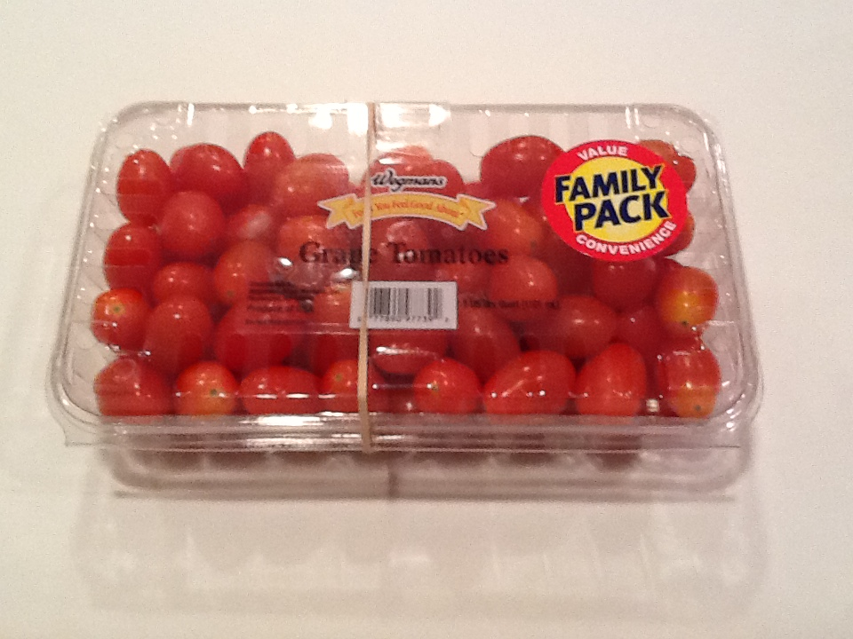
How many tomatoes are in the package?
Video Answer

Slide 37
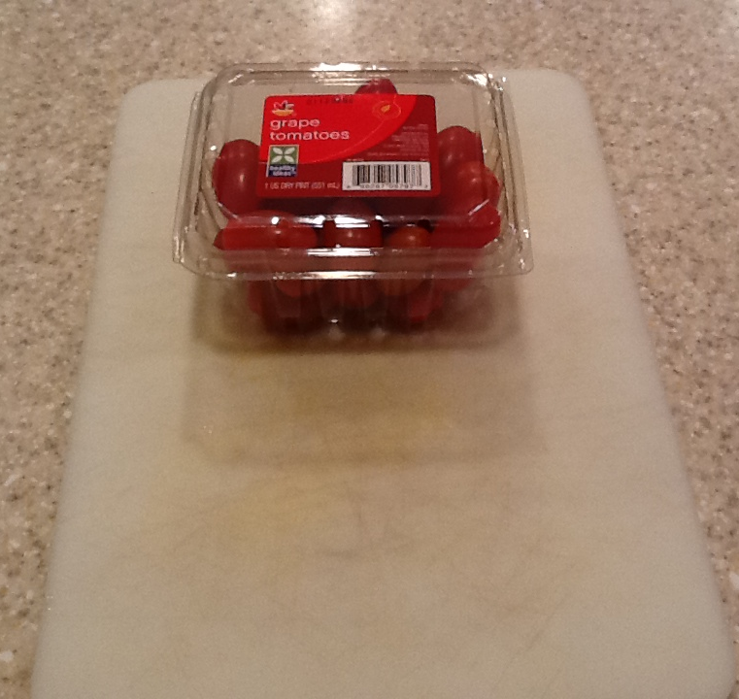
How many tomatoes are in the package?
Video Answer

Slide 38
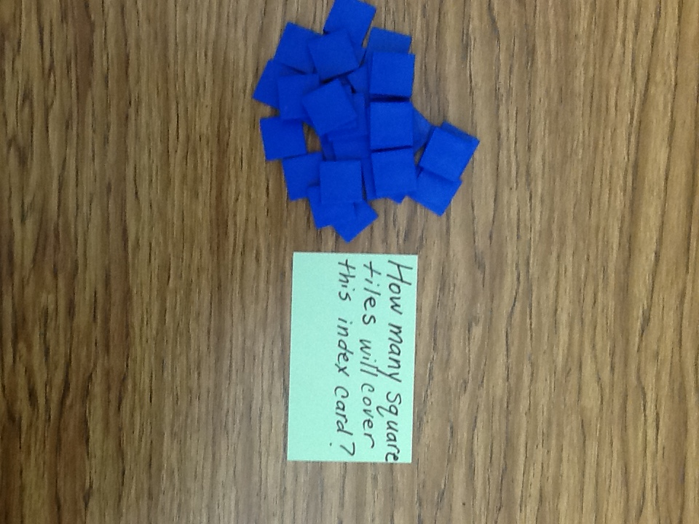
How many square tiles will cover the green card?
Video Answer

Slide 39
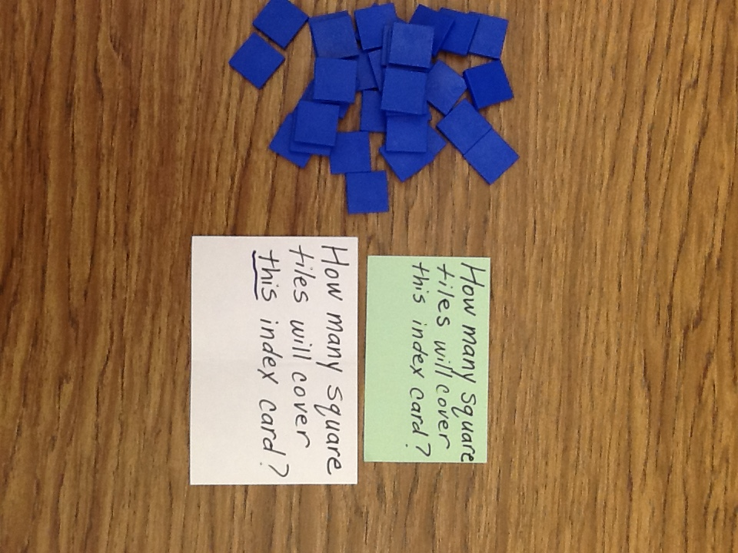
How many square tiles will cover the white card?
Video Answer

Slide 40
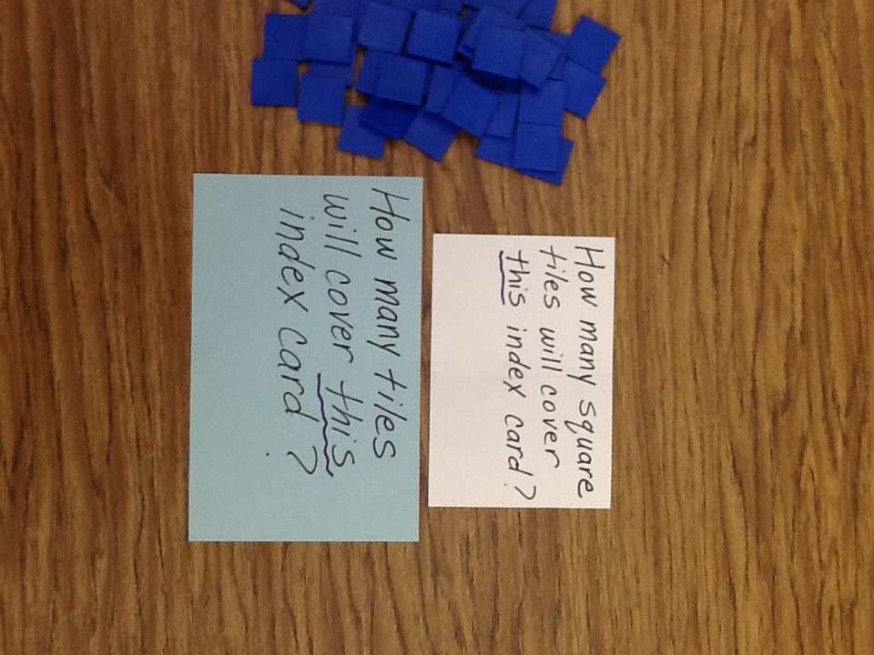
How many square tiles will cover the blue card?
Video Answer

