Slide 1
Going Places Safely
Grade K-2 Safety Lesson #2

Slide 2
Digital Wellness – Big Idea
Ensure students, at every grade level, have the tools, resources, and skills to interact personally, socially, and educationally in the real world and in digital spaces.
Encourage all students to make safe, healthy, and positive decisions to live a digitally balanced life in our technology-rich world.

Slide 4
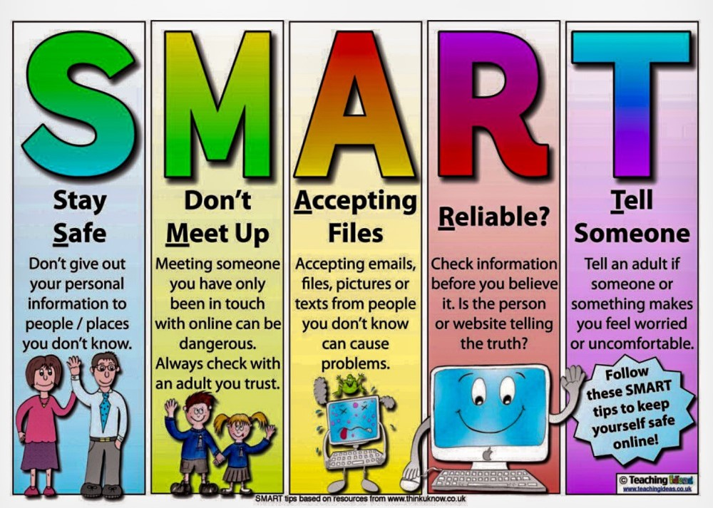
Learning intentions 4-1 How can we go places safely on the internet?
Staying safe . . .
Discover that the internet can be used to visit faraway places and learn new things.
Compare how staying safe online is similar to staying safe in the real world.
Explain rules for traveling safely on the internet..
Learn the SMART anacronym for staying safe

Slide 5
Preparation
Book: Webster’s Friend by Hannah Whaley
Video: Webster’s Friend – Online Story Link in Slide #6
Video: BrainPop Internet Safety Link in Slide #8
Handout: Emoji Colouring Sheet Link in Slide #10 – Photocopy for students
Game Statements Link in Slide #10
SMART poster Link in Slide #12

Slide 6
ACTIVATE - READ
Webster’s Friend by Hannah Whaley
Webster thinks he has made a friend online... but who is he really talking to? Webster tries his best to impress when he makes a new friend online.
Told in playful rhyme, this story takes a turn when the friend wants to meet and Webster finds out who he has really been talking to! Webster’s Friend delicately introduces the concept of online safety to young readers, offering an early caution about strangers online and the pitfalls of anonymity on the internet.
Read Aloud

Slide 7
AQUIRE - Discussion
What did you notice or connect to from the book?
Why do you think Webster told so many lies
while talking to his “friend” online?
2. Do you think he made a wise decision?
3. What could have happened if he met his on-line friend in person?
4. Webster was on his way to tell his father – what else could he have done?
Think about these questions on your own, then share your thoughts with a partner.

Slide 8
APPLY - Watch
Click on the image below to watch the video.
BrainPop Internet Safety
3:46

Slide 9
AQUIRE - EXPLORE
Talking to strangers is just ONE thing you can do while online that isn’t safe.
You need to be aware of other situations that might come up while online.
Each situation will require one of three actions: STOP, SLOW (ask an adult), GO
STOP – UNSAFE: The website looks like it’s for adults; it is asking for personal information; I got here by accident.
CAUTION - ASK an ADULT: The website wants me to type in information or download something; I’ve been here before BUT not by myself; It looks like fun but I’ve never been here before.
GO – SAFE: I’ve been here before it’s been approved by a trusted adult; The website is just the right age for me

Slide 10
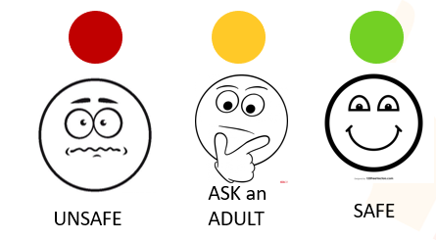
Emoji Game
Colour each emoji appropriately. THEN, listen to what is being read to you and hold up the correct emoji for what you would do.
Emoji Colouring Sheet
List of scenarios

Slide 11
ACQUIRE SMART ACRONYM
S
M
A
R
T
Stay safe
Don’t Meet up
Accepting Files
Reliable
Tell Someone
Use the SMART acronym when encountering scenarios on the internet.
Discuss this with the students. Have them think about what this would look like if they don’t know what each of the letters represent. They could even develop their own ACRONYM that they might remember better.

Slide 12
Apply - Create
The SMART acronym may be difficult for very young children to remember. Create a visual poster with the acronym written across the top to help remind the young user what each of the letters represent.
SMART poster

Slide 13
Additional Resources
Books | Videos | Teacher Resources
30 Technology Books for Kids Curated List of Digital Citizenship Resource Books The “Techie Teacher” top Tech Books (view in Edge) | Brain Pop Jr Common Sense Media Net Safe Utah Net Smartz | SD72 Learning Commons Brain Pop Jr Common Sense Education Net Safe Utah Net Smartz InCtrl Cyber Wise Media Smarts (Canadian)

Slide 14
Teacher Notes
Tips
This lesson introduces the student to the different feelings they may feel while in different online situations and what to do about it.
Extension Activities
Visit the BrainPop site for additional ideas.
Take Home Resources
CYBERWISE
NET SAFE UTAH
NETSMARTZ FOR PARENTS
COMMON SENSE MEDIA
INTERNET SAFETY AT HOME TIP SHEET
PROTECTING YOUR KIDS ONLINE
DIGIZEN.ORG-CHILDNET INTERNATIONAL

