Slide 1
Screen Free Time
Grade K-2 Etiquette Lesson #1

Slide 2
Digital Wellness – Big Idea
Ensure students, at every grade level, have the tools, resources, and skills to interact personally, socially, and educationally in the real world and in digital spaces.
Encourage all students to make safe, healthy, and positive decisions to live a digitally balanced life in our technology-rich world.

Slide 4
Learning intentions 3-1 When is it polite to turn off technology?
No more Screen Time
Learn the term “screen free timet” and when this is appropriate.
Understand that is NOT JUST about using technology appropriately but WHEN it is appropriate to use it.

Slide 5
Preparation
Book: Webster’s Manners by Hannah Whaley
Video: Webster’s Manners – Online Story Link in Slide #6
Video: Device Free Dinner Link in Slide #9
Brainstorm: Headings – Device Free, Screen Time
Handout: Device Free Poster Link in Slide #10 – Photocopy for students

Slide 6
ACTIVATE - READ
Webster’s Manners by Hannah Whaley
Webster learns about a new set of digital manners, helping him to be polite with technology and take care of his favourite gadgets and toys. However, the cheeky spider soon turns the tables on his daddy and makes him agree to the same rules! This fully illustrated picture book can be used to prompt: Conversations about taking care of electronic toys and gadgets with young children Child safety when using technology and mobile devices Screen time planning for both parents and children Healthy attitudes towards screen based entertainment
Read Aloud

Slide 7
AQUIRE - Discussion
What did you notice or connect to from the book?
1. Why do you think Webster’s parents were
nagging him about his technology use?
2. Do your parents nag you too? Why?
3. What other times do you think it would be appropriate to turn off his technology?
4. Why do you think Webster made sure his dad
Followed the same set of “rules”?
Think about these questions on your own, then share your thoughts with a partner.

Slide 8
Acquire - Brainstorm
Screen free
Screen time
Think about times in your day where it should be “DEVICE FREE” and others when it’s okay to have “SCREEN TIME”

Slide 9
apply - Watch
Click on the image below to watch the video.
Device Free Dinner
1:22

Slide 10
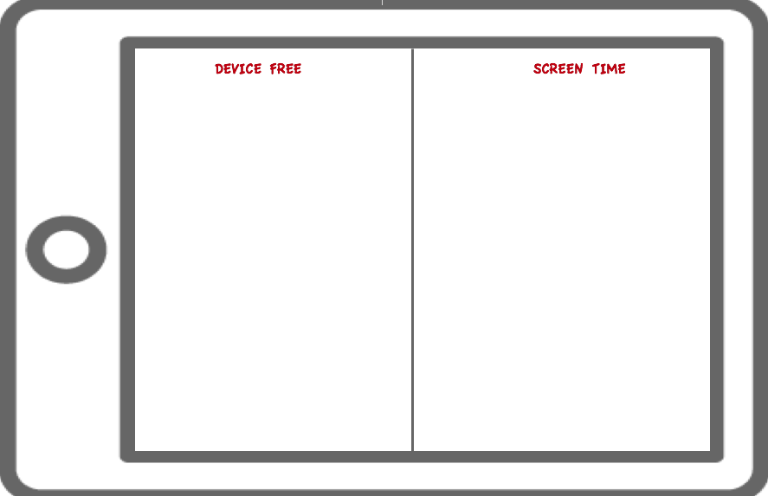
APPLY - CREATE
DEVICE FREE POSTER
The Sesame Street characters all put their devices away before sitting down to dinner. This is ONE way to show respect to others by having a device-free moment.
Using the video AND the list you generated with your class, create a poster showing a “device-free” moment and a “screen-time” moment.

Slide 11
Additional Resources
Books | Videos | Teacher Resources
30 Technology Books for Kids Curated List of Digital Citizenship Resource Books The “Techie Teacher” top Tech Books (view in Edge) | Brain Pop Jr Common Sense Media Net Safe Utah Net Smartz | SD72 Learning Commons Brain Pop Jr Common Sense Education Net Safe Utah Net Smartz InCtrl Cyber Wise Media Smarts (Canadian)

Slide 12
Teacher Notes
Tips
This lesson helps students understand that there is a time and place for technology use.
Extension Activities
Students generate a list of healthy and appropriate screen-time activities.
Take Home Resources
CYBERWISE
NET SAFE UTAH
NETSMARTZ FOR PARENTS
COMMON SENSE MEDIA
INTERNET SAFETY AT HOME TIP SHEET
PROTECTING YOUR KIDS ONLINE
DIGIZEN.ORG-CHILDNET INTERNATIONAL
It also helps the student think about why it is important to have device free moments.
Develop a FAMILY pledge to create with their families about having device-free family time AND what can they do instead of screen-time activities.

