Slide 1
FIPPA and you!
Freedom of Information and Protection of Privacy Act

Slide 2
FIPPA For teachers and students . . .
The Freedom of Information and Protection of Privacy Act (FIPPA) in BC protects everyone's personal identity and information.
It prevents organizations and institutions from selling it to marketing firms
It also protects your privacy from scammers and criminals

Slide 3
By Law...
We have an obligation to protect your privacy.
If we want to publish your work on the internet (or ask you to do so), we must obtain written ‘informed’ consent first.
We cannot store any of your personal information on servers that are located outside of Canada without prior written consent.

Slide 4
All of these are on foreign servers
Mostly in the US
...there are many more!

Slide 5
What is the big deal about foreignservers?
By storing files/images/personal information on foreign servers, the data is subject to laws of that foreign country.
In the US, this is the US Patriot Act. This allows the US government to access data stored on these servers.

Slide 6
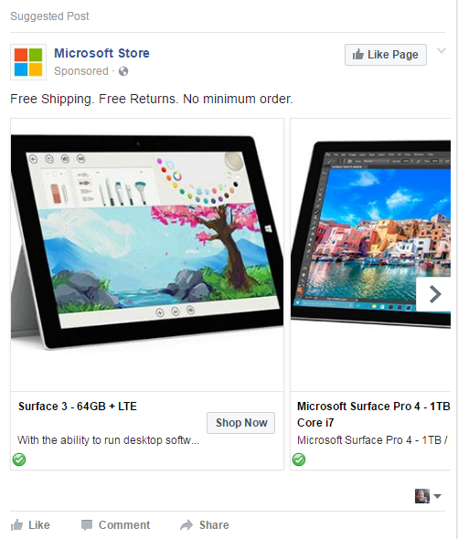
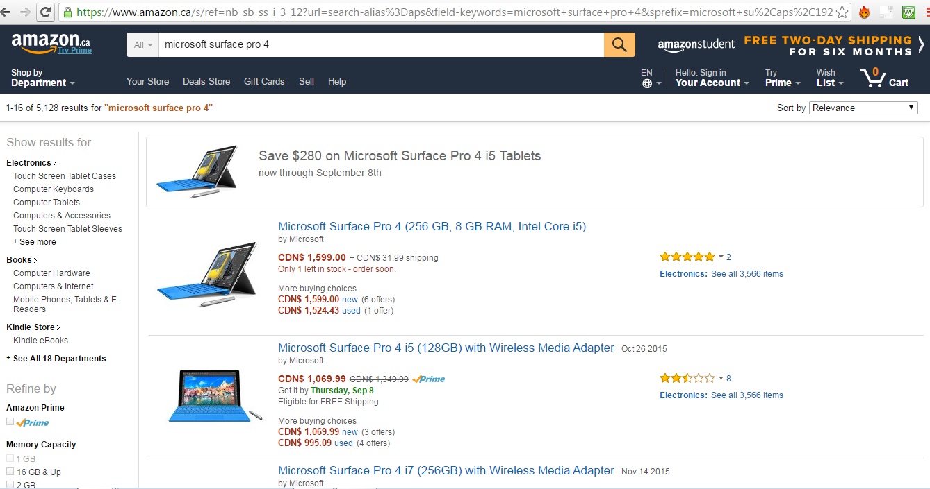
Data Mining
Furthermore, some providers data-mine to sell information for targeted advertisements:

Slide 7
Your @stu.sd72.bc.ca account created for Microsoft Office use, is created by the school district.
This provides access to Office 365 through office.com
Word
PowerPoint
Excel
Teams
Outlook

Slide 8
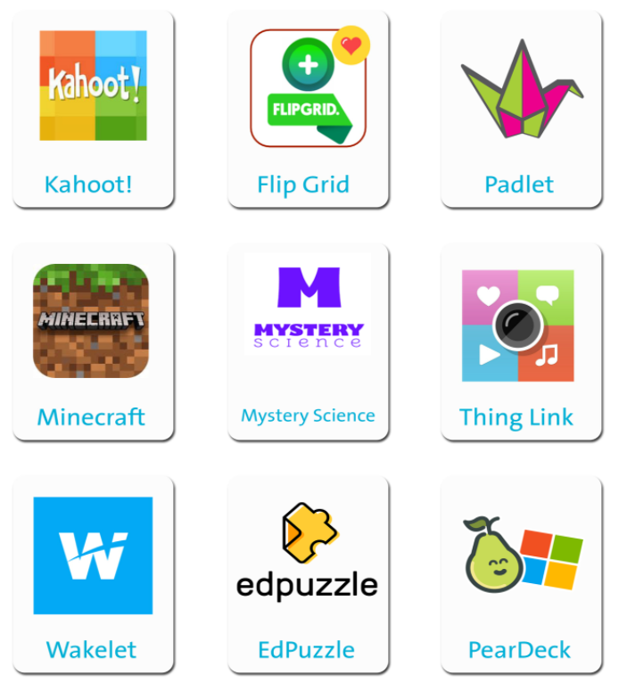
SD72 Account for Digital Apps
This will also be the account that you use to sign up for the digital apps you may be using in class.

Slide 9
When using these apps with this account . . .
Users Must:
User Must Not:
Use
Only use your @stu.sd72.bc.ca for educational, school related activities.
Abide
Abide by the School District #72 Technology and Acceptable Use Guideline
Report
Report any inappropriate behaviour immediately to a teacher, counsellor, or administrator.
Surrender
Surrender account details to an administrator upon request.
Post or volunteer
Post or volunteer any private or personal information online.
Engage
Engage in any illegal or inappropriate activity online.
Bully or pressure
Bully or pressure others to engage or do something they do not feel comfortable
Give
Give account information to any other person, including close friends.

Slide 10
By providing INFORMED CONSENT you . . .
Acknowledge
01
Acknowledge that any information, including your first and last name, stored on servers located in the US is subject to the data laws of that country.
Abide
02
Agree to abide by the SD #72 Technology and AU Guideline, and will not engage in cyberbullying, or inappropriate/illegal activity online.
Agree
03
Agree to immediately report any inappropriate or illegal activity to a teacher, counsellor, or administrator.

Slide 11
. . . will not volunteer any private or personal information (other than first and last name) about
yourself
other students
anyone else
on any of the online tools you will be accessing with your SD72 Microsoft Account (@stu.sd72.bc.ca).

