Slide 1
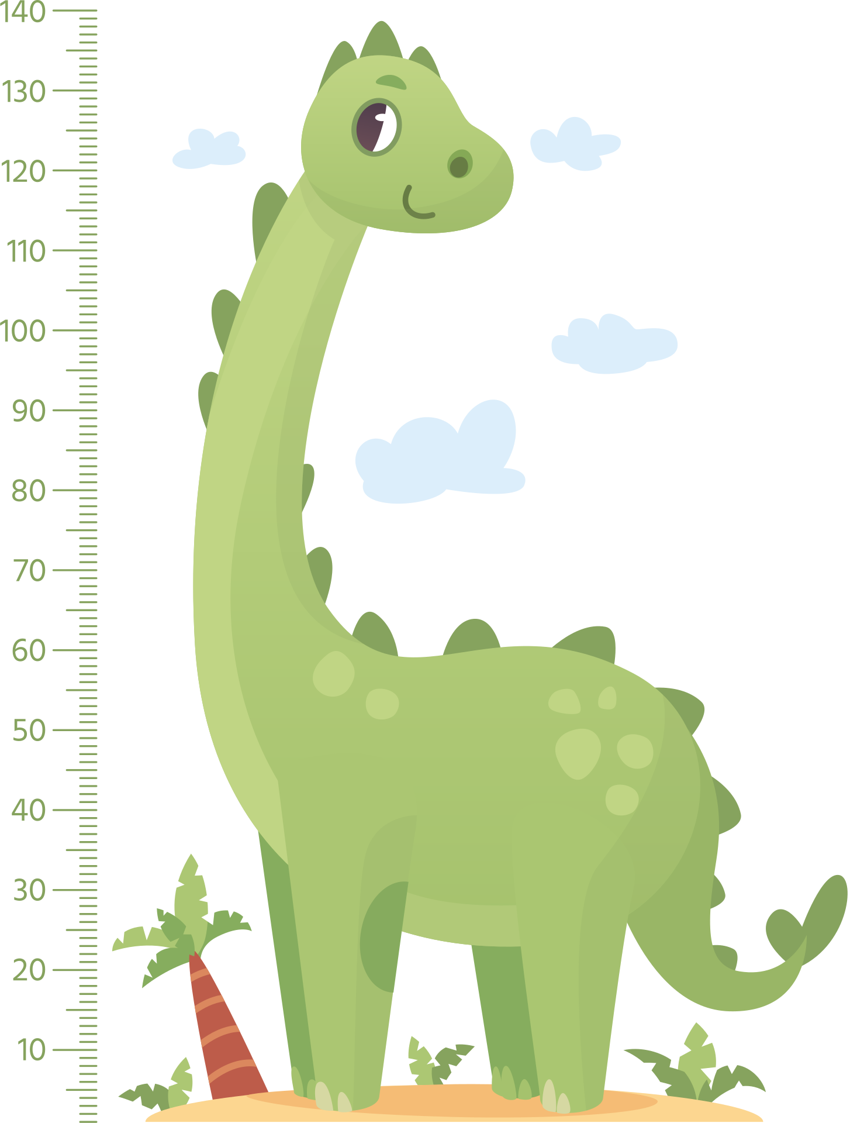
Name: ___________ Date: ___________
I AM THIS
TALL!

Slide 2


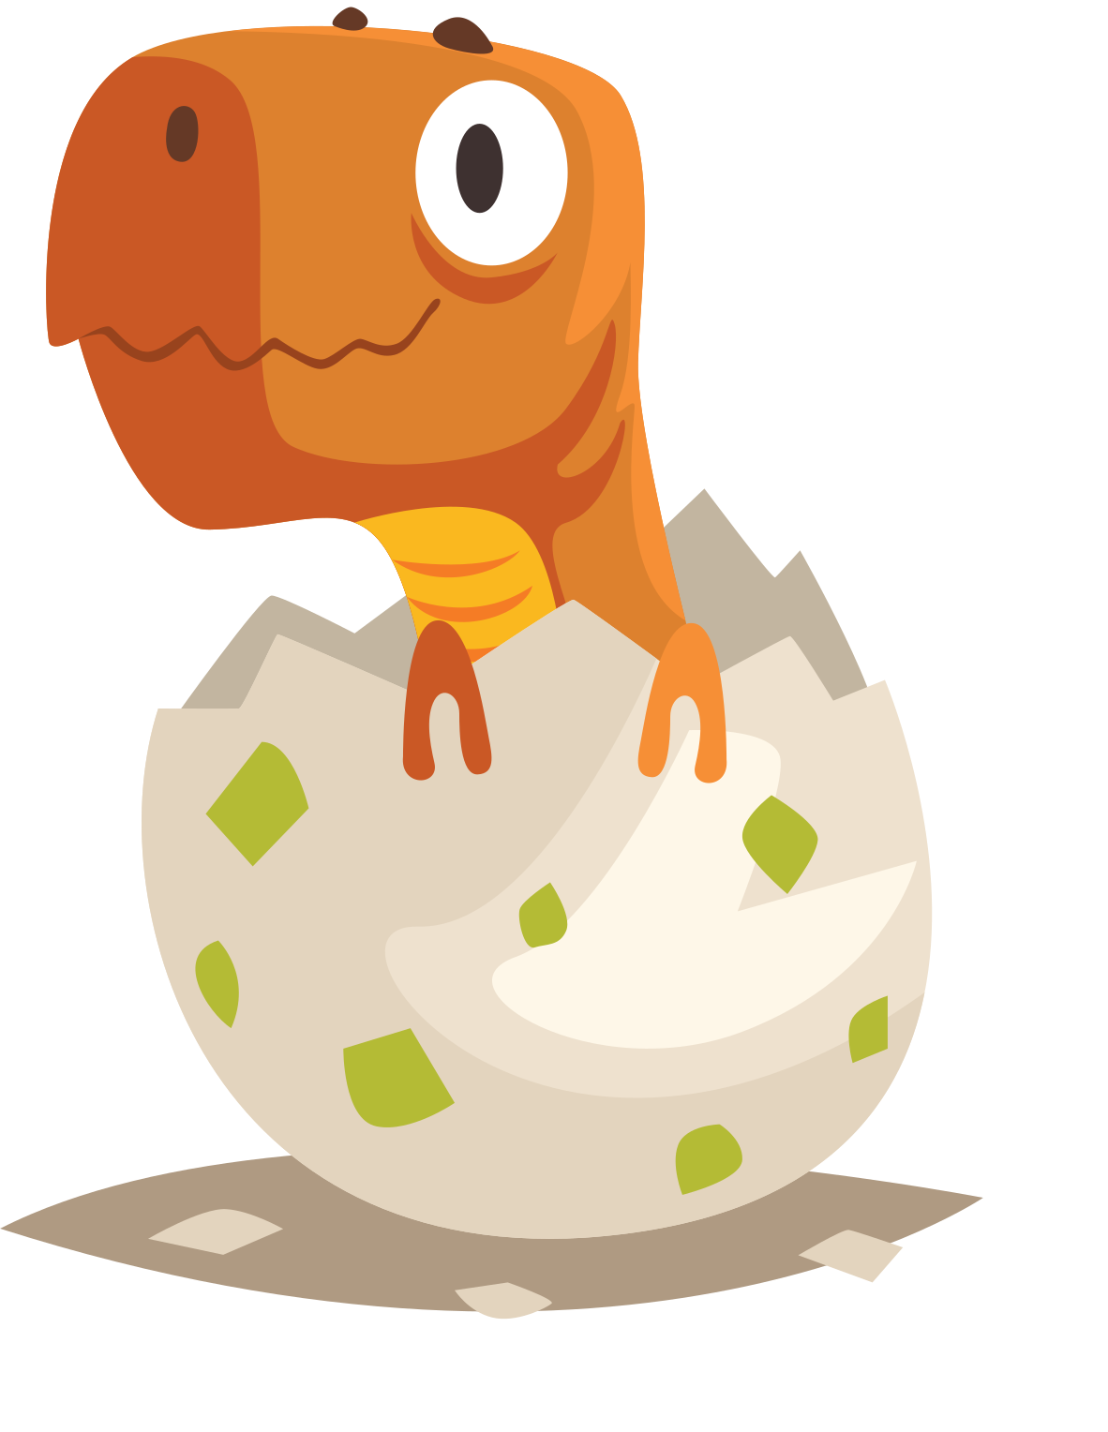
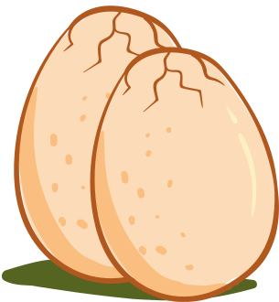

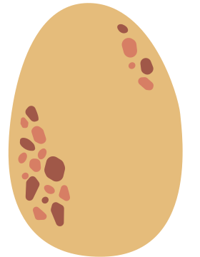
Dinosaur
Missing Number
1
3
7
9
13
15
19

Slide 3

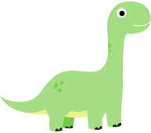
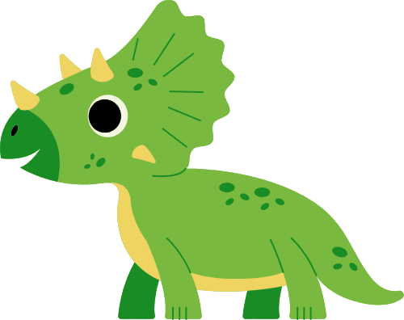

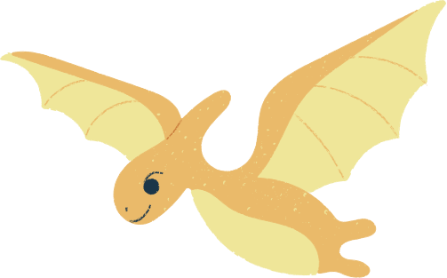
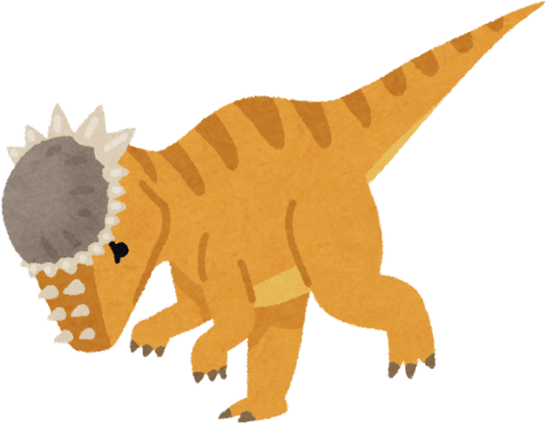
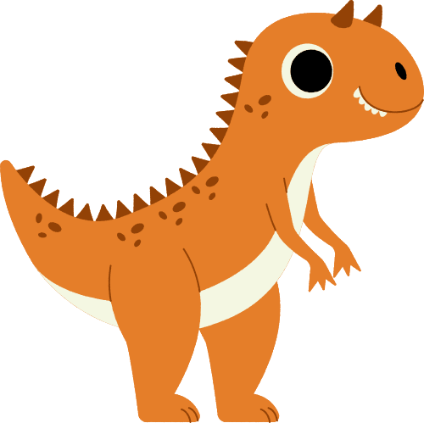
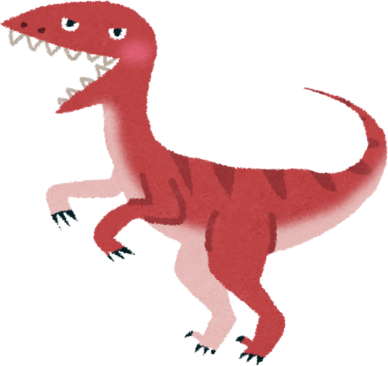
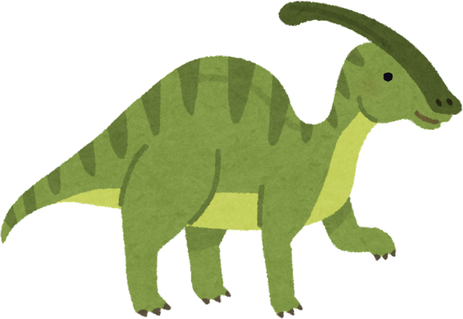
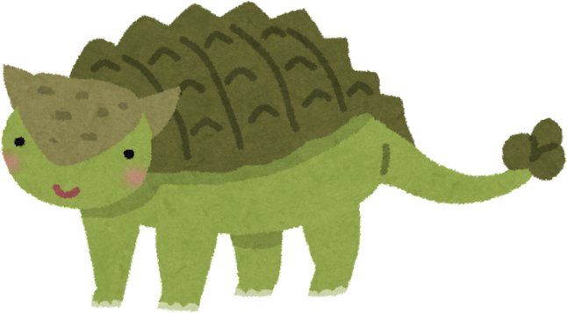
Name:
Class:
Count and Match
Match groups of dinosaurs that have the same number!

Slide 4

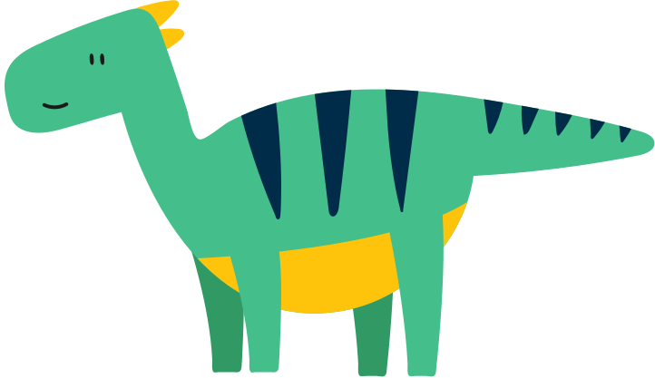
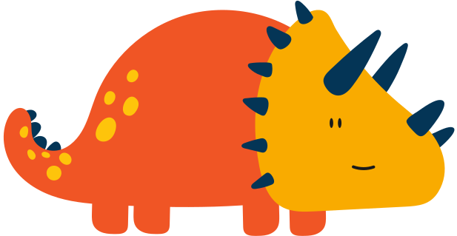
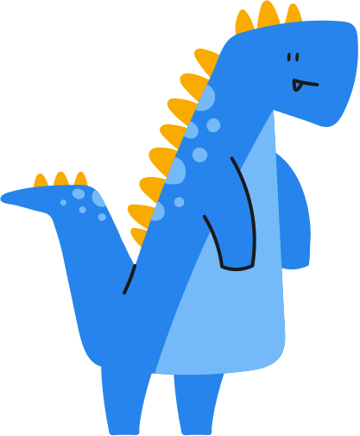
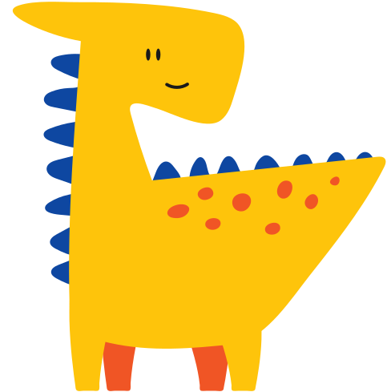

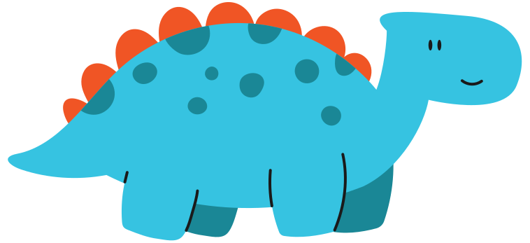
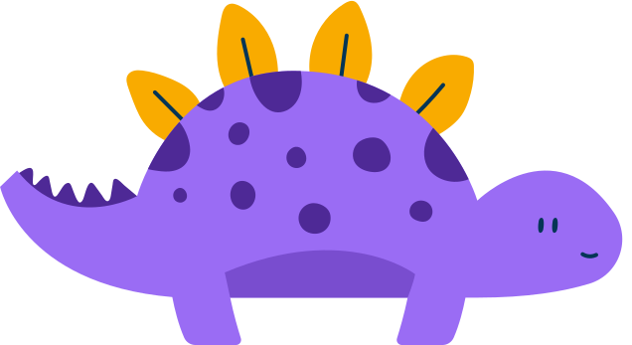
Name:
Date:
Count the Dinosaurs!
Count how many of each dinosaur type you see and write the number

Slide 5
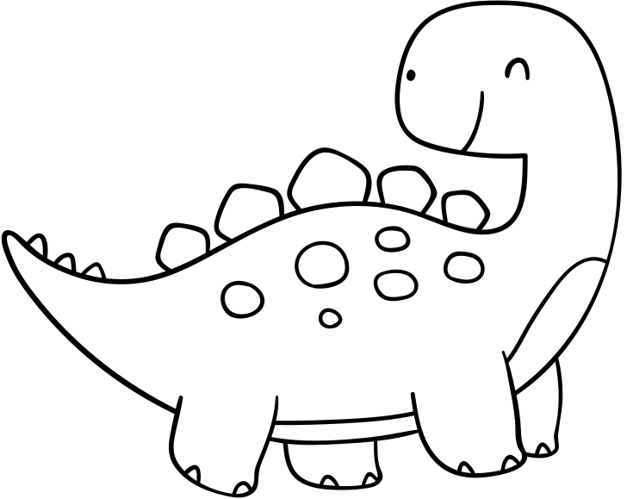

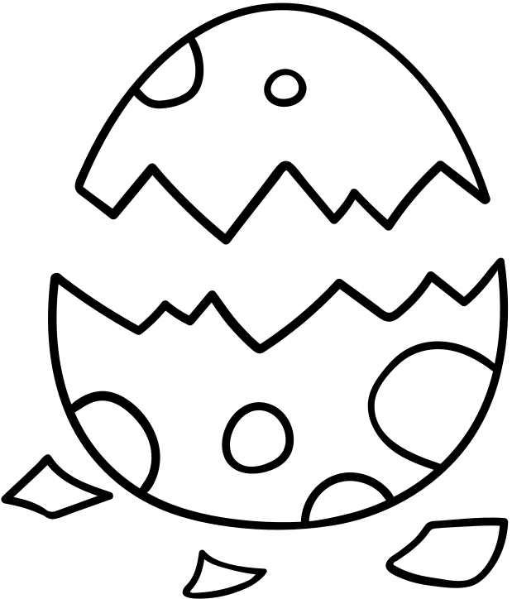
PRE-WRITING SKILLS
Help the dinosaur find the egg.

Slide 6
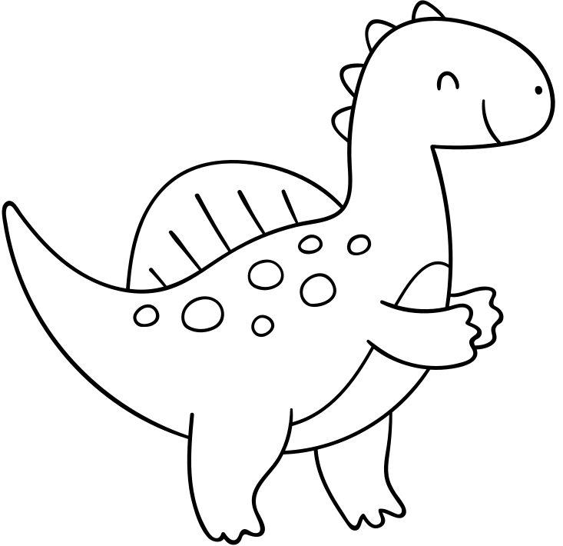

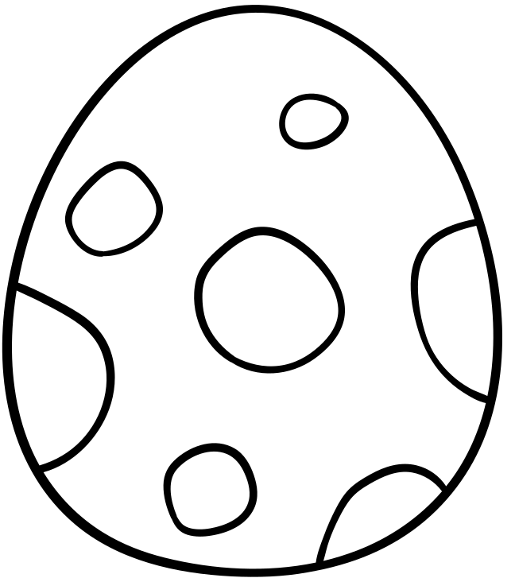
PRE-WRITING SKILLS
Help the dinosaur find the egg.

Slide 7
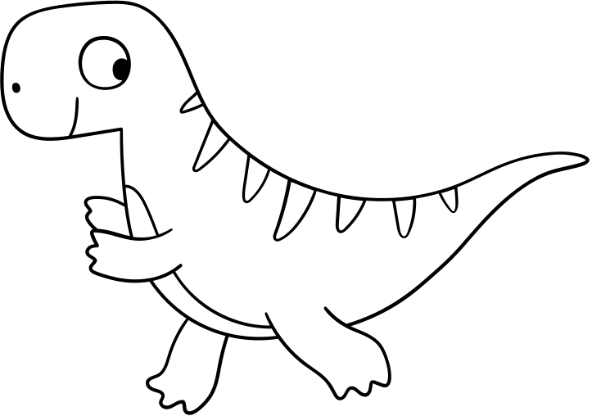
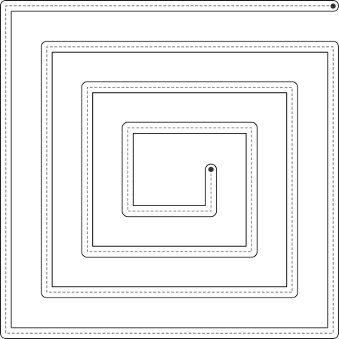
PRE-WRITING SKILLS
Help the dinosaur find the egg.

Slide 8
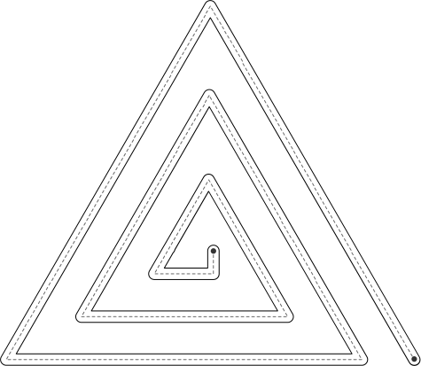
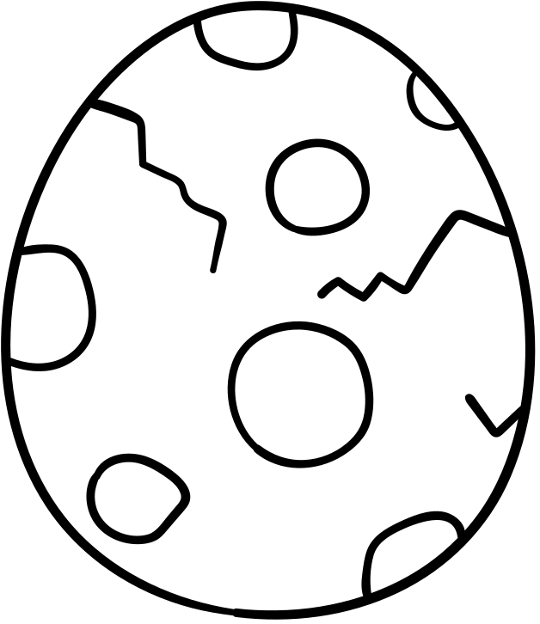
PRE-WRITING SKILLS
Help the dinosaur find the egg.

Slide 9
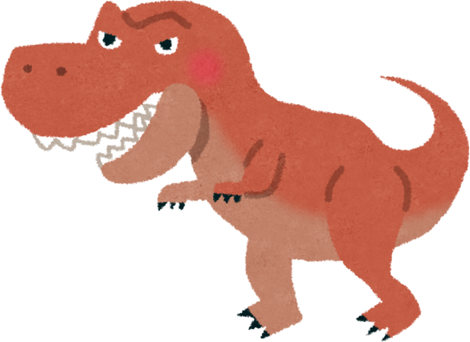

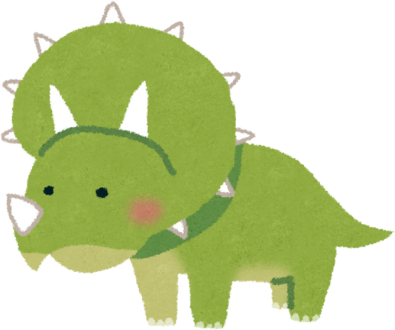

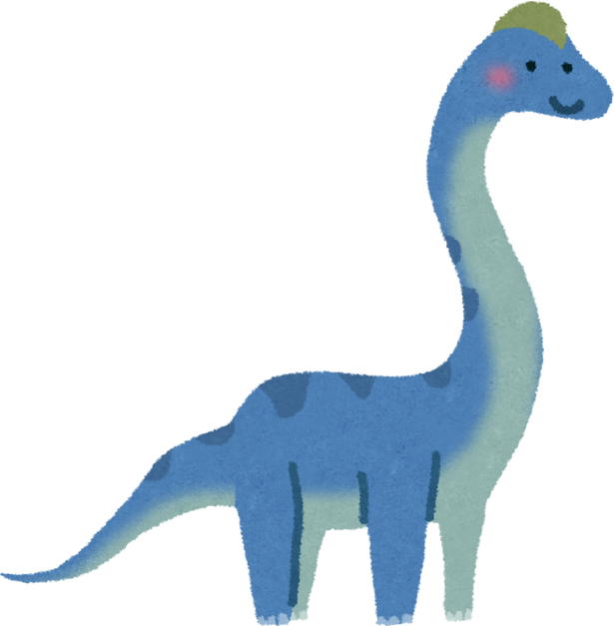

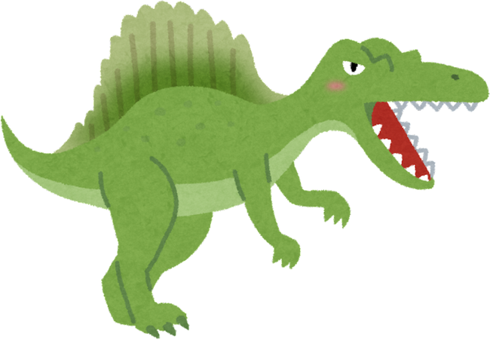

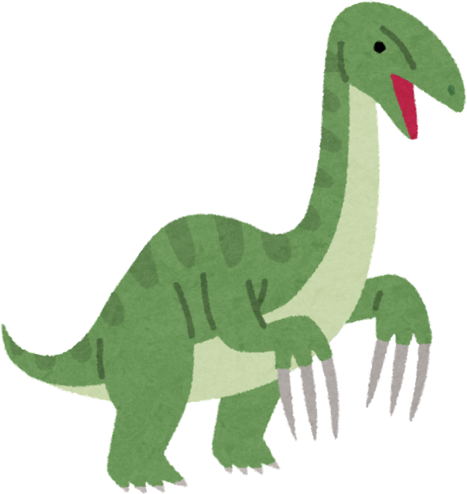
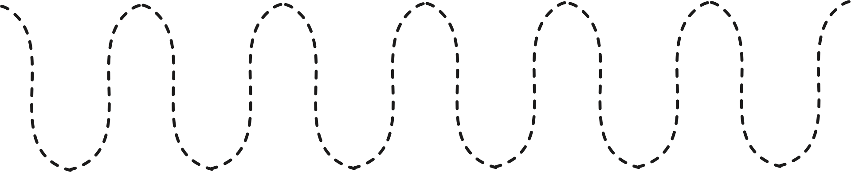
Name:
Date:
DINOSAUR
TRACING ACTIVITY
Trace the different lines to help the dinosaurs move

Slide 10

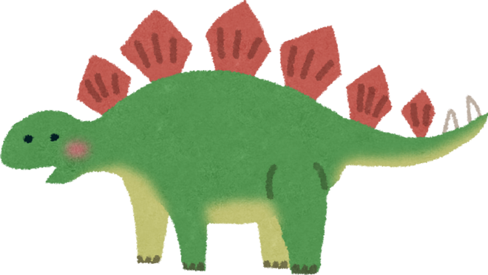



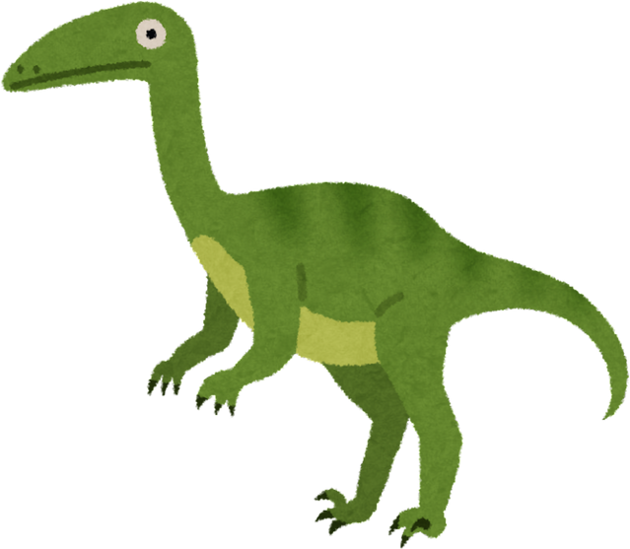
Name:
Date:
DINOSAUR
TRACING ACTIVITY
Trace the different lines to help the dinosaurs move

Slide 11
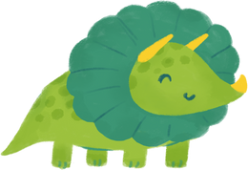
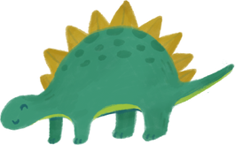
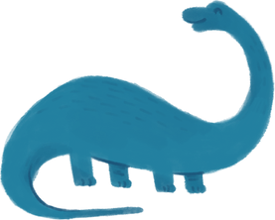
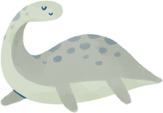
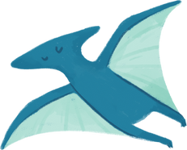
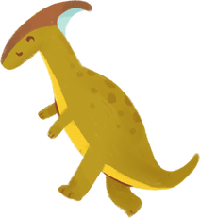
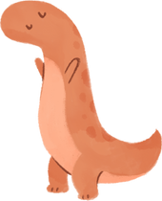
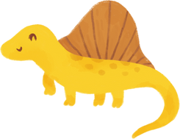
Name:
Grade:
Date:
Dinosaur Counting
Count the dinosaurs and write the numbers (1-10) in the boxes.

Slide 12
Name:
Grade:
Date:
Dinosaur Counting
Count the dinosaurs and write the numbers (1-10) in the boxes. Then color.

Slide 13
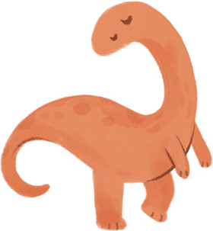
Name:
Grade:
Date:
Dinosaur Counting
Count and write the number of animals you see

Slide 14
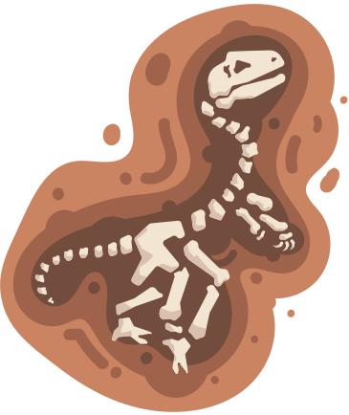
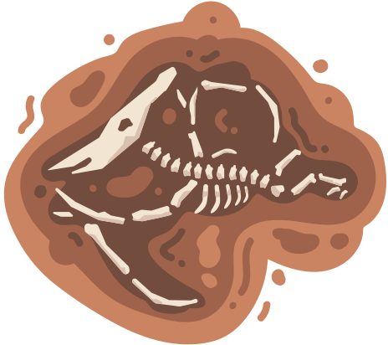
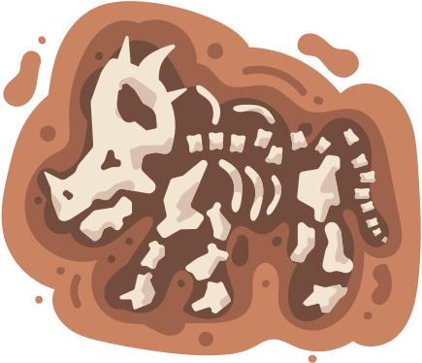
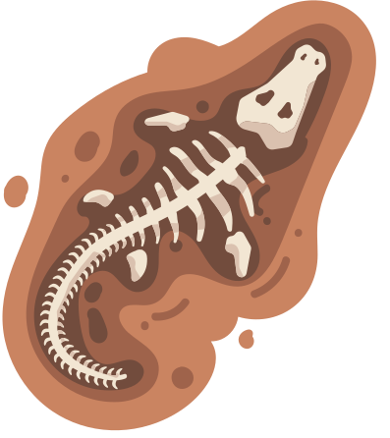
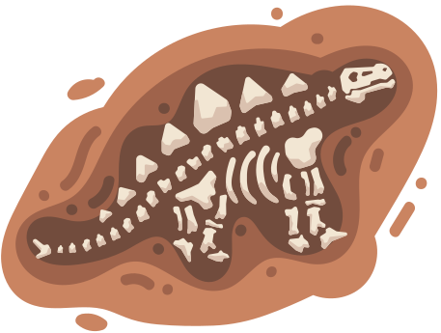
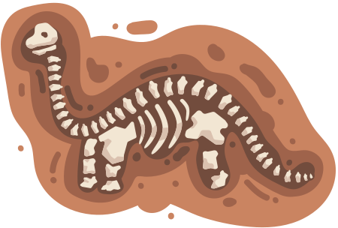
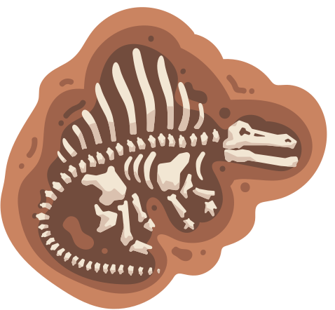





Dinosaur Memory Game
Print (x2), cut and start playing

Slide 15
Dinosaur Memory Game
Print (x2), cut and start playing

Slide 16










Name:
Date:
Dinosaur Patterns
Can you complete these dinosaur patterns? Cut and glue

Slide 17











Slide 18



Dinosaur
Numbers

Slide 19

zero

Slide 20

one

Slide 21

two

Slide 22

three

Slide 23

four

Slide 24

five

Slide 25

six

Slide 26

seven

Slide 27

eight

Slide 28

nine

Slide 29

Name:
Date:
Dot-to-Dot
Connect the dots from 1 to 40, this way you practice counting
and discover a cute dinosaur.
triceratops

Slide 30

Name:
Date:
Dot-to-Dot
Connect the dots from 1 to 60, this way you practice counting
and discover a cute dinosaur.
t-rex

Slide 31

Name:
Date:
Dot-to-Dot
Connect the dots from 1 to 40, this way you practice counting
and discover a cute dinosaur.
t-rex

Slide 32

Name:
Date:
Dot-to-Dot
Connect the dots from 1 to 80, this way you practice counting
and discover a cute dinosaur.
pteranodon

Slide 33

Name:
Date:
Dot-to-Dot
Connect the dots from 1 to 29, this way you practice counting
and discover a cute dinosaur.
stegosaurus

Slide 34

Name:
Date:
Dot-to-Dot
Connect the dots from 1 to 50, this way you practice counting
and discover a cute dinosaur.
stegosaurus

Slide 35

Name:
Date:
Dot-to-Dot
Connect the dots from 1 to 38, this way you practice counting
and discover a cute dinosaur.
brachiosaurus

Slide 36




Resource Page

Slide 37




Name:
Date:
Dino Math
Count to ten with these Dino counting exercises.
+
+
+
+

Slide 38
Name:
Date:
Dino Math
Count to ten with these Dino counting exercises.
+
+
+
+

Slide 39



All About _________’s Favourite Dinosaur
Name: ______________
Size: _________
What it ate: _______________
Where it lived: ___________________
An interesting detail: _______________
________________________________
My Dinosaur Drawing

