Slide 1
Understanding Copyright
Grade 6-8 Citizenship Lesson #3

Slide 2
Digital Wellness – Big Idea
Ensure students, at every grade level, have the tools, resources, and skills to interact personally, socially, and educationally in the real world and in digital spaces.
Encourage all students to make safe, healthy, and positive decisions to live a digitally balanced life in our technology-rich world.

Slide 4
Preparation
Video: Understanding Copyright: Link in Slide #6
Print Definition Worksheet: Link in Slide #7
Fair Use Decision Tool: Link in Slide #10
Video: What is Creative Commons: Link in Slide #11
Create Padlet: Example in Slide #12

Slide 5
Learning intentions 2-3 Understanding what copyright and fair dealing is in reference to the digital world and how they then use that information.
Copyright
Define the terms "copyright," "public domain," and "fair dealing and creative commons."
Identify the purpose of the factors of Fair Dealing.
Identify the purpose of the Creative Commons license.
Apply fair dealing and creative commons licensing to real-world examples, making a case for or against.

Slide 6
ACTIVATE - Video
Watch the video below by clicking on the image.
What is Copyright?
1:14

Slide 7
DEFINITIONS
Use the worksheet provided to fill in some examples.
Copyright | Public Domain | Fair Dealing | Creative Commons
Copyright is the exclusive legal right to produce, reproduce, publish or perform an original literary, artistic, dramatic or musical work. (It is usually the creator BUT sometimes it’s the employer that is the copyright owner (film studio). | Works that are not protected by copyright. You are free to use them in any way you choose - no restrictions on copying and adapting, no need to seek permission, and no uncertainty about your rights as a user. | The use of material from a copyright protected work (literature, musical scores, audiovisual works, etc.) without permission when certain conditions are met. People can use fair dealing for research, private study, education, parody, satire, criticism, review, and news reporting. | A type of license that enable the free distribution of an otherwise copyrighted "work". A CC license is used when an author wants to give other people the right to share, use, and build upon a work that the author has created.

Slide 8
Acquire – Compare Fair USE (US) VS Fair Dealing (CANADA)
Us VS Canada
FAIR DEALING
The video you just watched was created for an American audience. Each country has their own set of “rules” around copyright and the “Fair Use” guidelines is one of them.
In Canada we have the “Fair Dealing” guidelines which is similar in many ways BUT does have some differences.
People can use fair dealing for
research
private study
education
parody
satire
criticism
review
news reporting
In order to ensure your copying is fair, you need to consider several factors such as the amount you are copying, whether you are distributing the copy to others, whether your copying might have a detrimental effect on potential sales of the original work and whether there are copyright free alternatives available.

Slide 9
Acquire – Think-Pair -share
Do you think you can use any type of music, video or pictures in your projects you create for your teacher because it falls under the “education” use for Fair Dealing?
Take a moment to think silently about this question.
Then, take turns sharing your response with your partner.

Slide 10
APPLY – FAIR DEALING DECISION TOOL
Use the link below to access the Fair Dealing Decision Tool.
Brainstorm a number of different copyrighted material that may be used in school. THEN use the tool to determine whether the “intended use” is allowed by the Fair Dealing guidelines.
FAIR DEALING DECISION TOOL

Slide 11
ACTIVATE - Video
Watch the video below by clicking on the image.
What is Creative Commons?
1:14

Slide 12
Acquire – Think-Pair -share
Creative Commons (CC) license was created so people could safely share and use material on the internet.
1. Have you ever used CC material off the internet to remix/reuse/distribute material for your personal use?
One of the terms regarding the use of CC material is to credit the creator.
2. Did you remember to credit the creator? Think about the “ethical” reasons (fairness) why this would be important and discuss.
Take a moment to think silently about these questions.
Then, take turns sharing your response with your partner.

Slide 13
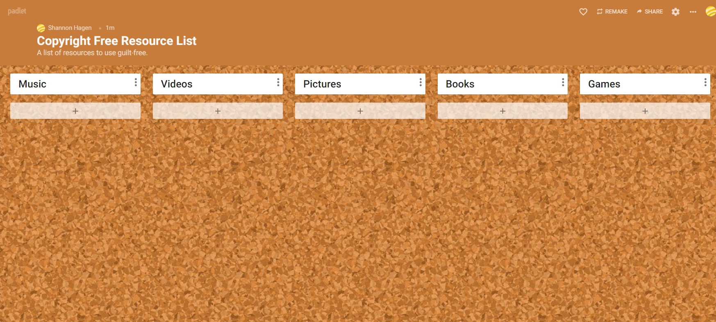
APPLY – COPYRIGHT FREE/CREATIVE COMMONS RESOURCE LIST
Use the padlet created by your teacher to copy and paste websites that provide copyright free or creative commons material.
This might be for pictures, videos, music, books and games.

Slide 14
Teacher Notes
Backrounder
Canada – Copyright
Extension Activities
Create a class poster for Cop such as THIS one.
Take Home Resources
Copyright Video
Fair Dealing
Fair Dealing Decision Tool
Fair Dealing Guidelines
Project Gutenberg
Creative Commons
Creative Commons Search page
Creative Commons Music sites
Access the Quizlet created for Understanding Copyright.
Play “Click if you Agree” for Fair Dealing scenarios

