Slide 1
Over Use of Screen Time
Grade 6 – 8 Wellness Lesson #3

Slide 2
Digital Wellness – Big Idea
Ensure students, at every grade level, have the tools, resources, and skills to interact personally, socially, and educationally in the real world and in digital spaces.
Encourage all students to make safe, healthy, and positive decisions to live a digitally balanced life in our technology-rich world.

Slide 4
Preparation
Kahoot: Are You Addicted to Technology Link in Slide #6
Video: Traffic Light Link in Slide #7
Brainstorm: Headings – Consuming Media/Producing Media
Book: Chicken Clicking by Jeanette Willis
Game Instructions Link in Slide #12
Game Statements Link in Slide #12

Slide 5
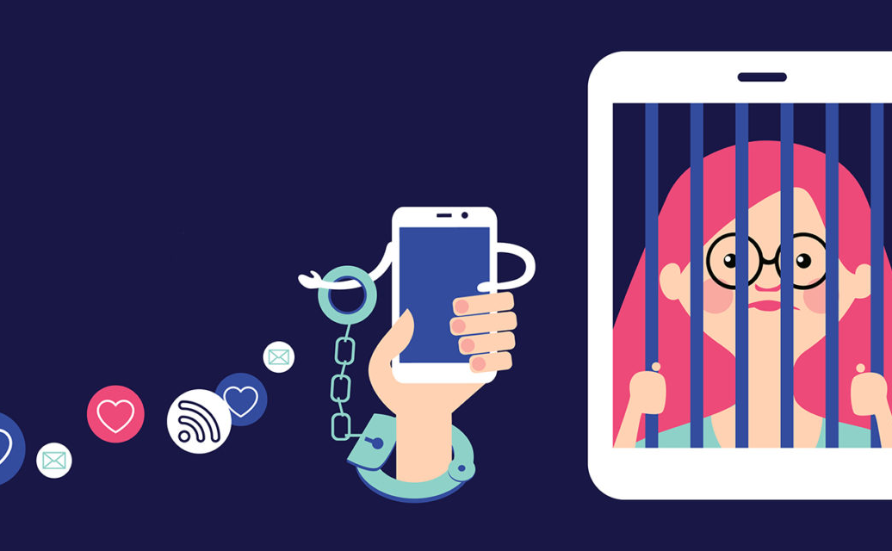
Learning intentions 1-3 Screen Time – The Unhealthy Side Affects of Overuse
Are You Addicted
What happens to the teenager brain with too much screen time?
How to develop heathly digital media habits.
Consumers vs. Producers – what is the difference?

Slide 6
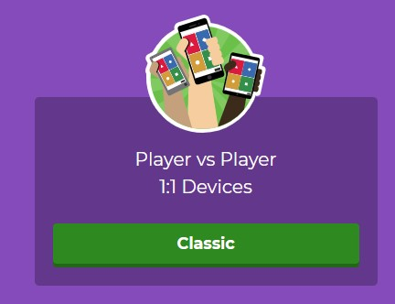
Activate - Kahoot
Play the “Are You Addicted to Technology” quiz by clicking on the image on the right.
Click on the Player vs Player option

Slide 7
ACTIVATE - Video
Watch the preview of “Screenagers” by clicking on the link below.
It explores the complex lives teenagers have with their phones as well as their friends.
The Drug-like effect of screen time on teenagers.
7:31 minutes

Slide 8
AQUIRE - Brainstorm
Technology use can be broken down into two different types of uses:
Consuming and Producing.
Consuming
producing
Brainstorm the different types of activities that might fall into the two different columns.

Slide 9
Apply -Discuss . . .
Is your use of screen time balanced
(consumer vs producer)?
Why do you think adults should help you put limits on your use of consuming technology?
What are some of the things you could start/stop doing that would make your digital habits healthier?
Notes:
This discussion can occur as a large class, share/pair, jigsaw or any other type of collaborative activity.

Slide 10
apply - EVALUATE
Read the iPhone contract, in the form of a letter, Janell Burley Hofmann wrote to her 13 year old son, Gregory.
It is THREE pages long and very detailed.
If you were to agree to a contract, what might some of the items listed be included in yours?
What would DEFINTELY be excluded?
What else that is not listed might you include?
iPhone Contract Letter

Slide 11
apply - RECORD
Using the ideas from the previous slide, create your own contract.
Limit it to TEN items so make sure each item is important.
Create it using an infographic such as piktograph, PowerPoint, or venngage
Print it off and post it where you can see it.
Be sure to create a signature line for you to sign.
Notes:
Lead an informal discussion – where does your wheel land – is this good / bad?

Slide 12
EXTENSION - Challenge
Watch the video:
“Brief by spectacular – teens on tech”
One question posed in the video was:
“can you imagine going a few days without technology”
What would your answer be?
Could you develop a plan that would allow you to be successful at this?

Slide 13
Teacher Notes
Background
Phone Addiction Fighter Apps
Extension
See Previous slide – Tech Free Challenge
Family/Home
Copy of iPhone Contract in form of a letter
Parenting in the Screen Age (book)
Family Media Plan (American Pediatrics)
Apps that will help reduce screen time
How to Set Up Your Child’s Cell Phone
Canada Privacy Website-Online Privacy House Rules
Kids and Computer Eye Strain
How to Enable Night Light Blue on Chrome OS
How to Enable Night Shift on iOS
What Would Happen if you Didn’t Sleep (video)
Do research on the health affects of “technology addiction”.

