Slide 1
THE FAKE REALITY
Grade 6 – 8 Wellness Lesson #2

Slide 2
Digital Wellness – Big Idea
Ensure students, at every grade level, have the tools, resources, and skills to interact personally, socially, and educationally in the real world and in digital spaces.
Encourage all students to make safe, healthy, and positive decisions to live a digitally balanced life in our technology-rich world.

Slide 4
Preparation
View: Counsellor Keri Website for Teacher Backgrounder
Video: How Social Media is Ruining Your Life Link in Slide #6
Game Instructions Link in Slide #8
Game Statements Link in Slide #8
Video: Who Are You Online Link in Slide #9
Collaboration: Create place for students to anonymously post their answers – Options in Slide 10

Slide 5
Learning intentions 1-2 How can teens use social media in a way that doesn’t cause unnecessary stress?
The Fake Reality
Identify what is a “fake highlight reel”.
Identity reasons why people might create fake social media accounts and why this may cause undue stress or anxiety.
Investigate how life on social media can be different than real life and the stressors it may create for people.

Slide 6
ACTIVATE - Video
Watch the video below by clicking on the image.
How Social is Media Ruining Your Life: The Fake Reality
(4:18)

Slide 7
ACQUIRE - Discuss . . .
What is SOCIAL APPROVAL?
Why is it so important?
Do you believe the following statement is true? Why or Why not?
~“People who spend more time on Facebook are more depressed than those who don’t.”~
Notes:
This discussion can occur as a large class, share/pair, jigsaw or any other type of collaborative activity.

Slide 8
GAME
Think of the terms “Behind the Scenes” and “Fake HighLight Reel”.
Why do you think posting JUST the highlight reel might create an unreal representation of the person’s life?
How might this create undue stress for those people looking at it?
STAND UP – SIT DOWN
Instructions
GAME STATEMENTS
Notes:
Click on each of the icons for learn more about how to play the game. The information icon will explain the directions, the question mark icon will provide the list of questions to ask the students.

Slide 9
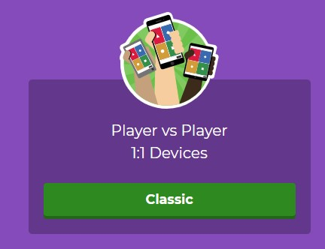
Optional - Kahoot
Play the “Fake Highlight Reel” quiz by clicking on the image on the right.
Click on the Player vs Player option

Slide 10
ACTIVATE - Video
Watch the video below by clicking on the image.
Who Are You Online?
(3:00)

Slide 11
apply - Evaluate
How are you trying to represent yourself online?
Do you use a fake highlight reel / FINSTA? How do you use it (them) differently than your “public” one?
How are your “likes” influencing you?
How does your online “Best-Self” make you feel about your “real” self?
Use mentimeter, padlet Microsoft Whiteboard or any other type of SAFE response type software to anonymously gather information from students.
You could also use any collaborative group strategy (as outlined in the Liberating Structures website) to collect these answers.
Notes:
Lead an informal discussion – where does your wheel land – is this good / bad?

Slide 12
apply - CREATE
Produce your own app screen
Create phone apps that would result in happiness rather than stress.
App Creation Instructions
Notes:
Hand out the individual student Balance Sheet handout. Have them refer to the chart on the board and help them generate things that might be of more relevant to them.

Slide 13
Teacher Notes
Background
Read through the webpage by “Counselor Keri”.
Extension
Have students create a “vocab” list of all the words associated with the creation of second media accounts. (SPAM, FINSTAS)
Family/Home
Help Kids Balance Their Media Lives
Family Activity
How to Set Screen Rules that Stick
Canada Privacy Website-Online Privacy House Rules
Do a class tally of ALL the social media account s the students have – represent in a graph.
SPAM & FINSTA accounts
Why Teens create Finsta accounts

