Slide 1
Is Your Brain Ready for Social Media
Grade 6 - 8 Wellness Lesson #1

Slide 2
Digital Wellness – Big Idea
Ensure students, at every grade level, have the tools, resources, and skills to interact personally, socially, and educationally in the real world and in digital spaces.
Encourage all students to make safe, healthy, and positive decisions to live a digitally balanced life in our technology-rich world.

Slide 4
Preparation
Video: When is Your Brain Ready for Social Media Link in Slide #6
Brainstorm list on board: Pros and Cons of the use of Social Media
Video: Friendships and Social media Link in Slide #9
Definition: FOMO: Slide #10
Print: Red Flag Handout: Link in Slide #11,
Activity: Memes: Slide #12

Slide 5
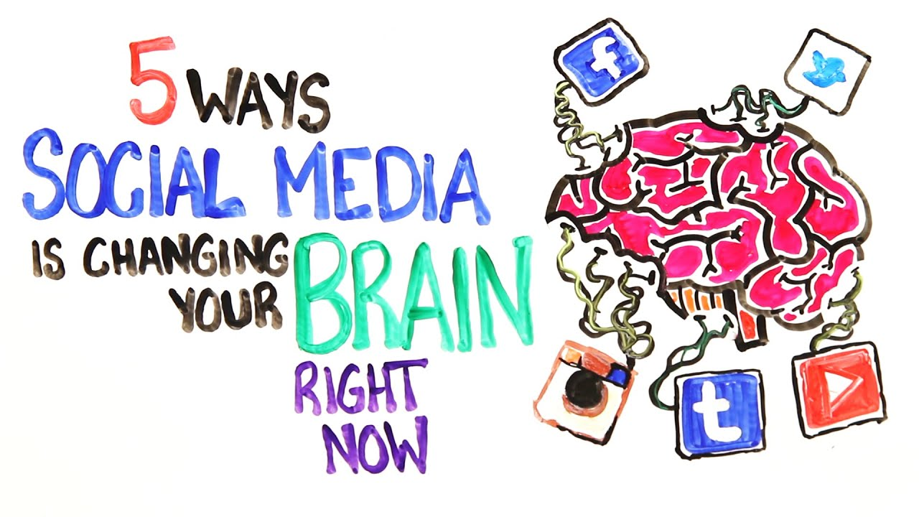
Learning intentions 1-1 When is Your Brain Ready for Social Media
Brain readiness
Identify the role of social media in their lives.
Reflect on the positive and negative effects social media use has their lives.
Recognize "red flag feelings" when using social media and develop strategies to get them thinking about ways to handle them.

Slide 6
ACTIVATE - Video
Watch the video below by clicking on the image.
When is Your Brain Ready for Social Media
(1:57)

Slide 7
Activate Discuss . . .
When do you think your brain is ready for social media?
Why is 13 the general age of consent for online platforms?
How do you use (OR have seen) social media?
Notes:
This discussion can occur as a large class, share/pair, jigsaw or any other type of collaborative activity.

Slide 8
Acquire - SOCIAL MEDIA – PROS AND CONS
If used correctly, social media can have a VERY POSITIVE impact for the producers as well as the consumers of this type of media. However, it can also be very DETRIMENTAL when used in a negative or hurtful way. Generate some uses (or results) of both with your child.
Think about the positive ways teens are using social media (making connections).
pROS
Think about the negative ways teens are using social media (bullying).
CONS

Slide 9
ACTIVATE - Video
Watch the video below by clicking on the image.
Teen Voices: Friendships and Social Media
(3:13)

Slide 10
Acquire
Although social media is a great platform to make connections – it can also create a situation where someone could be excluded.
This is called Fear of Missing Out OR (FOMO).
What scenarios might arise where this could happen?
What could we do make sure to “minimize the red flag feelings” when this does occur. (excluding OR being excluded)

Slide 11
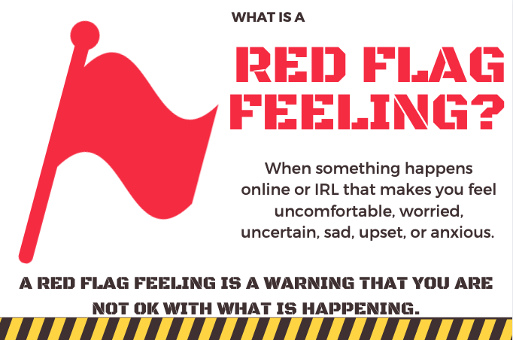
APPLY – RED FLAG FEELING SCENARIOS
Complete the attached handout from Common Sense Media.
Take some time to discuss the answers.
Red Flag Feelings Handout

Slide 12
MEME
APPLY – FOMO RED FLAG FEELING Solutions
. . .
Create your own meme that will be posted in the home providing a solution to FOMO situations. (not just a statement about fomo)

Slide 13
Notes
Background
Example of an EULA
Extension
Do research on how many Apps the students use have a 13+ user policy.
Family/Home
Help Kids Balance Their Media Lives
Parents “Ultimate Guides” to social media
Parental Controls
Canada Privacy Website-Online Privacy House Rules
Create a poster similar to THIS one about the security of the different apps.
Introduce AND talk about Producers vs Consumers of Social Media.
Legal Implications of EULA for kids
FIPPA (BC)
Privacy Commissioner (Canada)
Social Media and Education
Social Media and Mental Health
Negative Effects of Social Media on Teens

