Slide 1
Teacher Info Slides
What do I need to know before I teach this material?
​
*preview all content and videos before showing your class to ensure age appropriateness
Notes:
Student slides start at slide #4

Slide 2
Reminders When Answering Questions:
enders When Answering Questions
Set ground rules ahead of time,
set up an anonymous question box and give yourself time to formulate answers for the next session,
use reliable phrases,
always end with a safety message or direction of a reliable resource for more information,
tell students you may rephrase questions to protect confidentiality and safety of all students (no names, no questions that expose anyone)

Slide 3
Useful Phrases When Answering Questions:
some people may,
although not everyone will…
it’s important to understand the safety of…,
experts believe,
doctors suggest,
the safest way…(always end with safety as the message),
ask your family what their rules are or values are about…,
that’s an interesting question: I bet they might have an answer on one of our trusted websites: let’s find out,
sometimes people think of questions that will shock or gross us out but it doesn’t mean they are safe, true, likely or even possible,
not everything you see or hear about it is true (media literacy),
In this question I wonder if there is consent of each person and if anyone would be in harm (redirect difficult questions to safety)…

Slide 4
Health 6/7 – A Year
Lesson 6: Gender and Sexual Identity

Slide 5
Let’s review
How do we behave in Health Class?
Notes:
Go over the ground rules as a class – Print handout of rules for students included as well if you want to print it and hand it out

Slide 6
Ground Rules:
This is ‘Body Science!’ Learning about the body is fun and it helps us:
Learn how to care for our own bodies
Understand our body belongs to us and our rights
Helps us get along with other people and not cause harm to anyone else
Teaches us how to get out of unsafe situations and who to go to for help
Be private: no using other people’s names, or personal stories. We only talk about our bodies with people we trust, and trusted adults. This information is only appropriate for your age group and older: do not share with younger kids at lunch who may not be ready for it.
Personal Values: Everyone has their own set of beliefs and family values. Even if our values aren’t the same as someone else’s we still show respect and honour the diversity that exists.
Giggly wigglies: sometimes bodies are funny. If you have to laugh…follow the 3 second rule, take a deep breath and look at the ground until you can join the group again.

Slide 7
Ground Rules continued:
Use scientific terms and words: slang is ok, but always use scientific word as well. Using scientific words teaches a universal language of health.
“Interesting”: doctors never say things are gross, or say “ewww”. Instead they say “interesting…” it’s a good word to use when we don’t know what to say!
No personal questions. This rule saves a lot of embarrassing moments. It’s ok for students and teachers to not answer personal questions.
All other questions are ok: there is no such thing as a bad question in health class. There is a time and a place for questions though. Always have a piece of scrap paper out for you to write down questions that may come up so you can ask them at the appropriate time or submit it anonymously to the question box.
Support: sometimes different feelings may come up and you might need to talk with a counselor or teacher after the lesson.

Slide 8
The classroom is a safe spot for you to share your thoughts and feelings.
We have rules, because we want to make sure everyone is able to share their feelings without fear.

Slide 9
ACTIVITY: Think – Pair - Share
Parts of Your Identity
What makes you….you?
Notes:
Brain storm in a think-pair-share model: What makes you, you?
Think about these things:
Things we get to choose
Things we are born into, born as
Things we are taught, and learn

Slide 10
We don’t get to pick:
DNA
Chromosomes
Hair colour
Melanin in on skin
eye colour
How we taste cilantro
If we can smell sulphur in urine after eating asparagus
Left/right/ambidextrous
Innie outie belly button
Hitchhiker’s thumb
Tongue roller
Widow’s peak
Sex assigned at birth
Gender identity
Sexual orientation
You will get to pick as you get older:
Where you will live
Friends
Hobbies
Education
Beliefs
Values
Culture
Religion
Gender expression
Notes:
Many things are decided for us when we are younger (like how we have to dress, who are friends will be, what our family believes in) but as we get older we get to make our own choices about these things
*Gender expression (dress masculine-feminine-androgynous continuum)

Slide 11
Sexual Identities: We all have...
Primary/Secondary sex organs
Sex assigned at birth
Sex characteristics
Orientation
Gender Identity
Notes:
Primary organs: AKA gonads, used for reproduction: ovaries/testes
Secondary organs: penis, vagina, uterus
Sex assigned: male, female, intersex
Characteristics: develop at puberty...voice deeper, hair, breasts, .
Orientation: LGB Q P A
Identity: cis gender, queer, non binary, 2 spririt, trans, fluid, and more

Slide 12
ACTIVITY: KWL Handout
1. KNOW - Write down everything you already KNOW ABOUT Gender and orientation
2. Wonder - Write down everything you wonder about Gender and orientation
3. Learn - At the end of this we will add on what we've learned today
Notes:
Handout the KWL sheet to each student
Pre assess what they know about sexual identity - gender and orientation​
Brainstorm some questions from the wonders

Slide 13
Flow Chart Illustrating the Diversity of Sex
https://www.scientificamerican.com/sciam/cache/file/164FE5CE-FBA6-493F-B9EA84B04830354E_source.jpg
Notes:
diversity in all species, Humans like to put things in boxes​
VERY COMPLEX

Slide 14
VIDEO: Will people treat this baby differently as a girl?

Slide 15
VIDEO: Boys Don’t Cry

Slide 16
VIDEO: How did pink become a girly color?

Slide 17
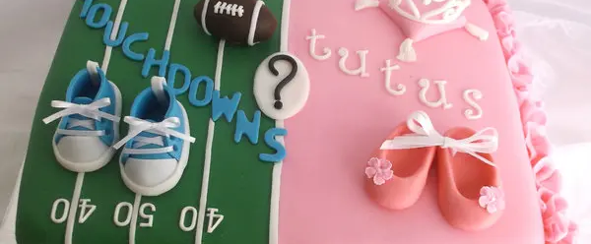
The difference between Sex and Gender
Notes:
Gender (should be called sex) reveal parties?
Gender is a social construct of what we define as masculine or feminine.
Gender identity is a deep internal sense in the head/heart of being masculine, feminine, neither, both...it can be fluid and change over time.
age 2 notice differences in boys/girls,
age 4 assert stronger sense of own identity,
puberty may realize identity doesn’t match changes occuring in body.

Slide 18
Sex is Assigned at BiRTH by a Docter looking at primary sex organs
Notes:
-sex assigned at birth
dr asigns a sex therefore guessing gender by looking at primary sex organs (penis, testicles, vulva, clitoris, vagina etc)
This can pose problem for intersex folks and for those who don’t identify masculine just because they have a penis (non binary) for example (parts match identity = binary)

Slide 19
VIDEO: Gender roles and Stereotypes
Notes:
Discussion Questions
What are some traditional gender roles shown in the video?
How might people express their gender in ways that don’t match traditional gender roles?
How do you think it would feel to be able to express your gender in a way that doesn’t match traditional gender roles? Why?
What are some things you can do if you see a person being bullied for expressing their gender in a way that does not match traditional gender roles?

Slide 20
VIDEO: Range of Gender Identities

Slide 21
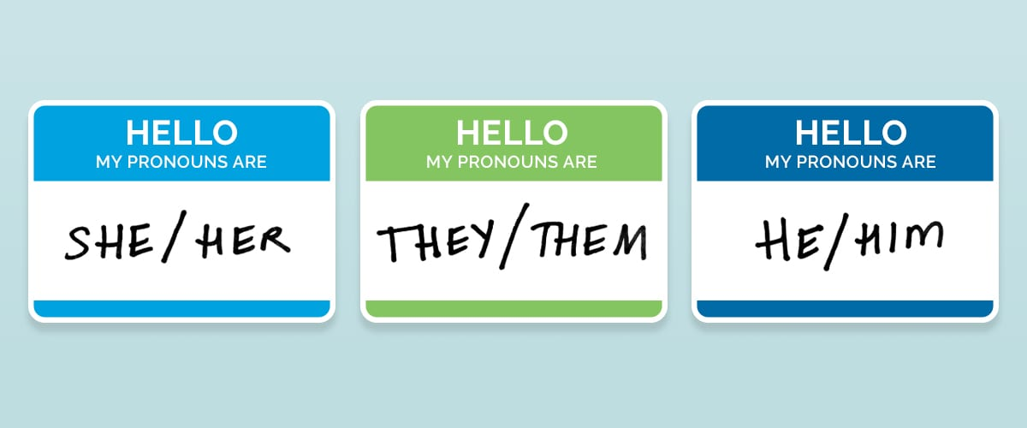
You get to pick your pronouns
Notes:
pronouns (he/him, she/her, they/them), bathrooms, LGBTQ2S

Slide 22
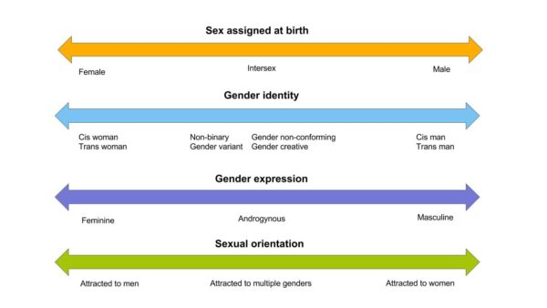
Sexual Identity and Gender Identity
Notes:
Sex assigned at birth, gender identity, gender expression, and sexual orientation are on a sliding scale. They all move independently from each other.
If someone was experiencing changes that don’t feel right for them (didn’t align with their gender identity), they can talk to a trusted adult or a doctor or counselor.
Transgender is when a person does not identify as the gender they were given as a baby. Some people who are trans will take hormones, some may have surgery, and many do not.
Gender is just one part of someone’s identity. There is also one’s sex assigned at birth (or biological sex), gender expression, and sexual orientation.

Slide 23
ACTIVITY: Gender Unicorn Sliding Scale
Notes:
Handout “The Gender Unicorn” scale. Have each student privately use the sliding scale and assess themselves.
If technology is available students can go to https://transstudent.org/gender/ and use the interactive sliding scale instead of paper.

Slide 24
EXIT TICKET: Finish KWL
GO BACK TO YOUR kwl Handout and fill in the LEARN COLLUMN. What did you learn today?

Slide 25
Questions ?
Notes:
Question Box time: Have students fill out questions and address them next class.

