Slide 1
Teacher Info Slides
What do I need to know before I teach this material?
Notes:
Student slides start at slide #4

Slide 2
Reminders When Answering Questions:
enders When Answering Questions
Set ground rules ahead of time,
set up an anonymous question box and give yourself time to formulate answers for the next session,
use reliable phrases,
always end with a safety message or direction of a reliable resource for more information,
tell students you may rephrase questions to protect confidentiality and safety of all students (no names, no questions that expose anyone)

Slide 3
Useful Phrases When Answering Questions:
some people may,
although not everyone will…
it’s important to understand the safety of…,
experts believe,
doctors suggest,
the safest way…(always end with safety as the message),
ask your family what their rules are or values are about…,
that’s an interesting question: I bet they might have an answer on one of our trusted websites: let’s find out,
sometimes people think of questions that will shock or gross us out but it doesn’t mean they are safe, true, likely or even possible,
not everything you see or hear about it is true (media literacy),
In this question I wonder if there is consent of each person and if anyone would be in harm (redirect difficult questions to safety)…

Slide 4
Health 6/7 – A Year
Lesson 5: Conception and Safety

Slide 5
Let’s review
How do we behave in Health Class?
Notes:
Go over the ground rules as a class – Print handout of rules for students included as well if you want to print it and hand it out

Slide 6
Ground Rules:
This is ‘Body Science!’ Learning about the body is fun and it helps us:
Learn how to care for our own bodies
Understand our body belongs to us and our rights
Helps us get along with other people and not cause harm to anyone else
Teaches us how to get out of unsafe situations and who to go to for help
Be private: no using other people’s names, or personal stories. We only talk about our bodies with people we trust, and trusted adults. This information is only appropriate for your age group and older: do not share with younger kids at lunch who may not be ready for it.
Personal Values: Everyone has their own set of beliefs and family values. Even if our values aren’t the same as someone else’s we still show respect and honour the diversity that exists.
Giggly wigglies: sometimes bodies are funny. If you have to laugh…follow the 3 second rule, take a deep breath and look at the ground until you can join the group again.

Slide 7
Ground Rules continued:
Use scientific terms and words: slang is ok, but always use scientific word as well. Using scientific words teaches a universal language of health.
“Interesting”: doctors never say things are gross, or say “ewww”. Instead they say “interesting…” it’s a good word to use when we don’t know what to say!
No personal questions. This rule saves a lot of embarrassing moments. It’s ok for students and teachers to not answer personal questions.
All other questions are ok: there is no such thing as a bad question in health class. There is a time and a place for questions though. Always have a piece of scrap paper out for you to write down questions that may come up so you can ask them at the appropriate time or submit it anonymously to the question box.
Support: sometimes different feelings may come up and you might need to talk with a counselor or teacher after the lesson.

Slide 8
The classroom is a safe spot for you to share your thoughts and feelings.
We have rules, because we want to make sure everyone is able to share their feelings without fear.

Slide 9
FEELINGS AND EMOTIONS
Hormones cause lot’s of new feelings including
MADS
SADS
GLADS
If you need to talk to someone about these feelings, there is resources such as talking to a safe person at school or even calling the Kids Help Phone.
Kids Help Phone:
Call: 1-800-668-6868
Text: ‘connect’ to 686868
Notes:
Brainstorm how young people can manage their new feelings and emotions (good segway into mental health and wellness strategies)
Important that if sad or mad feelings are bothering you or lasting more than 2 weeks, you should talk to a safe adult Demo calling kids help phone in class

Slide 10
Video: Feeling Depressed, Happy, and Other Emotions
Notes:
Brainstorm how young people can manage their new feelings and emotions (good segway into mental health and wellness strategies)
Important that if sad or mad feelings are bothering you or lasting more than 2 weeks, you should talk to a safe adult Demo calling kids help phone in class

Slide 11
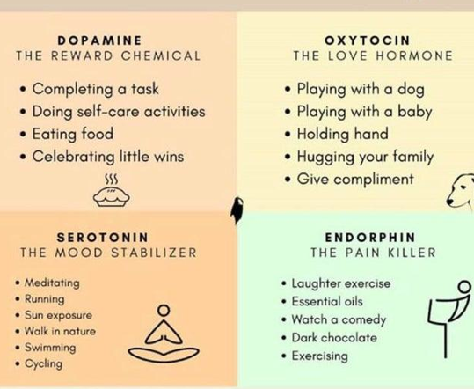
Ways to Hack Happiness Chemicals
WAYS TO HACK HAPPINESS CHEMICALS

Slide 12
HORMONES CAUSE AN INCREASE IN SEXUAL FEELINGS
KNOW YOUR PERSONAL BOUNDARIES
EXPRESS YOUR BOUNDARIES
QUALITIES OF A HEALTHY FRIENDSHIP/RELATIONSHIP
WAYS TO DEAL WITH REJECTION
CRUSHES
BUTTERFLIES
LIKING NEW PEOPLE
CHANGES IN RELATIONSHIPS
Notes:
New sexual feelings can be confusing. Brainstorm how to keep your friendships and boundaries with someone you like.
Brainstorm ways to deal with possible rejection

Slide 13
Video: First Kiss and Showing Affection
Notes:
Brainstorm how young people can manage their new feelings and emotions (good segway into mental health and wellness strategies)
Important that if sad or mad feelings are bothering you or lasting more than 2 weeks, you should talk to a safe adult Demo calling kids help phone in class

Slide 14
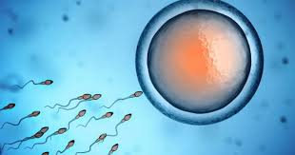
REPRODUCTION
Sexual Reproduction: How humans make more humans
2 parents combine genetic information
Egg and sperm connect
Vaginal sex/intercourse can lead to reproduction
You don’t ever have to if you don’t want!
Family values
Notes:
During puberty the body will start to be able to reproduce (ability to make babies). It takes an ova and a sperm to reproduce
To make new humans, people reproduce.
This involves the egg and the sperm meeting. This is different that asexual reproduction where there is one parent to creates offspring (fact, that is a female who creates all daughters in asexual reproduction)
This can be done sexually or by having vaginal sex: when the penis delivers sperm in to the vagina. Another name for that is intercourse.
Most people wait until they’re older to have sex (in fact most wait until after high school before the have sex for the first time) many wait until they are married, many wait until they are in love, some choose never to have sex.
If a couple need help making a baby the doctor can put the egg and sperm together in a lab and then put that into the uterus where the baby will grow
You get to decide if you ever have sex or not, and when is right for you!
Families usually have their own rules about sex. Ask your family what your values are.

Slide 15
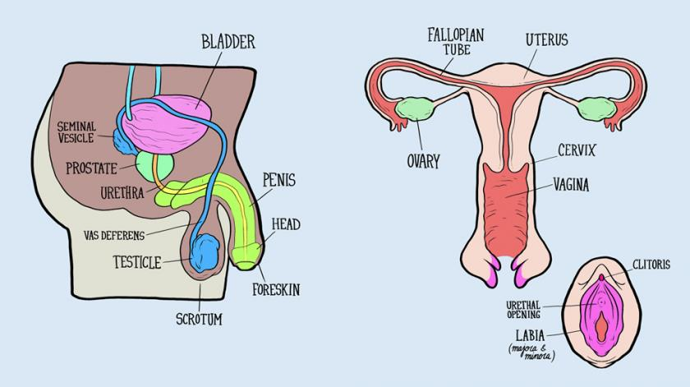
For detailed diagram handout click here
Notes:
When a baby develops in the uterus they all start out with the same body parts: all babies start out with gonads. For some babies the gonads stay inside the body and are called ovaries. For some babies the gonads drop down and are outside the body which are called testicles.
All babies start out with a clitoris which is a sensitive bump at the top of a vulva. For some babies this bump grows outside the body and is called the penis.

Slide 16
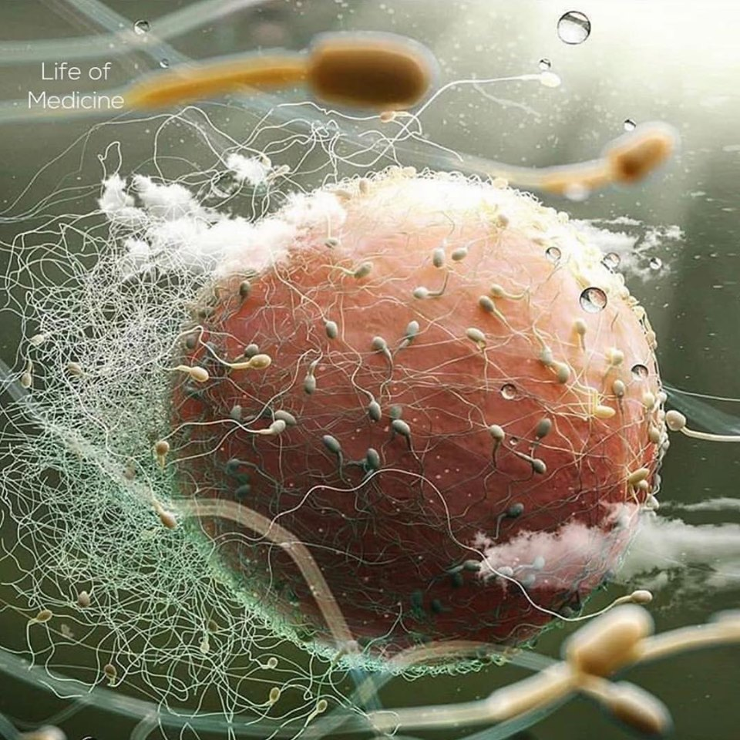
Notes:
Egg with sperm

Slide 17
CONSENT is MANDATORY
for any type of touch, especially sexual touch
Asking if the partner wants to
Giving permission
Enthusiastic “Yes!”
Body language
Close in age
“No”
Silence
Pressure
“maybe”
are all NOT CONSENT
Notes:
Any type of sexual touch requires consent. This is the LAW. People have to get permission from their partner to touch them. Both partners have to want to and say ‘Yes!’ enthusiastically.
A person can say no and that means that the other person cannot touch them.
A person can also change their mind and say no even if they said yes before.
Just because someone consents to kissing doesn’t mean they consent to more. You always have to check in to ask if it’s OK!
It is not ok for a person to pressure or guilt someone to consent.
Someone cannot consent if they have been drinking alcohol or on drugs.
Also a teenager cannot consent to someone who is much older than them.
If someone is 12 or 13 they cannot consent to someone who is more than 2 years older than them. If someone is 14 or 15 they cannot consent to someone who is more than 5 years older than them.
If someone says no, or is silent, or says maybe, or says i will if you want me to...they are not consenting.
What body language would be a sign they are not ok or not consenting?

Slide 18
VIDEO: Consent Explained
Notes:
Why is consent important?
How can you express your personal boundaries?
What can you do if someone crosses your personal boundary?
https://www.youtube.com/watch?v=5vmsfhw-czA

Slide 19
CONCEPTION
Penis becomes erect and releases sperm (ejaculation)
In 1 teaspoon of sperm there are 500,000,000 sperm
Sperm travel through the vagina, past the small opening in cervix, up fallopian tubes and looks for an egg.
If there is no sperm in the body the egg dissolves and the uterus sheds its lining
Only one can get into the egg then the door closes to the egg
What about Fraternal Twins and Identical Twins?
Notes:
Fraternal twins are made when the ovaries release not one but two eggs in the month: one sperm goes to each of the eggs
Identical twins are made when one sperm and one egg connect and then split down the centre.

Slide 20
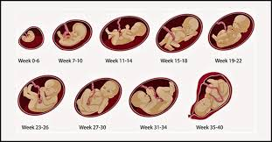
PREGNANCY
Egg and sperm connected
Cells start to multiply
Zygote embryo fetus baby
Notes:
The egg and the sperm connect and become a zygote which finds a soft place to land in the mother’s uterus. It will grow there for about 40 weeks or 9 months or until the baby is born
A zygote is a fertilized egg. After 2 weeks of growing it is called an embryo. After about 3 months of growing it’s called a fetus.

Slide 21
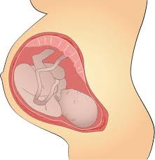
HOW BABIES GROW
PLACENTA
UMBILICAL CORD
NAVAL
Notes:
The mother’s body creates a new organ to support the baby called a placenta. It provides nutrients to the baby through the umbilical cord which attaches to the baby’s belly button (naval). Everything the mother eats/drinks gets passed through the umbilical cord. The mother also gets rid of any waste the baby makes by taking it back through the cord and her body eliminates it for the baby.
When you are born the umbilical cord is cut and you healed to get an innie or outie belly button. It doesn’t hurt when it is cut: it feels the same as cutting your hair.

Slide 22
BIRTH
Labour
Contractions
Vaginal birth
Cesarean birth
Notes:
When a baby is ready to come out, the mother will feel cramps/contractions. This is the start of labour which can be a long process of the baby making it’s way out of the body.
Some women give birth by the baby moving through cervix, the vaginal canal and out through the vagina and some give birth with the help of a doctor who makes a cut on the lower abdomen. That’s called a C section or cesarean.
Ask student to share their birth stories.
Choose one option below:
Video on reproductive system, conception and birth 7min
Animation ‘Where Do Babies Come From’ 3 min
Cartoon “Pregnancy and Reproduction Explained’ 3 min
Welcome to Life 8 billion views (conception to birth 3 min)

Slide 23
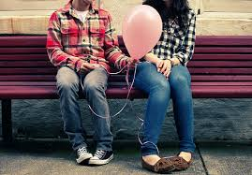
ACTIVITY: BRAINSTORM
INTIMACY
How to show you care without touch:
Notes:
Intimacy is the feeling of being close to someone and connected to them. Brainstorm ways to show you care (focus on without touch)
Spend time together, say nice things to each other, buy gifts, write a poem, do something nice for them, laugh together, go on an adventure together etc
Once touch is added it can change a relationship. Touch can feel good but it can also have it’s risks

Slide 24
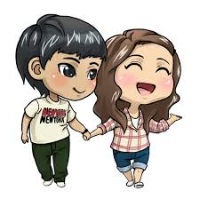
RISKS OF TOUCH
Any type of sexual touch has risks including:
REGRET
HARM TO THE OTHER PERSON
STIs PREGNANCY
Notes:
Before someone chooses to have sexual touch with another person they have to know the risks. These could include feelings of regret (if they do something before they are ready, or if it changes their relationship after)
Harm: if someone’s boundaries are not respected or someone is pressured before they are ready. This is why consent and respect is so important!!
Infections and pregnancy

Slide 25
BOUNDARIES
ACTIVITY: Kids in the Know Handout
Personal boundaries
Family rules
Limits
Trust your instincts
Think about your limits ahead of time
Practice being assertive
Know how to ask for consent
Notes:
Do Kids in the KNow lessons
Where on your body do you feel when a boundary has been crossed: gut feeling, instinct, little voice inside you, (if it’s not a OMG YES! Then it’s an OMG NO.)
Have kids practice assertiveness skills, how to say no, how to get consent, how to deal with rejection

Slide 26
VIDEO: What are STIs
Notes:
Why is consent important?
How can you express your personal boundaries?
What can you do if someone crosses your personal boundary?
https://www.youtube.com/watch?v=5vmsfhw-czA

Slide 27
SEXUALLY TRANSMITTED INFECTIONS
STIs
STI and STD mean the same thing
All sexual touch can spread STIs
They live in mucous membranes which are the dark/wet/warm skin on our bodies
Notes:
STIs are like a cold or flu virus but spread through sexual touch.
STIs are spread when our dark, wet, warm body parts touch fluids that carry STIs. Dark warm wet skin on our body is called a mucous membrane and infections can easily pass through this thin skin into our systems. These membranes are found in places like our mouth, vulva, penis, anus.
So if a couple had sexual touch that involved any of those body parts they have to protect against any infections.
If someone has never had sexual touch with another person then they do not have STIs.

Slide 28
TYPES OF RISK
FLUIDS that transmit STIs
Blood
Breast milk
Vaginal fluid
Semen/sperm
Rectal fluid
AREAS ON BODY WHICH CAN GET INFECTED
Mouth
Vulva
Penis
Anus
Notes:
Not everyone will have all types of sex in their lives. They exist so it’s important to know how to lower the risks for each type of touch.
If any of these fluids touch any of these body parts there is a major risk of infections. STI happen to most people and it’s not true it only happens to people who ‘sleep around’ or have lots of partners. They can happen to anyone even the first time someone has sexual touch!

Slide 29
Sexual Transmitted Infections
BACTERIAL
Chlamydia
Gonorrhea
Syphilis
VIRAL
Human Papillomavirus (HPV)
Human Immunodeficiency Virus (HIV)
Hepatitis A, B, C
Herpes
Notes:
There are many types of STIs. They are also very common. 5/6 people who ever have sex will get one in their lifetime. Most people won’t know they have an STI because they don’t show symptoms. That’s why people who have sexual touch get tested for STIs regularly. They can do this at a doctor or at a clinic like Options For Sexual Health.
The bacterial ones are curable! The viral ones have no cure but there are medications that help slow down the damage and make the person feel better
For some of the viral ones there are vaccines that prevent someone from getting them. Like in grade 6/9 you can get Gardasil to prevent HPV and there’s one for Hepatitis B most kids get as babies
STI Fact Sheets and Common Questions Answered

Slide 30
HOW TO LOWER RISK OF STIs
GET VACCINATED
ABSTAIN
HAVE FEWER SEXUAL PARTNERS
GET TESTED
USE PROTECTION (condoms)
*Cartoon How to use a condom 2 min
Notes:
Vaccines for HPV in grade 6 (all genders) and Grade 9 (if you missed it in grade 6). Can also get for free until 21, then it cost $600!
Abstain (not have sexual touch) as long as possible. The only 100% not to get an STI is not to have sexual touch.
Make sure you really know your partner and get tested at a clinic.
Using protection like a condom can lower risk of STIs (and also pregnancy). Internal condoms (female condoms), external condoms (male condoms), and dental dams (esentially a the same material a condom is made of placed over the vulva or anus) are all ways to create a barrier from fluids to mucous membranes

Slide 31
Using technology fill out the Reproductive System Terms for Students Handout using KidsHealth.org to find the answers
ACTIVITY: Reproductive System Terms
Notes:
Activity: Reproductive System Terms for Students Using KidsHealth.org

Slide 32
Where to get more information
School counselor or teacher
Nurses or doctors
https://sexual-education.sd68.bc.ca/teens/help/
www.kidshealth.org
1-800-sex-sense (call to ask any question about sex or bodies)
Visit the ‘Options for Sexual Health Clinic’ in Nanaimo
Printable resource list for students
www.sexandu.ca
Anonymous question time next week?
Puberty guides for each student (see ‘go to resources’)

Slide 33
Questions ?
Notes:
Question Box time: Have students fill out questions and address them next class.

