Slide 1
Teacher Info Slides
What do I need to know before I teach this material?
Notes:
Student slides start at slide #4

Slide 2
Reminders When Answering Questions:
enders When Answering Questions
Set ground rules ahead of time,
set up an anonymous question box and give yourself time to formulate answers for the next session,
use reliable phrases,
always end with a safety message or direction of a reliable resource for more information,
tell students you may rephrase questions to protect confidentiality and safety of all students (no names, no questions that expose anyone)

Slide 3
Useful Phrases When Answering Questions:
some people may,
although not everyone will…
it’s important to understand the safety of…,
experts believe,
doctors suggest,
the safest way…(always end with safety as the message),
ask your family what their rules are or values are about…,
that’s an interesting question: I bet they might have an answer on one of our trusted websites: let’s find out,
sometimes people think of questions that will shock or gross us out but it doesn’t mean they are safe, true, likely or even possible,
not everything you see or hear about it is true (media literacy),
In this question I wonder if there is consent of each person and if anyone would be in harm (redirect difficult questions to safety)…

Slide 4
Health 6/7 – A Year
Lesson 4: Puberty – Penis’ and Testicles

Slide 5

Let’s review
How do we behave in Health Class?
Notes:
Go over the ground rules as a class – Print handout of rules for students included as well if you want to print it and hand it out

Slide 6
Ground Rules:
This is ‘Body Science!’ Learning about the body is fun and it helps us:
Learn how to care for our own bodies
Understand our body belongs to us and our rights
Helps us get along with other people and not cause harm to anyone else
Teaches us how to get out of unsafe situations and who to go to for help
Be private: no using other people’s names, or personal stories. We only talk about our bodies with people we trust, and trusted adults. This information is only appropriate for your age group and older: do not share with younger kids at lunch who may not be ready for it.
Personal Values: Everyone has their own set of beliefs and family values. Even if our values aren’t the same as someone else’s we still show respect and honour the diversity that exists.
Giggly wigglies: sometimes bodies are funny. If you have to laugh…follow the 3 second rule, take a deep breath and look at the ground until you can join the group again.

Slide 7
Ground Rules continued:
Use scientific terms and words: slang is ok, but always use scientific word as well. Using scientific words teaches a universal language of health.
“Interesting”: doctors never say things are gross, or say “ewww”. Instead they say “interesting…” it’s a good word to use when we don’t know what to say!
No personal questions. This rule saves a lot of embarrassing moments. It’s ok for students and teachers to not answer personal questions.
All other questions are ok: there is no such thing as a bad question in health class. There is a time and a place for questions though. Always have a piece of scrap paper out for you to write down questions that may come up so you can ask them at the appropriate time or submit it anonymously to the question box.
Support: sometimes different feelings may come up and you might need to talk with a counselor or teacher after the lesson.

Slide 8
The classroom is a safe spot for you to share your thoughts and feelings.
We have rules, because we want to make sure everyone is able to share their feelings without fear.

Slide 9
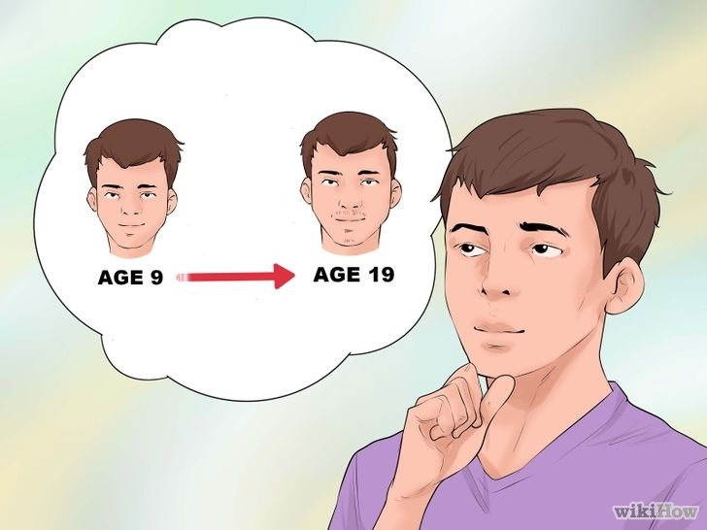
Learning Objective
At the end of the health ed. unit, I will be able to identify and differentiate physical changes between different bodies, understand and recognize physical emotional changes, and discuss the changes in my body in a mature, respectful way.
I will be able to describe parts of the reproductive anatomy of someone with testicles and learn about physical changes in the body.

Slide 10
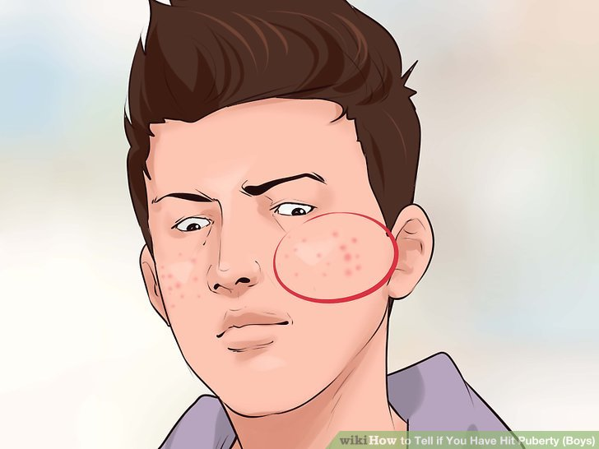
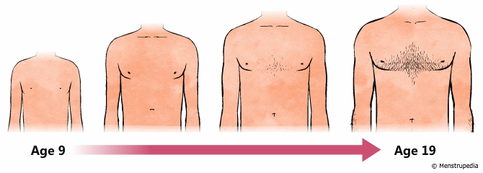
What changes happen to people who have testicles?
Hair growth (pubic area, under the armpits, and on the face)
Pimples or acne
Voice gets deeper
Penis and testicles grow
Sperm is produced

Slide 11
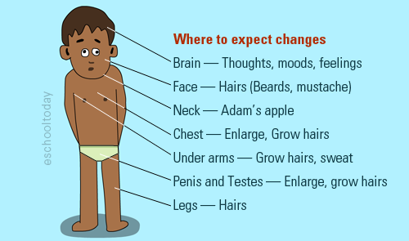
What changes happen to people who have testicles?
Muscles grow
Grow taller
Weight gain is normal
Hair and skin become oily and you may get pimples
Body sweats more

Slide 12

VIDEO: Top Signs Boys are in Puberty

Slide 13
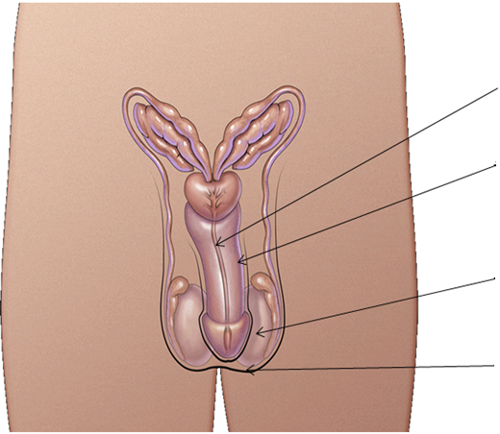
Reproductive System
Urethra
Penis
Testes or Testicles
Scrotum
Notes:
Scrotum – The sac of skin which holds the pair of testes.
Penis – It is a spongy, muscular organ that becomes enlarged and erect when sexually aroused. It varies in size. Testicles grow first so your penis may look as if it is shrinking. It isn’t. It can take a while for your penis to grow. Penises, like noses and ear and hands, come in all sizes and shapes and colours. They vary how they curve and stick out when erect. Penises, when erect, are more alike in size than when they are soft. They al work.
Urethra – The tube through which urine and semen leave the body.
Testicles (testes) – The male sex glands which produce sperm and testosterone (a male hormone).
Epididymis – A tube on the surface of each testicle which stores and transports sperm to the vas deferens.
Vas deferens – A sperm duct which leads from each testicle to the ejaculatory duct.
Seminal vesicles – Pair of glands which add a nourishing fluid to the sperm.
Prostate gland – Produces a milky fluid which forms part of the semen.
Bladder – A bag-shaped organ which holds the urine until it is discharged.

Slide 14
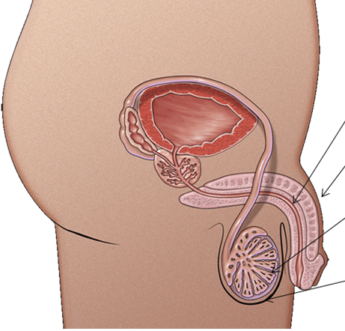
Reproductive System
Bladder
Seminal Vesicle
Prostate Gland
Urethra
Penis
Epididymis
Testicle or Testes
Scrotum
Notes:
Scrotum – The sac of skin which holds the pair of testes.
Penis – It is a spongy, muscular organ that becomes enlarged and erect when sexually aroused. It varies in size. Testicles grow first so your penis may look as if it is shrinking. It isn’t. It can take a while for your penis to grow. Penises, like noses and ear and hands, come in all sizes and shapes and colours. They vary how they curve and stick out when erect. Penises, when erect, are more alike in size than when they are soft. They al work.
Urethra – The tube through which urine and semen leave the body.
Testicles (testes) – The male sex glands which produce sperm and testosterone (a male hormone).
Epididymis – A tube on the surface of each testicle which stores and transports sperm to the vas deferens.
Vas deferens – A sperm duct which leads from each testicle to the ejaculatory duct.
Seminal vesicles – Pair of glands which add a nourishing fluid to the sperm.
Prostate gland – Produces a milky fluid which forms part of the semen.
Bladder – A bag-shaped organ which holds the urine until it is discharged.

Slide 15
Testes
Reproductive organ which produces the hormone testosterone and sperm
Similar to ovaries which produce the hormones estrogen and progesterone and eggs
Two testes (just like how people with vulvas have two ovaries)

Slide 16
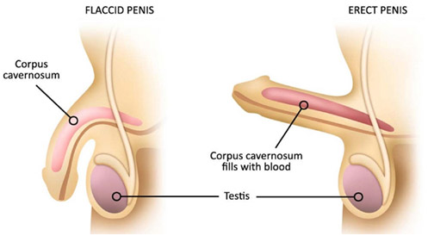
What Is an Erection?
Definition: an enlarged and rigid state of the penis
Sponge-like tissue fills with blood
Blood enlarges the penis
Makes it stand up and hard
Notes:
Semen is the fluid that can come out of the penis. It is grey or white colour and has sperm in it.
If students ask: ejaculation is also called an orgasm which is when the muscles contract and cause a good/pleasure feeling in the private part area

Slide 17
What Causes an Erection?
Boys get erections for all kinds of reasons.
  When a boy has to go to the bathroom
  When nervous or anxious
  By touching their penis
  Sometimes for no reason during puberty
  When you wake up in the morning
Notes:
However it happens is okay. It’s a private thing so it’s not something we announce. If it happens and you want it to go away…think of something really boring

Slide 18
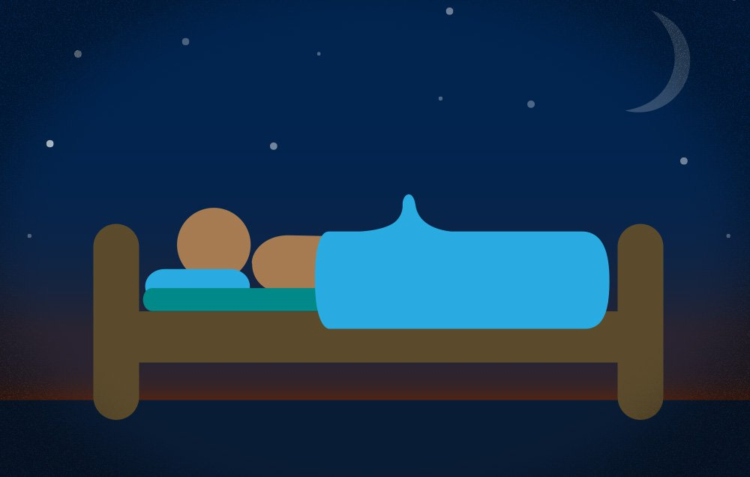
Nocturnal Penile Tumescence (NPT)
Colloquial term: “morning wood”
NPT is when you wake up with an erect penis
Common occurrence
Usually goes away after a few minutes

Slide 19
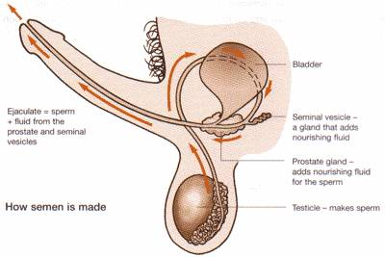
Ejaculation
Semen is released through the urethra
Semen is a whitish, sticky liquid that contains sperm

Slide 20
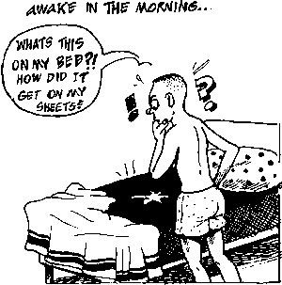
Nocturnal Emissions
Also called a “wet dream”
Happens when you ejaculate while sleeping

Slide 21
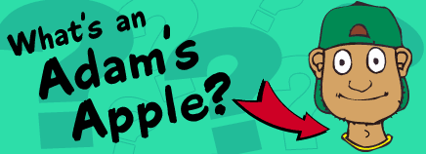
Adams Apple
The larynx, your voice box, grows larger
Deepens your voice
Appears in front of the throat
Both boys and girls have larynxes, but boys’ grow larger during puberty. That’s why boys have Adam's apples and girls don’t.

Slide 22
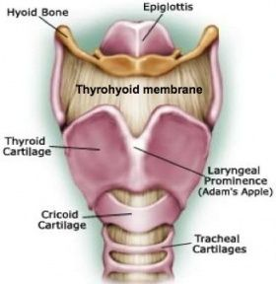
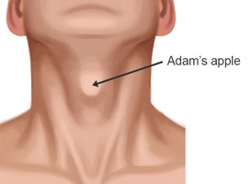
Adams Apple

Slide 23
Male Voice Change
may become squeaky during the transition to a deeper voice as the larynx grows
Voice may crack
Lasts a few months
Usually occurs around middle to high school

Slide 24
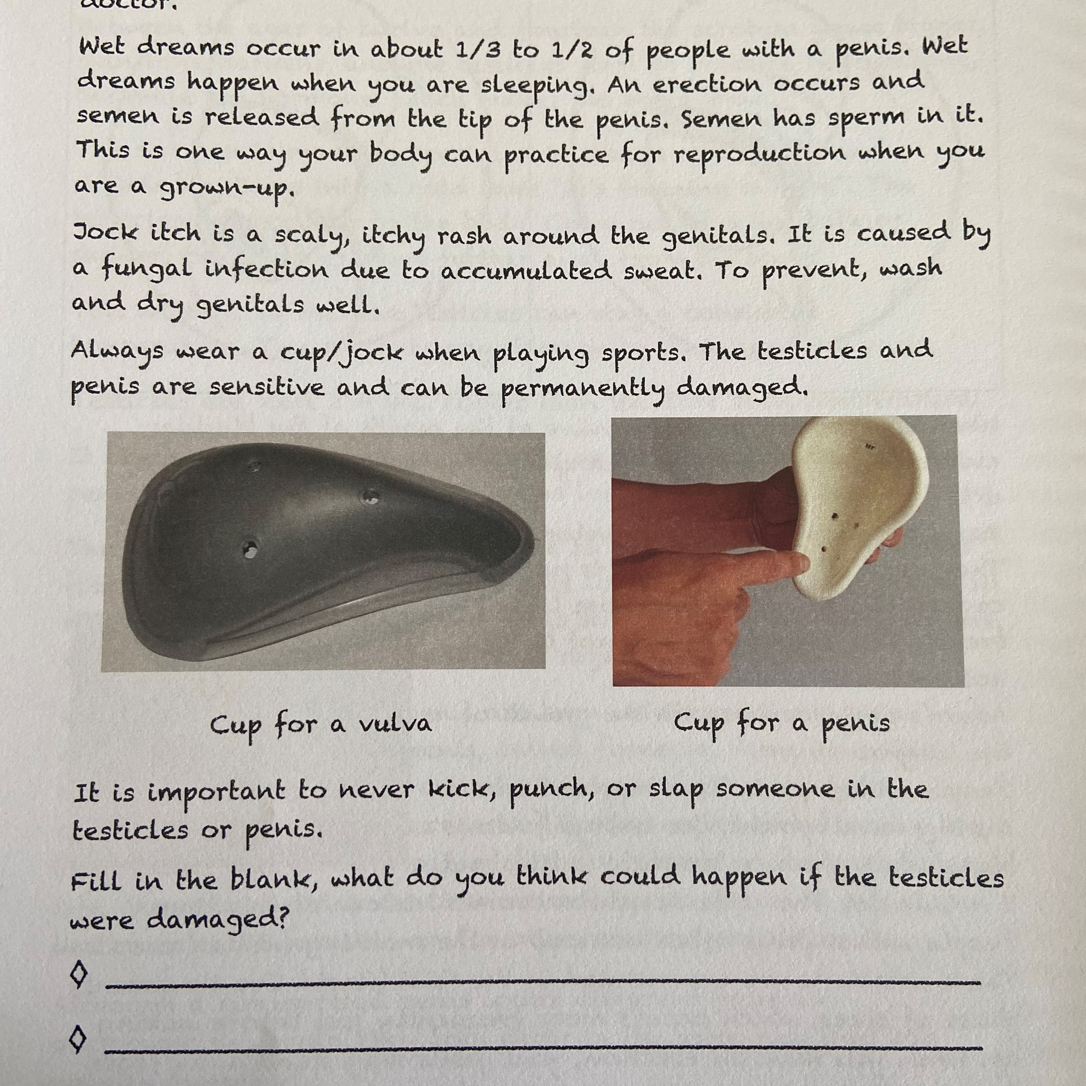
ACTIVITY: Handout Package
Read and complete all the questions in the handout package
Notes:
Print the package of Keri Isham. Book: “Puberty: Coming to a body Near You”. Pages 42, 56- 59
Have students complete all activities in the package

Slide 25
Questions ?

