Slide 1
Teacher Info Slides
What do I need to know before I teach this material?
Notes:
Student slides start at slide #4

Slide 2
Reminders When Answering Questions:
enders When Answering Questions
Set ground rules ahead of time,
set up an anonymous question box and give yourself time to formulate answers for the next session,
use reliable phrases,
always end with a safety message or direction of a reliable resource for more information,
tell students you may rephrase questions to protect confidentiality and safety of all students (no names, no questions that expose anyone)

Slide 3
Useful Phrases When Answering Questions:
some people may,
although not everyone will…
it’s important to understand the safety of…,
experts believe,
doctors suggest,
the safest way…(always end with safety as the message),
ask your family what their rules are or values are about…,
that’s an interesting question: I bet they might have an answer on one of our trusted websites: let’s find out,
sometimes people think of questions that will shock or gross us out but it doesn’t mean they are safe, true, likely or even possible,
not everything you see or hear about it is true (media literacy),
In this question I wonder if there is consent of each person and if anyone would be in harm (redirect difficult questions to safety)…

Slide 4
Health 6/7 – B year
Lesson 3: Healthy Relationships

Slide 5
Let’s review
How do we behave in Health Class?
Notes:
Go over the ground rules as a class – Print handout of rules for students included as well if you want to print it and hand it out

Slide 6
Ground Rules:
This is ‘Body Science!’ Learning about the body is fun and it helps us:
Learn how to care for our own bodies
Understand our body belongs to us and our rights
Helps us get along with other people and not cause harm to anyone else
Teaches us how to get out of unsafe situations and who to go to for help
Be private: no using other people’s names, or personal stories. We only talk about our bodies with people we trust, and trusted adults. This information is only appropriate for your age group and older: do not share with younger kids at lunch who may not be ready for it.
Personal Values: Everyone has their own set of beliefs and family values. Even if our values aren’t the same as someone else’s we still show respect and honour the diversity that exists.
Giggly wigglies: sometimes bodies are funny. If you have to laugh…follow the 3 second rule, take a deep breath and look at the ground until you can join the group again.

Slide 7
Ground Rules continued:
Use scientific terms and words: slang is ok, but always use scientific word as well. Using scientific words teaches a universal language of health.
“Interesting”: doctors never say things are gross, or say “ewww”. Instead they say “interesting…” it’s a good word to use when we don’t know what to say!
No personal questions. This rule saves a lot of embarrassing moments. It’s ok for students and teachers to not answer personal questions.
All other questions are ok: there is no such thing as a bad question in health class. There is a time and a place for questions though. Always have a piece of scrap paper out for you to write down questions that may come up so you can ask them at the appropriate time or submit it anonymously to the question box.
Support: sometimes different feelings may come up and you might need to talk with a counselor or teacher after the lesson.

Slide 8
The classroom is a safe spot for you to share your thoughts and feelings.
We have rules, because we want to make sure everyone can share their feelings without fear.

Slide 9
Healthy Relationships
Boundaries, assertiveness skills, not being a bystander, responding to harassment

Slide 10
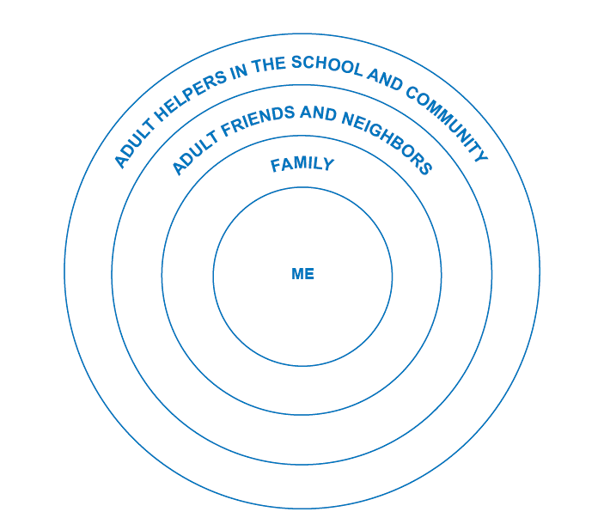
RELATIONSHIPS
THE WAY YOU ARE CONNECTED TO OTHER PEOPLE
Notes:
The most important relationship you have is with yourself. Take time to develop your interests, values, beliefs. Know your self worth, ways to grow your self esteem/ways to hurt your self esteem.
Each level reflects different levels of intimacy and closeness.

Slide 11
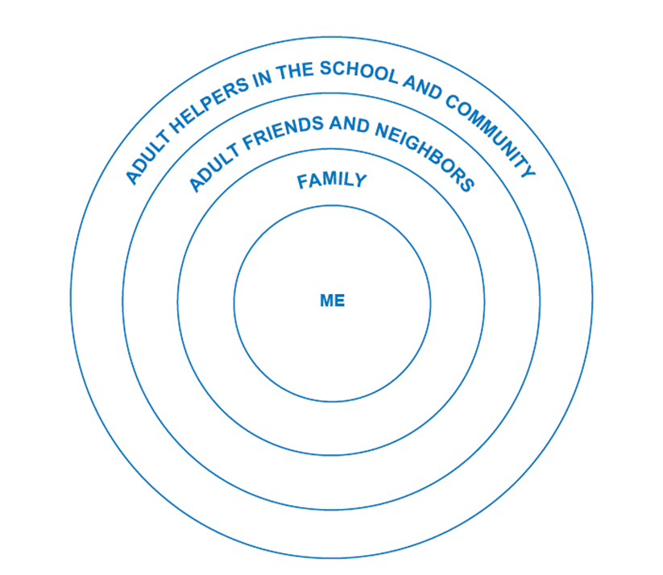
EACH RELATIONSHIP NEEDS THESE QUALITIES
RESPECT, PATIENCE, KINDNESS
DEPENDABLE, LISTENING, HONESTY
TRUST, ENJOYMENT, INTIMACY
SELF RESPECT, SELF CARE, POSITIVE SELF TALK
Intimacy: sharing of thoughts and feelings and experiences
WHERE WOULD A RELATIONSHIP FIT IN?
Notes:
Each layer requires different levels of trust and qualities to be healthy. Note, for strangers, they are just people we just haven’t met yet. Not all strangers are good/not all are bad...just like at any level: even for family...not all family members we have healthy relationships with.

Slide 12
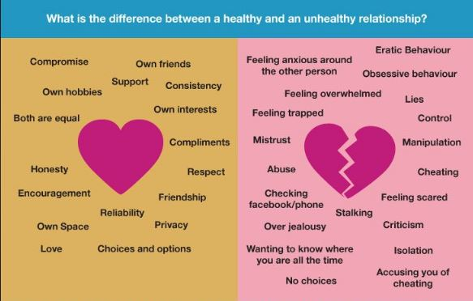
Healthy relationships take skill and practice!
Notes:
Talk about how you would demonstrate these healthy qualities at each level
Talk about who teaches people healthy relationship skills
Besides our family, how else can we learn the skills to have healthy relationships

Slide 13
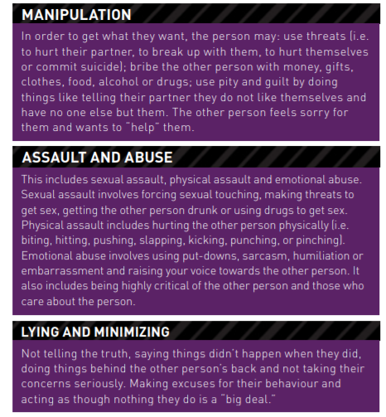
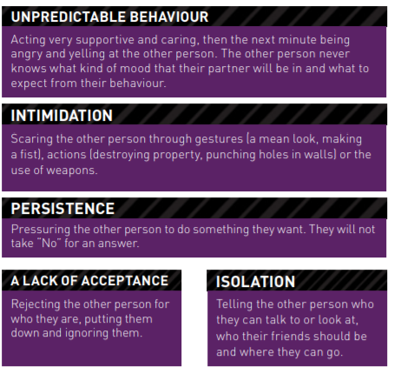
UNHEALTHY RELATIONSHIPS
Notes:
Print handout from: https://needhelpnow.ca/pdfs/NHN_relationships_en.pdf

Slide 14
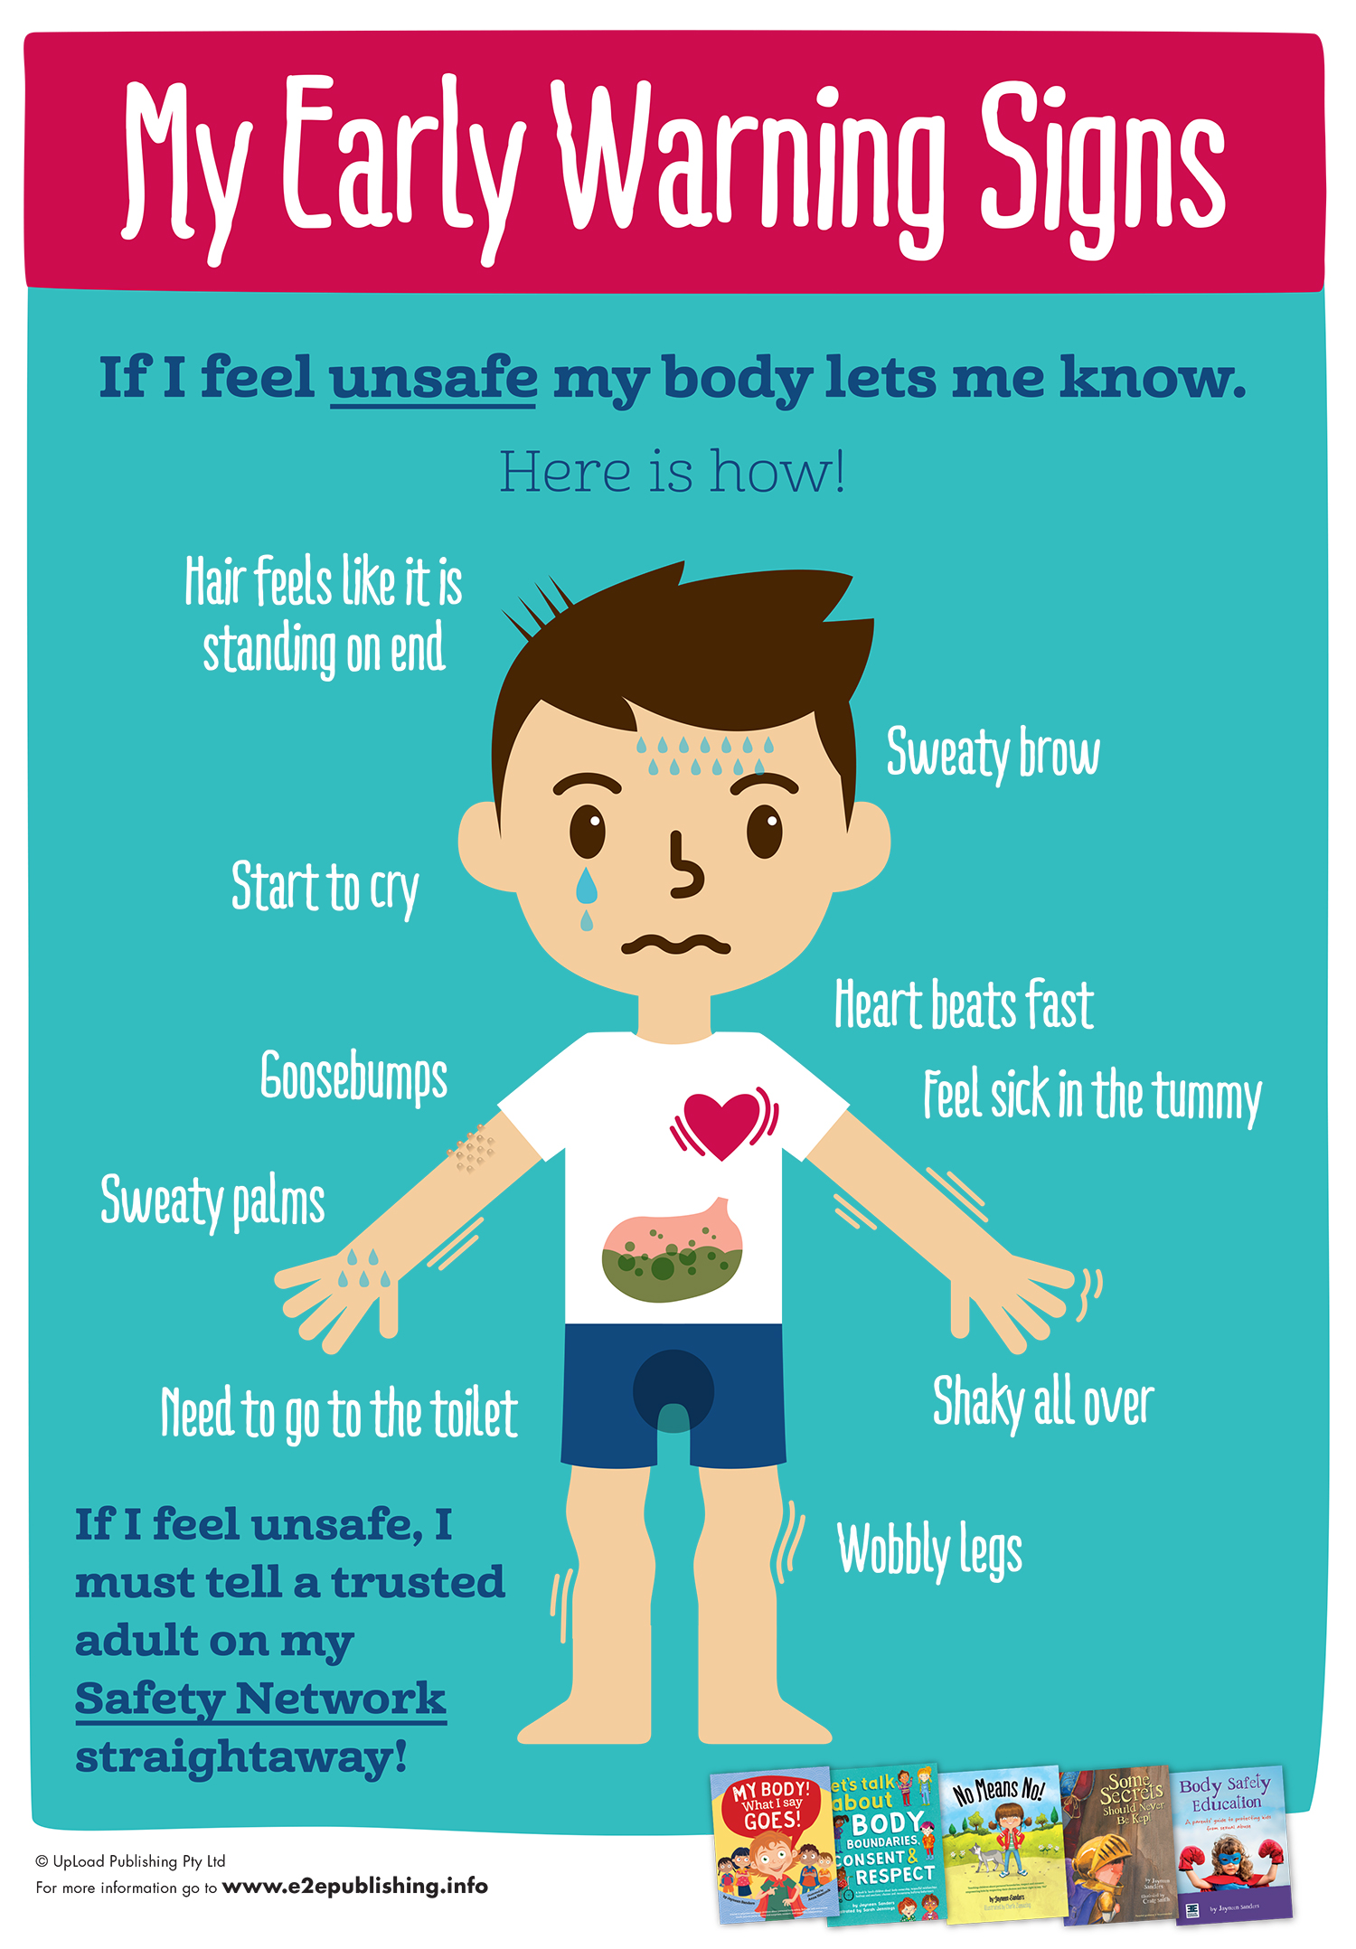
HOW DO YOU KNOW WHEN IT TURNS UNHEALTHY
Gut feelings
Instincts
Early warning signs
Little voice in you
Put yourself in their shoes (empathy)

Slide 15
Video: Teasing not just harmless fun

Slide 16
Video: What is sexual assault?

Slide 17
ACTIVITY: Think-Pair-Share Think about these questions, Talk about them with a partner, and then share out as a class: -What are some examples of sexual assault or sexual abuse in the video? -What does giving consent look like? -What doesn’t it look like? How do you ask for consent? -What are some examples of situations in which a person cannot consent? -If someone has been sexually assaulted or abused, who should they talk to?

Slide 19
VIDEO: Sexual Assault – It can happen to anyone?

Slide 20
Sexual Assault:
If any of these things happens to a child, it is never their fault! Grown ups and teenagers know the rules about these things It can be confusing and hard for a child to report it. It’s ok to report even years later! Counselors, safe adults, teachers are all good people to report to
Model how to access: -Kids Help Phone website and 1-800-668-6868, -VI Crisis Line

Slide 21
Consent
What does giving consent look like?
“yes!” “Sure!” “ok!” “I totally want to!”
What doesn’t it look like?
Silence, nodding head, looking away
How do you ask for consent?
“Would you like to..”
“can I…” “do you like….”
“how are you feeling…” “is it ok if we…”
Check body language: look at the message their body is telling you!
crossed arms, looking away, covering their body, ignoring you, mumbling, sighing
Remember you can change your mind at any time about consent and consenting to one thing doesn’t mean you consent to other things!

Slide 22
VIDEO: Consent Explained

Slide 23
What are some examples of situations in which a person cannot consent? -Under age -drunk -high -feeling pressured -they are under someone’s power/control
Notes:
*see ‘Is That Legal?!’ for age of consent chart on page 4

Slide 24
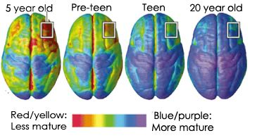
What parts of the brain are red in pre-teens?
Notes:
frontal lobe and along the top back of brain. Showing still maturing, not fully developed

Slide 25
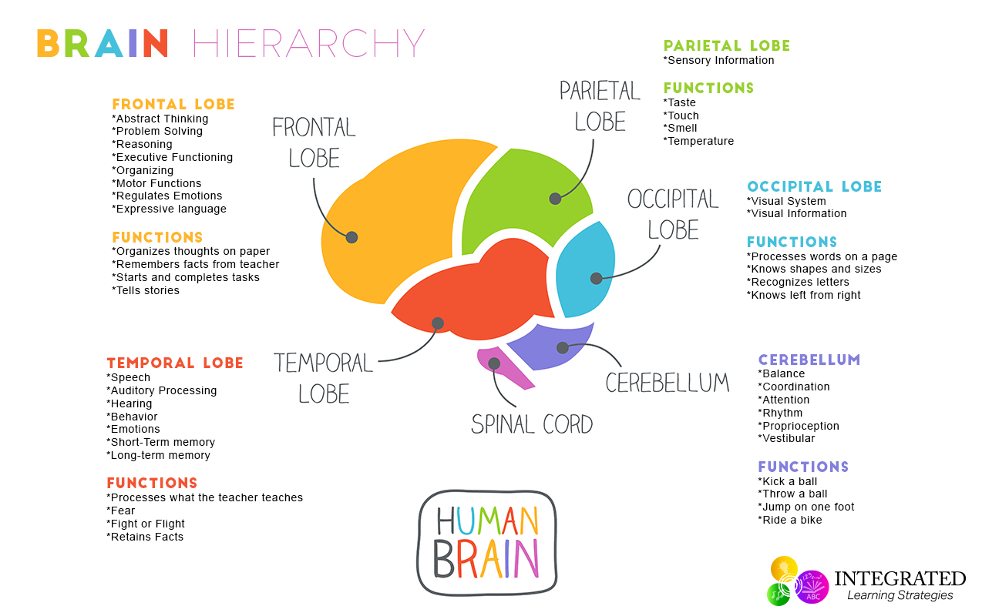
Notes:
The brain’s front area (known for making decisions and understanding risk, managing emotions) is still forming in teens.
That’s why they sometimes make decisions that they regret later.

Slide 26
Sexting
RULES:
Best advice is NOT TO SEND NUDE PICTURES. They come back to haunt people...
People will ask you...you have to get good at dealing with those pressure situations
It is wrong to ask someone to send a nude or sexy pic. It’s called harassment (which is against the law)
Dick pics are illegal (if someone sends you one report it to the principal or the police)
It is illegal to have a sexy/nude pic of a child (under 18) on your device
Once you press send you lose control
Showing your friends pics that were sent to only you is a crime
Everything you do on a phone/social media is traceable back to you. Make sure you create a positive footprint because it is permanent!
If a picture is shared without your consent or you’re being blackmailed/bullied report to www.needhelpnow.ca or www.erasebullying.ca
Notes:
Sending a sext is a text of a picture of a body that is of private body parts or pic of sexual touch.
If a person is about to send a risky nude pic their brain goes through a dopamine rush (their brain feels overwhelmed with a feel good chemical temporarily leading them to make a rash/impulsive decision) IF a person can wait 90 seconds, the dopamine will go back to normal and the person can make a rational decision. DON’T PRESS SEND
Watch cartoon and discuss two questions

Slide 27
VIDEO: Sexting – What should you do?
Notes:
Q: What happens on the other end when a nude is received (could it be shared with friends, a parent sees it, posted online...etc)
Q: What are some actual respectful ways to show you like or care for someone?

Slide 28
Ways to respond to someone asking for a nude
Uhhh No!
Haha you wish
I’m good
As if!!!!
Ignore them
Send them a pic of something random
(want to build intimacy, send pics of cute animals...people always like those)

Slide 29
VIDEO: Sexting Scenarios

Slide 30
A DEVELOPING BRAIN EXPOSED TO….
PORN
MARIJUANA
DRUGS
TECHNOLOGY (SNAPCHAT, VIDEO GAMES, PHONES)
Notes:
Early exposure creates new brain pathways and affects the dopamine (feel good chemicals) making it easier to get addicted. Exposure to porn on a developing brain can be linked to more sexual violence, pressuring partners, and expecting partners to replicate harmful/painful/de-humanizing/exploitative sexual acts.

Slide 31
VIDEO: Being assertive, passive, aggressive

Slide 32
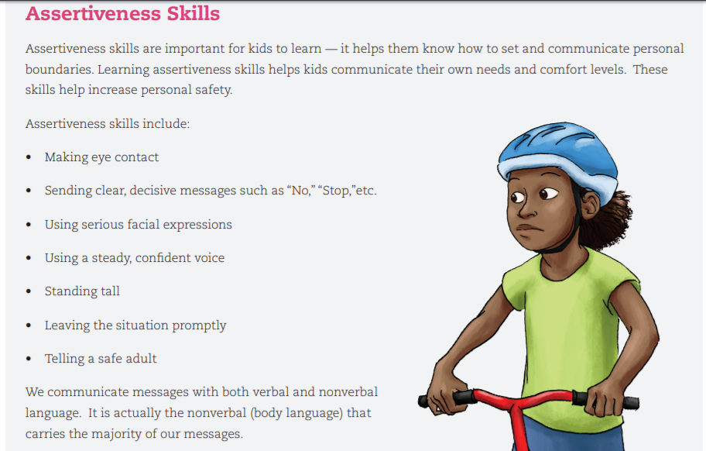
Tricks to become more assertive

Slide 33
VIDEO: More than a bystander

Slide 34
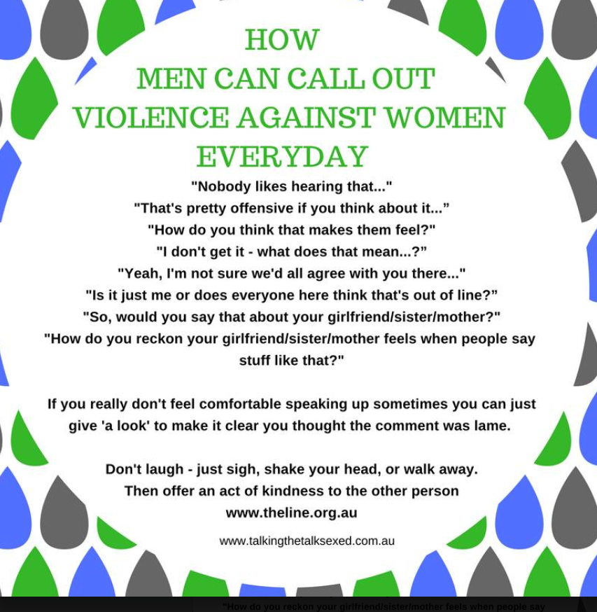
QUICK WAYS TO NOT BE A BYSTANDER

Slide 35
ACTIVTIY: Exit Scenarios
Listen to your gut feelings!
Read through the scenarios and discuss what you could do in each one:
Hearing a sexual comment and jokes that make you feel weird
2. Someone trying to flirt with you, and you feel uncomfortable
3. A classmate who always bumps into you, brushes against your body and you don’t want it
4. A friend tries to get you to watch something on the computer that’s inappropriate, disgusting, or not for kids
5. An older teen is trying to get your friend to do something dangerous or inappropriate
6. Someone you really like is pressuring you to do things you’re not ready for

Slide 36
Questions ?
Notes:
Question Box time: Have students fill out questions and address them next class.

