Slide 1
Teacher Info Slides
What do I need to know before I teach this material?
Notes:
Student slides start at slide #4

Slide 2
Reminders When Answering Questions:
enders When Answering Questions
Set ground rules ahead of time,
set up an anonymous question box and give yourself time to formulate answers for the next session,
use reliable phrases,
always end with a safety message or direction of a reliable resource for more information,
tell students you may rephrase questions to protect confidentiality and safety of all students (no names, no questions that expose anyone)

Slide 3
Useful Phrases When Answering Questions:
some people may,
although not everyone will…
it’s important to understand the safety of…,
experts believe,
doctors suggest,
the safest way…(always end with safety as the message),
ask your family what their rules are or values are about…,
that’s an interesting question: I bet they might have an answer on one of our trusted websites: let’s find out,
sometimes people think of questions that will shock or gross us out but it doesn’t mean they are safe, true, likely or even possible,
not everything you see or hear about it is true (media literacy),
In this question I wonder if there is consent of each person and if anyone would be in harm (redirect difficult questions to safety)…

Slide 4
Health 6/7 – A Year
Lesson 3: Puberty – Menstration

Slide 5
Let’s review
How do we behave in Health Class?
Notes:
Go over the ground rules as a class – Print handout of rules for students included as well if you want to print it and hand it out

Slide 6
Ground Rules:
This is ‘Body Science!’ Learning about the body is fun and it helps us:
Learn how to care for our own bodies
Understand our body belongs to us and our rights
Helps us get along with other people and not cause harm to anyone else
Teaches us how to get out of unsafe situations and who to go to for help
Be private: no using other people’s names, or personal stories. We only talk about our bodies with people we trust, and trusted adults. This information is only appropriate for your age group and older: do not share with younger kids at lunch who may not be ready for it.
Personal Values: Everyone has their own set of beliefs and family values. Even if our values aren’t the same as someone else’s we still show respect and honour the diversity that exists.
Giggly wigglies: sometimes bodies are funny. If you have to laugh…follow the 3 second rule, take a deep breath and look at the ground until you can join the group again.

Slide 7
Ground Rules continued:
Use scientific terms and words: slang is ok, but always use scientific word as well. Using scientific words teaches a universal language of health.
“Interesting”: doctors never say things are gross, or say “ewww”. Instead they say “interesting…” it’s a good word to use when we don’t know what to say!
No personal questions. This rule saves a lot of embarrassing moments. It’s ok for students and teachers to not answer personal questions.
All other questions are ok: there is no such thing as a bad question in health class. There is a time and a place for questions though. Always have a piece of scrap paper out for you to write down questions that may come up so you can ask them at the appropriate time or submit it anonymously to the question box.
Support: sometimes different feelings may come up and you might need to talk with a counselor or teacher after the lesson.

Slide 8
The classroom is a safe spot for you to share your thoughts and feelings.
We have rules, because we want to make sure everyone is able to share their feelings without fear.

Slide 9
Today you will learn about
the anatomy of a female (person with a vulva)
menstruation
changes in the female body

Slide 10
Learning Objective
I will be able to describe the process of menstruation, identify parts of the female reproductive system, and learn what to do when menstruation happens.
At the end of the health ed. unit, I will be able to identify and differentiate anatomy, understand and recognize physical emotional changes, and discuss the changes in my body in a mature, respectful way.

Slide 11
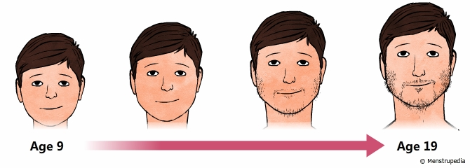
What is Puberty?
Talk at your tables to review our last lesson.

Slide 12
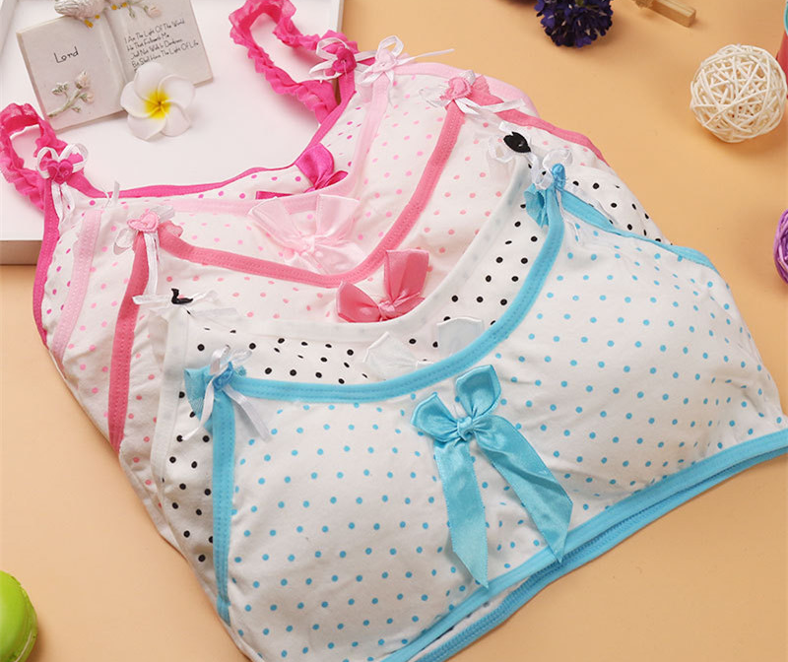
What changes happen to people with vulvas?
Grow taller
Bones grow
Fat content increases in breasts and hips, making your body curvier
Hair and skin become oily
and you may get pimples
Breasts get larger

Slide 13
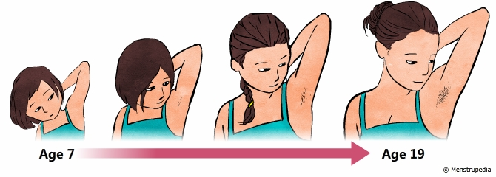
What changes happen to people with vulvas?
Hair grows under armpits and in pubic area
Voice gets a little deeper
May sweat more
Menstruation (period) begins
Mood swings

Slide 14
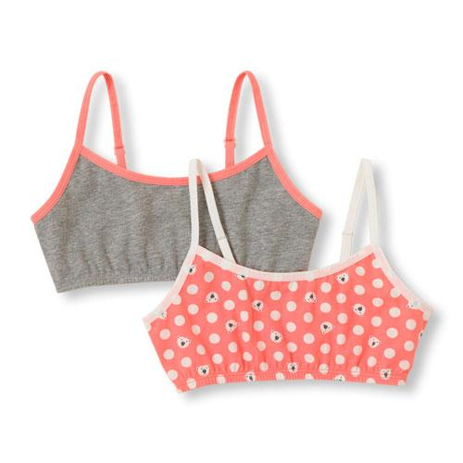
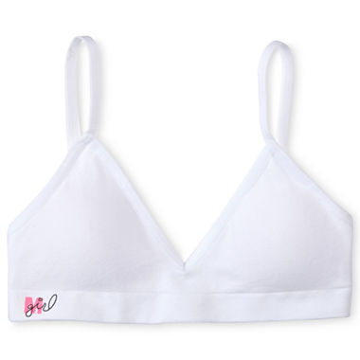
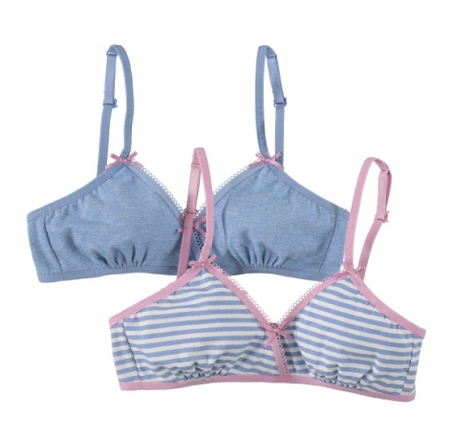
My breasts are getting larger! What do I do?
Might want to wear a training bra (also called a bralette or starter bra)
These are for people who are just beginning to develop their breasts and cannot yet fill out a standard bra

Slide 15
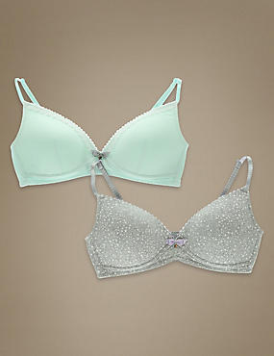
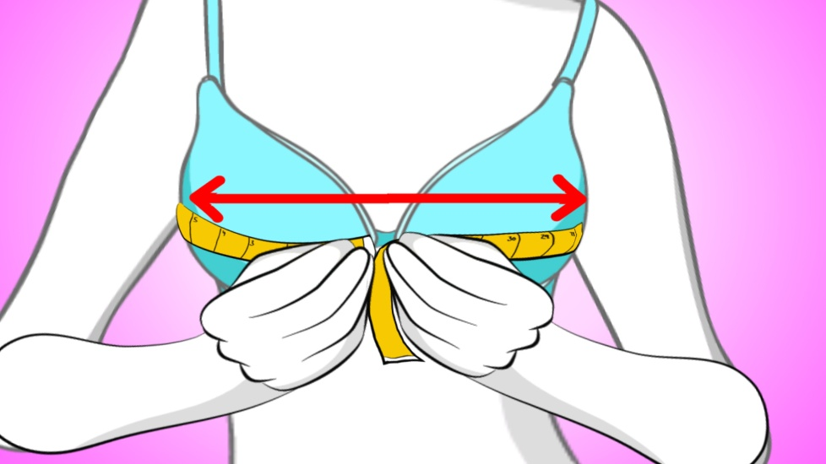
Changes in bra size
Your breasts will continue to grow until you reach adulthood
Weight gain or loss may affect your bra size

Slide 16
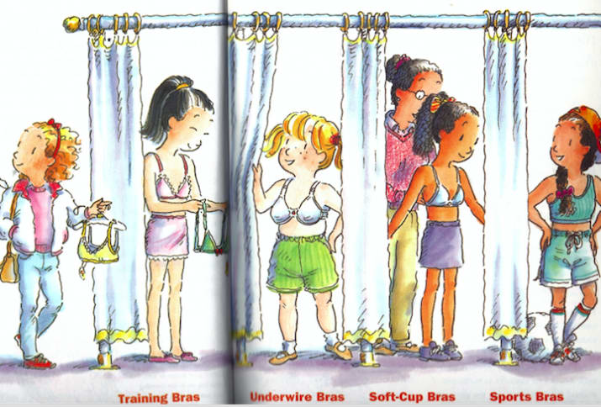
Different types of bras
You can have different types of bras for different occassions.
Training bras
Underwire bras – most support, good for women with larger breasts
Soft-cup bras – most comfortable, good for women with smaller breasts
Sports bras – good for active girls and women

Slide 17
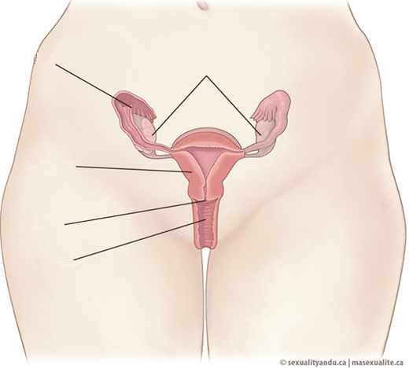
People with a Vulva
Fallopian Tube
Ovaries
Uterus
Cervix
Vagina
Notes:
Ovary – It releases egg cells and produces hormones (estrogen and progesterone).
Fallopian Tubes – Tubes leading from the ovary to the top of the uterus, that surround an ovary.
Uterus – Pear-shaped organ which nourishes and holds a developing fetus. It prepares for a pregnancy each month by forming a lining (waterbed) of blood/water and special tissues
Uterine Lining – The lining of the uterus which thickens and sheds during the menstrual cycle.
Cervix – The narrow inner end of the vagina, which leads to the uterus.
Vagina – A muscular tube which expands to fit a baby during birth and then goes back to original size

Slide 18
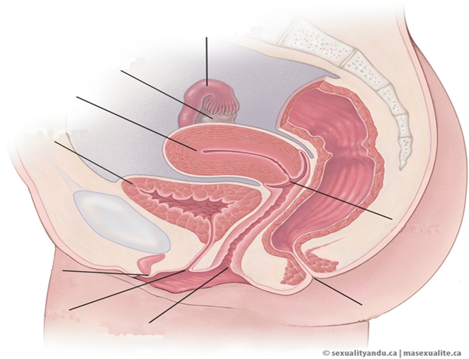
People with a Vulva
Fallopian Tube
Ovary
Uterus
Bladder
Cervix
Clitoris
Urethra
Rectum
Vaginal Opening
Notes:
Ovary – It releases egg cells and produces hormones (estrogen and progesterone).
Fallopian Tubes – Tubes leading from the ovary to the top of the uterus, that surround an ovary.
Uterus – Pear-shaped organ which nourishes and holds a developing fetus. It prepares for a pregnancy each month by forming a lining (waterbed) of blood/water and special tissues
Uterine Lining – The lining of the uterus which thickens and sheds during the menstrual cycle.
Cervix – The narrow inner end of the vagina, which leads to the uterus.
Vagina – A muscular tube which expands to fit a baby during birth and then goes back to original size
Vaginal Opening – The opening to the vagina covered with a hymen. It’s like a thin layer of skin that opens on it’s own as someone grows. For some people it doesn't open as fast so it may be painful to insert a tampon
Clitoris – a highly sensitive organ above the urinary opening which may provide a good feeling or pleasure to females when stimulated (touched).
If students ask: (an orgasm is tiny muscles that contract at the same time releasing a good feeling in the private part area)
Pubis – A fleshy pad of tissue which is covered with pubic hair.
Labia – Fold of skin (inner and outer) which protect the (inner, outer) internal reproduction organs.
Urethra-Tube that carries urine out of the body. When wiping, wipe from front to back to avoid bladder infections
Vulva-this is the whole private part area on a person that has a vagina. The vulva is the outside area which includes the labia, clitoris, urethra, and vagina

Slide 19
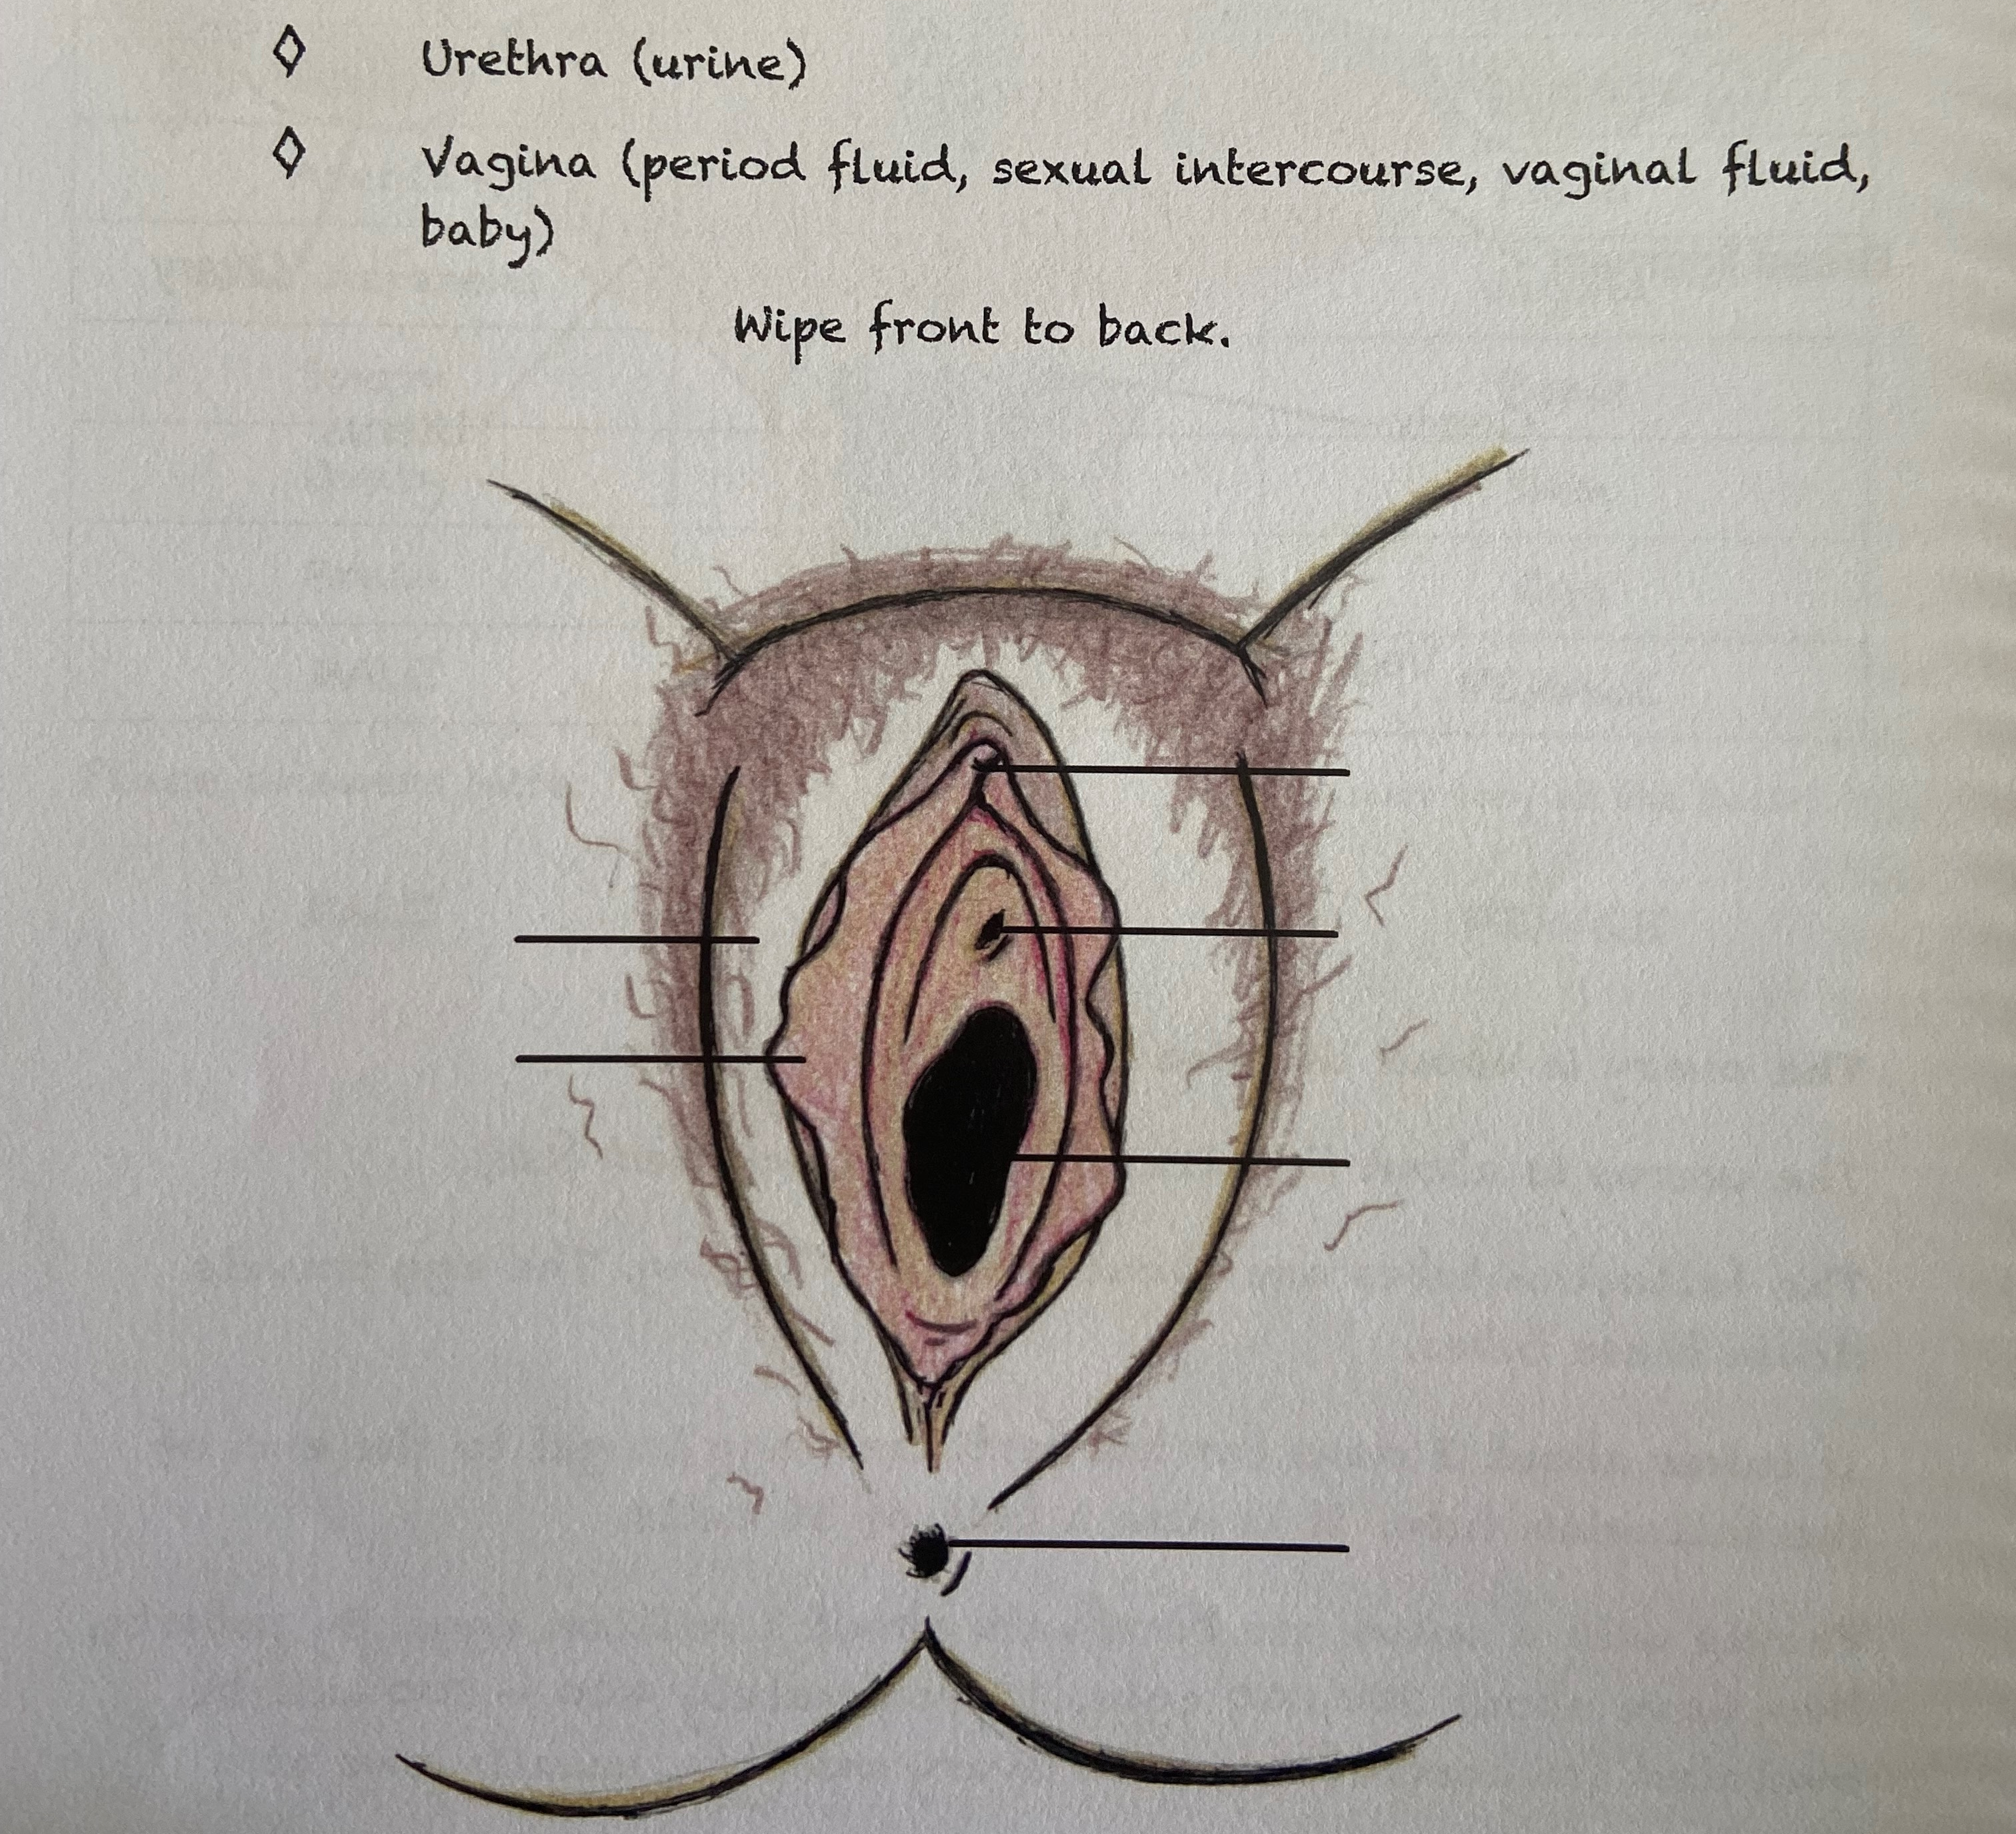
ACTIVITY: Label Vulva
Label the parts of the Vulva
Notes:
Handout a package to each student with the 5 pages from Keri Isham. Book: “Puberty: Coming to a body Near You”. Pages 36-40,55
Students complete the Vulva Labeling Activity on page 37

Slide 20
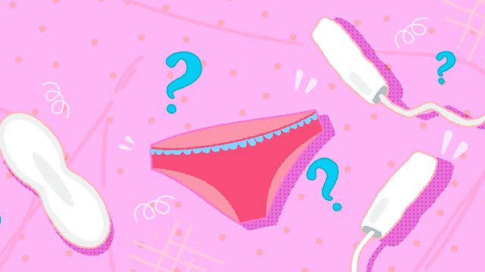
So What Are Periods and Why Do They Happen?
A person with a vulva is born with hundreds of thousands of tiny eggs, called ova – one is called an ovum
At puberty, hormones tell the ovaries it is time to start releasing an ova every month
Usually one egg at a time (usually once a month) develops and is released from an ovary
Notes:
One month usually the left side releases one ova, then the next month the right side releases one. A person can sometimes feel it being release (like a little cramp on one side) about 2 weeks before her period!

Slide 21
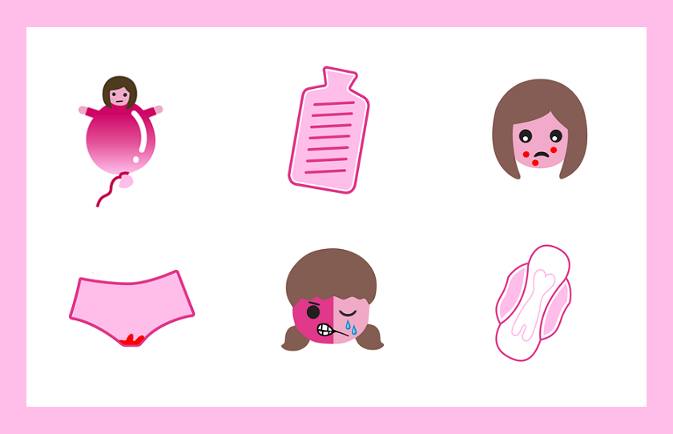
What Are Periods and Why Do They Happen?
At the same time, the uterus starts to grow a thick lining on the inside wall
The lining has lots of tiny blood vessels
The lining is there to protect and feed an egg that has combined with a sperm to form a fertilized egg
Notes:
If a fertilized egg attaches to the wall of the uterus this can result in a pregnancy

Slide 22
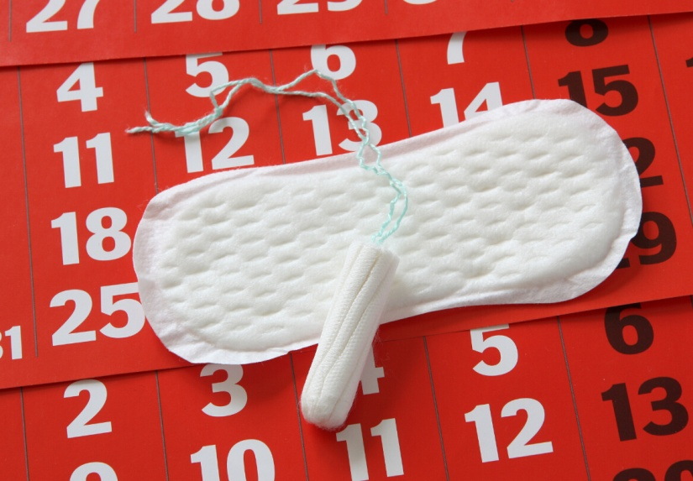
So What Are Periods and Why Do They Happen?
If an egg does not meet a sperm, the lining is not needed.
It breaks up
Mixed with some blood it comes out the uterus into the vagina and then out the vaginal opening
This is called menstruation but lots of females just call it their period.

Slide 23
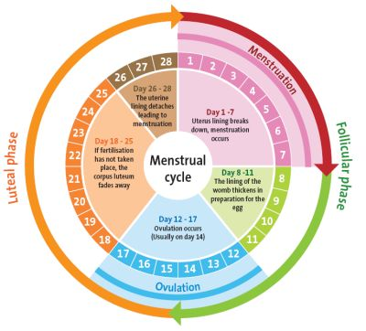
Menstrual Cycle
If a person with a vulva is not pregnant:
then her ovary releases another egg
uterus lining build ups
another period
This is called the menstrual cycle
People have periods once a month.

Slide 24
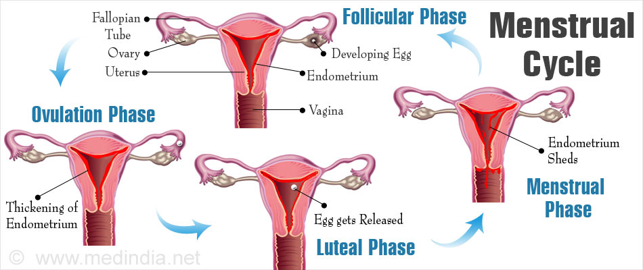
Menstrual Cycle

Slide 25
VIDEO: Menstruation What to Expect

Slide 26
When will I get my period?
No exact start time
Usually happens around the age of 9-13
Depends on diet and nutrition
May see some white or yellow discharge in underwear before period begins
How long will the bleeding last?
Each person is different. It can vary from 3 – 8 days
During a period you will only lose a few tablespoons to about half a cup of blood in that time – not a lot
Notes:
If a period is super painful or very heavy they talk to a safe adult or doctor.
To help ease pain: hot water bottles or a heating pad on the belly help, eating bananas, and medication like motrin/ibprofin/Tylenol help (not aspirin!)

Slide 27
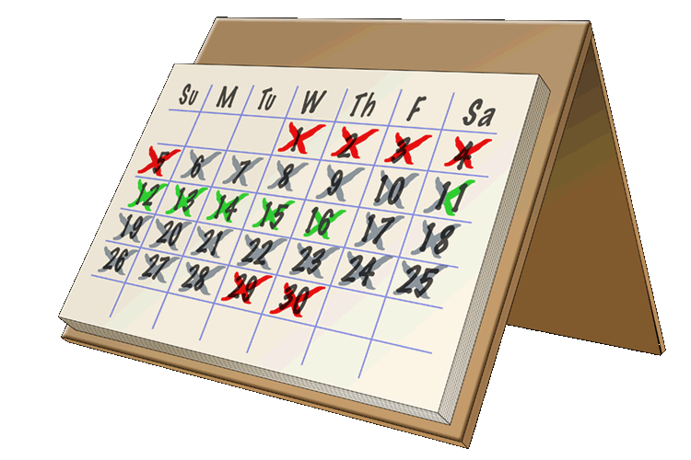
How often will I get a period?
At first there may not be any pattern to when you will get your next period
Most women eventually have a regular cycle
The length of a cycle is from the first day of bleeding one month to the first day of bleeding the next time it happens
Each person is different
may have a period every 23 days, some every 28 days and some every 35 days
Lots of girls keep a calendar to help them keep track of when they have their period and how long it lasts.

Slide 28
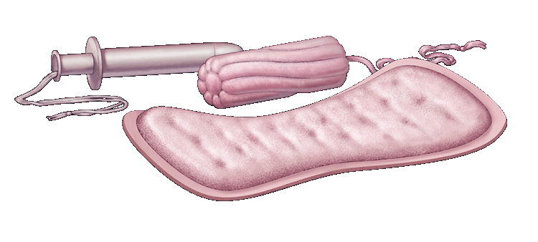
What Do I do When I Get My Period?
Pads or tampons are used to catch the blood that comes from the vagina
Pads are made of material that absorbs the blood
Most have a sticky strip on one side to hold the pad to the underwear
Pads come in a variety of sizes and shapes
Notes:
Pads are easier to use than tampons
Open up and show real pads

Slide 29
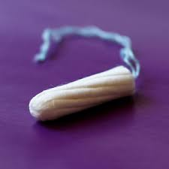
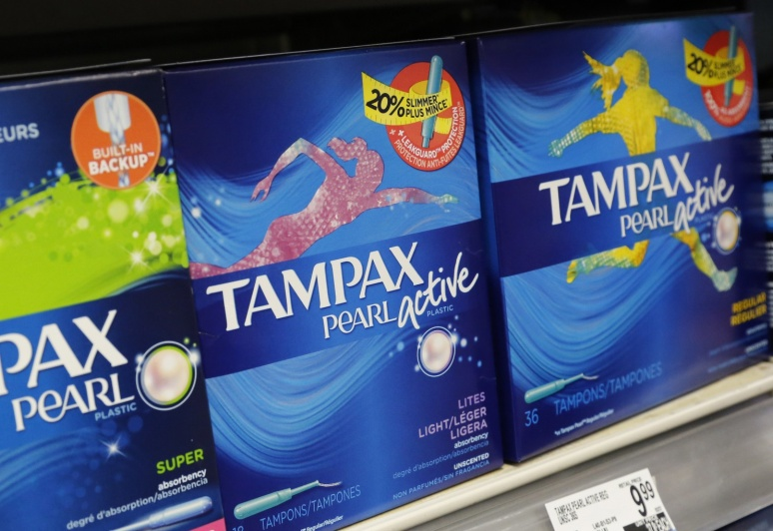
Tampons
A tampon made of soft material that fits inside the vagina to absorb the blood
Some people like to use tampons, especially if they are doing physical activities, but pads are fine too
They are good if you’re going swimming
Some people find them painful to insert: if so wait until older
to go into the water
Notes:
Can open a real one to show class
Using pads or tampons is an individual choice, some religions don’t condone use of tampons
Risk of using tampons – toxic shock syndrome (extremely rare, but teach to change before 8 hours)

Slide 30
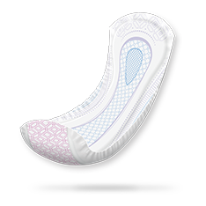
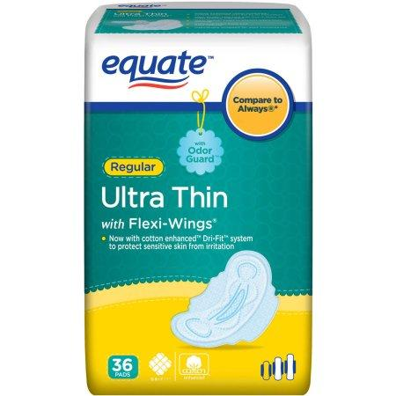
Pads
are a lining that go over your underwear
Cannot be used for swimming
have a sticky strip on one side to hold the pad to the underwear
come in a variety of sizes and shapes

Slide 31
VIDEO: Period Hygiene: Tampons, Pads and Menstrual Cups

Slide 32
ACTIVITY: PERIOD CHALLENGE
Answer every question correctly without the help of the people with ovaries
What age do girls normally start their period
starts between age 8-16
How often does it come
about once a month
Right before her period she gets some pain in her lower abdomen, what’s that called
cramps
How many days does it last
about 3-8 days
How much fluid (water, special tissues, and blood) leave the body every month
about 3 tablespoons of fluid
So it doesn’t get on their underwear what can they wear to catch the fluid
pads, panty liners, tampons, Diva Cups, the new period underwear like Thinx/Lunapanties etc
What would a girl use if there weren’t any supplies at her home
toilet paper short term.
Where in a school can she get pads if she gets her period at school
In the bathroom, counselors, or the front office
What adults could someone talk to if they had questions about periods
Teachers, counselors, principals, EAs, parents, nurses, doctors etc
Notes:
I like to play a game that makes it a little more fun. Rules are: people with testicles must answer every question correctly, if they get one wrong the people with ovaries win!! Kids love this and it takes the stress of the girls.

Slide 33
Questions ?
Notes:
Question Box time: Have students fill out questions and address them next class.

