Slide 1
Keep it Safe
Grade 3 – 5 Safety Lesson #1

Slide 2
Digital Wellness – Big Idea
Ensure students, at every grade level, have the tools, resources, and skills to interact personally, socially, and educationally in the real world and in digital spaces.
Encourage all students to make safe, healthy, and positive decisions to live a digitally balanced life in our technology-rich world.

Slide 4
Preparation
Video: Online Privacy for Kids Link in Slide #6
Brainstorm: Headings – Personal Information / Safe Information
Video: Traffic Light Link in Slide #8
Book: Chicken Clicking by Jeanette Willis
Game Instructions Link in Slide #12
Game Statements Link in Slide #12

Slide 5
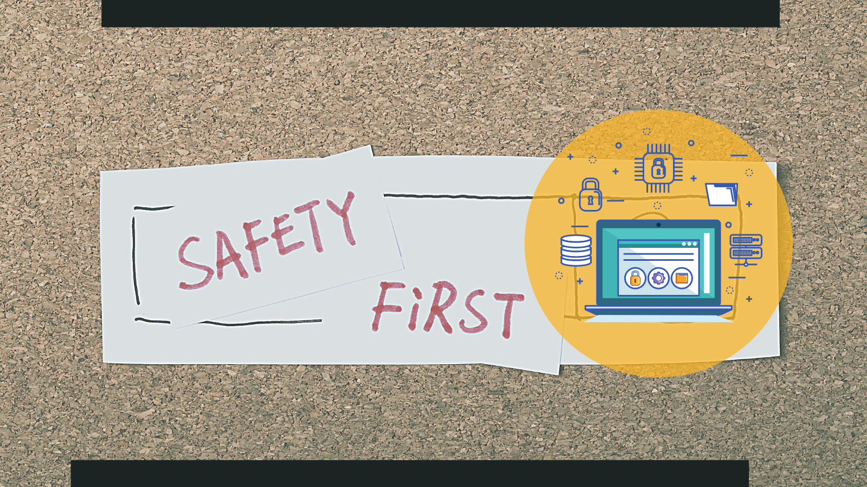
Learning intentions 4-2 What can we do to keep ourselves and others safe on the internet
be safe
Learn to manage personal data to maintain privacy and security.
Learn what to do if an online interaction makes them feel uncomfortable or unsafe

Slide 6
ACTIVATE - Video
Watch the video below by clicking on the image.
Online Privacy for Kids
3:00

Slide 7
Acquire - discuss
Things we should do
Things we shouldn’t do
The video mentioned a number of things the boy shared online he shouldn’t have. Talk about those as well as other things we shouldn’t do when online to keep ourselves safe.
Then talk about things we should do to help keep ourselves safe online.

Slide 8
apply - Evaluate
Watch the video –
Traffic Light – Trust Your Gut (1:00)
This talks about using the different colours on the traffic light in approaching online situations:
Green means GO!
To sites we trust.
Yellow means SLOW!
Being safe is a must.
Red means STOP.
Ask if it's OK.

Slide 9
GAME
online safety Traffic light
Instructions
List of statements
Notes:
Click on each of the icons for learn more about how to play the game. The information icon will explain the directions, the question mark icon will provide the list of questions to ask the students.

Slide 10
READ
Chicken Clicking by Jeanette Willis
This is a book that focuses on how to be safe online. The author writes about a chicken who often would go into the farmer’s house and search the web, purchasing items by clicking away. Next, the chicken is seeking a friend. The chicken begins talking to whom he/she believes is another fellow chicken. They decide to meet up. When they do, the chicken is shocked to find out he/she has been talking to a FOX!
Video Read Aloud

Slide 11
Teacher Notes
Tips
This lesson is important to help students be aware of who they are interacting with online – especially in apps that do NOT focus on younger users.
Extension Activities
Play Digital Passport game, “Share Jumper”.
Curate a “Safe” list of sites that are 100% safe for children.
Take Home Resources
Family Resource – Interacting with Friends Online
Digital Footprint & Identity – Family Activity
This lesson will help students recognize different scenarios with technology use and teach them strategies on how to deal with them.
Develop a “checklist” of things students should be aware of when interacting online (alone) without direct supervision.
Online Reputation Checklist
Protecting Your Child’s Private Information

