Slide 1
Secure Your Password
Grade 3 – 5 Safety Lesson #2

Slide 2
Digital Wellness – Big Idea
Ensure students, at every grade level, have the tools, resources, and skills to interact personally, socially, and educationally in the real world and in digital spaces.
Encourage all students to make safe, healthy, and positive decisions to live a digitally balanced life in our technology-rich world.

Slide 4
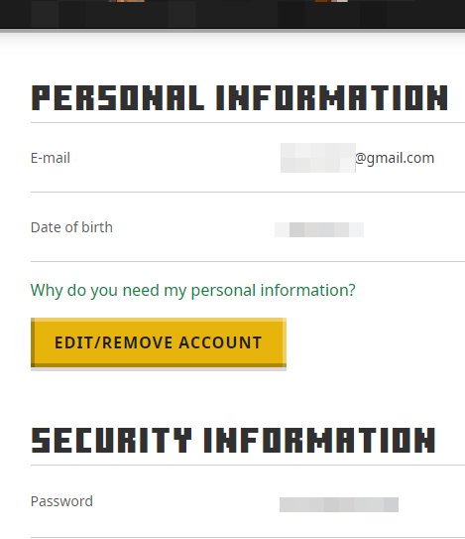
Learning intentions 2-1 How can we create a secure password and appropriate profile to protect our privacy.
password
profile
Learn the terms “password”.
Learn how to create a strong password.
Learn the term “profile”.
Learn what information is appropriate to include on our online profiles.

Slide 5
Preparation
Video: How to Create a Strong Password Link in Slide #6
Brainstorm: Headings – Personal Information / Safe Information
Video: Strong Password Link in Slide #10
Handout: PowerUp Password Sheet – photocopy for students
Game Instructions Link in Slide #12
Game Statements Link in Slide #12

Slide 6
ACTIVATE - Video
Watch the video below by clicking on the image.
How to Create a Strong Password
3:30

Slide 7
Acquire – Think-Pair -share
What is something in your life that you take steps to protect?
Why and how do you protect it?
Take a moment to think silently about these questions.
Then, take turns sharing your response with your partner.

Slide 8
Acquire – evaluate & connect
Passwords and Profiles are things that we need to be sure to protect. We do this by making sure we don’t include ANY personal information in them. This way it makes it hard for internet thieves to steal our information.
Personal information
safe information
Name
Birthdate
Address
Phone Number
. . .
. . .
. . .
Favourite book
Favourite colour
Numbers or Symbols
. . .
. . .
. . .
What else needs to be on the above lists?

Slide 9
Tips for creating a strong password
Start with a memorable phrase
Only a trusted adult should know your password
Never use personal information identity in your password
Create a password with at least 8 characters long.
Use letters, numbers and symbols in your password

Slide 10
APPLY - Video
Watch the video below by clicking on the image.
Strong Password
1:46

Slide 11
Apply – SECURE Your Password
Start with a memorable phrase
Only a trusted adult should know your password
Never use personal information identity in your password
Create a password with at least 8 characters long.
Use letters, numbers and symbols in your password
Using the password tips create your own secure password.
Create an appropriate avatar or profile name that you might use online.
Top 20 Most Popular Passwords
Secure Your Password Worksheet

Slide 12
GAME
STEP TO THE LINE
Instructions
List of Questions
Notes:
Click on each of the icons for learn more about how to play the game. The information icon will explain the directions, the question mark icon will provide the list of questions to ask the students.

Slide 13
Teacher Notes
Tips
This lesson helps reinforce the importance of NOT including ANY PII (personally identifiable information) on anything that is created online.
Extension Activities
Handout cardstock folded into 2” x 8” strips – have students create avatar name tags for their desks.
Take Home Resources
Strong vs. Weak Password Activity
5 Family Tips for Internet Safety
THEN try and guess which avatar goes with each student.
I also helps reinforcing NOT to share passwords with ANYONE.
CSM – Uh Oh – Scenarios.
Play Digital Passport game “Password Protect”
Protecting Your Child’s Private Information

