Slide 1
Digital Tracks
Grade 3 – 5 Etiquette Lesson #2

Slide 2
Digital Wellness – Big Idea
Ensure students, at every grade level, have the tools, resources, and skills to interact personally, socially, and educationally in the real world and in digital spaces.
Encourage all students to make safe, healthy, and positive decisions to live a digitally balanced life in our technology-rich world.

Slide 4
Preparation
Video: What’s Your Digital Footprint Link in Slide #6
Handout: Digital Tracks Handout – photocopy for students Link in Slide #7
Book: The Technology Tail by Julia Cook
Video: Your Digital Footprint Matters Link in Slide #11
Game Instructions Link in Slide #12
Game Statements Link in Slide #12

Slide 5
Learning intentions 3-2 Why should be careful of what we add to our digital footprint?
Digital tracks
Define the term "digital footprint" and identify how it affects online reputation..
Identify the impact digital footprints have on security, privacy and trust AND how we’re not always in control of this.
Understand what responsibilities they have for the digital footprints of themselves and others.

Slide 6
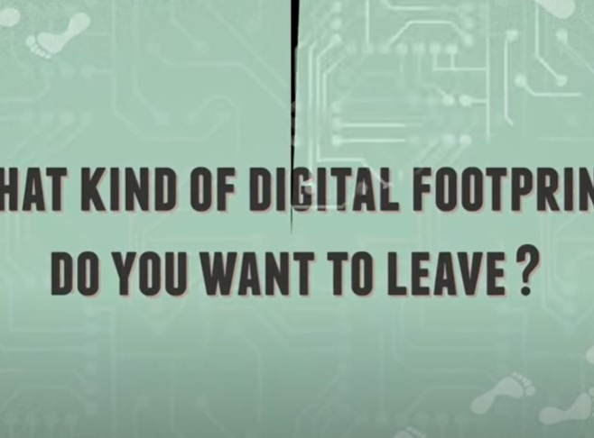
ACTIVATE - Video
Watch ONE of the videos below by clicking on the image.
What’s in Your Digital Footprint?
1:19
Digital Footprint
1:57

Slide 7
Acquire – connect
How can what I do online make me unsafe?
How can what I do online affect others?
Take a moment to think silently about these questions.
Then, with a partner fill out the worksheet your teacher has handed out. Be ready to share out your answers.
Digital Tracks Handout

Slide 8
Apply - Connect
What do you think some of our responsibilities are for being online? Both to ourselves and to others?
RESPONSIBILITIES TO OURSELVES
Show your best self when you're online
RESPONSIBILITIES TO OTHERS
Get permission before posting a pic of someone or tagging them
Only post things you're comfortable showing publicly
Treat others online how you would want to be treated
????? What else ?????
????? What else ?????

Slide 9
APPLY - READ
The Technology Tail by Julia Cook
This book focuses on the importance of understanding what a digital footprint is and how what is posted can have an effect on your life. It offers suggestions for parents and teachers to cover online safety, kindness, and respect in a world that revolves around being digitally connected.
Video Read Aloud

Slide 10
APPLY – Extend 5P’s for a Positive Digital Footprint If we apply the “5 P’s Rule” we will make sure we can leave a positive digital footprint.

Slide 11
ApPLY – WATCH
Click on the image to watch the video:
“Your Digital Footprint Matters”
(2:46)

Slide 12
Game – Apply Best Foot Forward
Game Instructions
Game Statements

Slide 13
Teacher Notes
Tips
Digital footprints can affect your online reputation for a long time. But kids don't always realize that digital footprints aren't just a personal matter. This lesson helps show your students how they can contribute to a positive digital reputation, both for themselves and for others.
Extension Activities
Students can create their own “Digital Tracks” using the blank footprints from the activity.
Take Home Resources
Digital Footprint and Identity - Family Activity
Family Tips for Posting Safely
Play Digital Passport game, “Share Jumper”.
Online Reputation Checklist
Protecting Your Child’s Private Information

