Slide 1
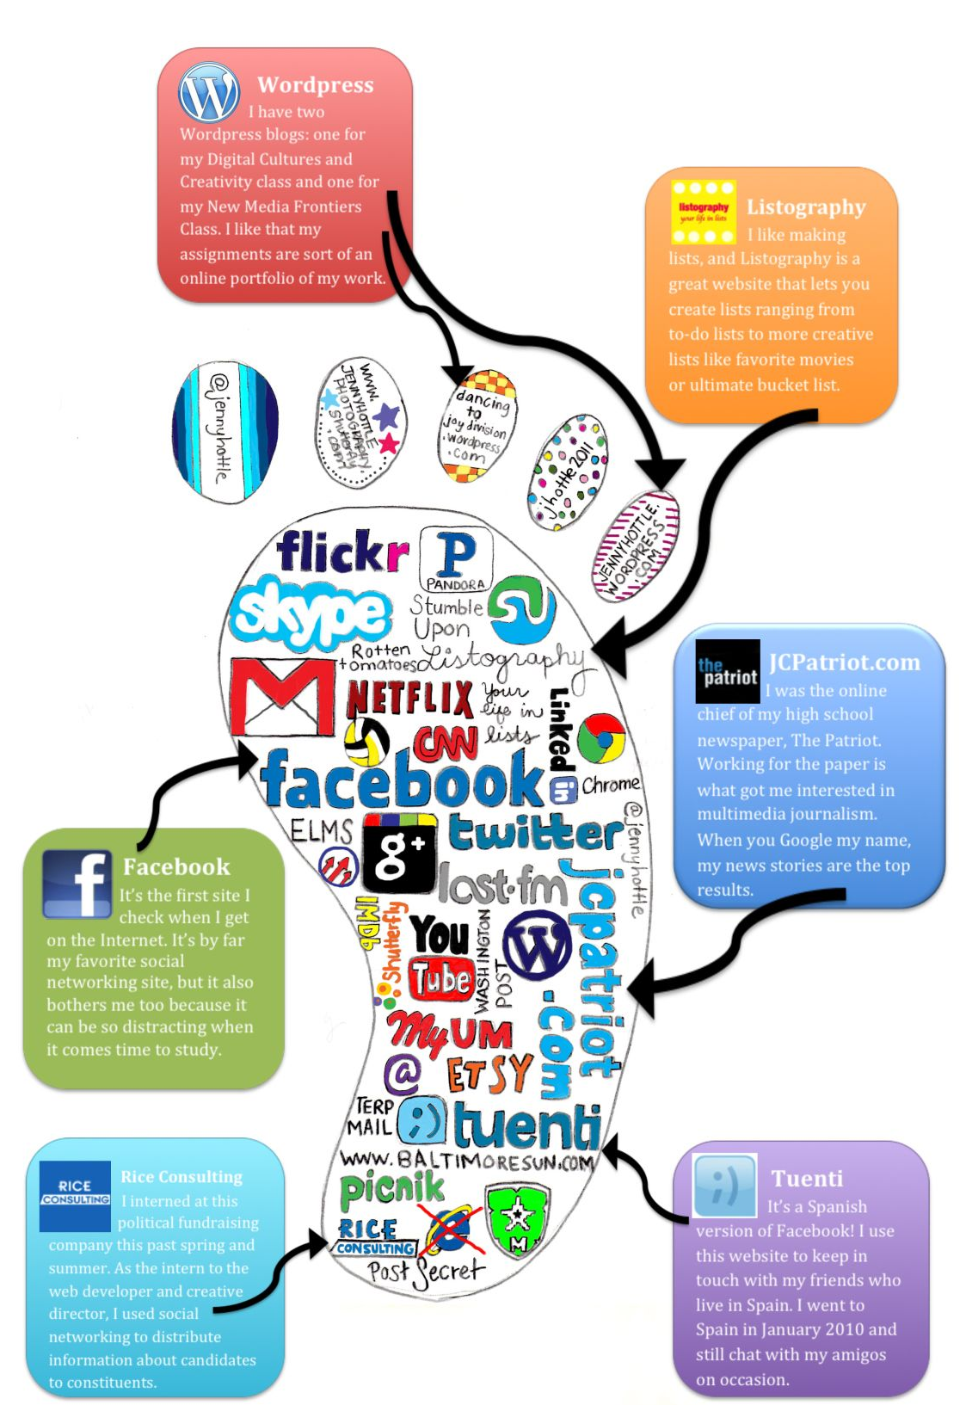
Put Your Best Foot Forward
If the statement is “true for you”, take a step forward or backwards depending on what each slide indicates.
IF it is “not true for you”, just stay where you are.
FORWARD
BACKWARD

Slide 2
I messaged something mean to someone.

Slide 3
I posted a picture of myself with something that could identify me in the background (school, house, name, birthday, etc)

Slide 4
I used a nickname NOT my real name for my profile name.

Slide 5
I shared a picture of myself online doing something embarrassing.

Slide 6
I posted a picture of myself AND someone else WITHOUT their permission.

Slide 7
I used YouTube to learn more about something.

Slide 8
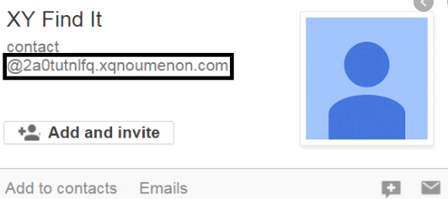
I shared my email address with someone I don’t know face to face.

Slide 9
I posted a picture of myself and my dog on Instagram.

