Slide 1
Mindful Messaging
Grade 3 – 5 Etiquette Lesson #1

Slide 2
Digital Wellness – Big Idea
Ensure students, at every grade level, have the tools, resources, and skills to interact personally, socially, and educationally in the real world and in digital spaces.
Encourage all students to make safe, healthy, and positive decisions to live a digitally balanced life in our technology-rich world.

Slide 4
Learning intentions 3-1 Online interactions should clearly communicate your intended meaning and recognize that words can have many connotations.
Netiquette
Learn what the work “netiquette” means.
Understand that it's important to think about the words we use because everyone interprets things differently.
Decide what kinds of statements are OK to say online and which are not.
Learn how to act if we receive a message online that we’re not sure how to react to.

Slide 5
Preparation
Video: Mindful Messaging: Link in Slide #6
Game Instructions: Link in Slide #8
Game Statements: Link in Slide #8
Video: It’s Just Netiquette: Link in Slide #11
Class Netiquette Goals: Home poster (Slide #12)
Book: Troll Stinks by Jeanne Willis & Tony Ross

Slide 6
ACTIVATE - Video
Watch the video below by clicking on the image.
Mindful Messaging
1:46

Slide 7
Acquire – Think-Pair -share
How can what I say online be perceived by others differently?
WHAT are some things I say online that might be perceived as negative?
WHAT are some things I say online that will ALWAYS be perceived as positive?
How can I be positive online when others are negative?
Discuss these questions with your child.

Slide 8
Because words can be interpreted differently by different people, it's important to think about the words we use and how they affect people. We might say something just to be funny, but someone might take it seriously, and it might hurt their feelings. (Just because you put JK or LOL after a hurtful statement doesn’t make it funny.) This can happen in person, and it can also happen online. It may even happen more online, because the words are just text -- we're not actually face-to-face with other people so they can’t hear our tone of voice and see the facial expressions.
What can we do to make sure ALL of our messages we send are meant to be positive?

Slide 9
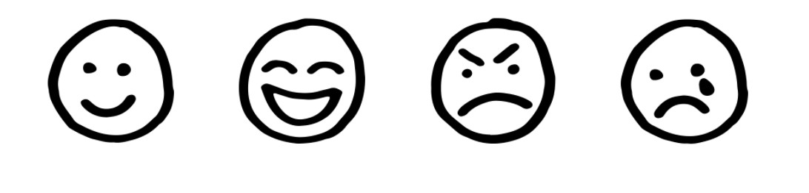
GAME
Which emoji fits
Instructions
List of statements
Notes:
Click on each of the icons for learn more about how to play the game. The information icon will explain the directions, the question mark icon will provide the list of questions to ask the students.

Slide 10
APPLY – CONNECT The internet has rules just like real life – this is called
NETIQUETTE
Internet
Etiquette
A network connecting computers globally.
A set of rules for everybody on how to behave properly.

Slide 11
ApPLY – WATCH
Click on the image to watch the video:
“Netiquette Only Lesson”
(4:49)

Slide 12
Apply – GENERATE – HOME Netiquette Goals
Respecting other people’s Privacy
Be conscience of what you share online
Use emojis to reflect the tone of the message
Respond to negative messages face to face to ensure the intent
Generate a home set of Netiquette goals that can posted in the home . . . what else can be added to the above list?

Slide 13
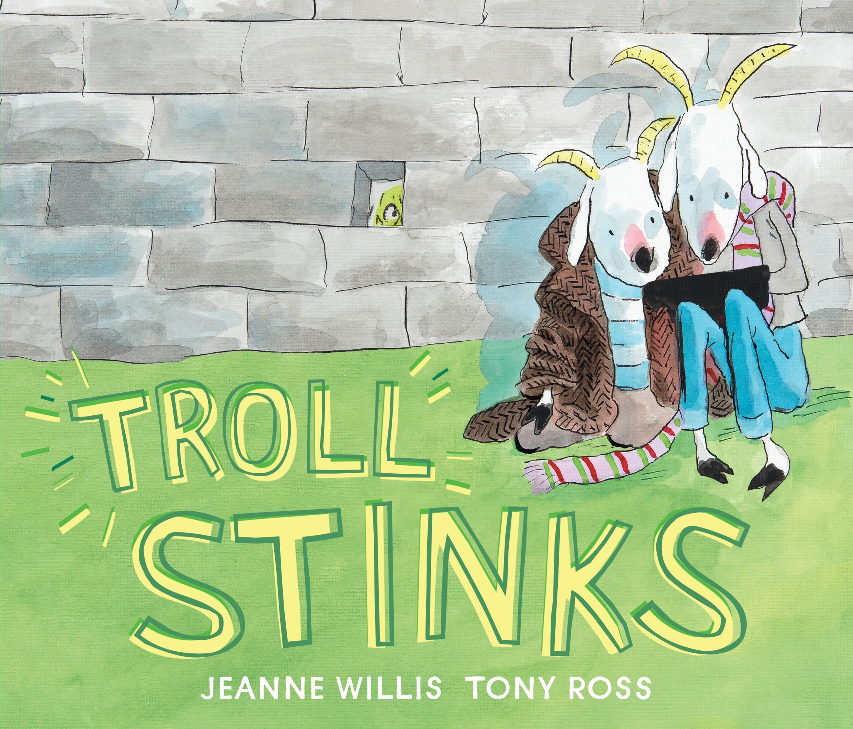
READ
Troll Stinks by Jeanne Willis & Tony Ross
Billy Goat and his best friend Cyril are messing about with the farmer's mobile phone, taking selfies and playing games . . . until they find the number for a troll. Their Grandpa Gruff says trolls are bad, so Billy and Cyril decide to get their own back by sending mean messages. After all, trolls really do stink! Don't they?
Read Aloud

Slide 14
Teacher Notes
Tips
This lesson is important as things can escalate very quickly online when messages are misinterpreted due to lack of knowledge.
Extension Activities
Students can create a poster of their own Netiquette goals.
Take Home Resources
Blocking Negative Chats online – Family Activity
Family Tips for Fighting Online Mean Behaviour
Watch Pause & Think . . . Discuss options for responding to negative messages.
This lesson helps students recognize statements that they think might be funny (face to face with visual cues) and how they can be interpreted online.
Relationships and Communication – Family Activity
Online Reputation Checklist

