Slide 1
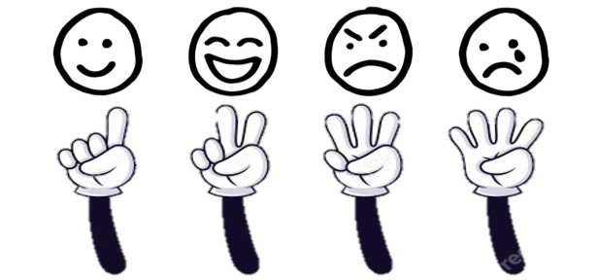
Emoji Game

Slide 2
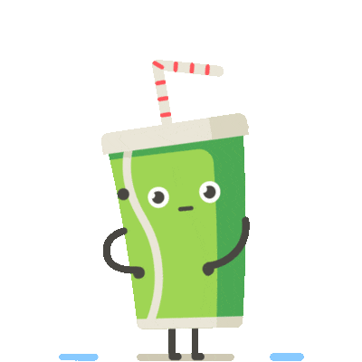
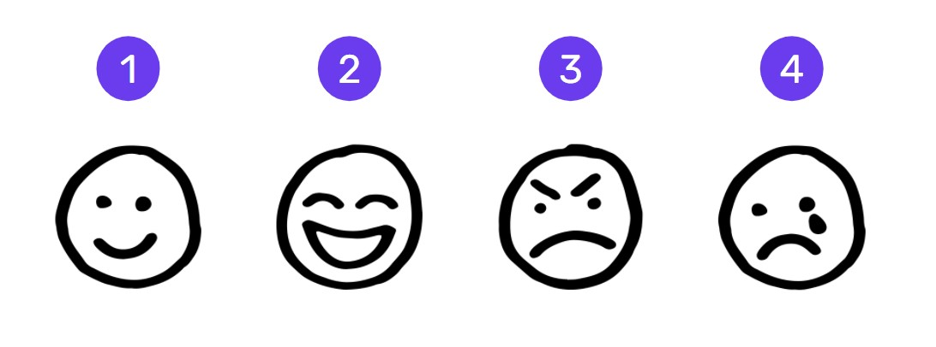
“I’m having a party and you’re not invited.”

Slide 3
“You’re so lame.”

Slide 4
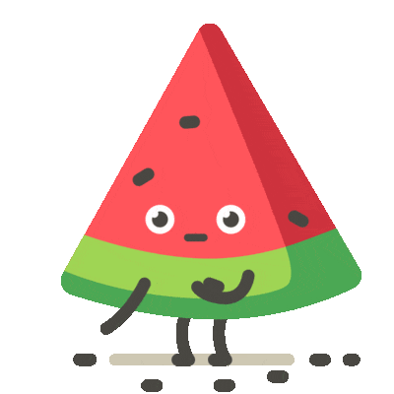
“You are an idiot”

Slide 5
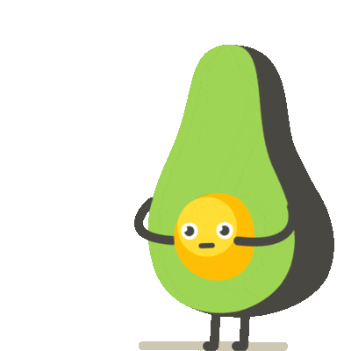
“I like your new haircut.”

Slide 6
“Dude”

Slide 7
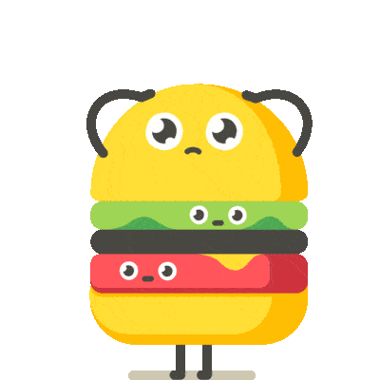
“You suck at this game.”

Slide 8
“Great picture.”

Slide 9
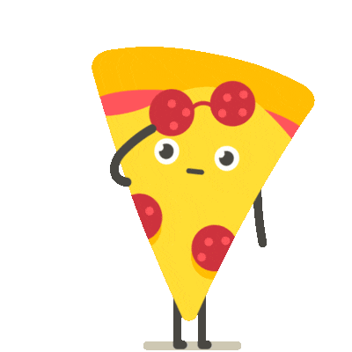
“You’re such a noob.”

Slide 10
“Oh, shut up.”

Slide 11
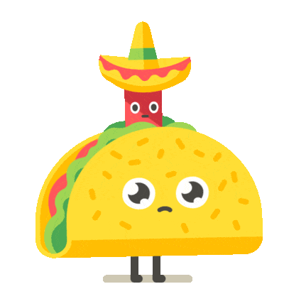
“DDDUUUHHHH.”

