Slide 1
Who’s is it Anyways – Copyright & Intellectual Property
Grade 3 – 5 Citizenship Lesson #2

Slide 2
Digital Wellness – Big Idea
Ensure students, at every grade level, have the tools, resources, and skills to interact personally, socially, and educationally in the real world and in digital spaces.
Encourage all students to make safe, healthy, and positive decisions to live a digitally balanced life in our technology-rich world.

Slide 4
Learning intentions 3-1 What rights and responsibilities do you have as a creator?
copyright
Define "copyright" and explain how it applies to creative work.
Define “intellectual property” and explain how it applies to creative work.
Describe our rights and responsibilities as creators.
Apply copyright principles to real-life scenarios.

Slide 5
Preparation
Video: Copyright Link in Slide #6
Brainstorm web on board: “Creator” as the heading in the middle.
Copyright Etiquette List: Can be done individually OR as a class poster (Slide #12)
Game instructions (Link in Slide #13)
Game scenarios (Link in Slide #14)

Slide 6
ACTIVATE - Video
Watch the video below by clicking on the image.
Copyright
4:40

Slide 7
What is a creator? What do they create?
AQUIRE - Brainstorm
Creator
Notes:
Suggest to the students that they are creators. What are some of the things they create – at home, at school, with friends etc.

Slide 8
Creator
~”Someone who creates something.”~
Songs | Food | Pictures
Stories | Videos/Movies | Art
Toy | Invention | House

Slide 9
Intellectual Property
Any products a creator creates becomes their ~”intellectual property”~.
(things that they have created from their own imagination)

Slide 10
Acquire Think-pair-share
Is it fair to “copy” something someone else created?
When would it be okay?
When would it NOT be okay?
Think about these questions on your own.
Share and discuss your answers with your partner.

Slide 11
COPYRIGHT
Apply-Definition
~“Legal protection creators have over the things they create so someone else can’t “steal” their idea.”~

Slide 12
Apply – GENERATE – copyright “etiquette”
OKAY TO SHARE
NOT OKAY TO SHARE
Thinking about what you discussed with your partner, generate a copyright “etiquette” list.

Slide 13
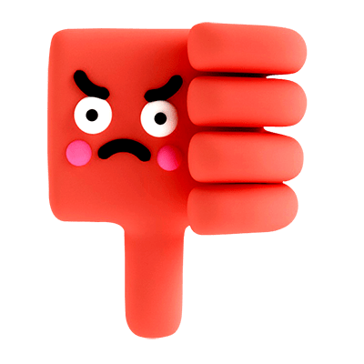
GAME
Thumbs up / thumbs down
Instructions
List of Scenarios
Notes:
Click on each of the icons for learn more about how to play the game. The information icon will explain the directions, the question mark icon will provide the list of questions to ask the students.

Slide 14
Teacher Notes
Tips
Copyright (plagiarism, illegal downloading, p2p sharing) is something that is VERY common but is not taught in the schools very often. This lesson, at a very basic level, addresses the underlying issue of why these are not “okay”.
Extension Activities
Students create a “wiki” with a number of links for free, copyright free, creative commons resources.
Take Home Resources
Getting the Goods Ethically
Intellectual Property
Students create a poster about “general” copyright rules.
Students generate a list of how they are accessing media in a copyright appropriate way (Netflix, iTunes store, etc)
Play Digital Passport game, “Mix and Mash”.

