Slide 1
Type your event details here

Slide 8
YOUR TITLE GOES HERE
Product Heading
Product Heading
Product Heading
Description
Description
Description
Product Heading
Product Heading
Product Heading
Description
Description
Description
Your Event Details Go Here

Slide 9
YOUR TITLE GOES HERE
Description
Description
Description
Description
Description
Description
Description
Description
Description
Description
Description
Description
Event Details Here
Event Details Here

Slide 10
YOUR TITLE GOES HERE
DESCRIPTION GOES HERE
DESCRIPTION GOES HERE
DESCRIPTION GOES HERE
DESCRIPTION GOES HERE
DESCRIPTION GOES HERE
DESCRIPTION GOES HERE
Event Details
Event Details

Slide 11
EVENT TITLE GOES HERE
8:00am
Agenda Topic Here
9:00am
Agenda Topic Here
10:00am
Agenda Topic Here
11:00am
Agenda Topic Here
12:00pm
Agenda Topic Here
1:00pm
Agenda Topic Here
2:00pm
Agenda Topic Here
3:00pm
Agenda Topic Here
Event details go here
EVENT DETAILS GO HERE

Slide 12
EVENT TITLE GOES HERE
EVENT DETAILS
Item Description
Item Description
EVENT SUBTITLE GOES HERE
Item Description
Item Description
Item Description
Item Description
Event Details
Event Details

Slide 13
EVENT TITLE
Exciting Info

Slide 15
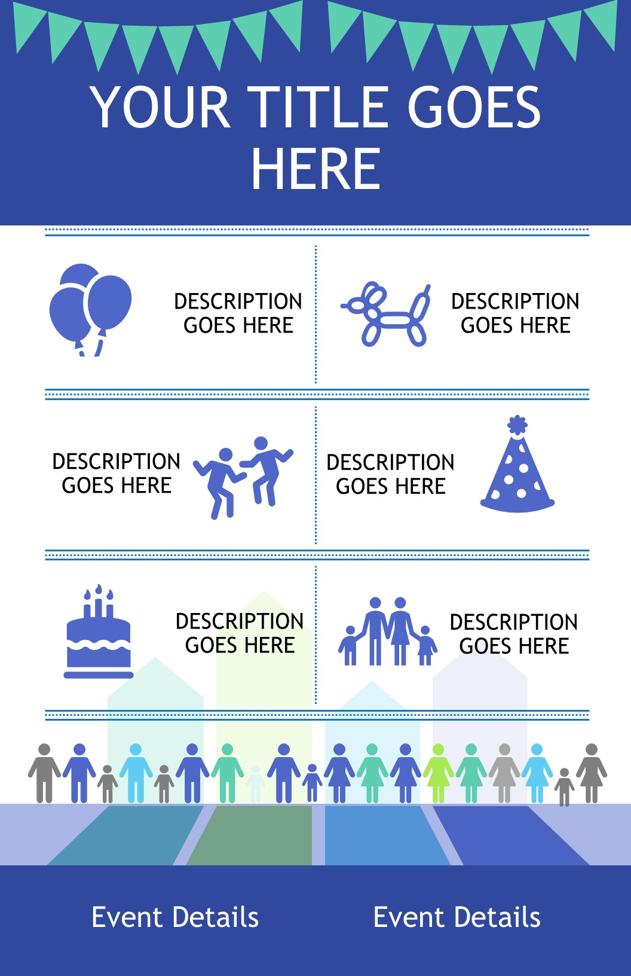
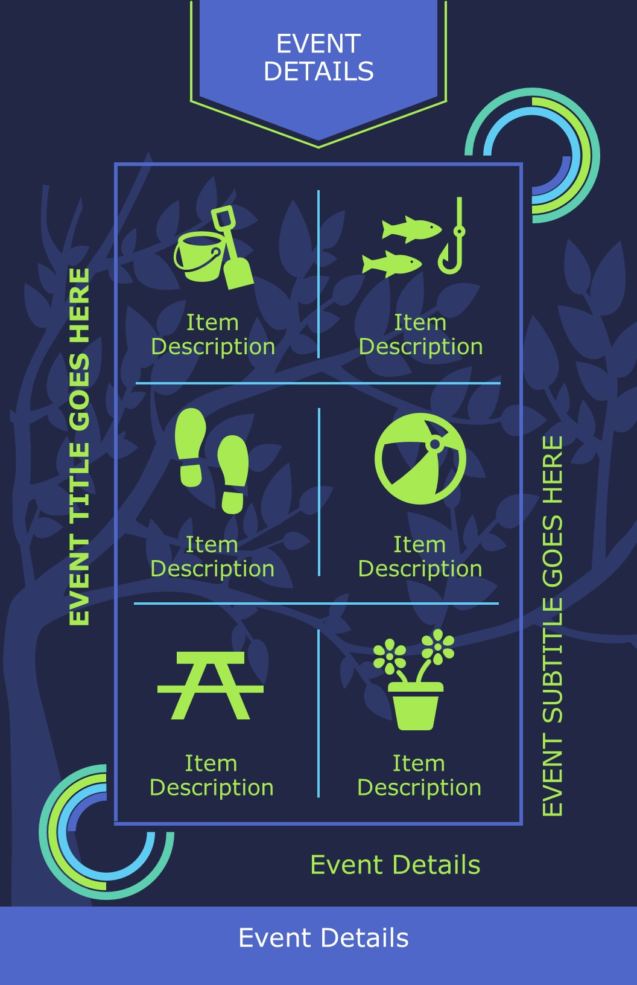
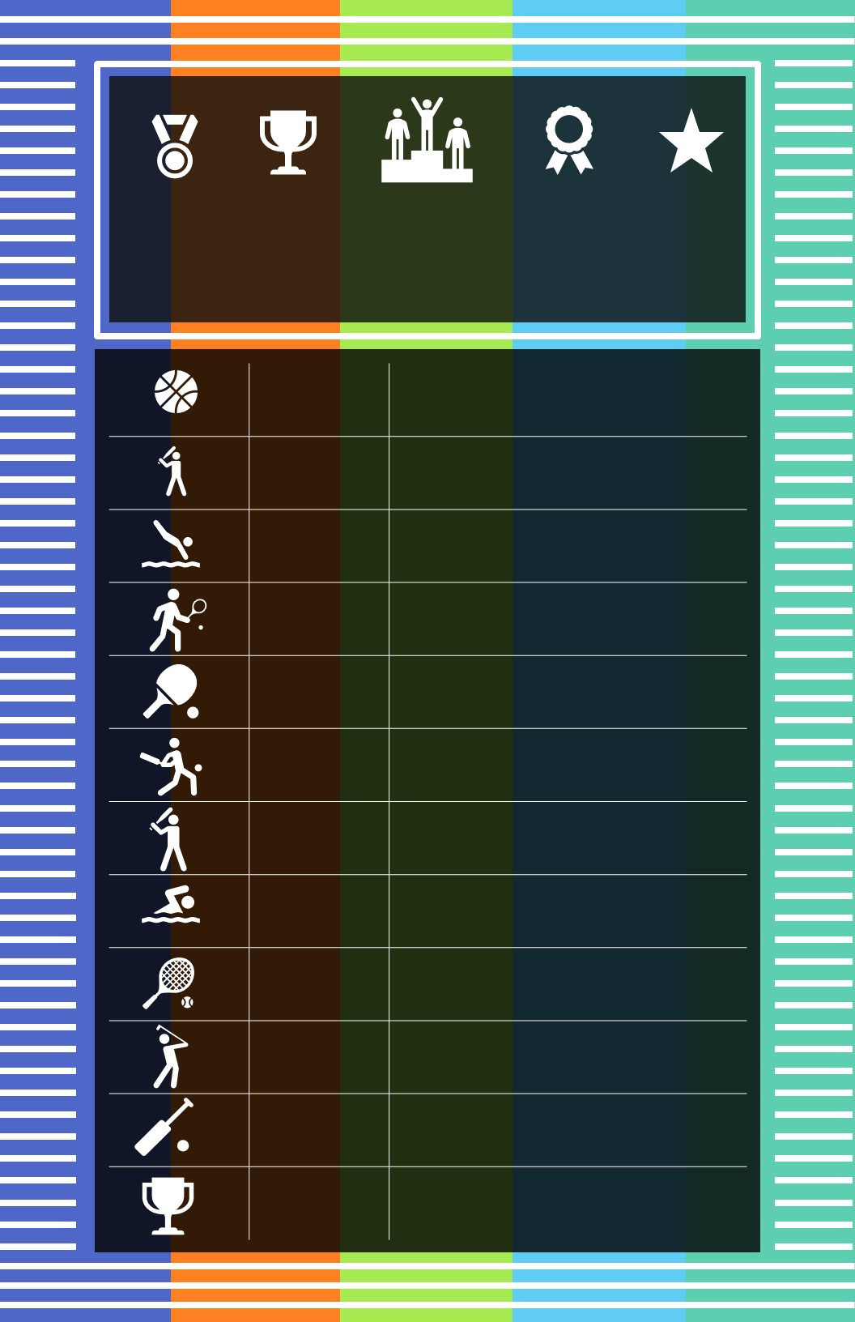
Community Center Template Examples

Slide 16
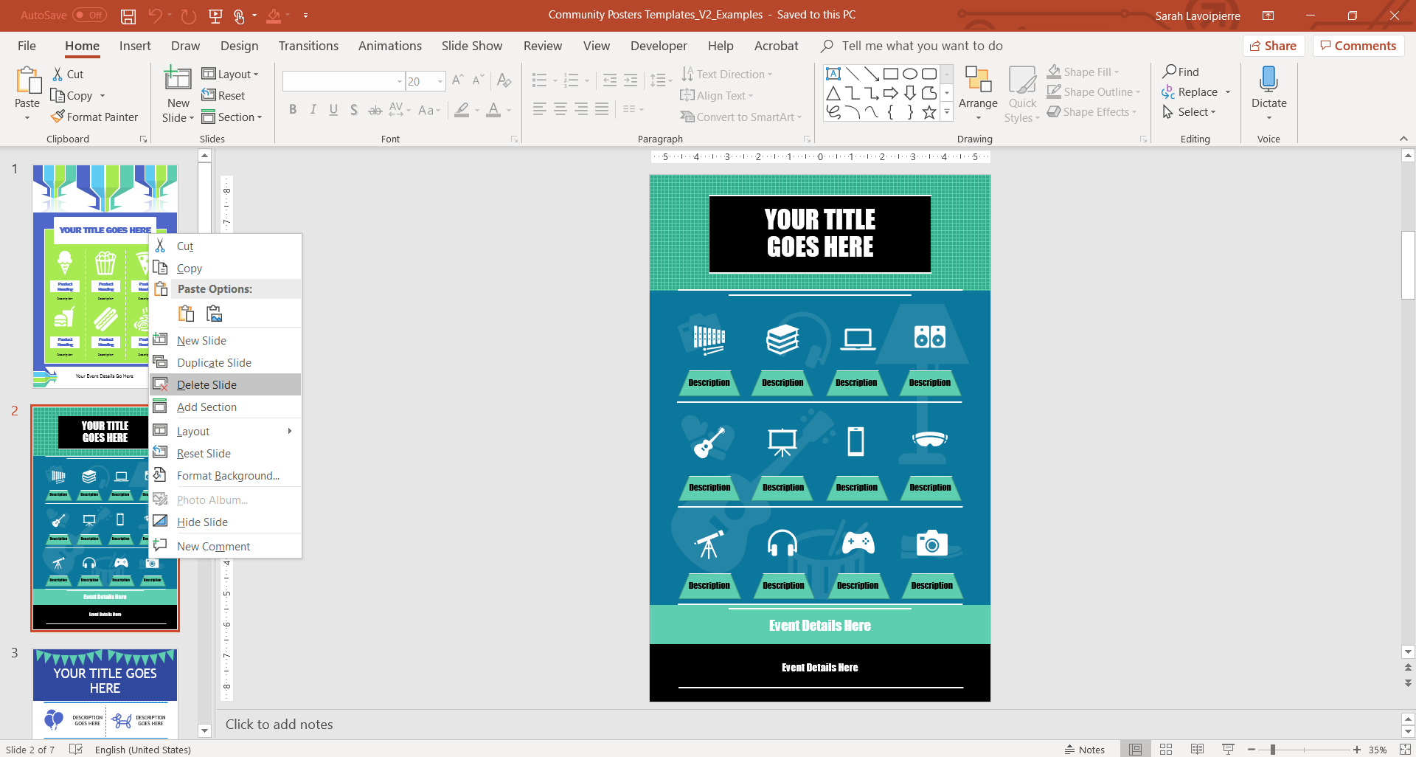
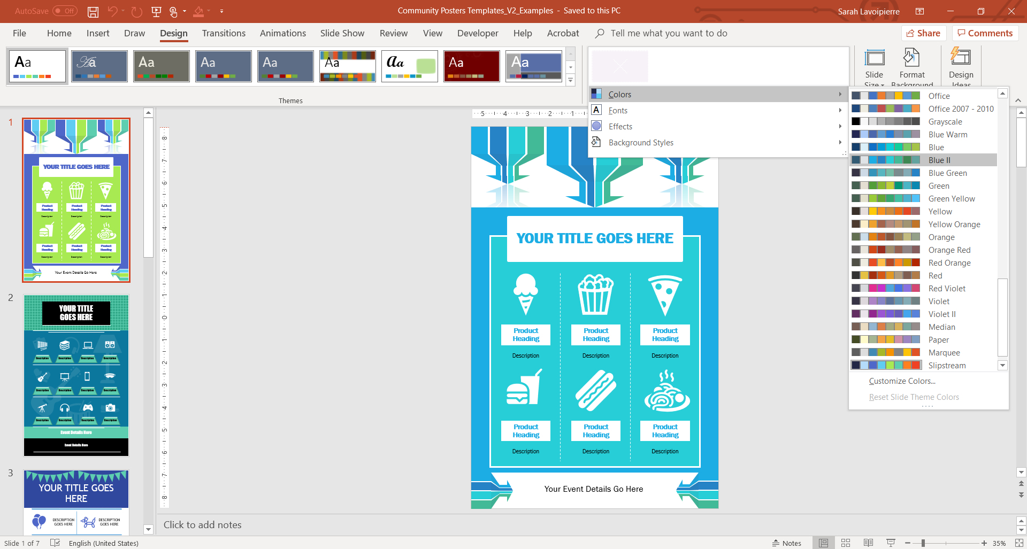
Community Center Template Instructions
Open the Community Events Template PowerPoint.
Delete the slides you do not want to use by right clicking on the slide itself in the left hand selection pane and selecting Delete Slide.
Click on the Design tab and select Variants >> Click on the down arrow and select >> Colors >> pick the colors you would like to use for your poster.

Slide 17
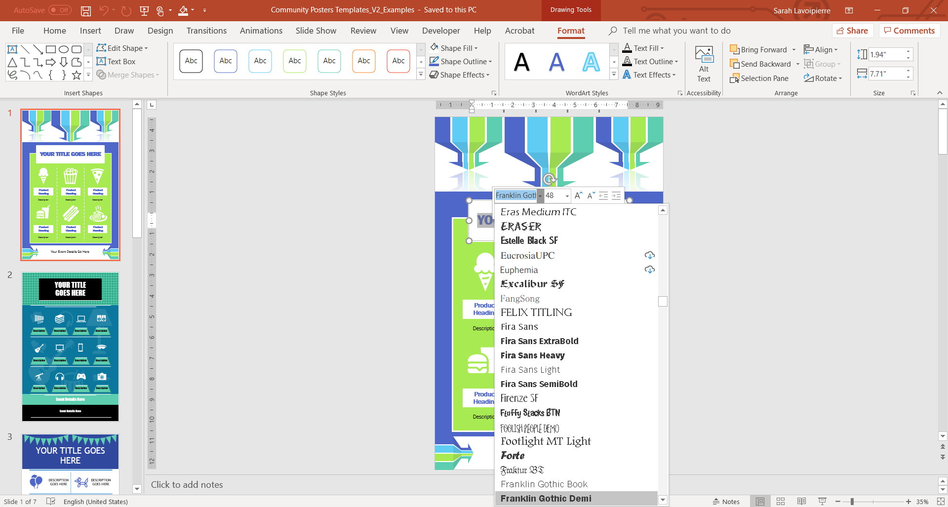
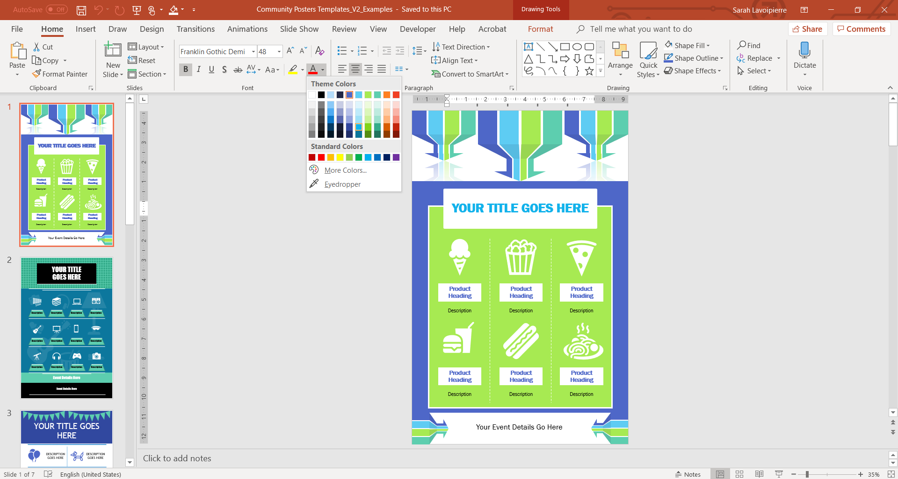
Select the Title Box Text and add your own Title with your preferred font selection.
5. Alternatively go to the Home tab and pick your specific preferences.

Slide 18
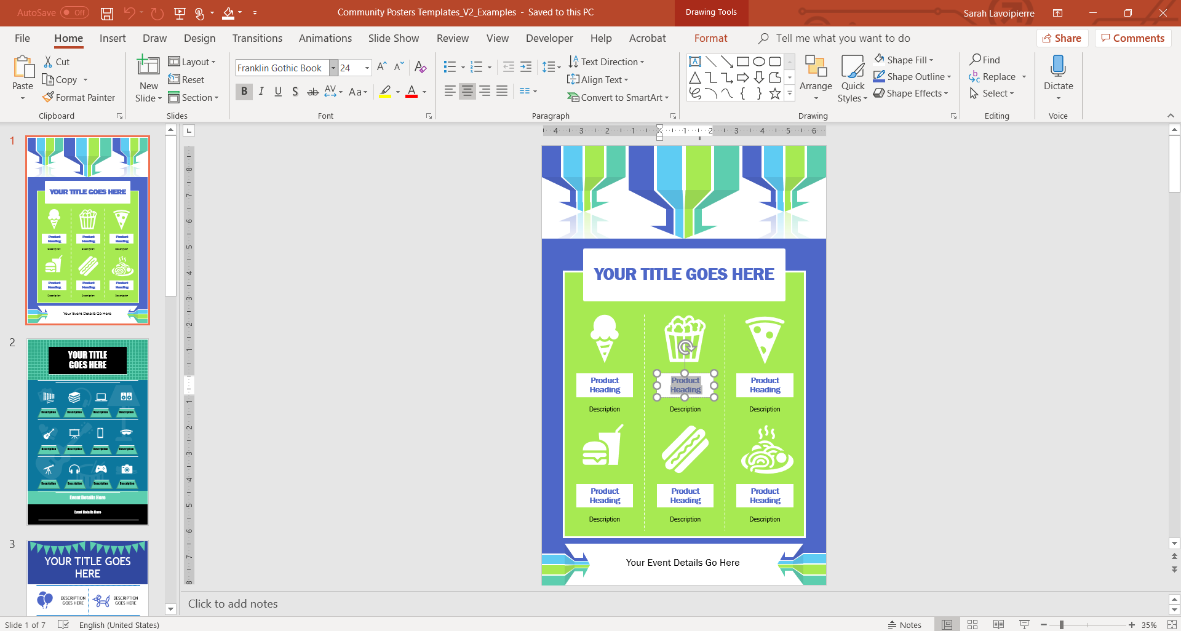
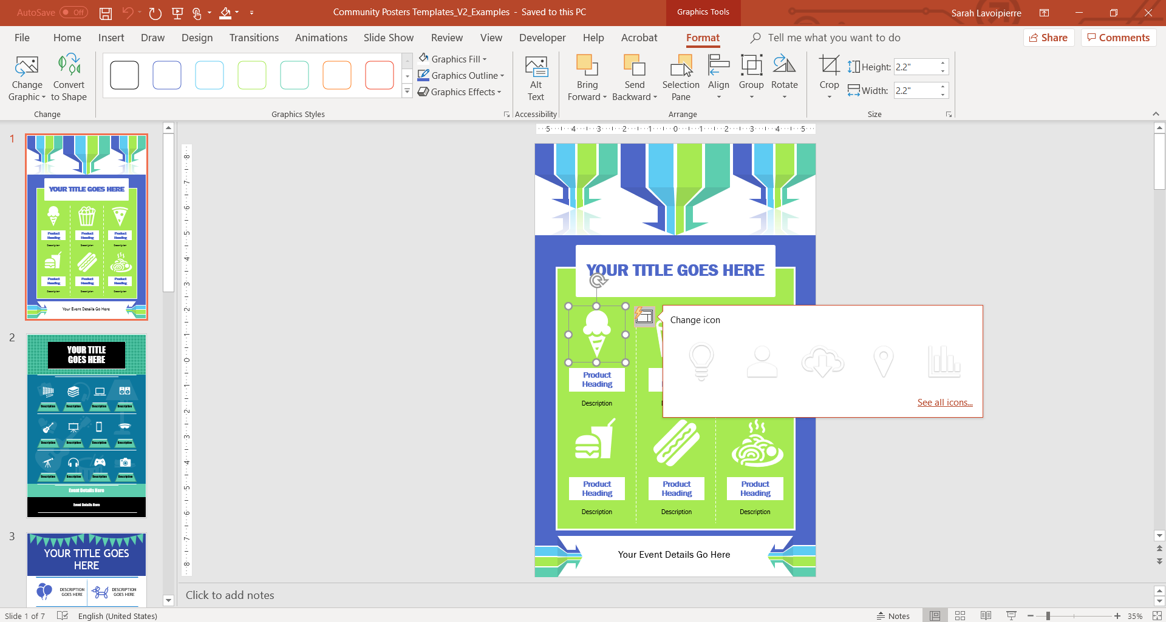
Select each font box and add your specific event details and utilize the Home tab for your preferred font formatting options.
If you would like to change / add any icons or shapes, click on the Icon and then choose your preferences.

Slide 19
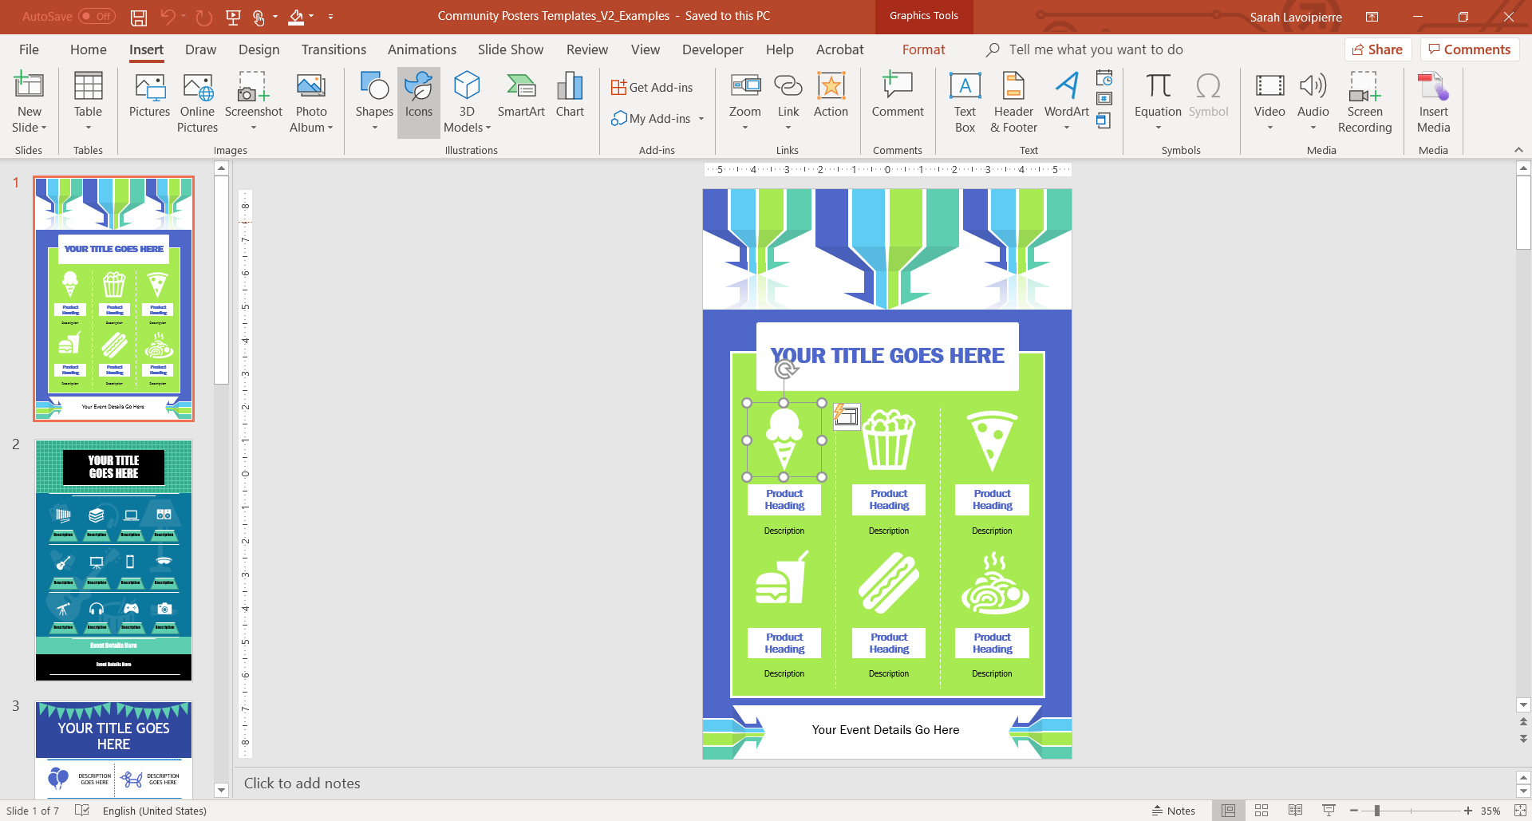
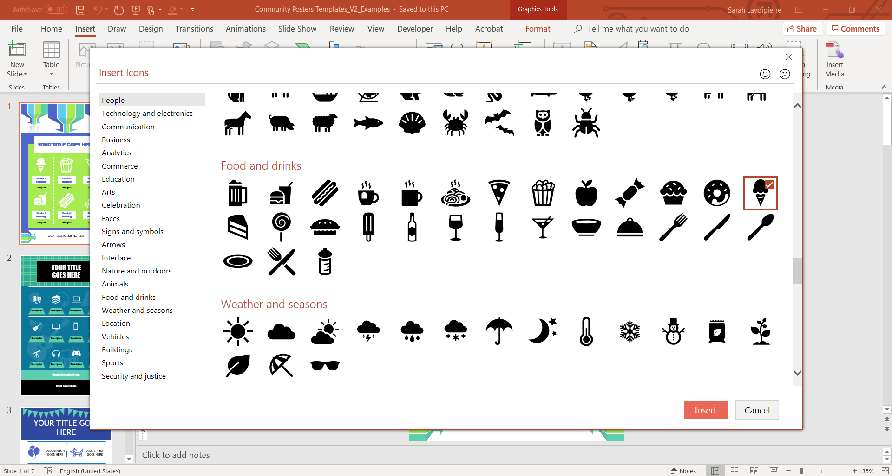
If you would like to add new icons to your poster, click the Insert tab >> Select the Icons button.
From here you can choose from a variety of icons available, click on the icon your would like to use and the click the Insert button.
For a quick video on how to insert an icon, watch this short video: https://aka.ms/PowerPointIcons

Slide 20
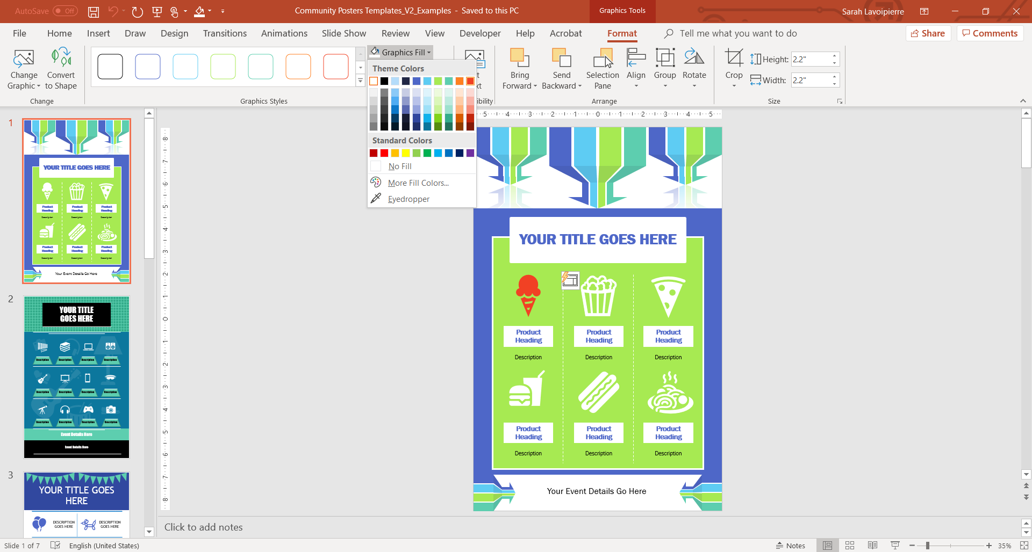
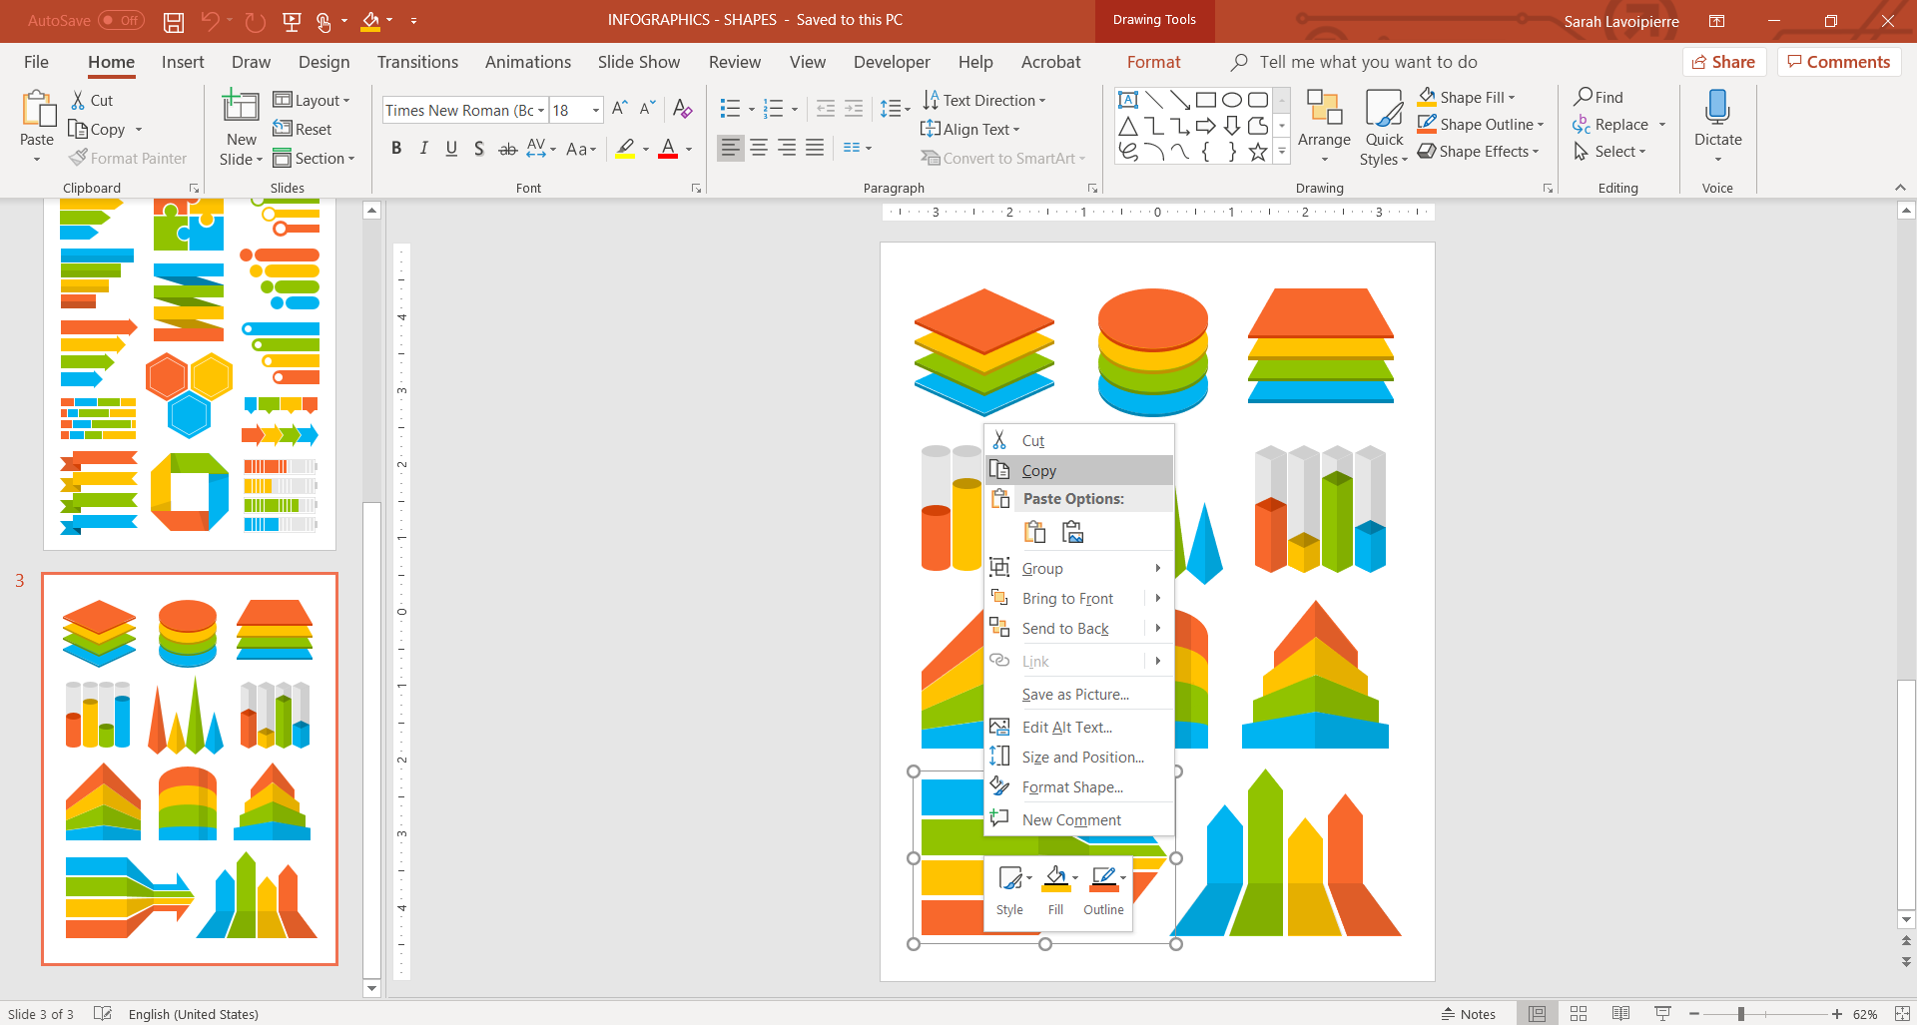
You can change the color and size of the icon you have selected by clicking on the Format tab and then choosing your preferences.
To change any of the shapes / graphics on your template, download one of our shape templates here: https://aka.ms/InfographicImages. Open your downloaded shape template and right click the shape you would like to use and select Copy.

Slide 21
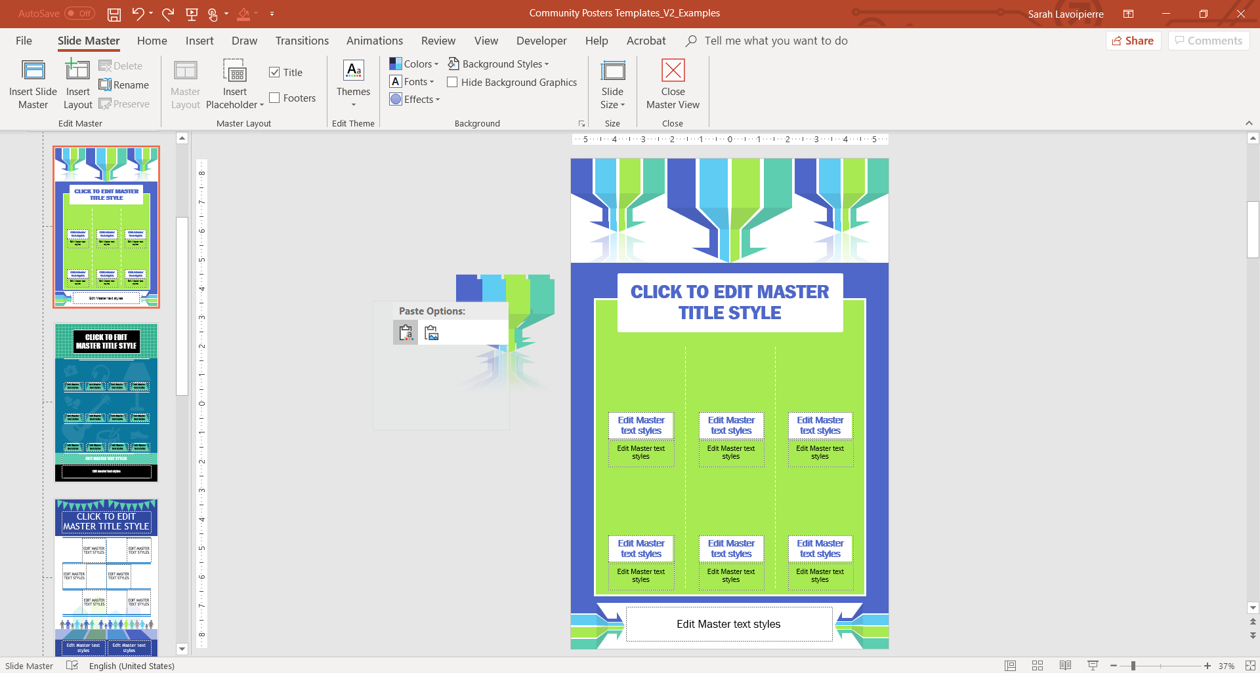
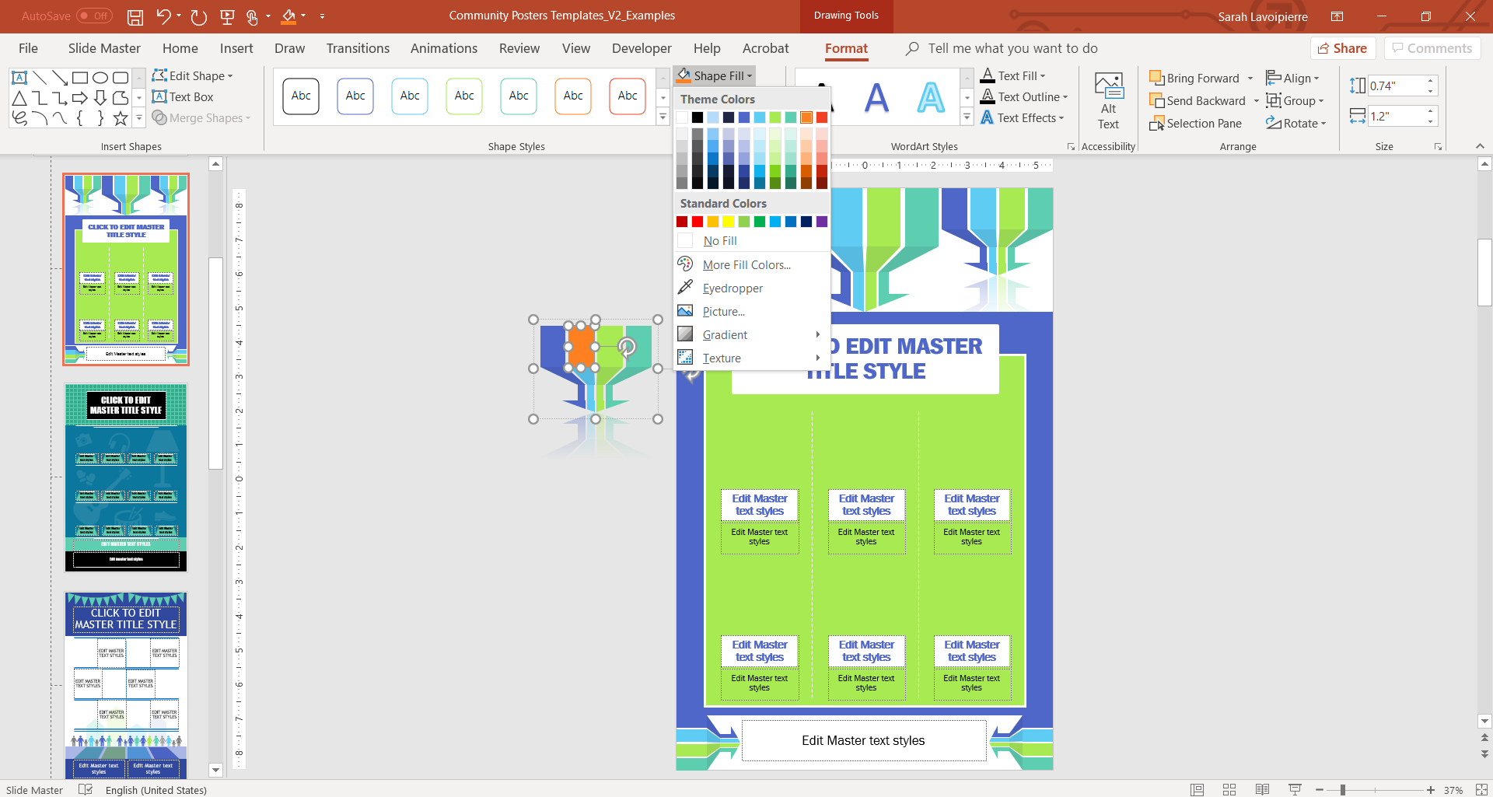
Right click to the side of your slide and select Paste to insert the shape you have copied from the shape template. (If you wat to change any existing shapes you will need to change them in the Master Slide view. View>> Slide Master and then edit shapes and any formatting as needed.)
To change the color of your chosen shape, select the Format tab >> click on the shape itself and choose your preferred color. If you want to color only a part of your shape >> click on the specific area you would like to recolor and select your preferences. You can also use the format tab to edit various options for your shape.

Slide 22
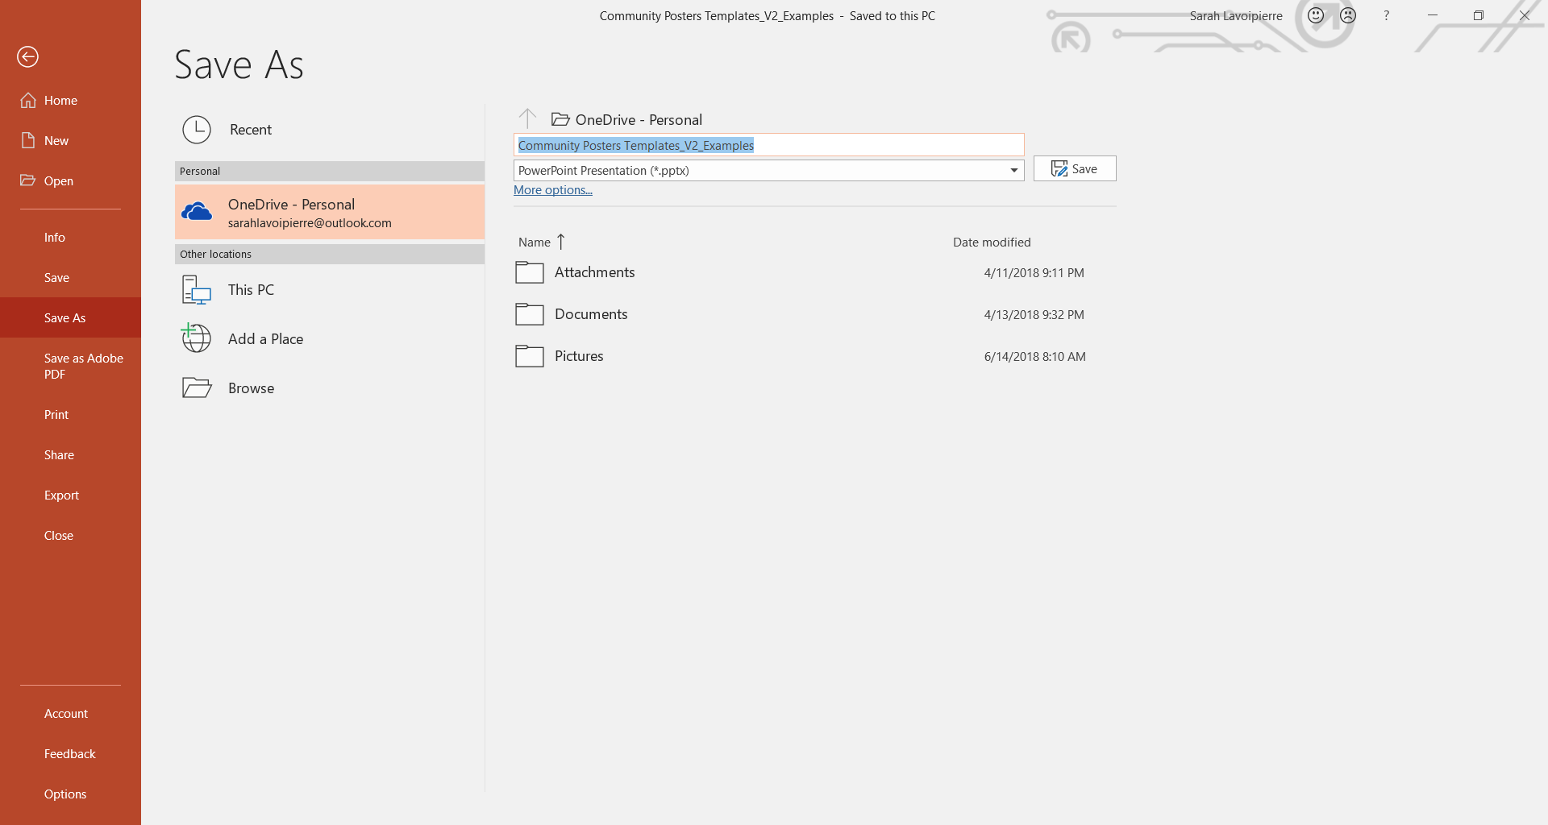
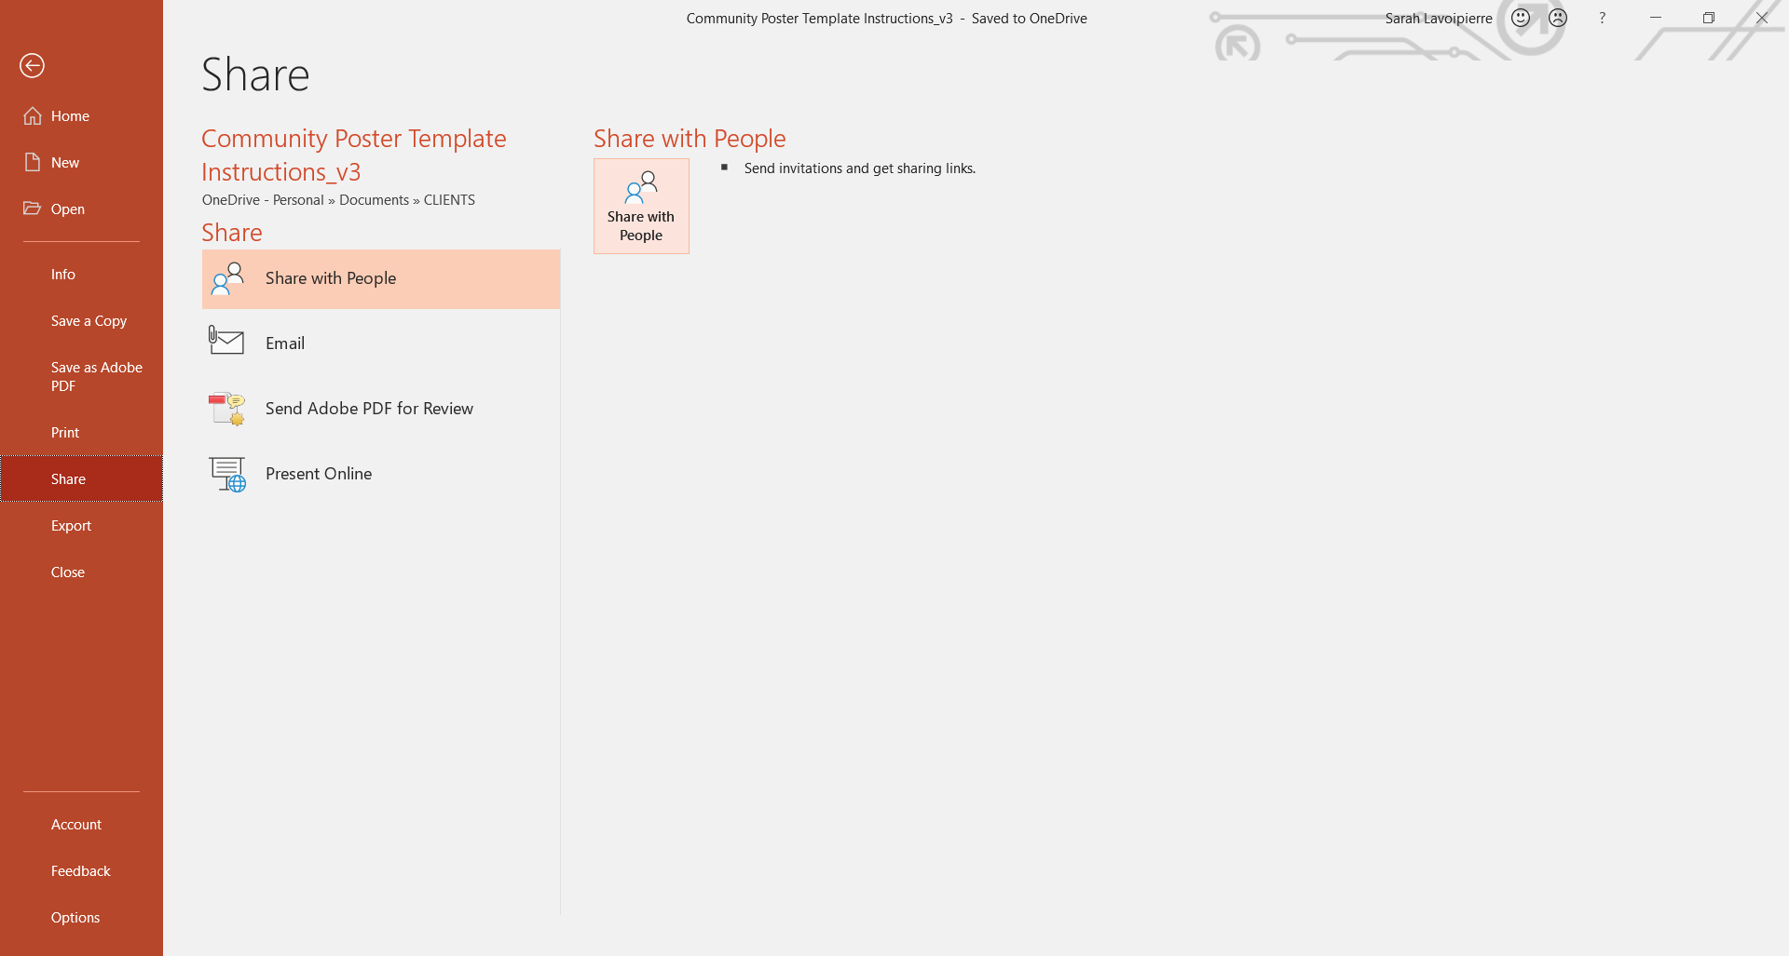
Don’t forget to save your new poster. Click on the File tab >> Select Save As and choose the folder and name of your design and click Save.
Once you have saved your file to your OneDrive Click on the Share tab >> and select how you would like to share your document. Choose Share with People and click on the Share with People Button to collaborate with others.

Slide 23
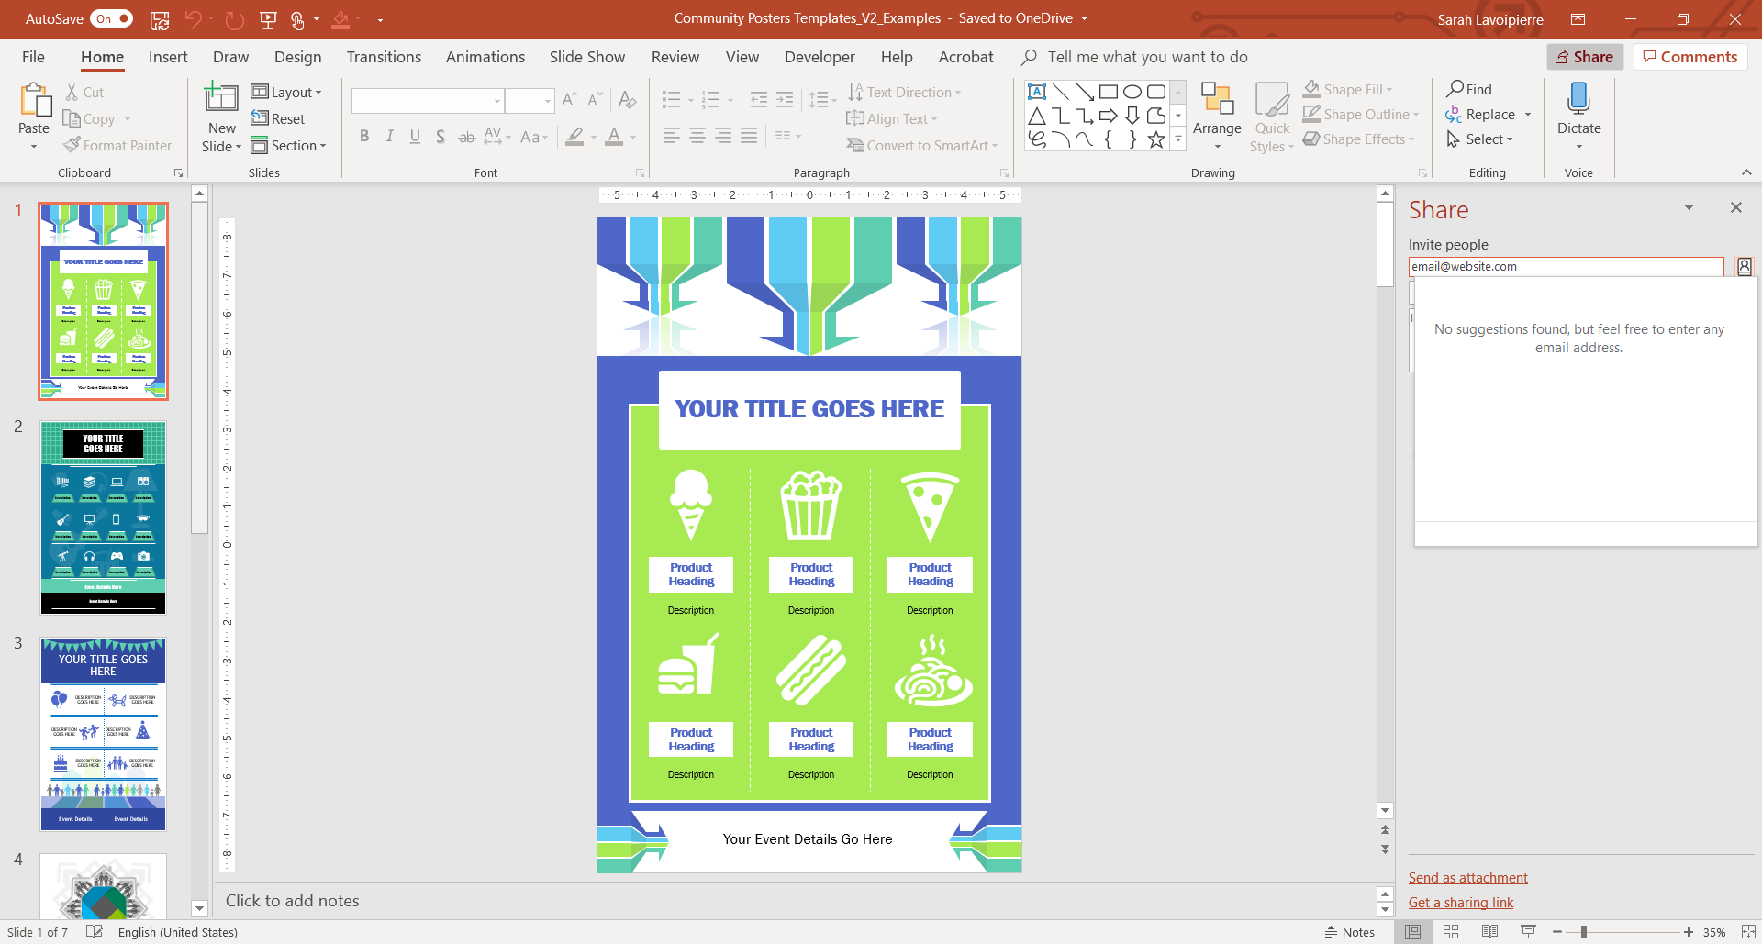
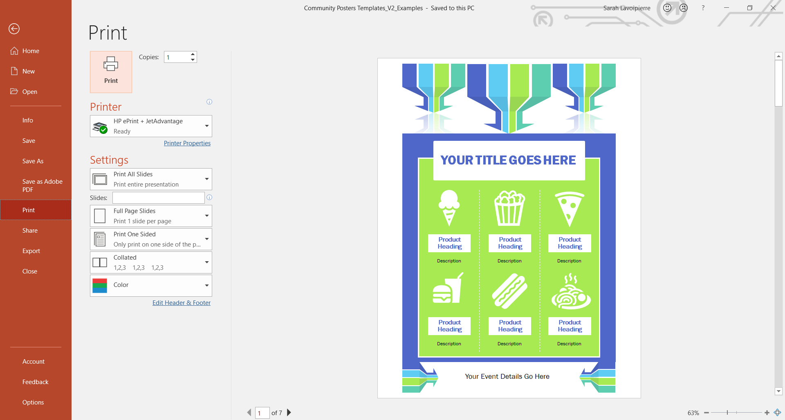
Enter the email address’ of the people you would like to share your file with on the right hand Share pane, once you have added all contacts you wish to share with, choose the options below your list to send as an attachment or as a link.
When you are ready to print your poster, click on the File tab >> Print and choose your preferences in the various print fields – You are now ready to print your poster!

