Slide 1
Be an Upstander Against Cyberbullying
Grade 3 – 5 Citizenship Lesson #1

Slide 2
Digital Wellness – Big Idea
Ensure students, at every grade level, have the tools, resources, and skills to interact personally, socially, and educationally in the real world and in digital spaces.
Encourage all students to make safe, healthy, and positive decisions to live a digitally balanced life in our technology-rich world.

Slide 4
Preparation
Video: What is Cyberbullying Link in Slide #6
Brainstorm list on board: Joking, Being Mean, Bullying, Cyberbullying as headings.
Infographic: Slide #9, Links to Templates and Examples
Book: Tease Monster by Julia Cook

Slide 5
Learning intentions 3-1 What is cyberbullying and what can you do to stop it?
cyberbullying
Recognize similarities and differences between in-person bullying, cyberbullying, and being mean.
Empathize with the targets of cyberbullying.
Identify strategies for dealing with cyberbullying and ways they can be an upstander for those being bullied.

Slide 6
ACTIVATE - Video
Watch the video below by clicking on the image.
What’s Cyberbullying?
1:14

Slide 7
Acquire – Think-Pair -share
Is there a difference between joking, being mean, and bullying?
What is it?
Where does CYBERBULLING take place?
Take a moment to think silently about these questions.
Then, take turns sharing your response with your partner.

Slide 8
Acquire - Brainstorm
Joking
Being mean
bullying
cyberbullying
Brainstorm specific examples – connect with Cyberbullying (same and differences).

Slide 9
Upstander
~a person who supports and stands up for someone else~
Discuss with the students what does an “upstander” look like. Where might they see this? Where might this be affective? How does being an upstander make them a good friend? How does being an upstander make them a good digital citizen. What might a upstander “superhero” be like?

Slide 10
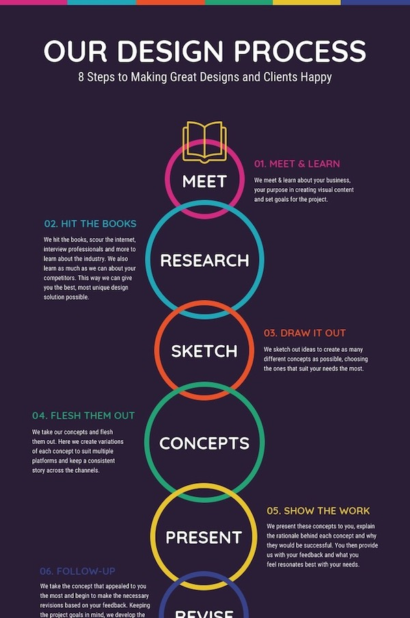
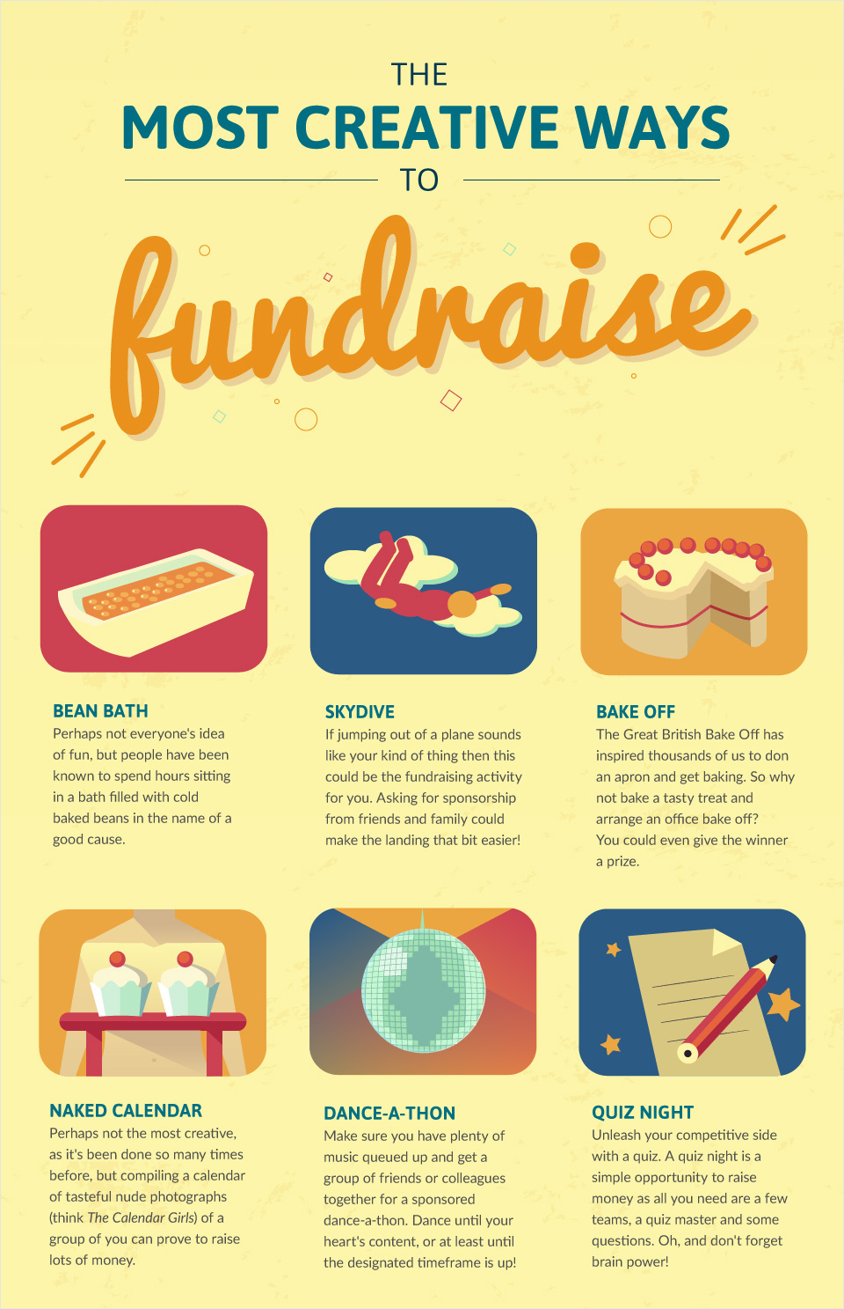
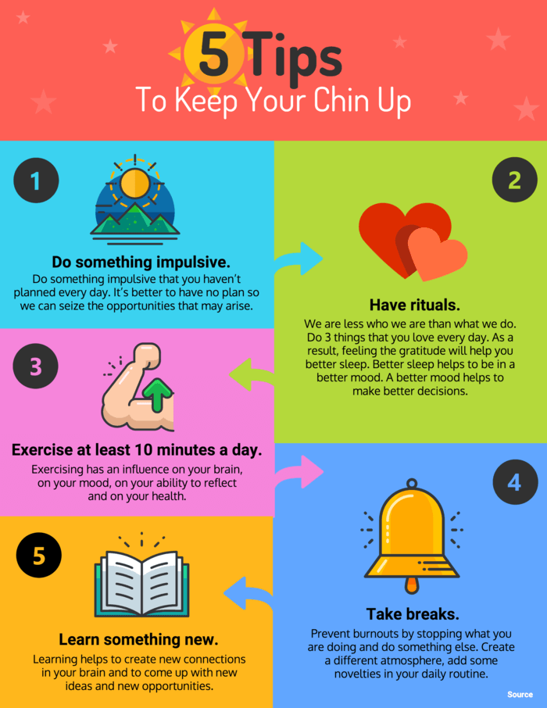
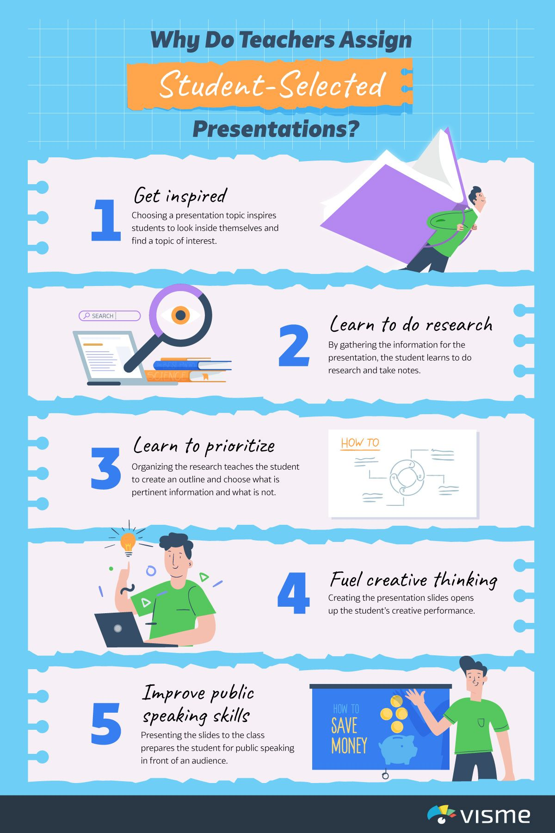
What does it take to be an Upstander?
APPLY – CREATE INFOGRAPHIC
Create an infographic that provides different ways a student can be an upstander when witnessing cyberbullying.
PowerPoint Infographic Templates

Slide 11
READ
Tease Monster by Julia Cook
Is the Tease Monster a friend or a foe? That's what One of a Kind has to figure out in this quirky tale.
One of a Kind has big feet and loves eating popsicles while standing upside down. He doesn't understand the difference between friendly teasing and mean teasing. When Purple laughs at One for being weird he feels rotten. And when Plaid called One a brainiac for getting an A+ on his math test he doesn't know what to say.
With help, he learns that teasing is part of life and that laughing at someone is mean teasing or bullying and can have a hurtful bite, but laughing with someone is alright when it's not done out of spite!
READ ALOUD

Slide 12
Teacher Notes
Tips
This lesson helps highlight the differences between “just joking (kidding) LOL” and actually being mean.
Extension Activities
Students can create their own comic strip with the Digital Superhero Upstander
Take Home Resources
Family Activity for Cyberbullying
Family Tips for Fighting Cyberbullying
It then helps identify WHAT is bullying & cyberbullying and not only what to do for the recipient but also people that might witness this behaviour. (bystander vs upstander)
Play Digital Passport game “Evolve”.

