Slide 1
Monitor Your Screen Time
Grade 3 – 5 Wellness Lesson #1

Slide 2
Digital Wellness – Big Idea
Ensure students, at every grade level, have the tools, resources, and skills to interact personally, socially, and educationally in the real world and in digital spaces.
Encourage all students to make safe, healthy, and positive decisions to live a digitally balanced life in our technology-rich world.

Slide 4
Preparation
Video: Balance is Important: Link in Slide #6
Posters made up with the following headings: Active; Learning; ScreenTime
Photocopy student handout: Link in Slide #9
Book: But it’s Just a Game by Julia Cook

Slide 5
Learning intentions 1-1 Creating a Balance with Screen Time
Create a balance
Learn to participate in different types of activities each day
Learn to find balance in the types of activities they participate in
Differentiate between “good” and “bad” types of screen-time

Slide 6
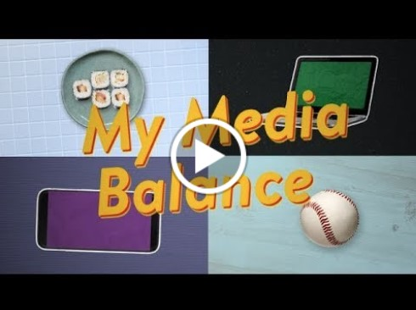
ACTIVATE - Video
Watch ONE of the videos below by clicking on the image.
Media Balance is Important
(1:57)
My Media Balance
(1:18)

Slide 7
AQUIRE - Brainstorm
ACTIVE
Learning
Screen Time
Activities can be broken down into THREE different types: active, learning and screen time. Brainstorm with your teacher different activities for each of these headings.
Notes:
Make a chart on the board with the three above headings. Leave spaces in-between each column so that the activities that might encompass both can be listed here (looking on YouTube for learning videos, using Wii for exercise etc). Keep this accessible as it will be referenced in the next activity.

Slide 8
Discuss . . .
Did you notice the different TYPES
of screen time that were listed?
Are ALL types of screen-time bad?
How are some screen-time choices more healthy or less healthy than others?
Notes:
This discussion can occur as a large class, share/pair, jigsaw or any other type of collaborative activity.

Slide 9
apply - record
Using the handout provided, fill out the type of activities you did over the last week.
Put a check mark beside each activity for every day you did it.
Balance Handout
Notes:
Hand out the individual student Balance Sheet handout. Have them refer to the chart on the board and help them generate things that might be of more relevant to them.

Slide 10
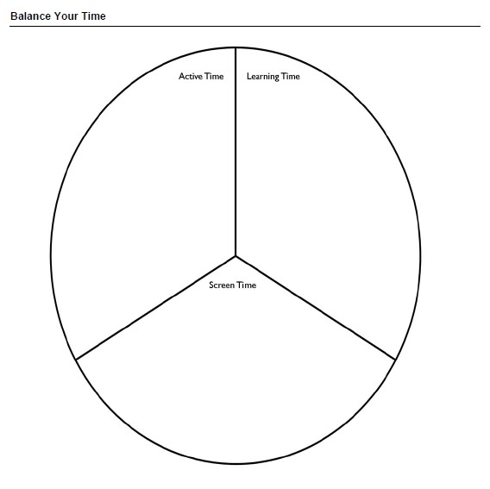
apply - Evaluate
Hold your completed balance wheel in front of you . . . Spin it until the section with the most activities or check marks are on the bottom.
Ask yourself
am I demonstrating a balance with screen-time
is my screen-time use something that could be considered “good”
is my screen-time too much towards the “bad” use
What does media balance look like for you?
bake cupcakes
walk my dog *****
ride my bike ***
play tag with my friends at recess *****
read a book *****
do my homework ***
watch YouTube about growing plants
Look up cupcake recipes
look at tiktok *****
watch videos on YouTube*****
check out Pinterest***
watch TV on Prime*****
Notes:
Lead an informal discussion – where does your wheel land – is this good / bad?

Slide 11
READ
But it’s Just a Game by Julia Cook
Meet Jasper! A young boy who is totally absorbed with playing video games "With my game controller in my hands, I'm the boss of my whole world! I can be who I want and do as I please. I can get the highest score. I get all the chances that I need. If I make a mistake it's ok. Everyone thinks I'm 'it on a stick!' And the bad stuff all goes away" Video game addiction is on the rise, but it can be prevented. This creative story book teaches both kids and adults how to switch out their game controller for a "life controller." Video gaming is becoming a part of our culture, and we must be strategic in creating a healthy gaming balance.
Online Story

Slide 12
Teacher Notes
Tips
This lesson is a great visual way for students to determine how balanced their screen-time usage is.
Extension
Media Choice Tracker
Reflecting on my Media
Family/Home
Help Kids Balance Their Media Lives
Family Activity
It also allows for a discussion to occur around HEALTHY screen-time not only in duration BUT in the choice of the type of screen-time that is chosen.
How to Set Screen Rules that Stick
Play Digital Passport game, “Twalkers”

