Slide 1
Minecraft Education
1-1 Introductory lesson – movement,

Slide 2
Integrating ADST
DESIGN
SKILLS
Technologies
Designs can be improved with prototyping and testing.
Skills are developed through practice, effort, and action.
The choice of technology and tools depends on the task.
~”The Applied Design, Skills, and Technologies curriculum builds on students’ natural curiosity, inventiveness, and desire to create and work in practical ways.”~
Goal and Rationale from BC ADST Curriculum
Minecraft EDU is a virtual land where users can create their own worlds and experiences using building blocks.
Using Minecraft EDU allows students to explore numerous educational concepts and curricular competencies in a game-based learning environment.
It requires the student to DESIGN, practice SKILLS and use TECHNOLOGY complete a task.
By using Minecraft EDU to teach curricular concepts, the ADST competencies are naturally being developed.

Slide 3
SD72 Minecraft Education Edition
Access Minecraft Education Edition from the Apps list on the Student Devices (tap the Windows key –> type in Mine -> select Minecraft.
Sign In using SD72 Microsoft login credentials. Students will have to use FULL account name: firstname.lastname@stu.sd72.bc.ca & password.
Saved Worlds are access from “My Worlds”.
New Worlds are access from “Library -> Biomes & Worlds”

Slide 4
TASK
Complete the interactive Tutorials 1-3 for the students just learning how to use Minecraft.
Play-> View Library -> How to Play -> Start Here.
Gamers start with “hour of code 2020 – 2 villages”
Main screen->”Hour of Code”-> Hour of Code 2020 (Inclusion)
Complete self reflection sheet
Student Reflection

Slide 5
preparation
For TEACHER preparation, it is recommended to watch the Minecraft Education Tutorials on the following topics:
NEWBIES: First three tutorials: Movement; Place and Break; Interact See links on slide #10.
Play-> View Library -> How to Play -> Start Here -> . . .
GAMERS: Hour of Code 2020 – 2 Villages
Main screen->”Hour of Code”-> Hour of Code 2020 (Inclusion).
Print Student Reflection Sheet. See link on slide #8.
Student SD72 Microsoft login information.
Headphones for the students watching the tutorials.

Slide 6
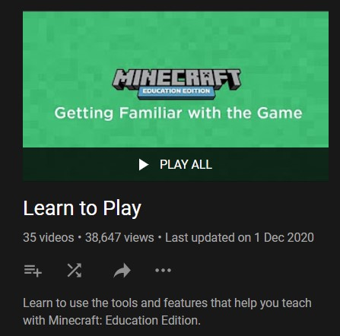
MINECRAFT READINESS
For those teachers who have NEVER encountered Minecraft Education Edition, here are some “get to know Minecraft” tutorials that will increase your comfort level before using with your students.
Getting Familiar with Minecraft Education (3:39)
Basic Controls in Minecraft (2:43)
Using the How to Play Tutorials :56)
“Learn to Play”
YouTube Playlist

Slide 7
Introduction – Learning the Minecraft Features
Lesson Summary
Access Minecraft from the student devices.
Learn how to sign into Minecraft Education Edition
Learn the basic functions in order to navigate in the Minecraft interface.
Lesson 1-1

Slide 8
Students will
Tutorials and hour of code
If newbies complete Tutorials 1-3, they could start navigating through the Hour of Code world.
Leave time for student reflection.
Newbies: Complete the first three interactive tutorials:
Movement (3:25)
Place and Break (7:59)
Interact (5:37)
2. Gamers Complete Hour of Code
Extension
Student Reflection

Slide 9
TIPS
When signing in, the student will need to use the full SD72 Microsoft login: firstname.lastname@stu.sd72.bc.ca
Students can save worlds and access them again later from their own world.
Pressing “H” on the keyboard will display the navigation keys on the screen.
The function of the different buttons on the mouse will change with interaction: these functions will be displayed on the screen.

Slide 10
Video – Tutorial
Movement (3:25) Place and Break (7:59) Interact (5:37)
Play-> View Library -> How to Play -> Start Here -> . . .
Movement
Place and Break
Interact

Slide 11
MINECRAFT KEYBOARD & MOUSE CONTROLS

Slide 12
Resources
Ed Centre Resources | Minecraft Tutorials | Minecraft Websites
Item 01 | Minecraft EDU YouTube Channel | Minecraft Education Edition
Item 02 | Microsoft Educator Centre | Minecraft EDU Wiki
Item 03 | Minecraft Webinars and Training | Minecraft - Edutopia
Item 04 | Minecraft Teacher Academy | Minecraft – Common Sense Education
Item 05 | SD41 Minecraft Blog (Scroll to bottom for tips and tricks) | @PlayCraftLearn - Twitter
 | Minecraft Starter Kit | Pinterest - @PlayCraftLearn
 | Learning to Play – Educator Community | Minecraft Class Lessons
 |  | Minecraft Educator Community

