Slide 1

Welcome (or Welcome Back) to Timberline Secondary!!
t
2026-27

Slide 2
School Staff and Support Services
Introductions:
Principal – Mr. Zlatanov
Vice Principal – Ms. Friederich
Counsellors – Mr. Chenard, Ms. Noren
Youth Care Workers - Sharene Zemanek & Ronnie Billows
Learning Support Teachers – Ms. Fraser, Ms. Humphreys, Ms. Williams
Career-Life Connections 12 & Grad – Ms. Murphy, Ms. Moray
Indigenous Support Teacher – Ms. Ubriaco
Careers – Mr. Fitzpatrick

Slide 3

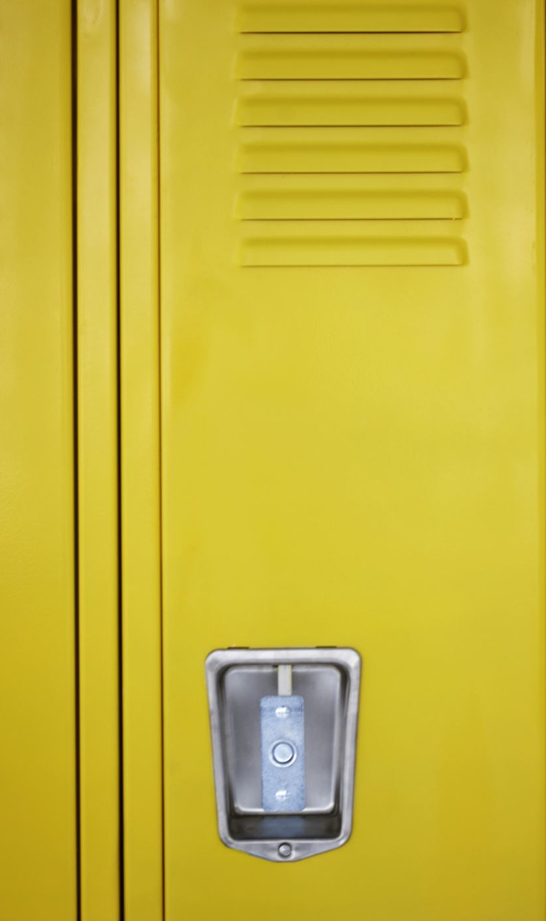
Hallways & Washrooms
Hallways
  Please avoid gathering in groups which block hallways and locker
  When it is lunch time, take the opportunity to go outside and get some fresh air
Washrooms…
  …are not places to socialize. Be respectful of others needing to use them
  Cell phones should not be used in washrooms for privacy concerns

Slide 4


Learning Commons & Gym
Learning Commons
  This space needs to be booked by your teacher for use during class time
  It will be open during lunch for quiet activities – no food
Gym
  The gym will be open at lunch
  Students are to follow the direction of the supervising teacher(s)

Slide 5
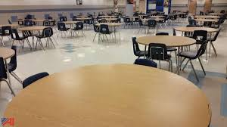
FOOD
Lunch Time
Places to eat are:
  Cafeteria
  Friendship Room
  Outside
  Some classrooms (check with the teacher)
NIC Cafeteria and the Timberline eating area…
  …Is open to students before school and at lunch. Please note that only grade 12’s with study blocks should be in the cafeteria and eating area during class time ​
  There is limited seating available. Please clean your table and exit the cafeteria when you’re done eating for students who may be waiting

Slide 6
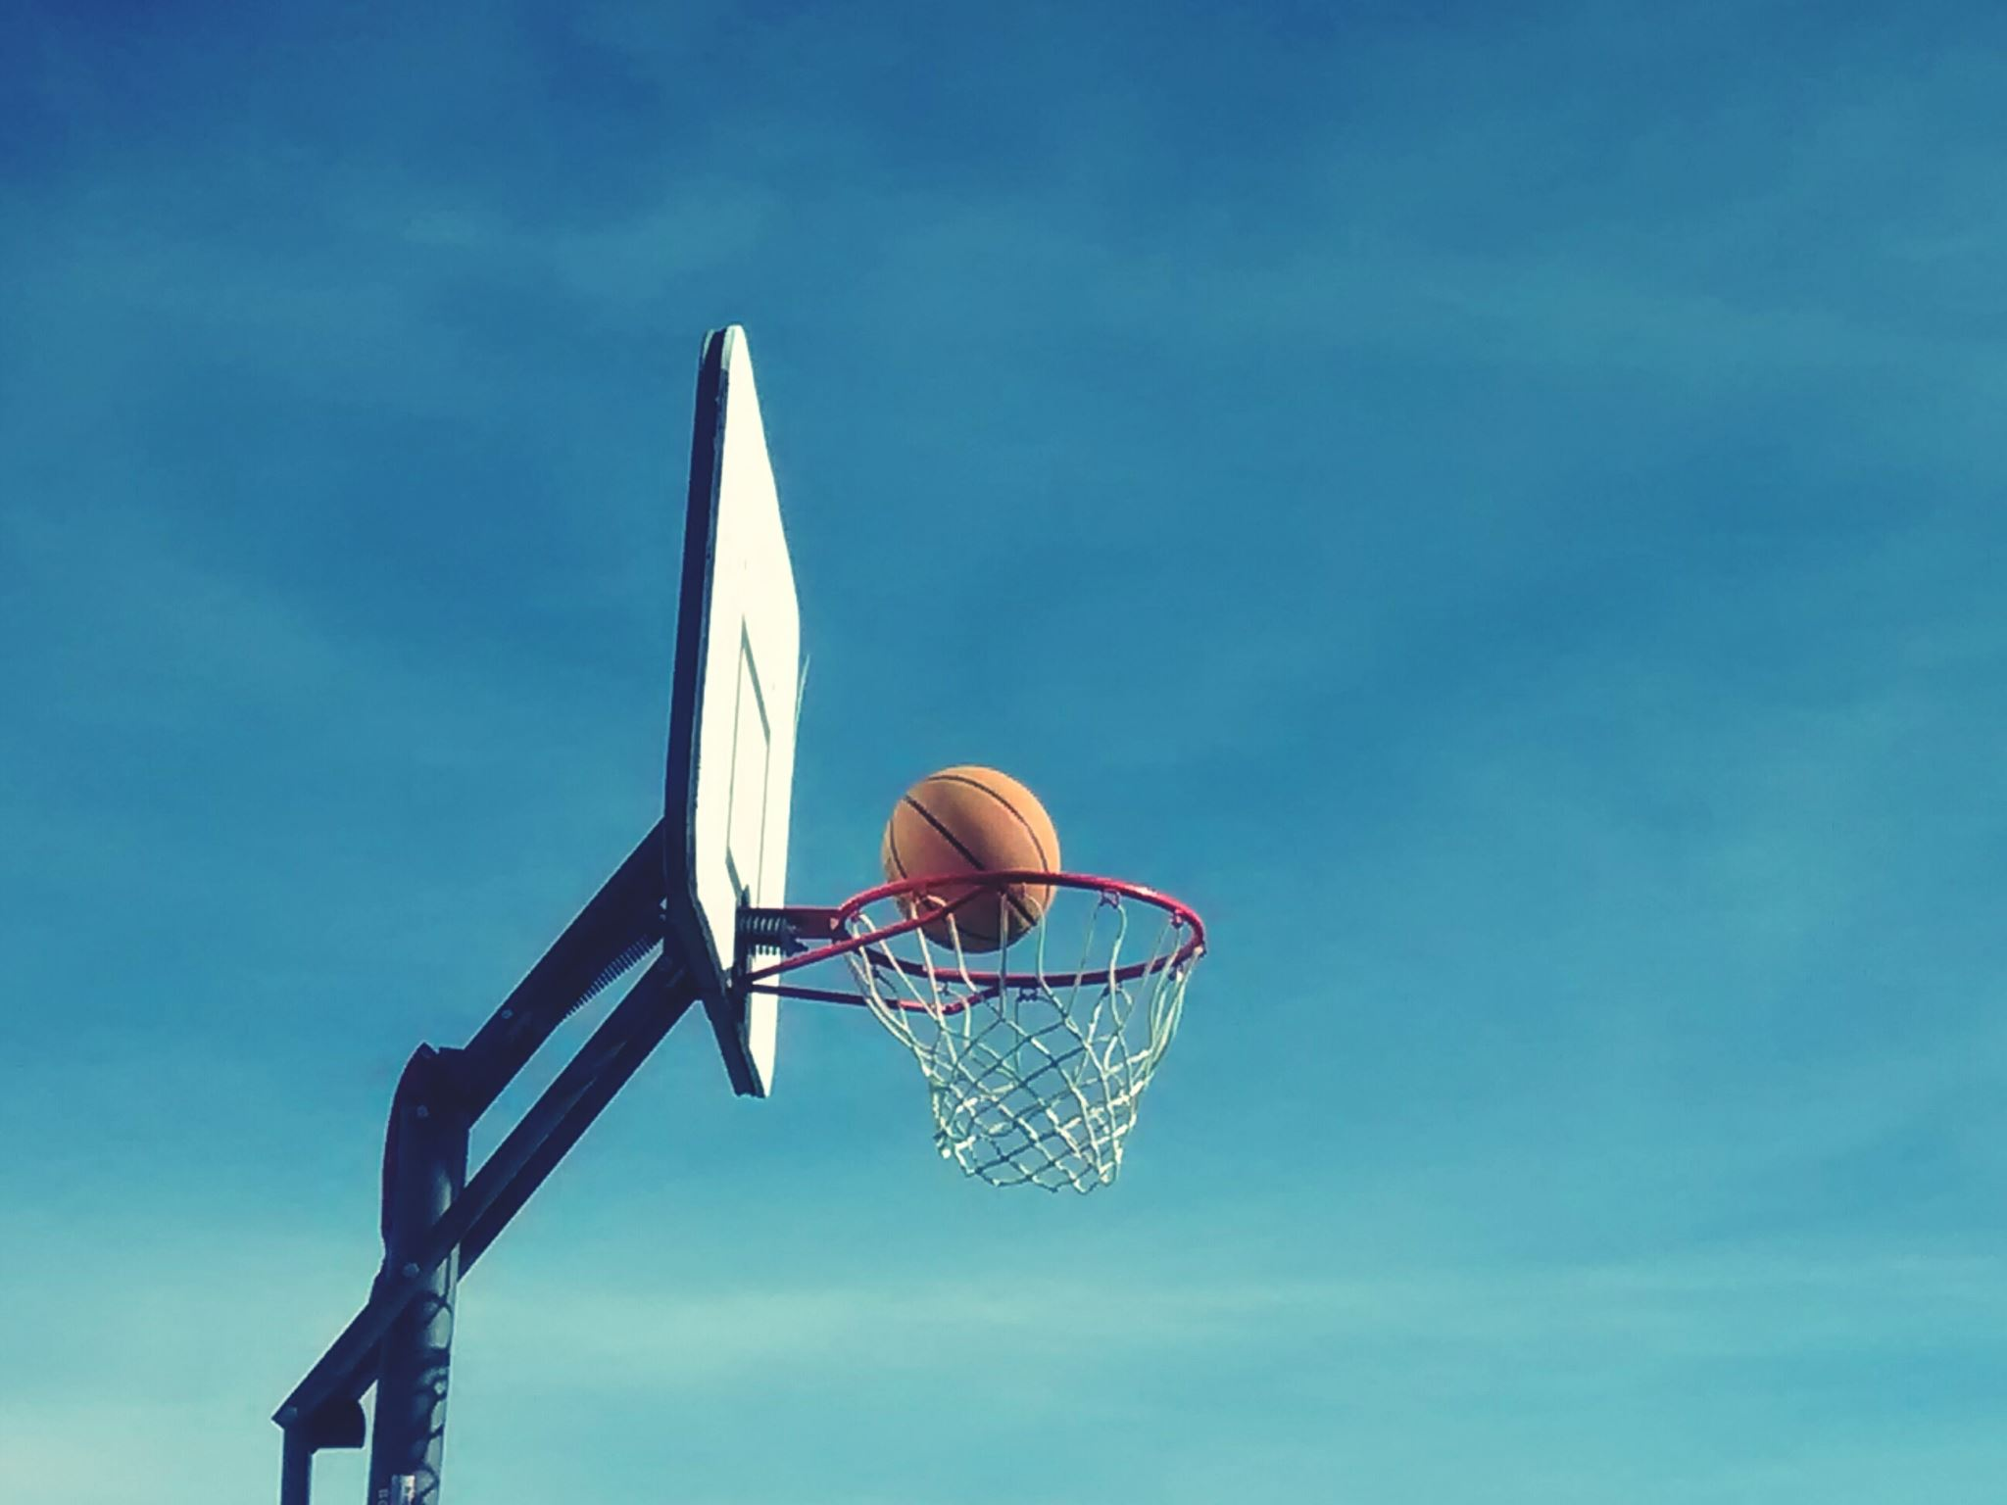


Extra Curricular Activities
Sports teams and clubs. Athletics meeting Friday this week at lunch in the Theatre for anyone wanting to play a sport this year
Leadership Opportunities
Do you have an idea for a club? Talk to a teacher, counsellor, or the Administrators.
Musical Theatre
Look for more information in the daily announcements over the coming weeks.

Slide 7

TIMBERLINE ATHLETICS
“The Power is in the Pack”
Sign up for Fall Teams NOW on the Athletics board (outside of the Gym)
Jr. Boys’ Volleyball
Sr. Boys’ Volleyball
Jr. Girls’ Volleyball
Sr. Girls’ Volleyball
Boys’ Soccer
Cross country
E-sports
Is your Parent interested in driving this year? Pick up the Driver abstract and CRC form before you leave.

Slide 8
Block Schedules
Monday, Tuesday,
Thursday, Friday,
Wednesday Flex
Rotating Week 1 and Week 2
A | 8:50 – 10:10 | 80 mins
Transition Time | 10:10 – 10:20 | (10 mins)
B | 10:20 – 11:435 | 75 mins
Lunch | 11:35 – 12:15 | (40 mins)
C | 12:15 – 1:35 | 80 mins
Transition Time | 1:35 – 1:45 | (10 mins)
D | 1:45 – 3:00 | 75 mins
A (WK 1) C (WK 2) | Flex Time: 8:50-9:35 Reg. class 9:35 – 10:30
Break | 10:30 – 10:40 | (10 mins)
A/C | 10:40 – 11:35
Lunch | 11:35 – 12:15 | (40 mins)
B (WK 1) D (WK 2) | 12:15 – 1:10
Break | 1:10 – 1:20 | (10 mins)
B/D | 1:20 – 2:15 Flex Time: 2:15-3:00

Slide 9
Information from the Counsellors
Course change requests can be submitted by email, Teams or by appointment. To make an appointment please email your counsellor.
Divided by your last name:
A-K - Ms. Noren
L-Z - Mr. Chenard
All students are expected to have a full course load at Timberline. Students in grade 12 will be considered for a study block after reviewing their graduation program with a school counsellor.
Students who need to see a counsellor about other matters can also book an appointment by email, use Teams, or see the Admin assistant at the counselling window.
If you have an emergency that requires immediate counselling support please come to the counselling office wait at the door until someone can help you. COURSE CHANGES ARE NOT AN EMERGENCY.

Slide 10


Slide 11
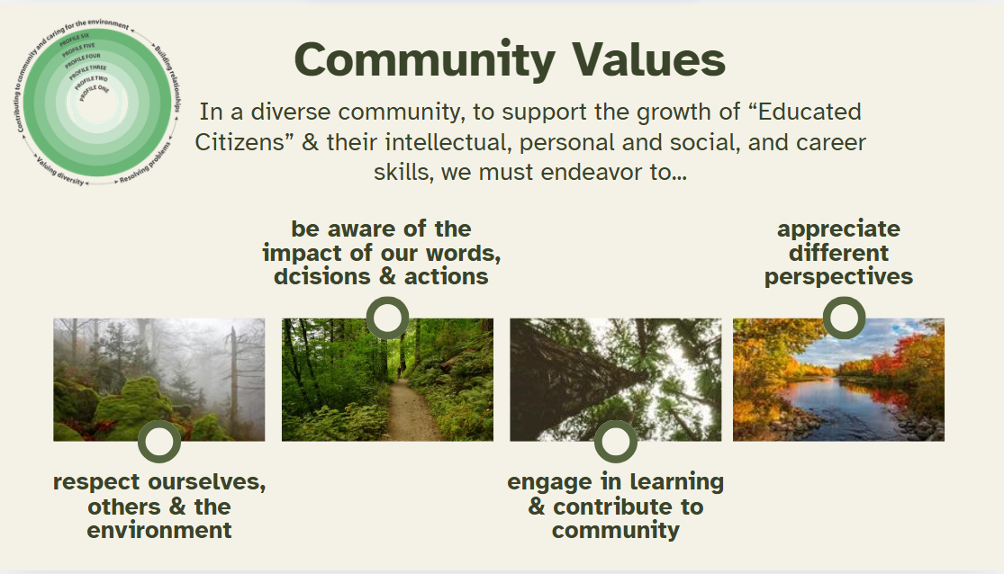

Slide 12



Code of Conduct
Our Code Of Conduct covers the entire campus, both North Island College and Timberline areas.
Timberline School Boundaries:
Triangle area – in the back of the school there is a barrier indicating the boundary between Timberline and NIC. Except for arriving and leaving the school, students are not be on NIC property during breaks or class time. If you’re curious about what the college has to offer, talk to a counsellor!
Students are only to use the paths in the forested areas as places to walk through on the way to or from school. They are not areas to gather in during breaks or class time.
Timberline is a substance free school!
This includes Alcohol, Drugs, Tobacco Products, Vaping
We care about you!
NOTE: There is no Smoke/Vape Pit anywhere on Timberline property – this includes the forest areas and parking lots.

Slide 13
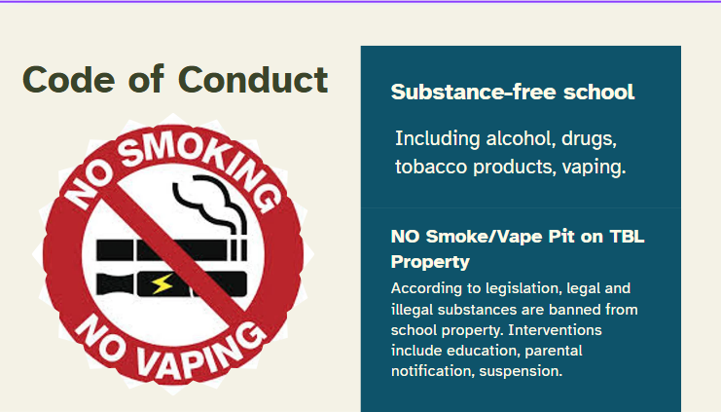

Slide 14
Code of Conduct
All members of our school community have the right to a harassment and violence free learning environment.​
Any verbal or physical threats are taken seriously and will be followed up on with appropriate consequences.
Do you have your drivers License? Be respectful of your driving in the parking lot, entries, and exits. Unsafe, erratic driving, horn honking, squealing tires, etc. may result in losing the privilege of having your vehicle at school. Parking lot use is discouraged during transition times
Trails – Please do not stop to gather; use trails for their intended purpose. They are school property. Be bear-aware!
Do you need someone to talk to? Check in with one of the counsellors, youth workers, admin, or your teacher!

Slide 15
Code of Conduct
Personal Electronic Devices
Cellphones, earbuds, apple watches etc are to be;
OFF and AWAY for THE DAY
OFF: device is turned off, notifications off as you enter the building (airplane mode)
AWAY: device is not on your person (backpack/locker/classroom caddy/home)
For THE DAY: during instructional time *unless directed by teacher for educational use* We encourage during breaks as well, however you are permitted to use them at breaks and lunch.
Cellphones are not permitted in washrooms

Slide 16
GRAD 2027 Coordinators:
Emma Moray and Angel Murphy
- Teams!! Find your "hidden channels" and set GRAD 2027 (Grade 12) to "show" so you get notifications.
- CLC12 (the course you need for graduation) will be launched next Friday on Brightspace.
- Grad Assembly and Parent info night will be: September 24th
Are you in Grade
12?

Slide 17

Want to Audition for
Timberline's Annual Musical?
Info from Ms. MacFarlane

Slide 18
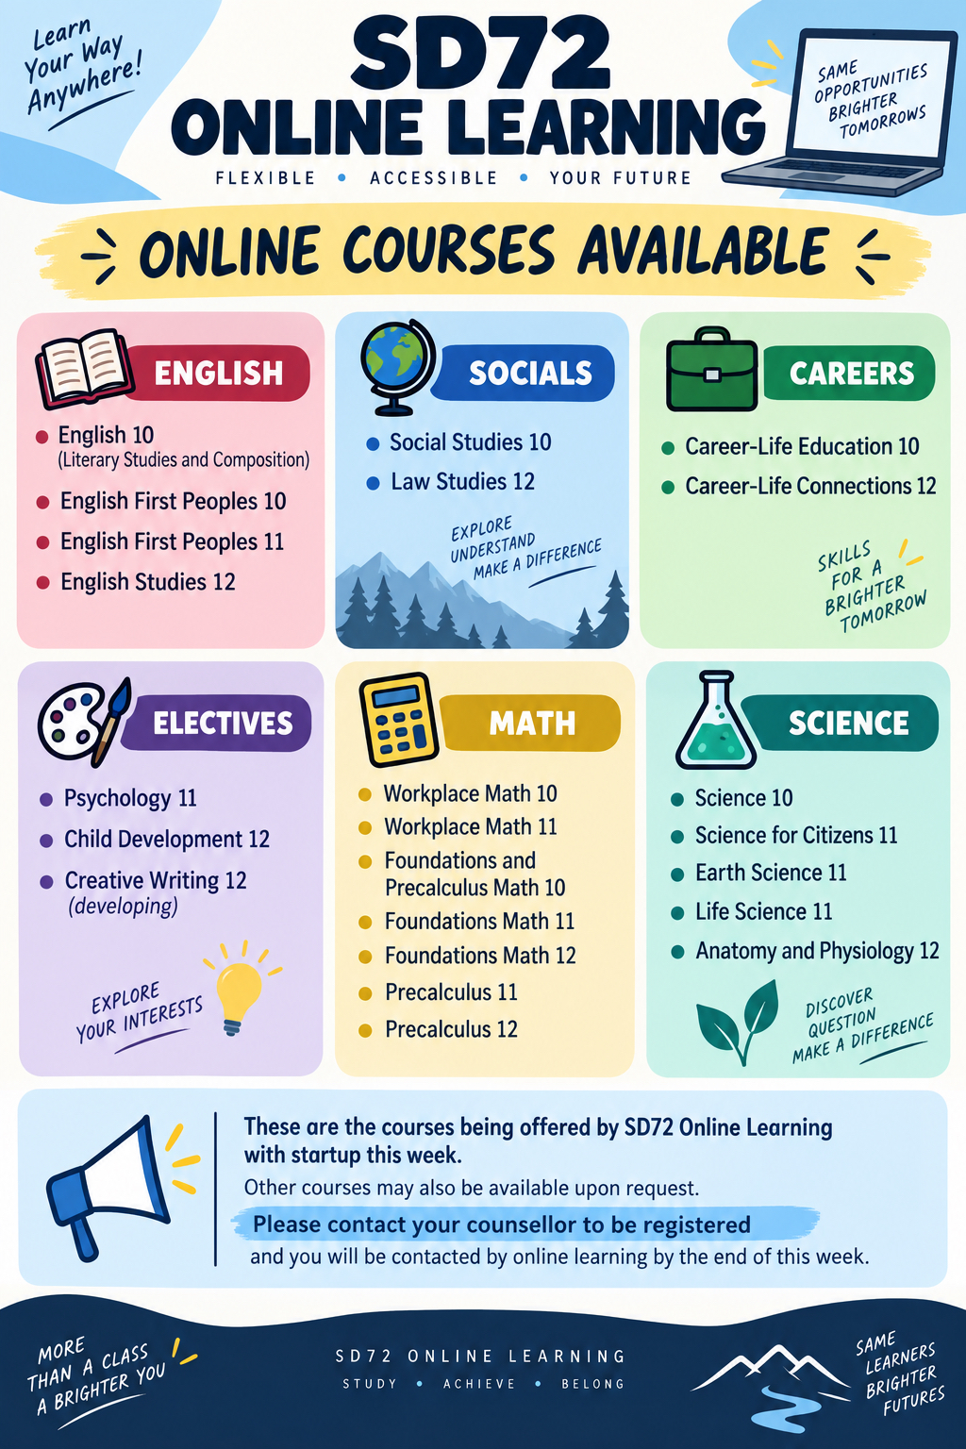




Online Learning
Info from Ms. McCormick

Slide 19


Questions or Comments? Connect with your teacher, counsellor or an Administrator. Thanks for your attention ☺

