Slide 1


WELCOME TO TIMBERLINE
Class of 2030

Slide 2
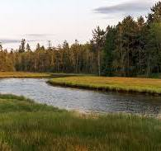

LAND
ACKNOWLEDGEMENT

Slide 3

Introduction to Timberline
Renewable balance
Wolf Pack
Values
& Timberline
Mandate
Timberline & NIC
Block
Schedule
Encouraging sustainable interaction between humans and nature.
Green future
School Supports
Community
Norms
Code of Conduct
Integrating conservation into modern urban and industrial planning.

Slide 4
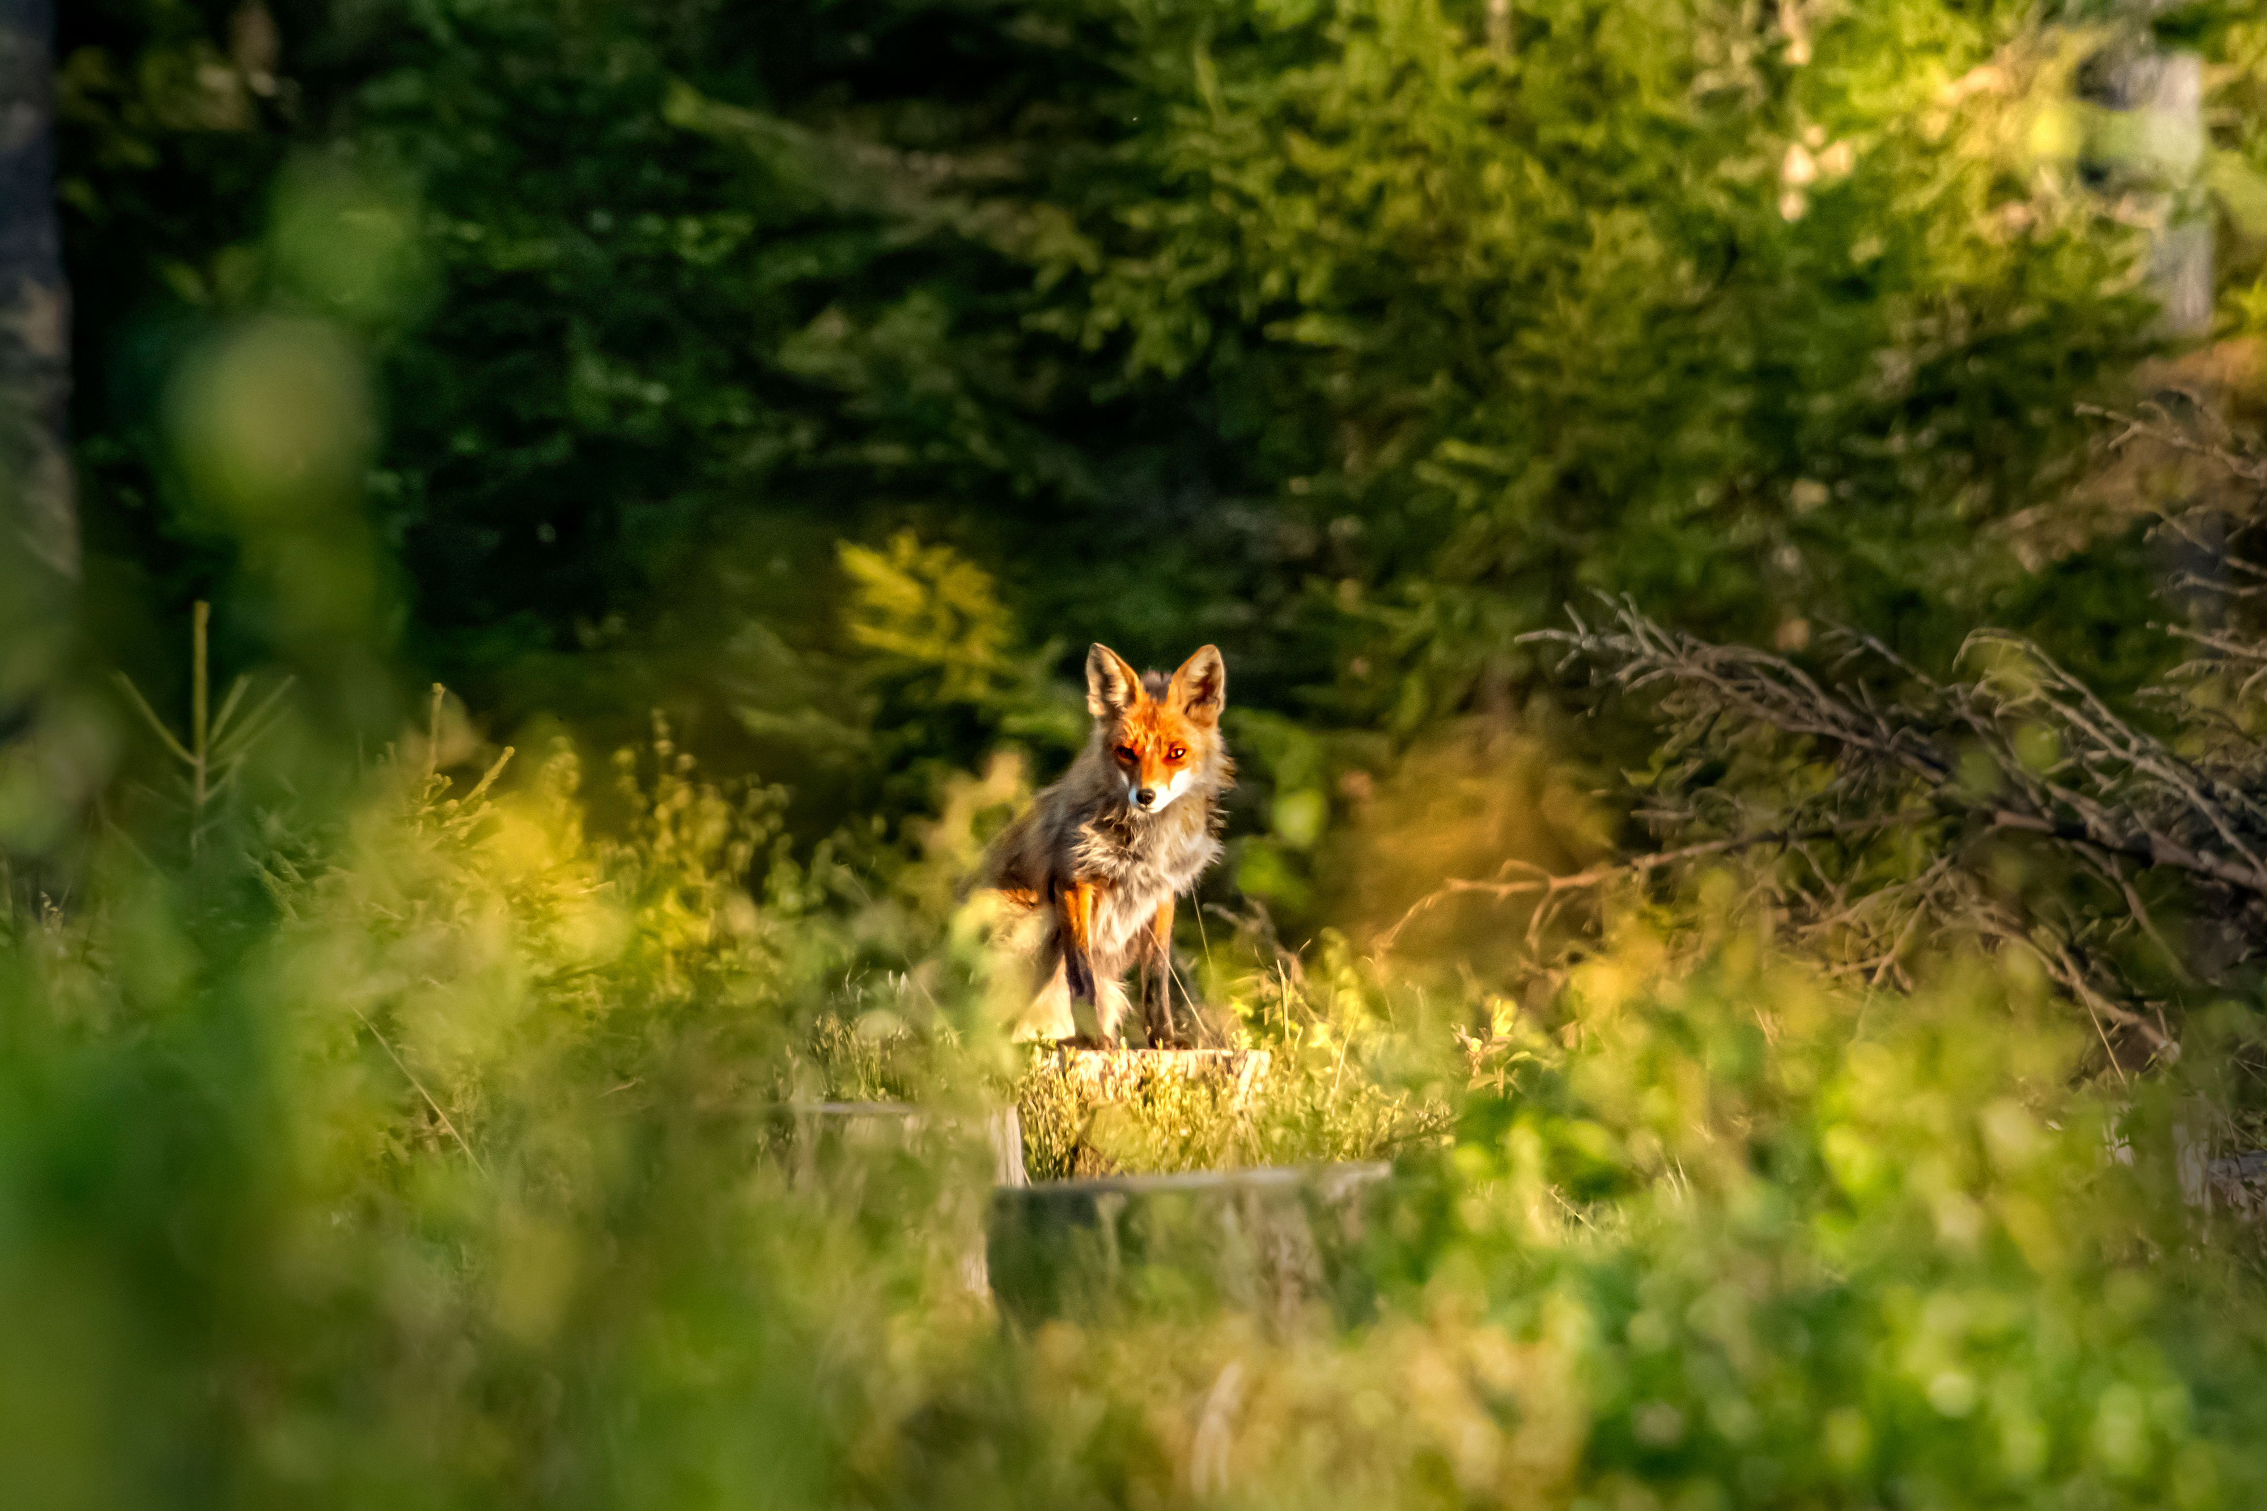
Welcome to the Wolf Pack
Loyalty
Family & Friendship
Teamwork
Protection
Wildness
Freedom
Instincts
Endurance
Curiousity
Playfulness

Slide 5
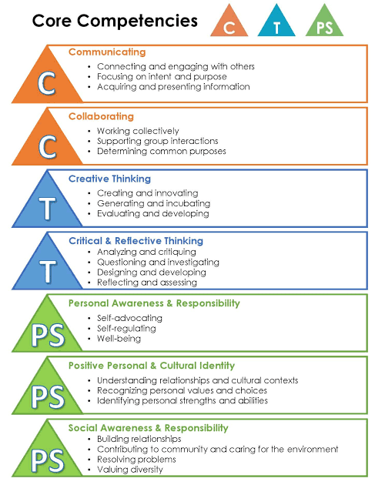
The Educated Citizen
The purpose of BC schools is to help students:
  reach potential
  attain knowledge & skills
  develop attitudes
needed for a meaningful life, healthy relationships, and a successful career.

Slide 6


Shared Space
Timberline & North Island College
NIC Spaces
NIC Bus Stop
are off limits
is off limits
Exceptions
Exceptions
Lunchtime:
Cafeteria & tables. When done, clean up & depart for others to use.
Field trips.
Students who have signed out.

Slide 7
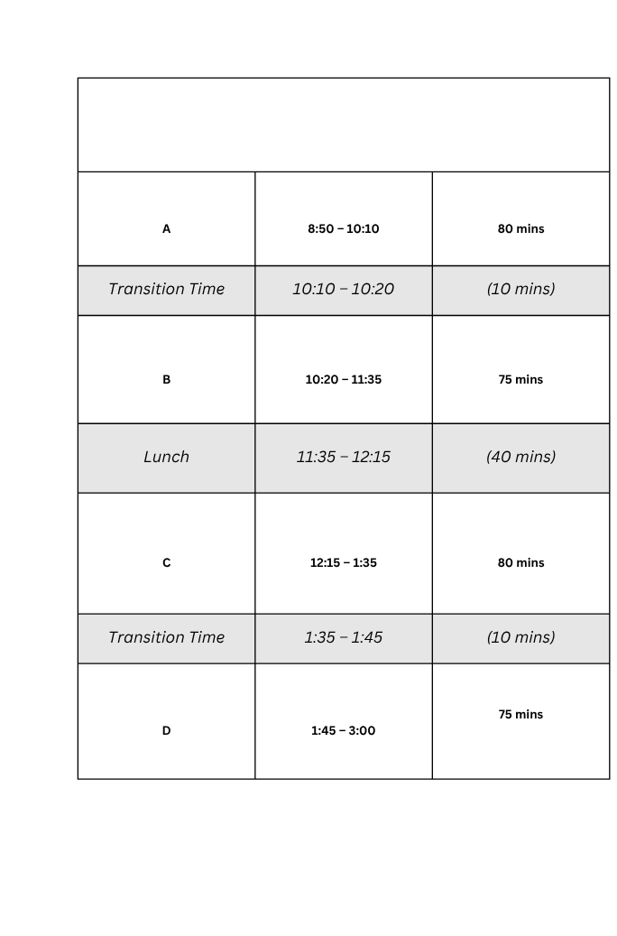
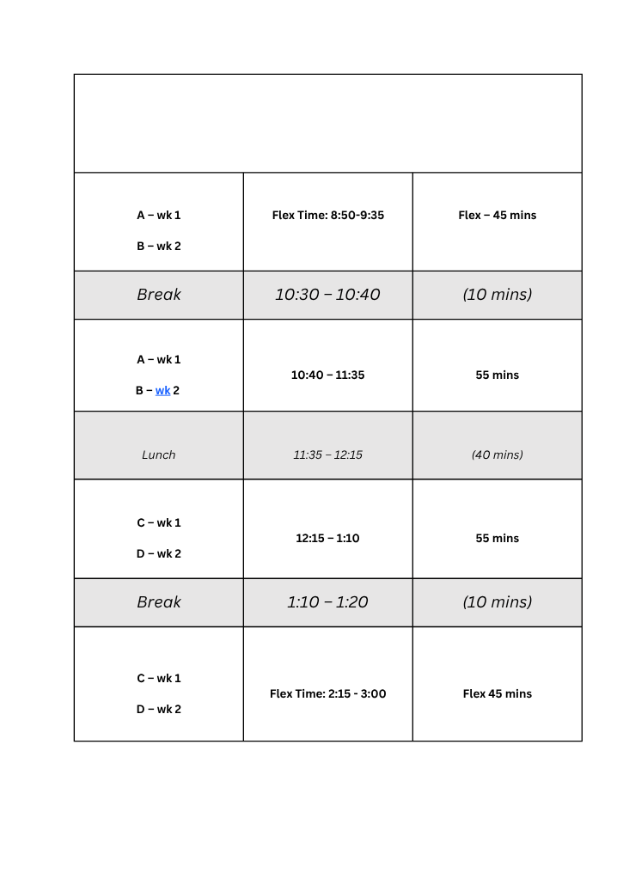
Block Schedules
Monday, Tuesday, Thursday, Friday Schedule
Wednesday “Flex” Schedule

Slide 8

Sharene Zemenek
Ronnie Billows
Youth Care
Counsellors
LST
Ms. Norren
Mr. Chenard
Ms. Fraser
Ms. Humphries
Ms. Hernandez
Admin
IST
School Staff &
Support Services
Principal:
Mr. Zlatanov
Vice-Principal:
Ms. Friederich
Ms. Ubriaco
(Indigenous Support Teacher)

Slide 9

Info from Your Counsellors
A - K: Ms. Norren - stacy.norren@sd72.bc.ca
L - Z: Mr. Chenard - ryan.chenard@sd72.bc.ca
  Course change request: email, message via Teams, make an appointment in person at student services
  Make an appointment via email or Teams for other matters. For emergencies, please wait at the door.

Slide 10
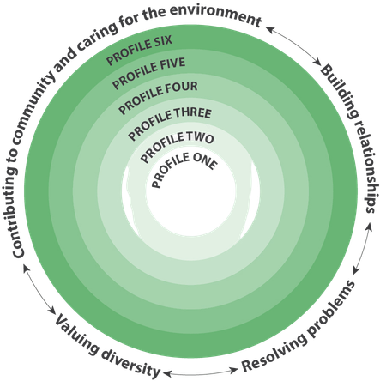

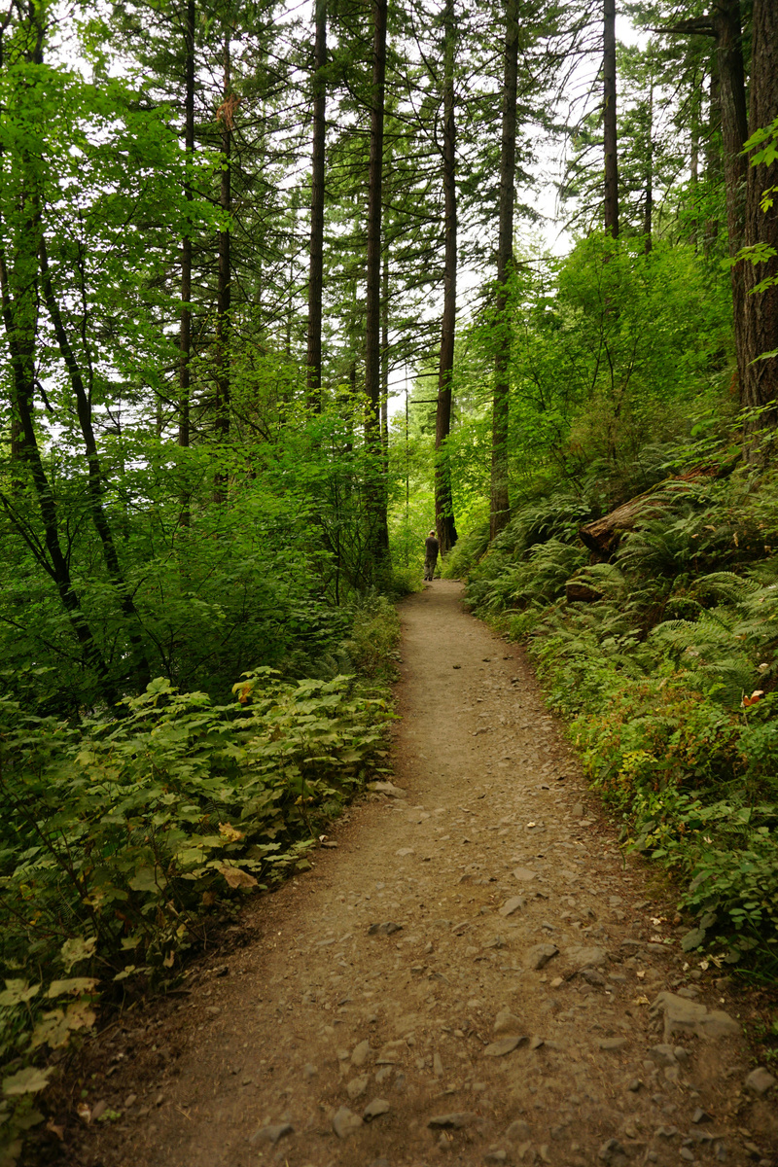

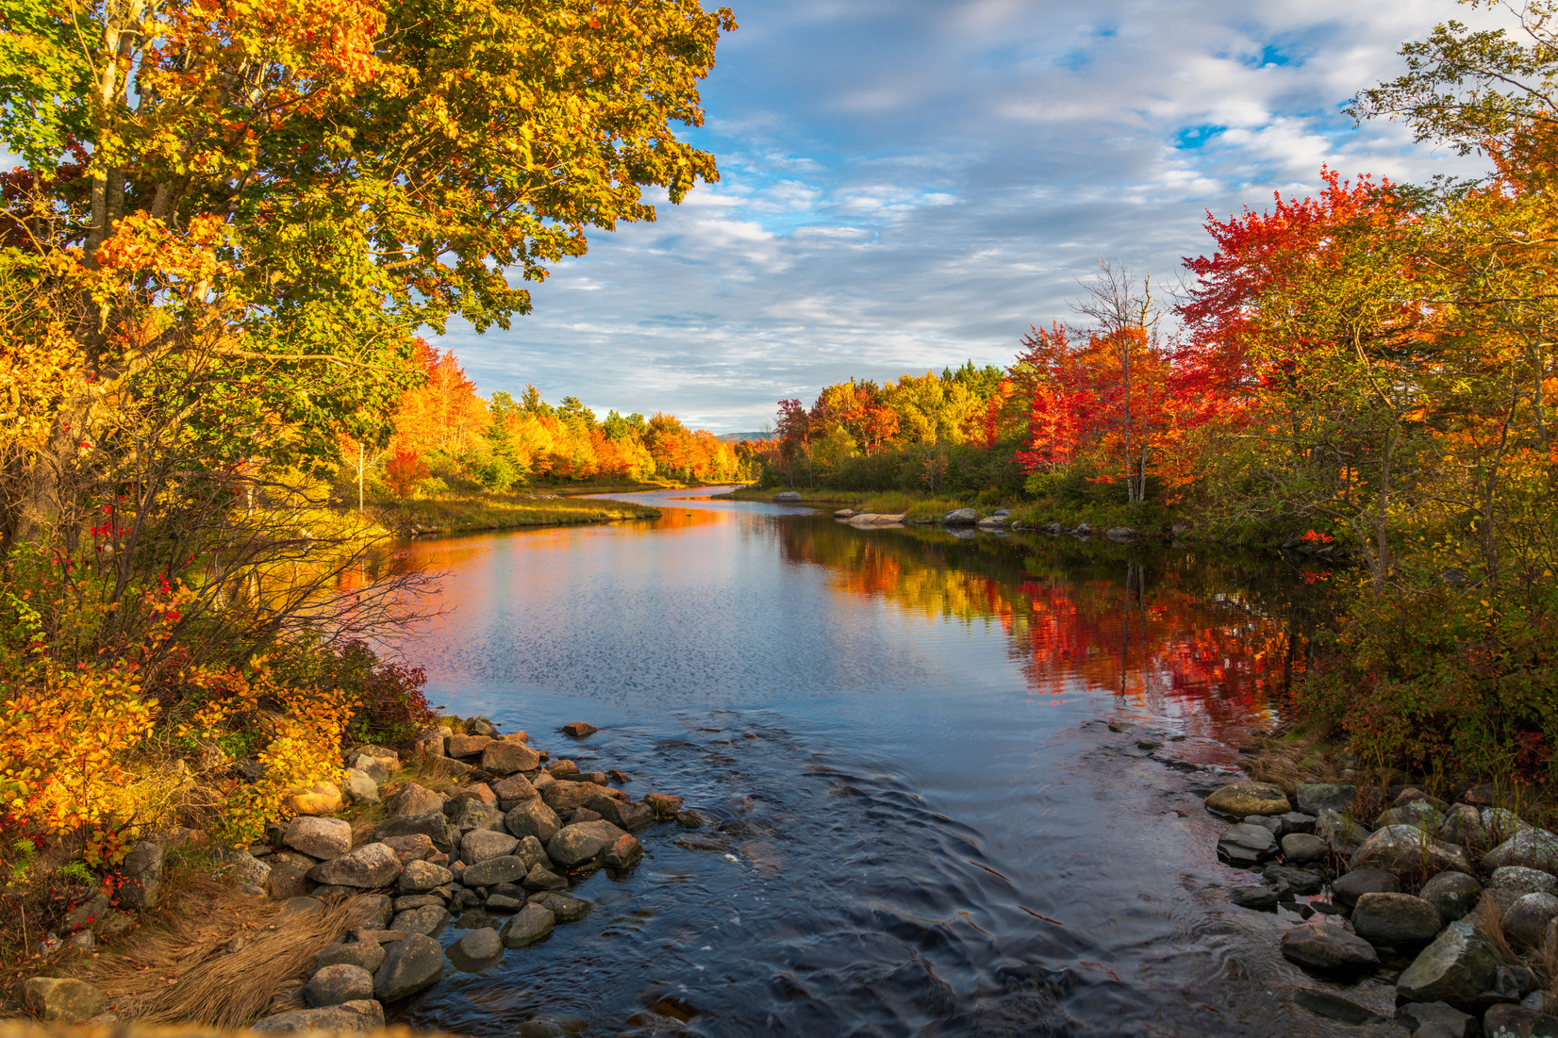
Community Values
In a diverse community, to support the growth of “Educated Citizens” & their intellectual, personal and social, and career skills, we must endeavor to...
be aware of the impact of our words, dcisions & actions
appreciate different perspectives
respect ourselves, others & the environment
engage in learning & contribute to community

Slide 11


Getting to know
your school community

Slide 12

Code of Conduct
Substance-free school
Including alcohol, drugs, tobacco products, vaping.
NO Smoke/Vape Pit on TBL Property
According to legislation, legal and illegal substances are banned from school property. Interventions include education, parental notification, suspension.

Slide 13
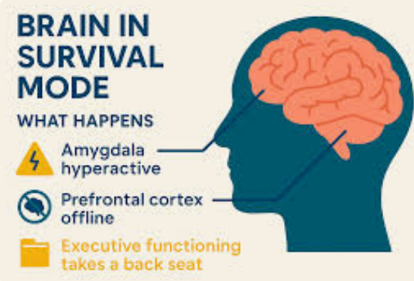

Code of Conduct
You are
safe here
  To learn, you must feel safe.
  You must be safe from bullying or harassment, & threats.
  Need to talk? See a YCW, Counsellor, Teacher, Administrator

Slide 14

Want to audition for the
Annual School Musical?
Info from Ms. MacFarlane

Slide 15
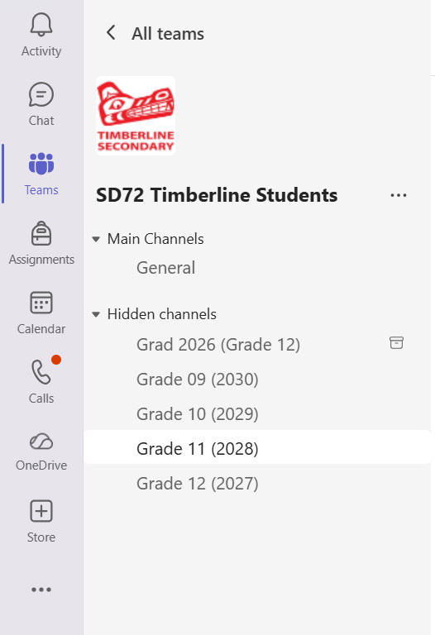

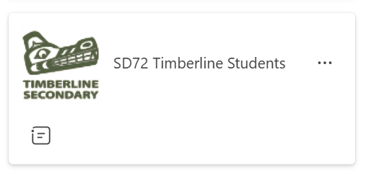

TEAMS
  Go to the Team, “SD72 Timberline Students.”
  Find your “hidden” Grade Channel.

Slide 16
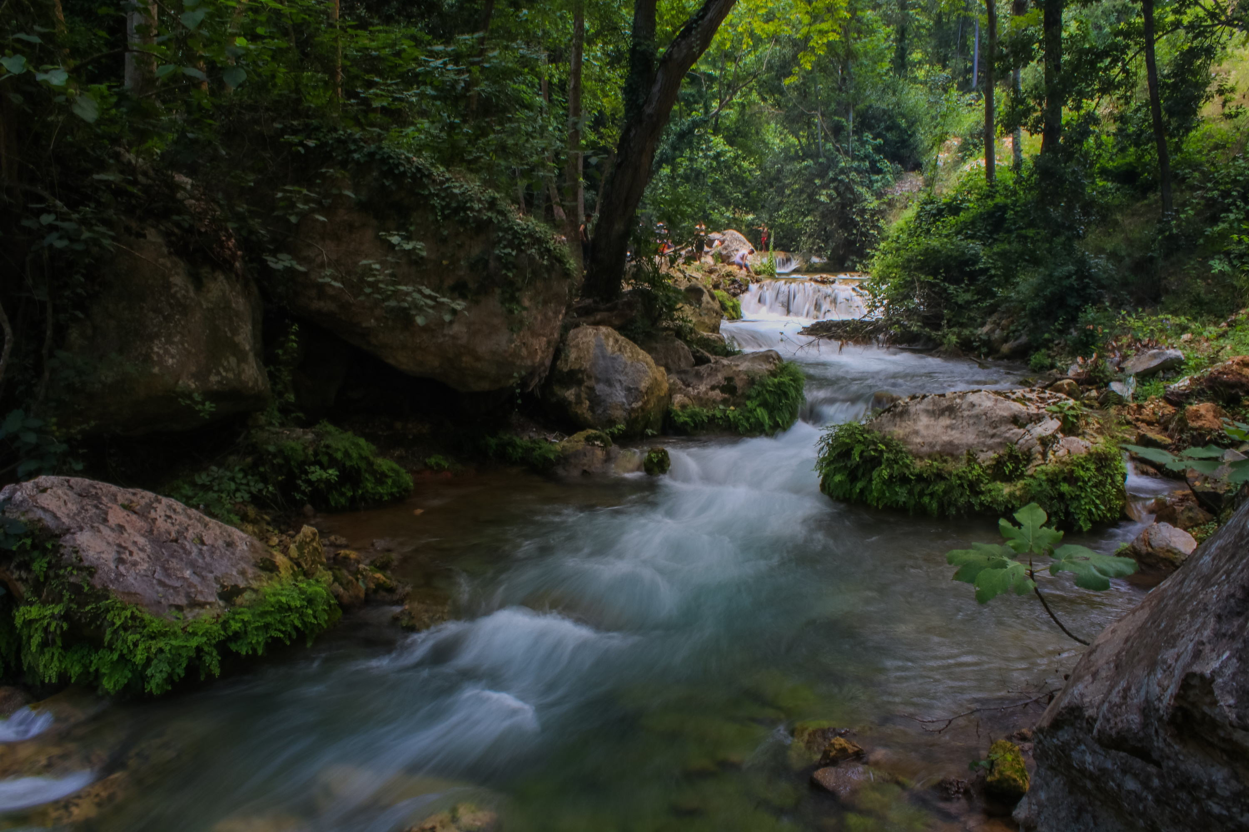
Thank You
Enjoy the Year, Timberline!
Grad 2030!!

