Slide 1

Grad 2026
Assembly
Tuesday September 22nd
Notes:
NOTE:
To change the image on this slide, select the picture and delete it. Then click the Pictures icon in the placeholder to insert your own image.

Slide 2
Grad Family
Info Night 2026/27
Tuesday, September 22nd
Notes:
NOTE:
To change the image on this slide, select the picture and delete it. Then click the Pictures icon in the placeholder to insert your own image.

Slide 3
Introductions
James Zlatanov – Principal
Rachel Friederich– Vice-Principal
Stacey Noren - Grad Counsellor: Students with the last name A-K
Emma Moray/Angel Murphy – Grad Coordinators/CLC12 Teachers
Ryan Chenard - Grad Counsellor: Students with the last name L-Z

Slide 4
Info from Counselling

Slide 5
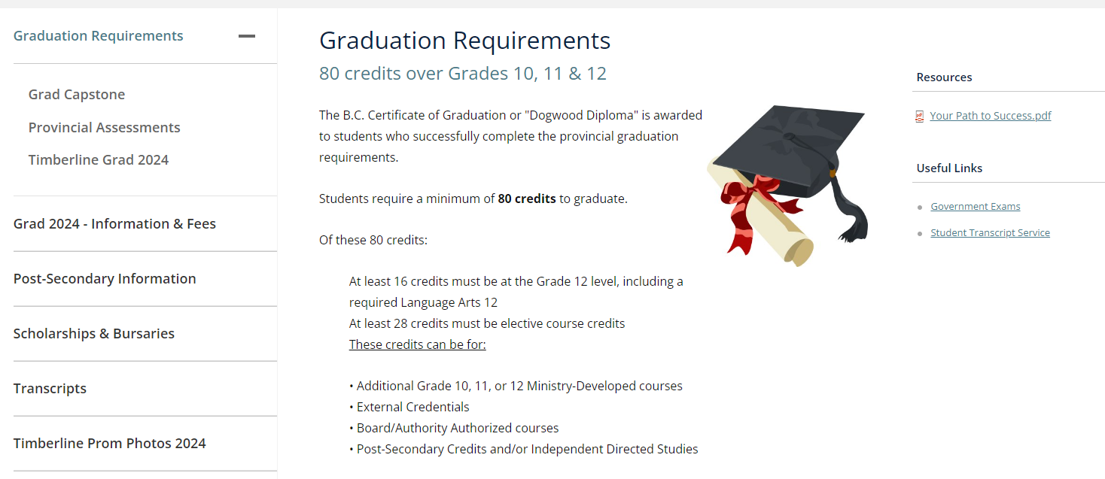
Timberline Website

Slide 6
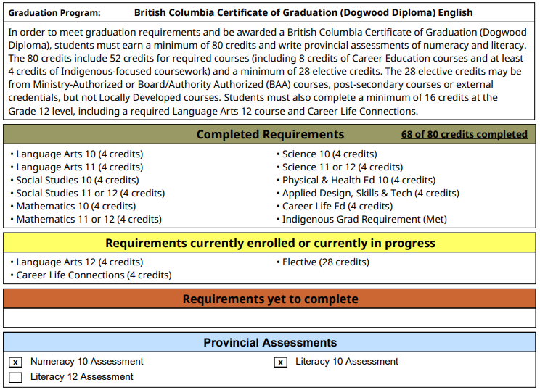
Grad Letters/Credit Verification
Sent home with November report card and again in the spring.

Slide 7
Ways to earn additional credits...
Out of timetable credits – Leadership, Yearbook, Guitar, Stagecraft
Work Experience – Summer Wex
External Credits – First aid, provincial and national sports teams, ICBC driver's course etc...

Slide 8

Online Courses
Completed by June 1st, 2027

Slide 9
Provincial Assessments
Grade 10
Numeracy
Grade 10
Literacy
Grade 12
Literacy

Slide 10
Study Blocks
Study blocks need approval from home, admin, and counsellors.
These are not automatic and they must be approved.
For grade 12s only.
Study blocks will be issued the first week of October.

Slide 11
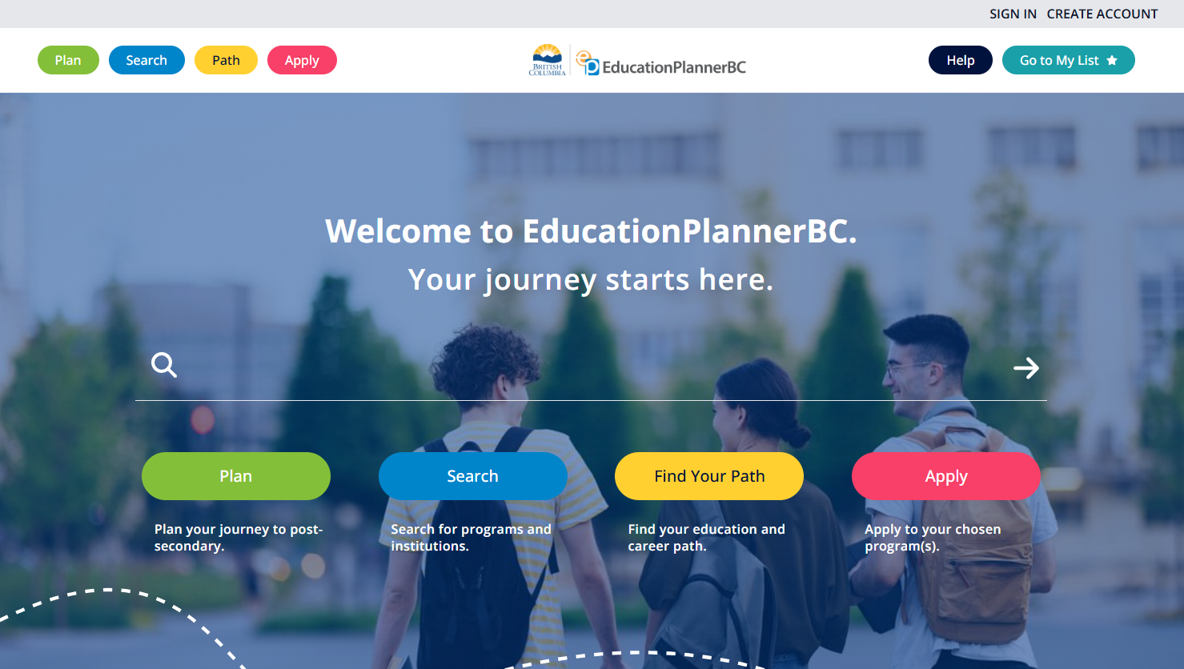
www.educationplannerbc.ca

Slide 12
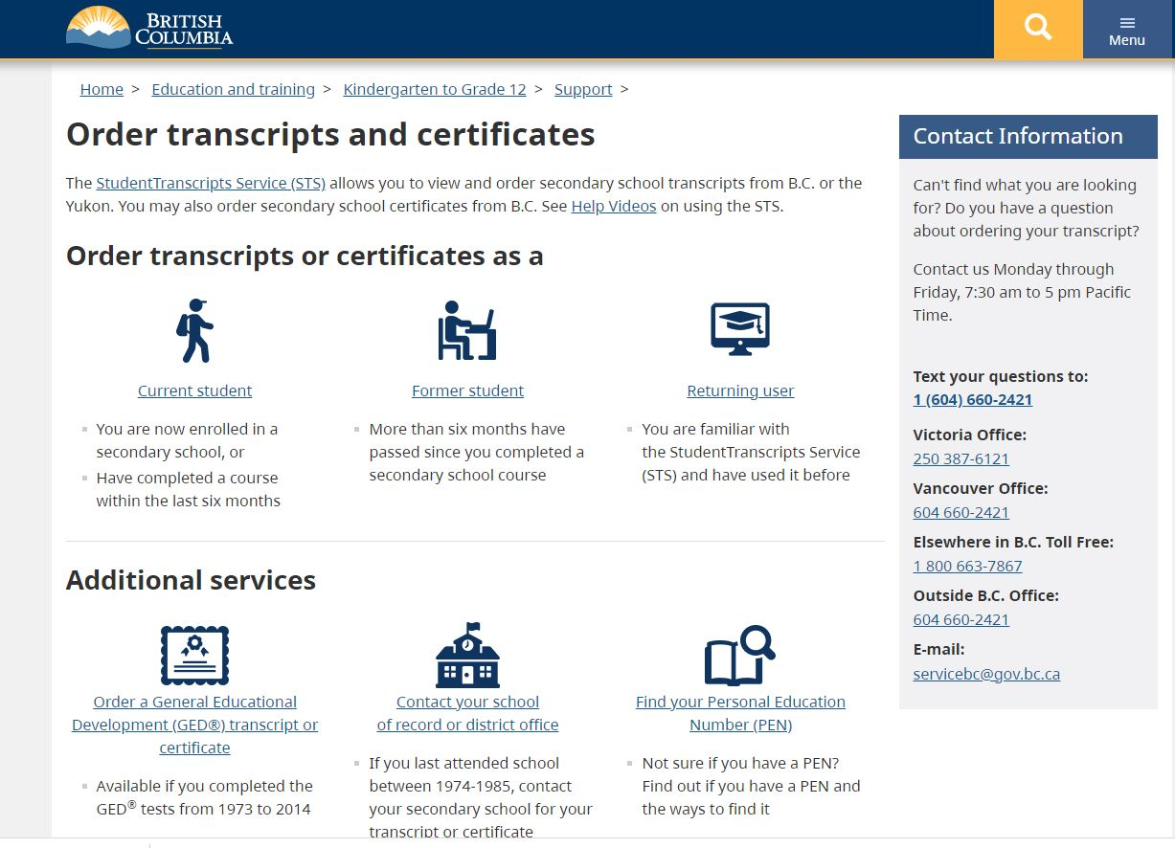
How to Order Your Transcript
Create a BCeID account at www.bceid.ca
Register for Student Transcripts Service once you have a BCeID account at
www.StudentTranscripts.gov.bc.ca
Transcripts are securely sent to colleges and universities directly from this site.
Paper instructions are available in the Counselling office.

Slide 13

Scholarships & Bursaries
How to find information:
  Teams – regular updates
  Counselling bulletin board
  Timberline website
  Ms. Noren
  Pay attention to scholarship announcements.
  Apply, apply, apply!

Slide 14
            THINGS TO KNOW......
Know your credits – check your MyEd account
Create an account with Education Planner BC
Research programs and schools – this is the student's responsibility
Ensure you know the required courses for the program you are applying for.
Many applications for college and university open October 1
Know when applications close
Always look for entrance scholarships on the website
Check Teams. Turn on notifications.

Slide 15
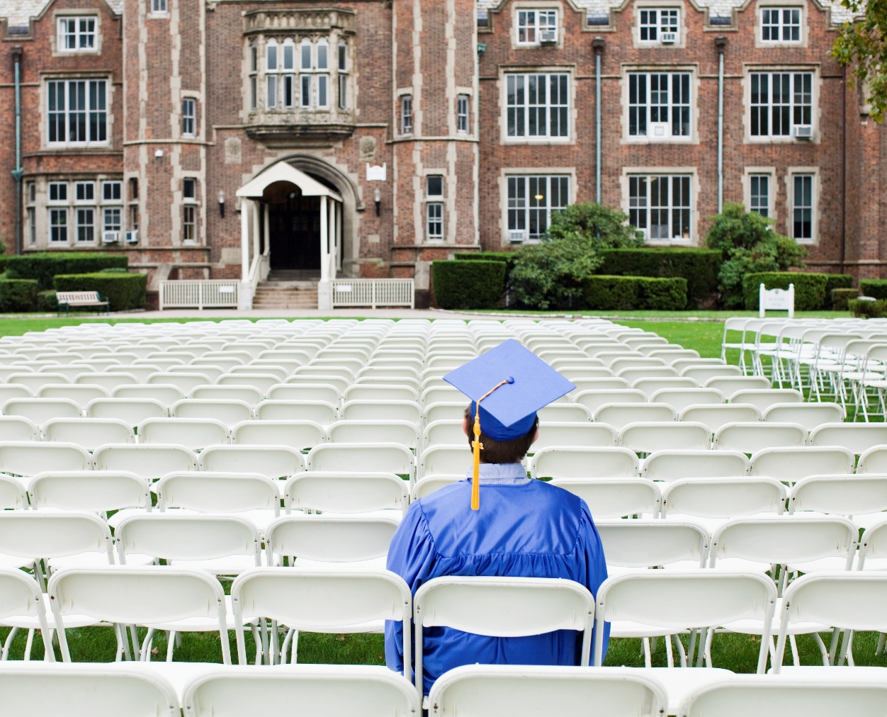
BC Post-Secondary Night
Monday, September 28
6:30-7:50PM presentations
8:00-8:30PM mini-fair

Slide 16

Career-Life Connections 12

Slide 17
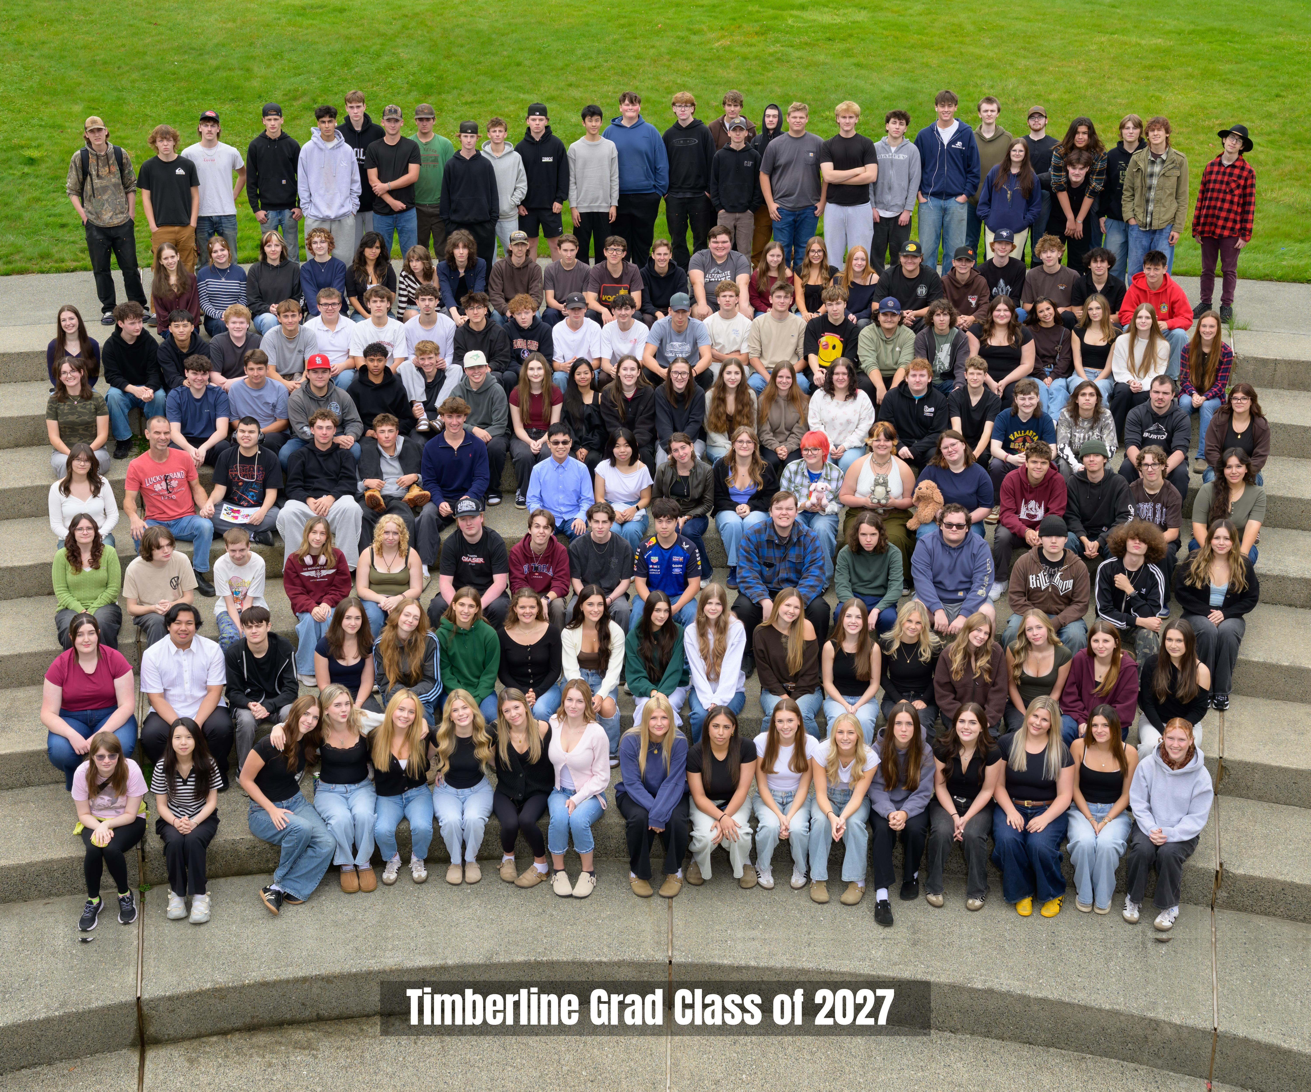

Slide 18
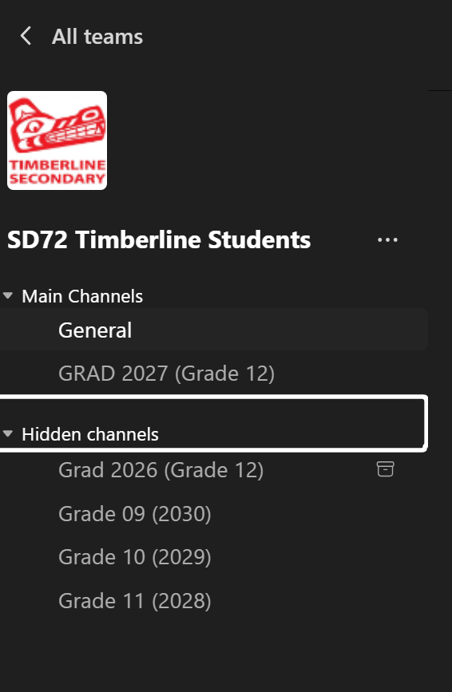
Where to get information: TEAMS/MY APPS

Slide 19
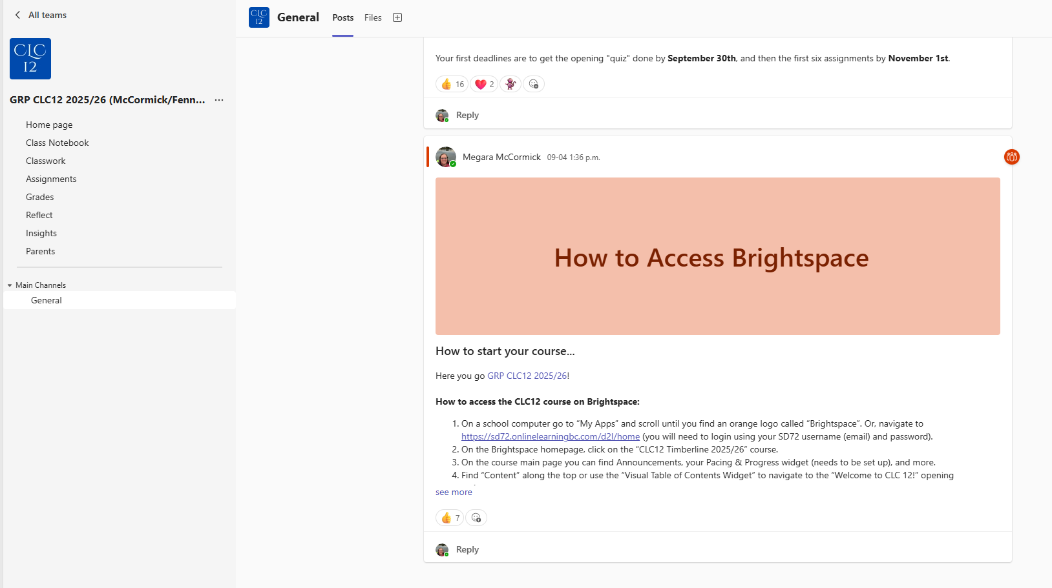
Where to get information: TEAMS/MY APPS

Slide 20
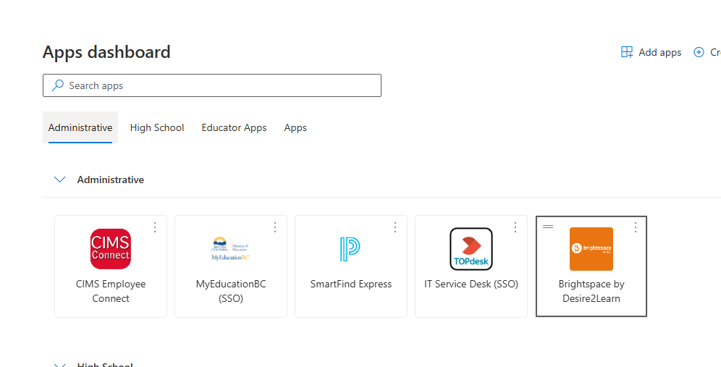

Where to get information: BRIGHTSPACE

Slide 21
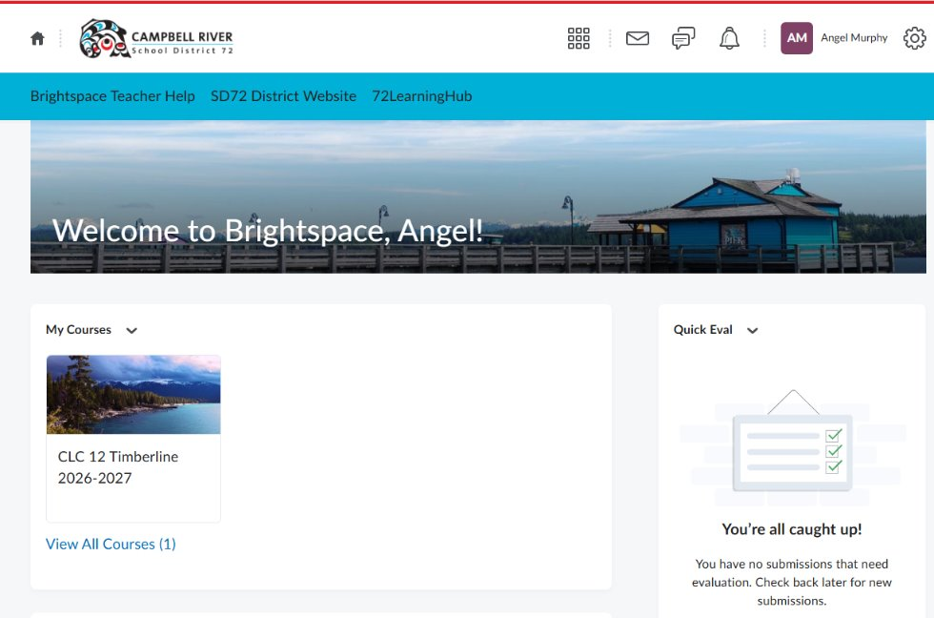
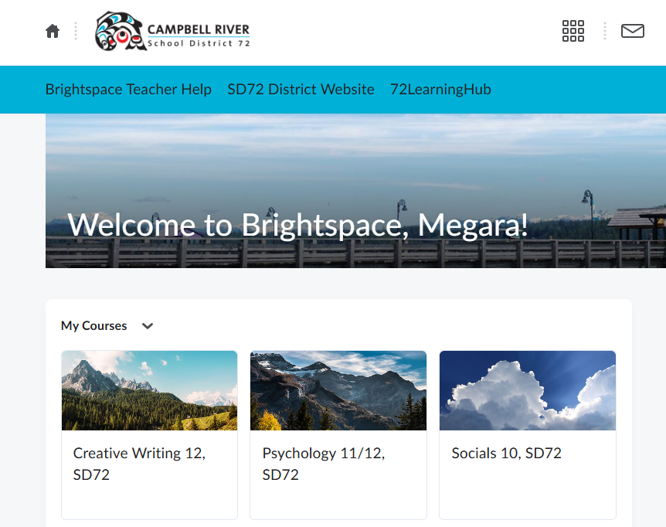
Where to get information: BRIGHTSPACE

Slide 22
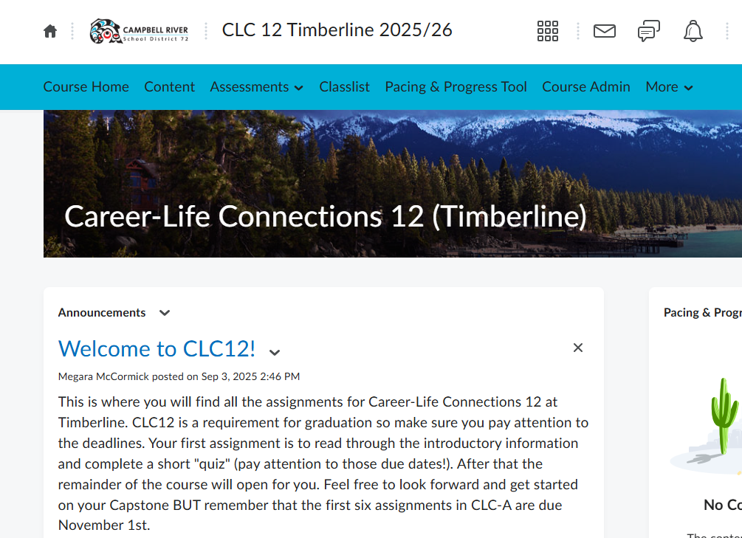
Where to get information: BRIGHTSPACE

Slide 23
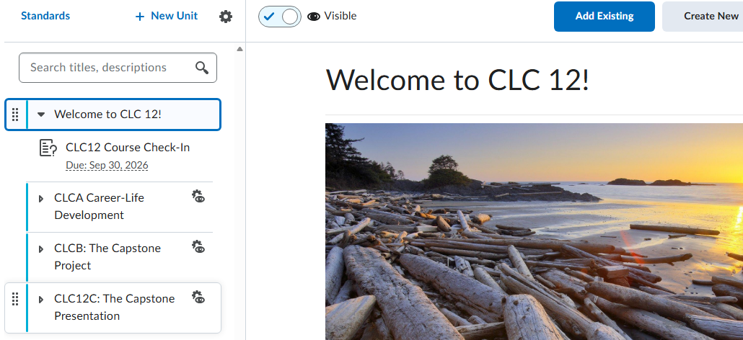

Slide 24

CLC12A: The Assignments
  Resume
  Proof of 30 hours work/volunteer
  Personal Profile
  Goal Setting
  Post-Secondary Plan
  Mentors Assignment
  All DUE November 1st
This Photo by Unknown Author is licensed under CC BY-SA-NC

Slide 25
CLC12B: The Capstone Project!
Students can start the Capstone process anytime by first completing the Capstone Proposal assignment in Brightspace.
Students will complete FOUR progress journals as they work on their Capstone Project. They must also attach proof of progress. The Capstone project should take 40+ hours.
Capstone Project is due on March 1st.

Slide 26
CLC12C: Capstone Presentation
Students will then present their Capstone to a mentor. A copy of the rubric and information on how to present is in the assignment in Brightspace.
The Capstone presentation is not just presenting the project, but also reflecting on their development in the core competencies, and communicating their post-secondary plan.
Presentations must be complete by May 1st.

Slide 27
Examples of Capstone Project
This is a PASSION PROJECT!
Something that tells us about who they are, what they enjoy doing, their growth in an area, or their future plans.
Learning a new piece of music; Learning any new skill
Participation in the School Musical
Rebuilding or fixing a vehicle
An art/writing/photography etc. portfolio
Inquiry project on a topic of choice
Extended investigation of your chosen career
Building a table or other furniture
Designing and implementing an athletic/personal training plan

Slide 28
CLC12 Support
In-person support is available during most FLEX afternoon blocks.
Mrs. Murphy – Library
Ms. Moray – B218
Quick question? Reach out on Teams chat Moray/Murphy.

Slide 29
Graduation celebrations

Slide 30
Grad Events
Good CLEAN fun!
  Movie night – Oct 2nd
  Dodge ball
  Tsawwassen Water slides
  Grad fashion show
  Trivia night
  Easter Egg Hunt
GRAD COMMITTEE
  Voice of the grad class
  Dreams → to → reality!
  Join us!

Slide 31
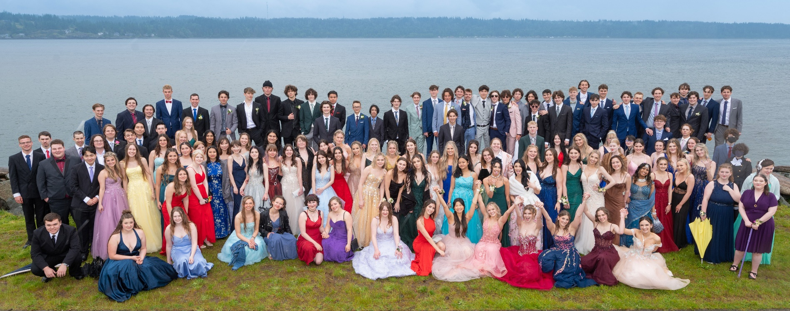
Important Dates
GRAD PHOTOS: December 15th/16th/17th
PROM: Saturday, June 5th
COMMENCEMENT: Wednesday June 23rd

Slide 32
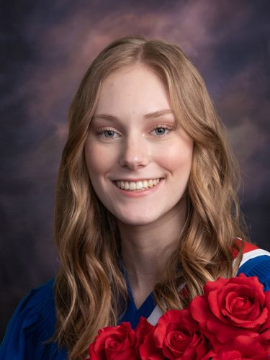
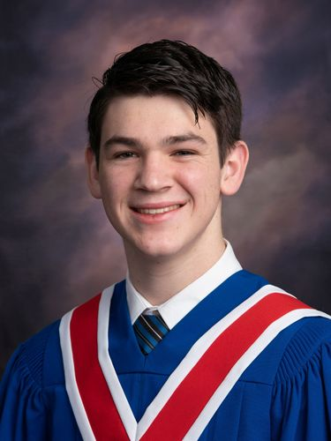
Grad Photos
December Tues 15th to Thurs 17th
Will be scheduled in advance
Draft schedule in early November
Final schedule December 1st
Sitting Fee is included in the commencement fee
Cap and gown is provided at appointment time

Slide 33
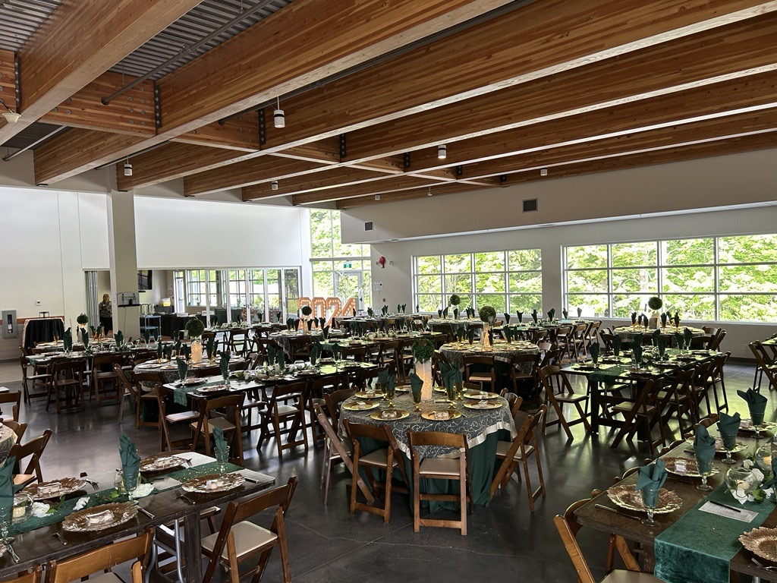
PROM – Saturday, June 5th
OPEN TO EVERYONE:
Photos at the Foreshore
---------------------------------------
For Timberline Grade 12 students only:
Formal dinner and dance (The gym transformed!).
Must be dropped off by a designated adult (cannot drive themselves) and be signed out (via phone call) at the end of night.

Slide 34
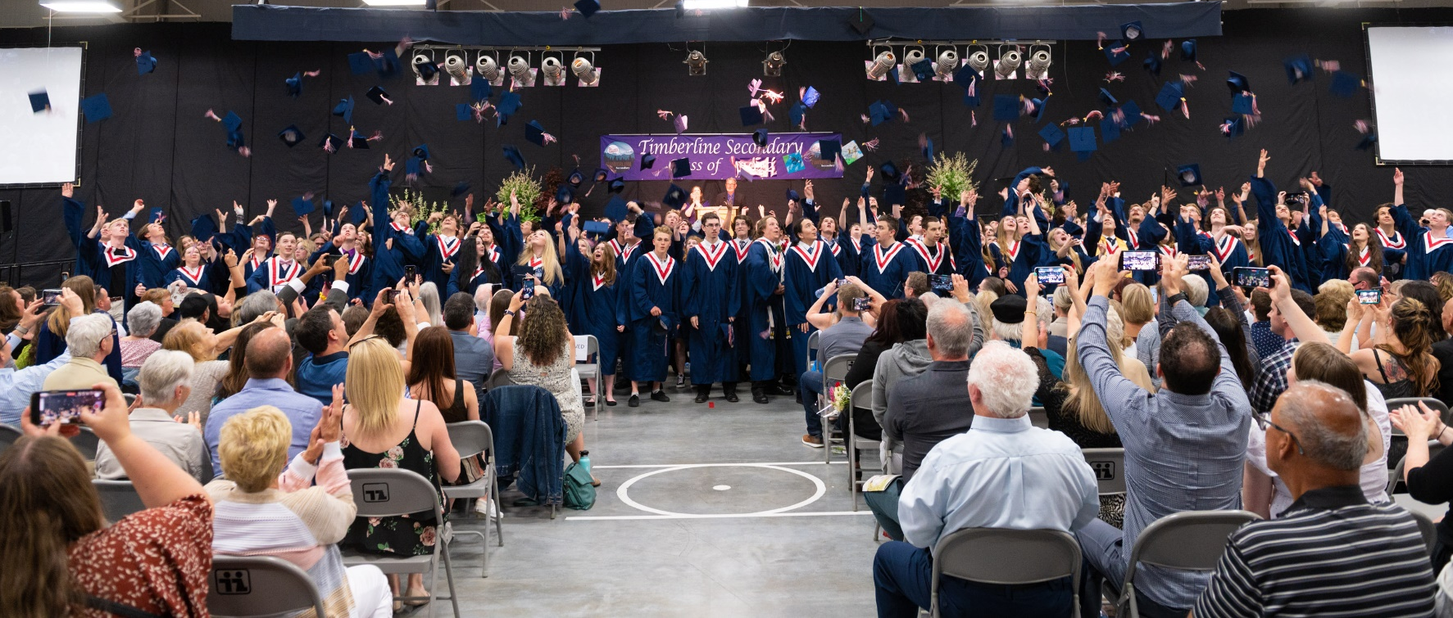
Commencement – Wednesday, June 23rd
Graduation Ceremony in the Arena
Cross the stage in cap and gown
Open to friends and family
Tickets on sale in May

Slide 35

Commencement Fee
Fee: $75
Includes:
  Cap, gown, tassel, and stole
  Two (2) tickets to commencement (Grads do not need a ticket)
  Sitting fee for Grad Photos
  Photography at commencement
  Additional costs

Slide 36

Commencement Tickets
Additional Tickets: Please note there will be a cap on tickets available per grad due to numbers (maximum 4 for a total of 6).
Any that are not picked up by a designated date in June will be made available to purchase on a “first come, first served” basis.

Slide 37
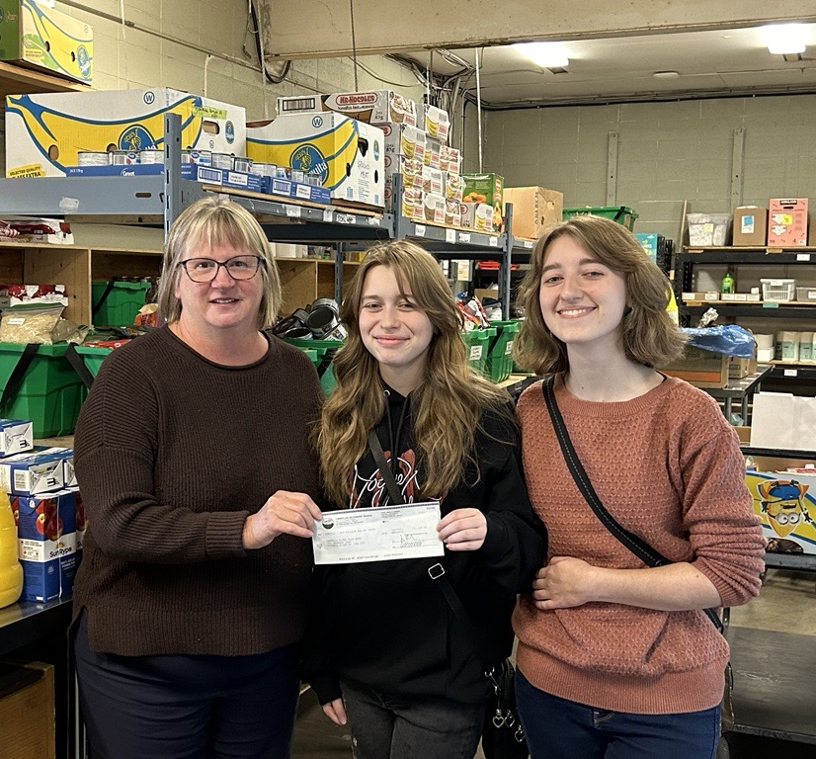
Fundraising
Fundraising is vital! All grad activities are “self-funded”.
Pays for:
  Prom (including ticket)
  Grad Gifts (“swag”)
  Yearbook
  All photography related to prom
  Prizes & costs of grad activities throughout the year
  Grad gift to the community
Each Grad is responsible for $225 in fundraising.

Slide 38

This Year’s (Organized) Fundraisers
Purdy’s Chocolate Bars – Open Now until Spring
DFS (Dieleman's) – Kitchen, Gifts, Seasonal (ship to anywhere in Canada) – Open Now until Nov 9th
Purdy’s Christmas – Open until late Nov
Winter Plants (Poinsettias) – Open until late Nov
Purdy’s Easter - February
Spring Plants – February/March
DIY Bottle Drive - YEAR-ROUND

Slide 39

Costs
Commencement Fee - $75
Fundraising - $225
Additional Commencement Tickets - $10 each (maximum 4)

Slide 40
Valedictorian (Awards Committee)
Average Grade of 80% in your 1st semester courses (min. 3) -> Teacher nominations
Short listed candidates will create a video of why they should be chosen to represent the class of 2027.
Grad Class Vote

Slide 41
The Importance of TEAMS (and Brightspace)
CLC12 Course: Required for graduation
Important Grad Information & Updates:
  Cap and Gown sizing
  Yearbook quotes
  Grad photo schedule
  Information about Grad Spirit Days and Events
  Post-Secondary information including scholarships & bursaries.
Notes:
Student presentation – End slide

Slide 42

How to Get Involved (Families)
Fundraisers
Check your email.
Prom Set-Up and Clean-Up
Checking in with your Grad!
Notes:
Parent presentation – End slide

Slide 43
Questions?

