Slide 1

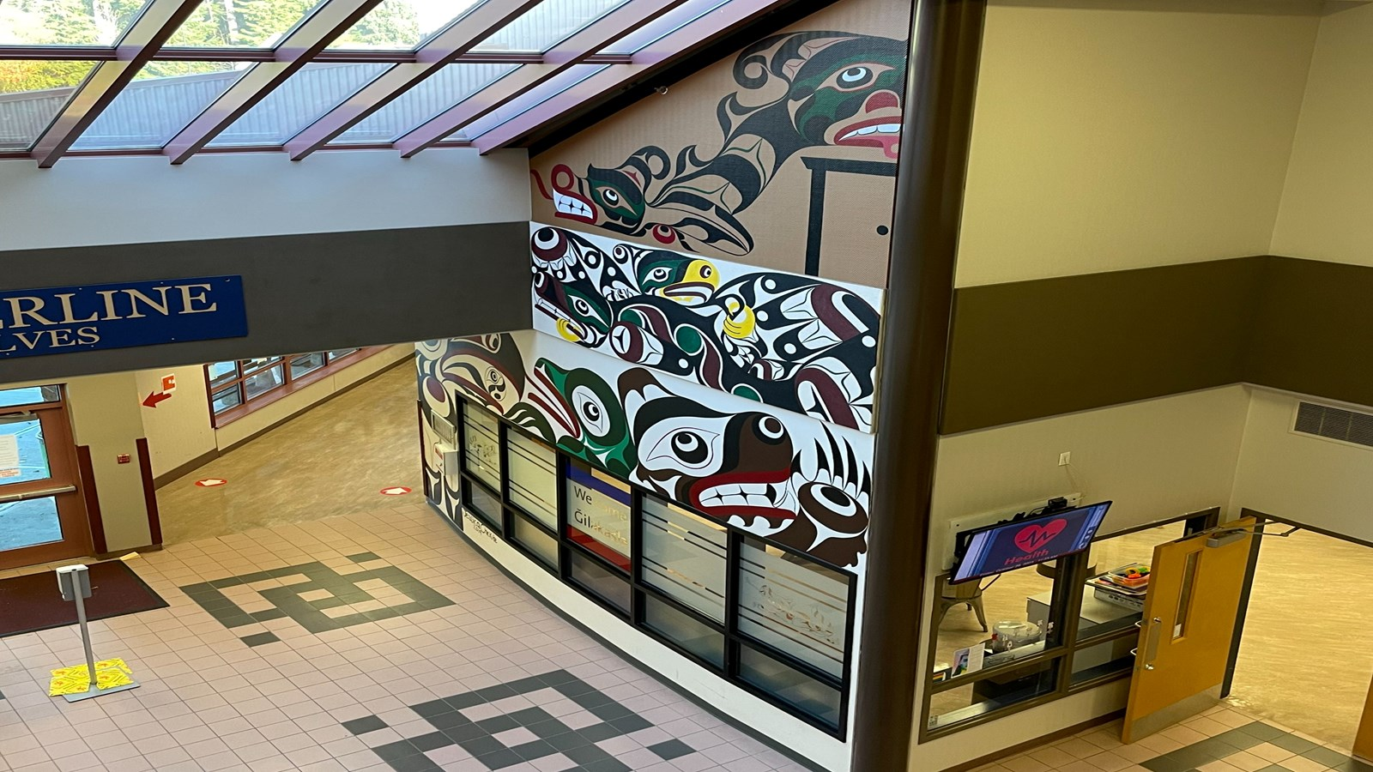
Welcome to
grade 9 - the Class of 2029!

Slide 2
First Day of School
  A block class lists posted, find your class and teacher
  Schedules, locker assignments given out
  Hot dog barbeque lunch provided at 11:30am
  School busses running at 11:45am
  Full day of school starting Wednesday, Sept. 3. All students in attendance

Slide 3
School Staff and Support Services
Introductions:
  Principal – Mr. Ruehlen
  Vice Principal – Mr. Zlatanov
  Counsellors – Ms. Noren, Mr. Chenard
  Youth Care Workers - Sharene Zemanek & Ronnie Billows
  Learning Support Teachers – Ms. Fraser & Ms. Griffith
  Indigenous Support Teacher – Ms. Ubriaco

Slide 4
Information from the Counsellors
Course change requests can be submitted by email, Teams, or by appointment. To make an appointment please email your counsellor or see the front desk person at student services.
The counsellor you are connected to for your academics is divided by your last name:
A-K - Ms. Noren
L-Z - Mr. Chenard
Students who need to see a counsellor about other matters can also book an appointment in person (see Ally at the counselling window), use Teams or by email. You can see either counsellor for personal matters.
If you have an emergency that requires immediate counselling support, please come to the counselling office, let Ally know and/or wait at the door. COURSE CHANGES ARE NOT AN EMERGENCY.

Slide 5
Hallways and Washrooms
Hallways
  Please avoid gathering in groups and blocking hallways and locker areas
  When it is lunch time, take the opportunity to go outside and get some fresh air
Washrooms
  Washrooms are not places to socialize. Be respectful of others needing to use them
  Cellphones are not permitted in washrooms for privacy reasons

Slide 6


Learning Commons and Gym
Learning Commons
  This space needs to be booked by your teacher for use during class time
  It will be open during lunch for quiet activities – no food
Gym
  The gym is open at lunch for activities. Indoor shoes only permitted on our new gym floor!
  Students must follow the direction of the supervising teacher(s)

Slide 7


Food
Lunch Time & Breaks: Places to eat are:
  Cafeteria
  College Commons Hallway
  Friendship Room
  Outside
NIC Cafeteria and the Timberline eating area
  Is open to students all day. Please note that only grade 12’s with study blocks should be in the cafeteria or eating area during class time
  Students are not to be in other areas of NIC unless going to or from the city bus loop. Please respect NIC property

Slide 8





Extra Curricular Activities
Sports teams and clubs
Look for more information in the daily announcements over the coming weeks.
Do you have an idea for a club? Talk to a teacher, counsellor or the Administrators.
Also coming soon - information regarding this year’s musical.

Slide 9

TIMBERLINE ATHLETICS
“The Power is in the Pack”
Sign up for Fall Teams NOW on the Athletics board (outside of the Gym)
Order Athletics warm-up gear NEXT WEEK
Jr. Boys’ Volleyball
Sr. Boys’ Volleyball
Jr. Girls’ Volleyball
Sr. Girls’ Volleyball
Boys’ Soccer
Cross country
E-sports
Every Athlete, potential Athlete, or fan of Athletics must get Athletics gear. We will support students financially so that everyone has a chance to participate in all activities available.
Required: 1 X moisture-wicking, long sleeve warm-up top to showcase that you are part of the pack
Order Online – Coming soon
Is your Parent interested in driving this year? Pick up the Driver abstract and CRC form before you leave.

Slide 10

Our School Community…
Is Respectful
Is Caring and supportive
Encourages involvement in school culture

Slide 11


Code of Conduct
Our Code Of Conduct covers the entire campus, both North Island College and Timberline areas.
Timberline Boundaries:
Triangle area to Mailman House –Except for arriving and leaving the school, students are not be on NIC property during breaks or class time. The cafeteria is off limits during class time and the NIC washrooms are always off limits
Students are only to use the paths in the forested areas as places to walk through on the way to or from school. They are not areas to gather in during breaks or class time.
Timberline is a substance free school!
This includes Alcohol, Drugs, Tobacco Products, Vaping
According to legislation any use of illegal substances on school properties is considered an offence and could result in a suspension from school.
NOTE: There is no Smoke/Vape Pit anywhere on Timberline property – this includes the forest areas and parking lots.

Slide 12
Code of Conduct
  All members of our school community have the right to a harassment and violence free learning environment.​
  Any verbal or physical threats are taken seriously and will be followed up with appropriate consequences.
  Need someone to talk to? Check in with one of the counsellors, youth workers, admin, or your teacher!

Slide 13
Code of Conduct
Personal Electronic Devices
Cellphones, earbuds, apple watches etc are to be;
OFF and AWAY for THE DAY
OFF: device is turned off, notifications off as you enter the building
AWAY: device is not on your person (backpack/locker/classroom caddy/home)
For THE DAY: during instructional time *unless directed by teacher for educational use* We encourage during breaks as well, however you are permitted to use them at breaks and lunch.
Cellphones are not permitted in washrooms

Slide 14




Time | Monday | Tuesday | Wednesday |  | Thursday | Friday
 |  |  | Week 1 | Week 2
8:55 - 10:20 | A | A | Flex Time: 8:55-9:40 ~~~~~~~~ A | Flex Time: 8:55-9:40 ~~~~~~~~ B | A | A
10:15 – 10:25 | Transition | Transition | Transition (10:35-45) | Transition (10:35-45) | Transition | Transition
10:30 – 11:40 | B | B | A | B | B | B
11:40 – 12:20 | Lunch | Lunch | Lunch | Lunch | Lunch | Lunch
12:20 – 1:40 | C | C | C | D | C | C
1:40 – 1:50 | Transition | Transition | Transition (1:15-25) | Transition (1:15-25) | Transition | Transition
1:50 – 3:05 | D | D | C ~~~~~~~ Flex Time: 2:20-3:05 | D ~~~~~~~ Flex Time: 2:20-3:05 | D | D

Slide 15
Shape of the Morning
Follow your A block classroom teacher when they have been called down to the stage
Class Time Schedule Today:
  A block: 9:20-10:15am
  Break: 10:15-10:25am
  B block: 10:30-10:45am
  C block: 10:50-11:05am
  D block: 11:10-11:30am
  11:35am: Hot dog lunch followed by dismissal

