Slide 1
Welcome To Timberline Grad Class of 2028!

Slide 2
Introductions and Welcome to our new Wolves
Principal and Vice Principal
Mr. Ruehlen
Mr. Taylor

Slide 3
Our Counsellors
Mr. Berg
Ms. Noren
Ms. Foster
Role of Counsellors at Secondary School

Slide 4
Our Youth Care Workers
Sharene Zemanek
Ronnie Billows
Role of Youth Care Workers

Slide 5
Attendance
Attendance and achievement are related.
At Timberline EVERYDAY counts.

Slide 6
Schedule for 2024-25
Time/Day | Monday | Tuesday |  | Thursday | Friday
8:55 – 10:15 10:15-10:25 | A Transition | A Transition |  | A Transition | A Transition
10:25 – 11:40 | B | B |  | B | B
11:40 – 12:20 | Lunch | Lunch |  | Lunch | Lunch
12:20 – 1:40 1:40-1:50 | C Transition | C Transition |  | C Transition | C Transition
1:50 – 3:05 | D | D |  | D | D

Slide 7
Flex Program
Weekly program on Wednesdays
2 classes per day instead of 4.
Running on a rotating week 1 and week 2 schedule
Teacher directed for attendance expectations
Flexible time once a week for classroom-based opportunities…
Student support
Student enrichment
Class outings

Slide 8
Flex Wednesday Schedule
Time | Schedule
8:55 – 9:40 | Period 1 Flex
9:40-11:40 | Period 1
10:35-10:45 | Break
11:40- 12:20 | Lunch
12:20 – 2:20 | Period 2
1:15-1:25 | Break
2:20-3:05 | Period 2 Flex

Slide 9
Code of Conduct
All members of our school community have the right to a harassment and violence free learning environment.
Any verbal or physical threats are taken seriously and will be followed up and consequenced accordingly.

Slide 10
Code of Conduct
Timberline is a substance free school
Alcohol, Drugs, Tobacco, Vaping
According to legislation any use of illegal substances on school properties is considered an offence and could result in a suspension from school.

Slide 11
Secondary School…Developing Independence and Responsibility
Breaks and lunchtime
Cafeteria use
Leaving campus
Lockers
Communication

Slide 12
Grade 9 Course Selections
Required Courses
English
Social Studies
Science
Math
Physical & Health Education (options available)
Electives
Choose 3 Electives and 2 Alternatives
Band at Timberline

Slide 13
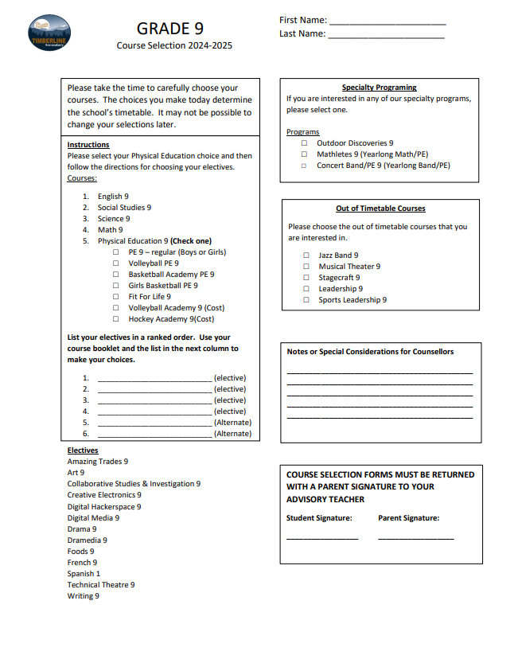

Slide 14
September First Day Of School Plans
Tuesday, September 3rd, 2024
Grade 9’s only in attendance that day
8:55-11:40am
Students will arrive at the school and find their name on a list for their A block class location
Schedules, procedures, locker selection etc will take place in A block
Students will experience a shortened rest of their semester 1 schedule that morning as well
Wednesday, Sept. 4th is a regular, full school day for all students

Slide 15
We wish you all the best as you begin your Timberline learning journey!
Welcome to the Den and howl with the Wolves!

