Slide 1
Course Selection 2024-25

Slide 2
The Student Course Selection determines what courses are offered next year.

Slide 3
Ensure you select the required courses for your grade and the correct number of Electives and Alternatives.

Slide 4
Any Required Courses that you have failed in grade 10 or 11 Must be Taken Over Again.

Slide 5
The Graduation Program
80 credits needed to graduate. 4 credits per course
Grade 10-12
Mandatory and elective courses
Know how many credits you have!

Slide 6
Grade 10 Course Selections
Required Courses
English
Social Studies
Science
Math 10: choose 1 of:
-Foundations of Math 10 (60% or higher in grade 9 math)
-Work Place Math 10
-Mathletes 10 (60% or higher in grade 9 math)
Physical & Health Education 10
Career Life Education (CLE) 10
Electives
Choose 2 Electives and 3 Alternatives

Slide 7
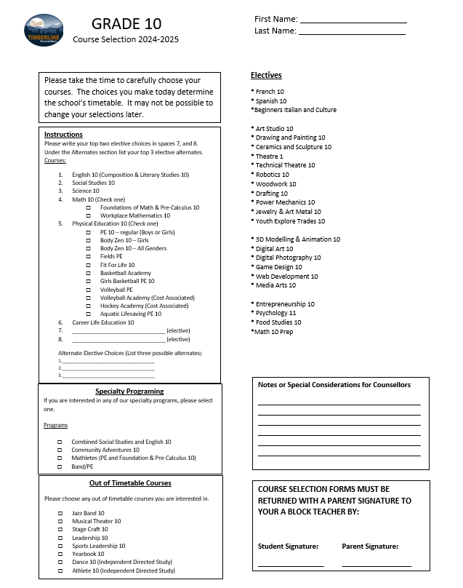

Slide 8
Grade 11 Course Selections
Required Courses
English First Peoples 11
1 Social Studies 12
1 Science 11
Math 11: choose 1 of:
-Foundations of Math 11
-Work Place Math 11
-Pre-Calculus 11
-History of Math 11
Electives
Choose 4 Electives and 3 Alternatives
Note: Study blocks are only for students in grade 12

Slide 9
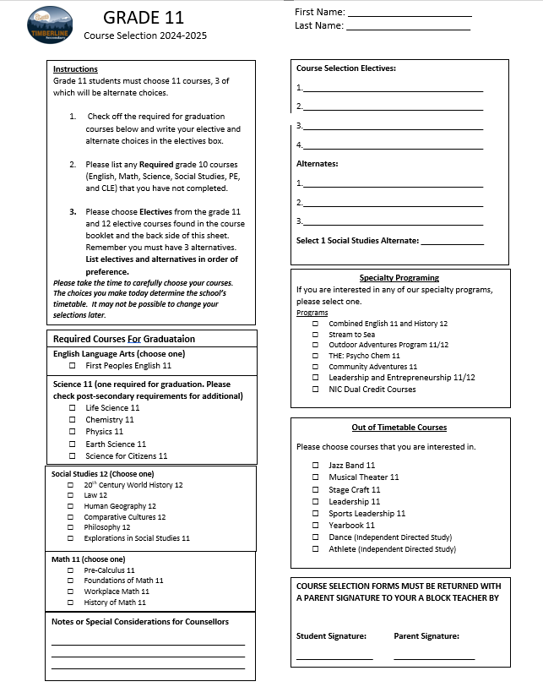
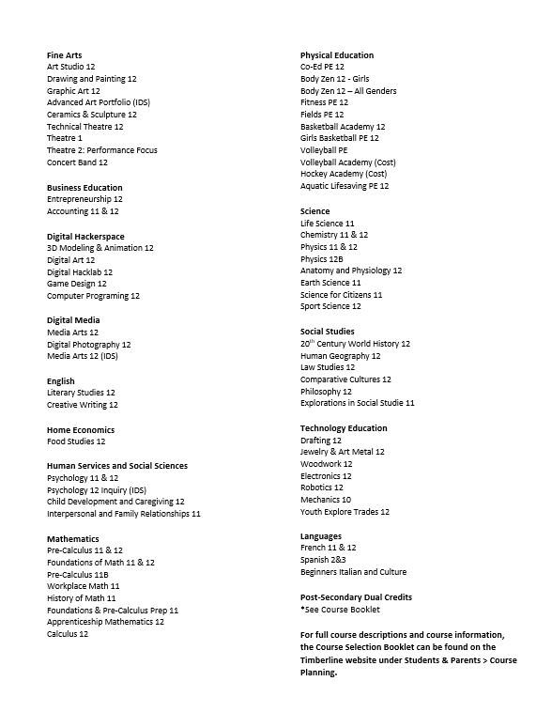

Slide 10
Grade 12 Course Selections
Required Courses
English 12
3 other grade 12 Required Courses of your choice
Electives
Choose 4 Electives and 3 Alternatives
Study Blocks are only considered in September and February at the beginning of each semester

Slide 11
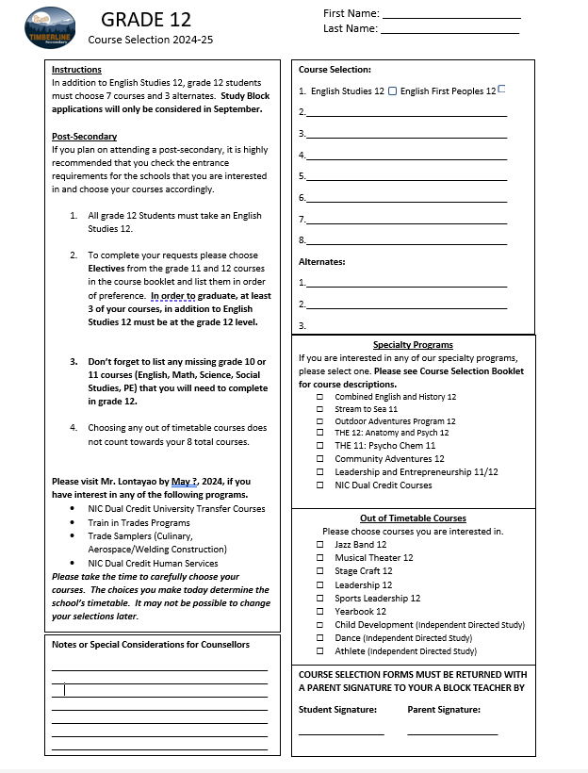

Slide 12
Career Life Connections (CLC) 12
Students will complete Career Life Connections 12 in their grade 11 and 12 years.
This is a 4-credit course that is required for graduation
CLC 12 will culminate with a Capstone Project in the Spring of Grade 12.
This is an out of timetable course, meaning that students are required to complete the course on their own time using Microsoft Teams as the course platform

Slide 13
Provincial Assessments
Numeracy Assessment: Students will need to write a Numeracy Assessment in Grade 10
Literacy Assessment: Students will need to write a Literacy Assessment in Grade 10 and Grade 12
Students may write each assessment up to 3 times between grades 10 and 12

Slide 14
Questions?

Slide 15
Grade 10 Course Selection
Grade 11 Course Selection
Grade 12 Course Selection

